Slide 1

Accreditation Program Updates
April 2025
NCALHD Meeting

Slide 2
Topics for Today
Strategic Updates
Proposed FY26 Fee Structure
Evidence Submission Upgrade Opportunity

Slide 3



Strategic Updates
Updating Administrative Rules
Aligning Reporting Requirements
Additional Opportunities!

Slide 4
Process to Date
Multi-year revision process
Phase 1: Updating HDSAI Interpretation Document
Phase 2: Evaluation
Phase 3: Modifying rule language
2020
Standards Workgroup reviewed HDSAI Interpretation & public comment (phase 1)
Strategic Planning
2021
Incorporated phase 1 public comment feedback
Released 2022 HDSAI interpretation Document
2022
Implemented phase 1 changes
Piloted and evaluated HDSAI options and partially remote site visits (phase 2)
Reformed Standards Workgroup for standard and activity review (phase 3)
2023-2024
Receive & incorporate feedback on proposed rules (phase 3)
Public comment in May 2023 and September 2024
Receive Board approval on revised 46 activities
2025
Present rule updates to CPH
Draft program materials aligned with new activities

Slide 5

Updating Administrative Rules
48C (Currently 48A)
Purpose
Definitions
Self-Assessment
Site Visit
Board Action
Informal Review Procedures
Applying for Accreditation
48D (Currently 48B)
Accreditation Requirements
Standards & Activities
  11 standards, 45 activities
Draft approved by NCLDHA Board during March meeting

Slide 6
From 10 Essential Public Health Services to Foundational Capabilities
Assessment
Policy Development
Assurance
Facilities & Admin
Governance

Slide 7
From 10 Essential Public Health Services to Foundational Capabilities
Assessment & Surveillance
Community Partnership
Equity
Organizational Competencies
Assessment
Policy Development
Assurance
Policy Development & Support
Accountability & Performance Mgmt
Emergency Preparedness & Response
Communications
Facilities & Admin
Governance

Slide 8
From 10 Essential Public Health Services to Foundational Capabilities
Assessment & Surveillance
Community Partnership
Social & Structural Determ. Of Health
Organizational Competencies
Policy Development & Support
Accountability & Performance Mgmt
Emergency Preparedness & Response
Communications

Slide 9
Flexible “On Ramp” Approach
Flexibility to adjust documentation requirements as field evolves
Tiered scoring
Alignment with current requirements

Slide 10
2025 Workplan
February
Introduce plan to CPH
“Finalize” draft language
Expanded standards workgroup to discuss documentation requirements
May
Initial rulemaking meeting with CPH
August
Second rulemaking meeting with CPH
September
Earliest approval by RRC, with delayed effective date
June/July
CPH public comment period
March-November

Slide 11
Anticipated Implementation
Winter 2025
Winter 2026
Fall 2026
Fall 2027
Winter 2027
Fall 2025
HDSAI Interp 2024
HDSAI Interp 2025
HDSAI Interp 2025
NEW DOC
NEW DOC
NEW DOC
Business as usual!
Transition

Slide 12
Tool #1: Old Activity Crosswalk
NCLHDA Activities | NCLHDA Doc Reqs | DHHS Reporting | FC | PHAB | 10 EPHS | New NCLHDA
1.1 | A | CHA checklist, 158, 539, 574 | A & S | 1.1.1 A | 1 | A.1
1.2 | A, B, C | SOTCH checklist | A & S |  | 1
… | … | … | … | … | …

Slide 13
Tool #2: New Activity Crosswalk
FC | Standard & Activity | Description | Activity Crosswalk | Doc. Require | PHAB | DHHS Reporting
Assessment & Surveillance | A.1 | conduct a community health assessment | 1.1 1.2 1.3 | TBD | 1.1.1 A | Consolidated Agreement CHA Checklist AA 158
Community Partnership | B.1 | involve community partners to develop and implement LHD programs and services | 11.1 11.2 12.1 12.4 | TBD | 4.1.1 A 4.1.2 A | AA 116 AA 129
… | … | … | … | … | …

Slide 14
Prototyping & Piloting Program Letter Improvements!
Fall 2026 agencies have been invited to participate in a quick pilot to test out sharing program letters via Smartsheet
Goal: see if Smartsheet is an effective way to share documentation between DPH, LHDs, and NCLDHA as we plan future documentation requirements and reporting alignment efforts

Slide 15
Proposed FY26 Fee Structure
Current annual fee (2019-2025): $3,250
Proposed annual fee for FY26: $3,750
Current cost of a site visit: $4,200

Slide 16
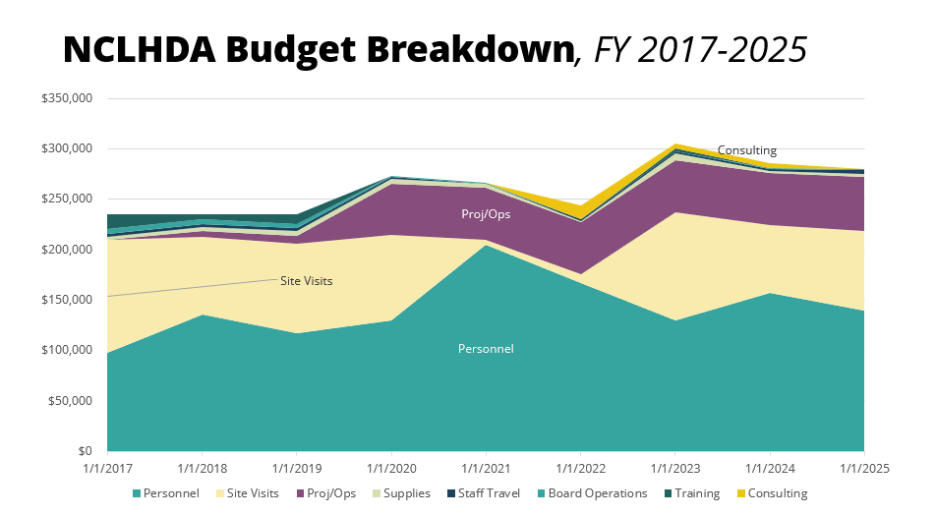
Budget increase of $550/LHD to cover dashboard software fees
Carried over underspent funds while site visits were paused to cover strategic efforts

Slide 17
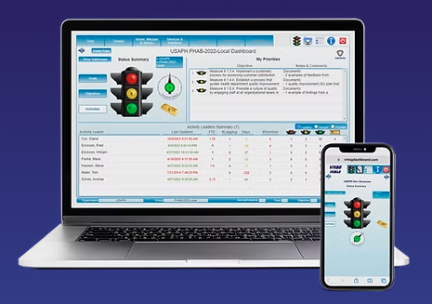
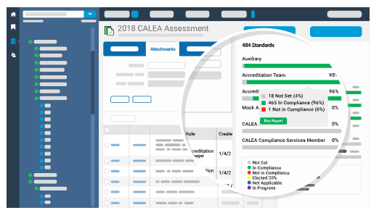
Evidence Submission Upgrade Opportunity
PowerStandards
VMSG
Same subscription costs
If interested, would need to secure initial setup funds ($50,000)

Slide 18
Thank you.
Margaret Benson Nemitz
NCLHDA Administrator
Margaret.Nemitz@unc.edu
Email us: NCLHDaccreditation@unc.edu
The North Carolina Local Health Department Accreditation Program is part of the North Carolina Institute for Public Health at the Gillings School of Global Public Health at the University of North Carolina at Chapel Hill.

