Slide 1
AA 117 Public Health Infrastructure: Local Workforce Development 5-YEAR FUNDING Through October 31, 2027
THE PURPOSE OF THIS FUNDING IS TO HELP MEET SHORT-TERM CRITICAL INFRASTRUCTURE NEEDS AND TO MAKE STRATEGIC INVESTMENTS WHICH WILL HAVE LASTING EFFECTS ON LOCAL PUBLIC HEALTH DEPARTMENTS IN NORTH CAROLINA.
FUNDING IS DISTRIBUTED TO EACH INDIVIDUAL LOCAL HEALTH DEPARTMENT BASED ON COUNTY POPULATION, SOCIAL VULNERABILITY, AND EQUITY INDICES
59 COUNTIES HAVE UTILIZED FUNDS (Counties with > $0 in FY25 expenditures)
TOTAL AMOUNT ALLOCATED TO LHDs: $18,221,039.00
TOTAL AMOUNT SPENT (JUL–OCT 2025): $1,915,434.26
PERCENTAGE SPENT: 10.52%
AVERAGE AMOUNT SPENT PER COUNTY (AMONG THOSE WITH SPENDING): ~$32,464.99

Slide 2
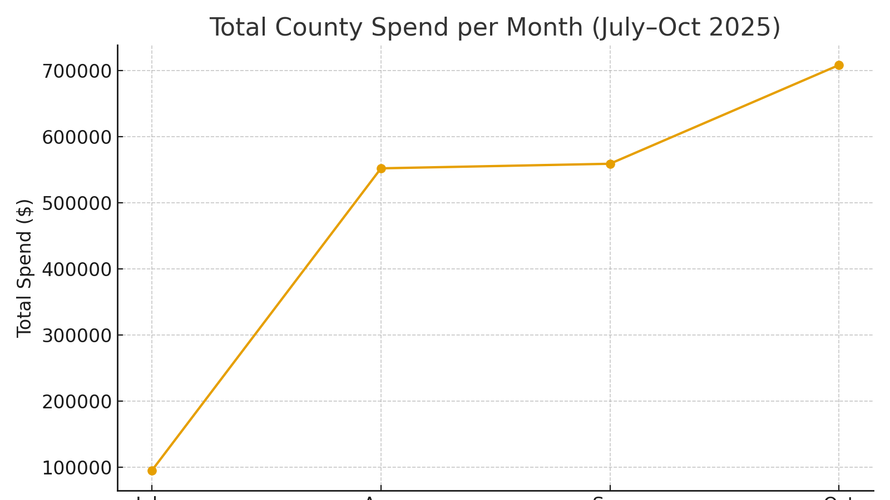
AA 117

