Slide 1
North Carolina Division of Public Health
ALHD Meeting
Overview of DPH Data Office and Data Modernization – Strategic Plan
August 20, 2025

Slide 2
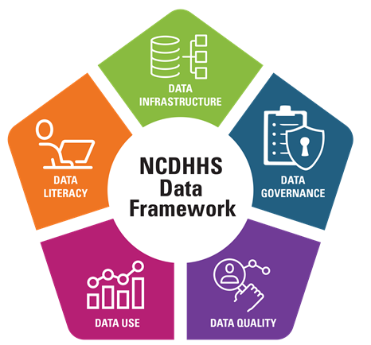
DPH Data Office
Priority strategy is data modernization
Prepare for more integrated, seamless data management, analysis, and integration
Established to drive Division-wide cultural transformation in data collection, governance, and use
Data as 1st class citizen, strategic business asset
Data strategy and roadmap built upon DHHS 5 data pillars
Goals executed in partnership with technology, legal, Division Programs, and strategic partner teams
Data support and resources to facilitate cross-system and interdisciplinary collaboration with a data centric focus
Overarching mission to improve the health and well-being of NC residents through more accessible, integrated, high-quality data
Hire 3 FTE staff to support efforts

Slide 3
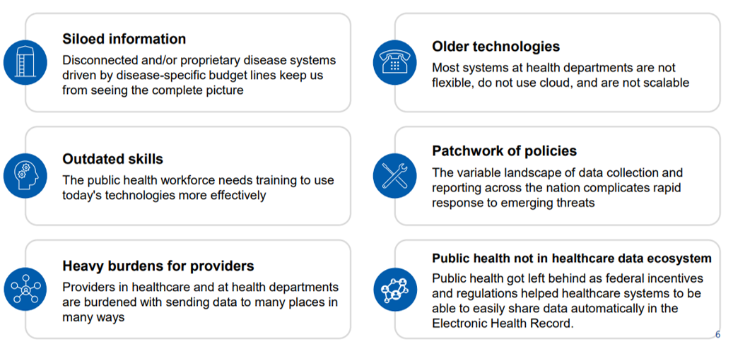
What is Data Modernization Trying to Solve?
State of the Art Workforce
Notes:
Guided by CDC's Public Health Data Strategy DPH data modernization efforts are led by the pursuit of answering this critical question. CDC – cite source

Slide 4
DHHS Enterprise Data Strategy
Data Infrastructure
Data Governance & Quality
Data Analytics, Visualization, & Use
Data Literacy & Training
High-quality, integrated, well-governed data available to DHHS & DPH data-driven strategic and operational decisions
Notes:
High level overarching departmental data strategy. Hayley Young and I worked on this presentation to highlight alignment between the DHHS and DPH data offices data modernization strategy. The focus of our presentation today.

Slide 5
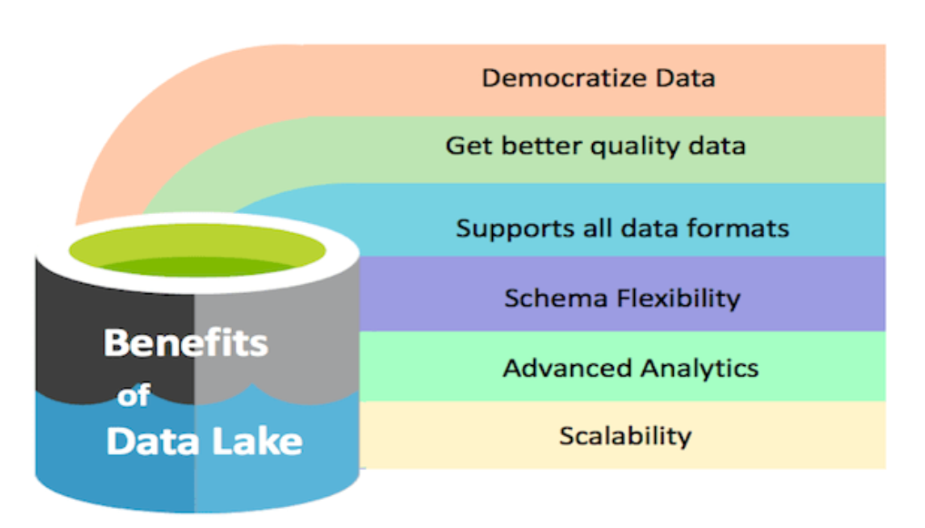
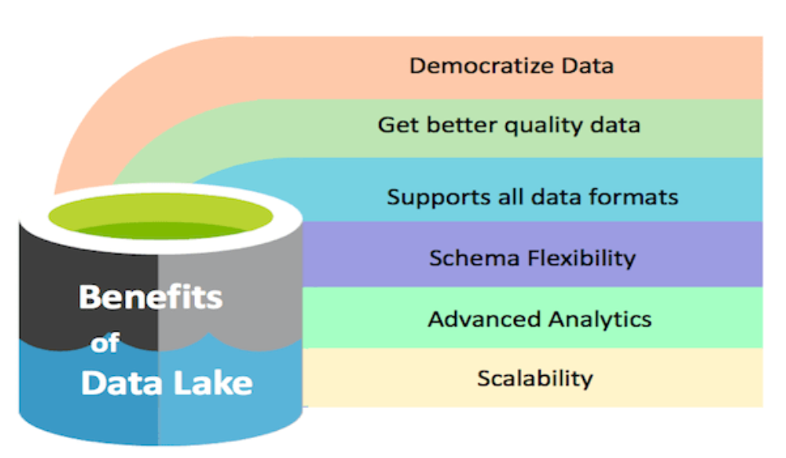
DPH Data Infrastructure – Consolidated Data Repository
A consolidated data repository is a foundational enabler of a successful Master Data Management (MDM) strategy. It contributes by creating a single source of truth, improving data quality and consistency, enabling data governance and control, supporting integration and interoperability, enhancing decision-making and analytics, and reducing operational costs and complexity.
Data Lake: A data lake is a consolidated data repository that ingests and stores large volumes of data in its original form. Data lakes provide core data consistency across a variety of applications, powering big data analytics, machine learning, predictive analytics, and other forms of intelligent action.
Taken from OvalEdge: https://www.ovaledge.com/data-lake-benefits
Notes:
Data lake A data lake is a consolidated data repository that ingests and stores large volumes of data in its original form. The data can then be processed and used as a basis for a variety of analytic needs. Due to its open, scalable architecture, a data lake can accommodate all types of data from any source, from structured (database tables, Excel sheets) to semi-structured (XML files, webpages) to unstructured (images, audio files, tweets), all without sacrificing fidelity. The data files are typically stored in staged zones—raw, cleansed, and curated—so that different types of users may use the data in its various forms to meet their needs. Data lakes provide core data consistency across a variety of applications, powering big data analytics, machine learning, predictive analytics, and other forms of intelligent action.
key benefit of a data lake is that you can store any and all data in one place incurring a low cost, pulling it as analytical needs arise.
Democratize data and make more accessible
Get Better Quality Data
With the tremendous processing power of a data lake, one can use tools to ensure the data is of good quality.
Technological Benefits
Data storage in native format
A data lake eliminates the need for data modeling at the time of ingestion. We can do it at the time of finding and exploring data for analytics. It offers unmatched flexibility to ask any business or domain questions and to glean insights.
Scalability
It offers scalability and is relatively inexpensive compared to a traditional data warehouse when we take scalability into account.
Versatility
A data lake can store multi-structured data from diverse sources. In simple words, a data lake can store logs, XML, multimedia, sensor data, binary, social data, chat, and people data.
Schema Flexibility
Traditionally schema necessitates the data to be in a specific format. For OLTP (Application Data), this is great as it validates data before entry. But for analytics, it’s an obstruction as we want to analyze data as is. Traditional data warehouse products are schema-based. But Hadoop data lake allows you to be schema-free, or you can define multiple schemas for the same data. In short, it enables you to decouple schema from data, which is excellent for analytics.
Supports not only SQL but more languages
Traditional data-warehouse technology mostly supports SQL, which is suitable for simple analytics but for advanced use cases, we need more ways to analyze data. A data lake provides various options and language support for analysis. It has Hive/Impala/Hawq which supports SQL but also has features for more advanced needs. For example, to analyze the data in a flow, you can use PIG, or to do machine learning you can use Spark MLlib.
Advanced Analytics
Unlike a data warehouse, a data lake excels at utilizing the availability of large quantities of coherent data along with deep learning algorithms. It helps in real-time decision analytics.
Advantages of data lakes
They provide easier collection and indefinite storage of all types of data.
They allow companies to transform raw data into structured data suitable for SQL-based analytics, data science and machine learning, all with lower latency.
Can be kept up to date more easily because it supports multiple file formats and provides a safe place for new data.
They offer flexibility for big data and machine learning applications.
Different tools can be applied to gain insight into what the data means.
Cost is cheaper than data warehousing.
Disadvantages of data lakes
Holding all kinds of data can be complex to manage.
If not managed properly, they can become disorganised and difficult to connect to analytics and business intelligence tools.
They tend to be more vulnerable to the development of data silos (data that is not accessible to all departments or teams in the company), which can then become data swamps (no metadata, unorganised).
Containing sensitive data can raise security concerns.
Initial investment and maintenance can be costly, especially when dealing with large volumes of data.
*https://www.telefonica.com/en/communication-room/blog/what-is-data-lake-advantages-disadvantages/

Slide 6
Proof of Value Use Case – Newborn Screening & Birth Records
Proof of Value: a pilot of a small prototype solution to develop a better understanding of resources requirements and cost estimates and explore the BIDP, data integration and entity resolution solutions to advance data modernization efforts within the Division.
Allow NC to determine and report on the number of newborns eligible for screening and the number screened. Currently, the target calls for a 95%+ screening rate within 5 days of birth, but NC does not currently know the number of newborns missing. Offers a solution to better understand the scope of this issue and inform programmatic improvements to improve screening rates.
Offer NCDHHS the opportunity to be a leader in this space and compare with other states implementing similar studies to define a gold standard.
Help DPH determine the resources required to establish the proposed architecture/ centralized data repository
Facilitate understanding what other technological solutions would be needed to establish the final data lake architecture

Slide 7
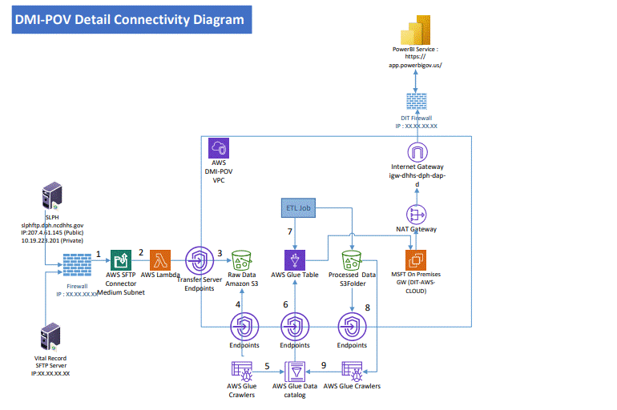
Architecture Diagram
Notes:
Building From Capabilities Enabled Through Covid Response New data support technology to improve automation for public/internal reporting
Business Intelligence Data Platform (BIDP)
AWS
Dell Boomi (data integration platform)
Robotics Process Automation (RPA)
Expanded data availability
Automated data feeds for routine/ongoing syndromic surveillance
Ability to quickly load & store new data sources in a centralized data environment to support new & urgent needs
Stronger data analytics capabilities
Expanded data visualization (internal and public-facing) to improve data insights (i.e., PowerBI)
Cross-program record linkage (e.g.,SLPH and SCHS, etc.)
Our data will partitioned, we will be adminsttrators giving us full control how data are used and shared. Giving us ability to participate in DHHS objectives while prioritizing DPH.

Slide 8
DMI Project Roadmap
Jan –Jun 2024 | Jul –Dec 2024 | Jan –Jun 25 | Jul –Dec 25 | Jan –Jun 26 | Jul – Dec 26 | Jan-Jun 27
Business Concept Stage (ITGB Step-1)
Initiation Stage
Planning and Design Stage
Proof of Value(POV) –Infra Setup - AWS Services & Data lake
UC#3-
UC#2-
UC#1-POV-(VRS & SPLH)
Business Case Stage (ITGB-Step-2)
Execution and Build Stage
Implementation Stage
Legend
Closeout Stage
Milestone
UC#
Use Case

Slide 9
DHHS Enterprise Data Strategy
Data Infrastructure
Data Governance & Quality
Data Analytics, Visualization, & Use
Data Literacy & Training
High-quality, integrated, well-governed data available to DHHS & DPH data-driven strategic and operational decisions
Notes:
Overarching departmental data strategy. The focus of our presentation today

Slide 10

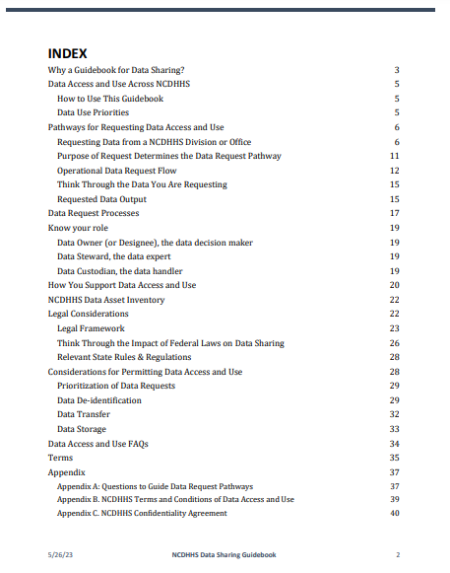
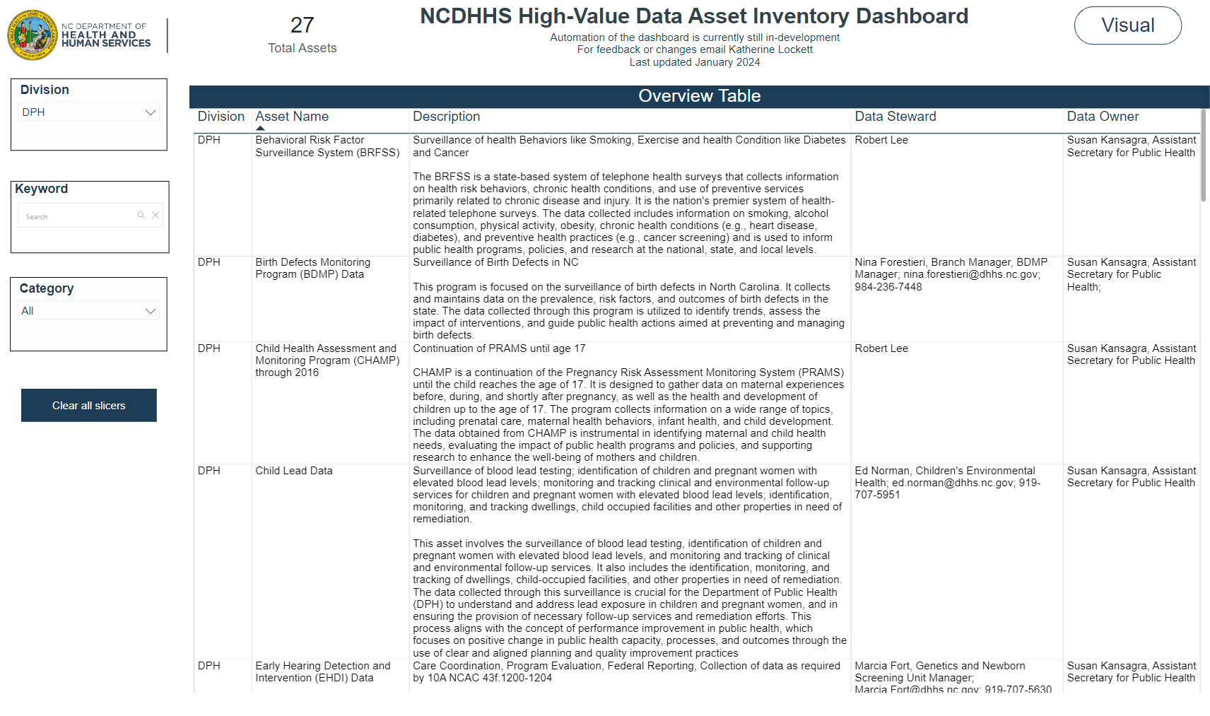
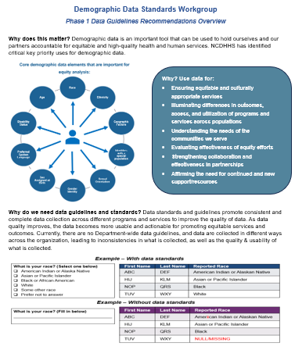
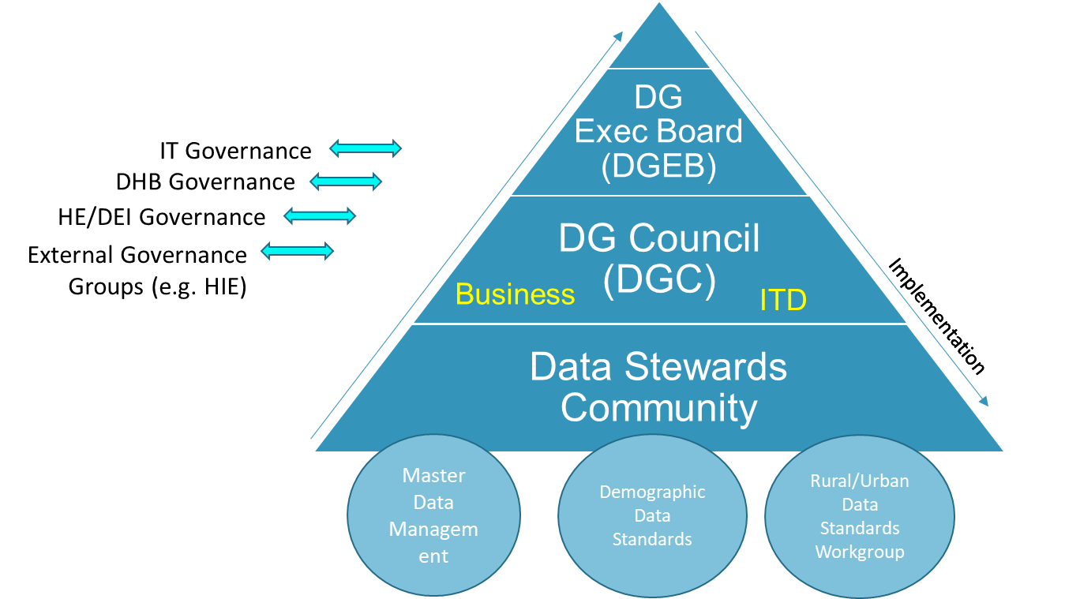
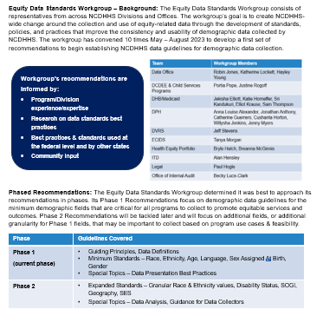
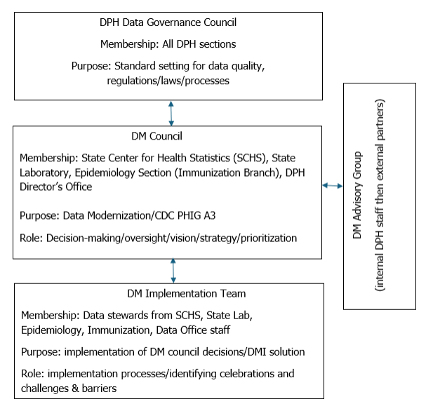
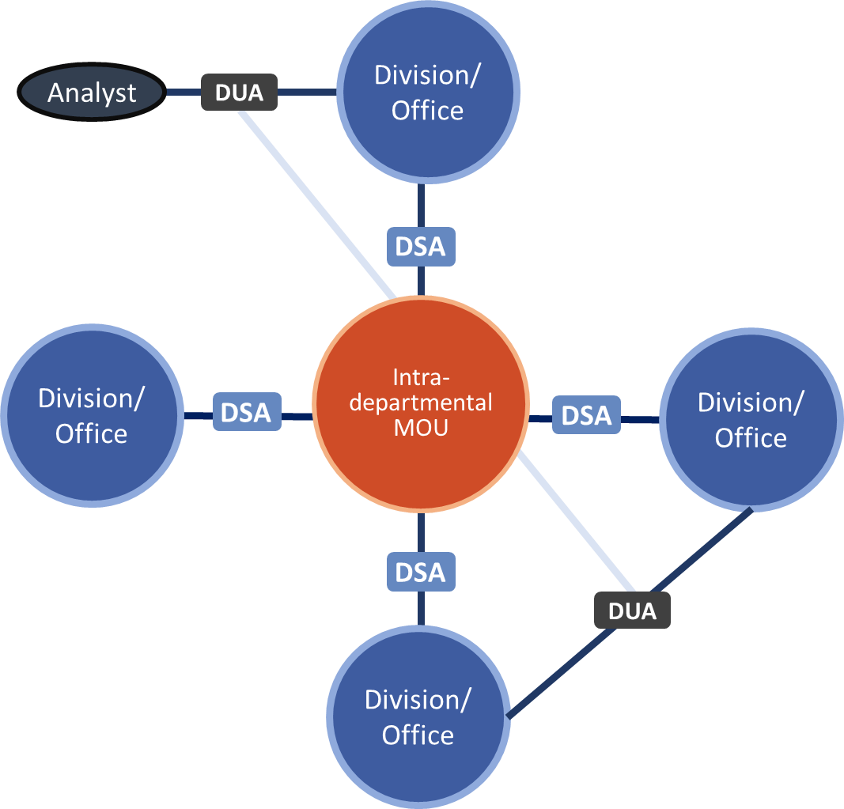
Data Governance & Quality – NCDHHS & DPH
Data Sharing
Data Standards
Data Stewardship
Metadata & Data Classification
Data Sharing Guidebook
Demographic Data Standards
DHHS & DPH Data Gov. Organization
Data Asset Inventory
Data Sharing Guidebook
Legal Framework
Data Asset Inventory Dashboard
NC DPH Data Office
Centralized data catalogue &
data definitions
Notes:
Data governance org
Data sharing – streamlining
Data standards/documentation
Metadata & Data Classification – as part of this effort, we will be conducting a division wide assessment to help illuminate data modernization efforts, enterprise catalogues, and assets.

Slide 11
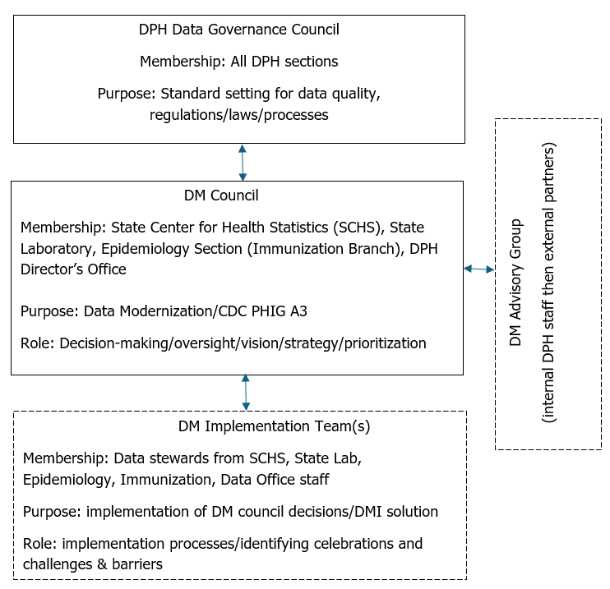
DPH Data Governance Structure
- - - In discussion
Notes:
This represents a proposed data governance structure in DPH. Dotted lines legend – in discussion and solidying approach to dotted line DM Implementation Team(s) leveraging existing groups

Slide 12
Data Modernization Council
Voting Membership – State Lab, State Center for Health Statistics, Epidemiology (Immunization Branch), and Division Office
Non-voting Membership* – DPH Data Office, Voting Membership Implementation Team Members
Purpose: visibility and strategic coordination of data modernization priorities and projects throughout the Division and ensure that DPH works collaboratively to make timely, actionable data available to decision-makers, public health workers, key public health system partners and the public, paving the way to fair and equitable opportunities for all North Carolinians to be safe and healthy.
Charter Approved and Initial Use Case Approved with Consensus
*membership anticipated to grow in 2025
Notes:
Current voting membership made up of programs who directly received DMI funding.
Schedule and plan to expand group in 2025 and beyond.

Slide 13
Data Governance Council (DGC)
Chair and Vice Chair – Sharon Loza, Virginia Niehaus
Voting Membership – TBD
Non-voting Membership* – TBD
Purpose: The mission of the DGC shall be to strategize, prioritize, and oversee activities across NCDPH related to data governance (DG). DG encompasses the people, processes, and information technology required to ensure data quality, integrity, availability, usability, and security throughout its lifecycle.
Charter Drafted; TA initiated with ASTHO; kickoff meeting in September

Slide 14
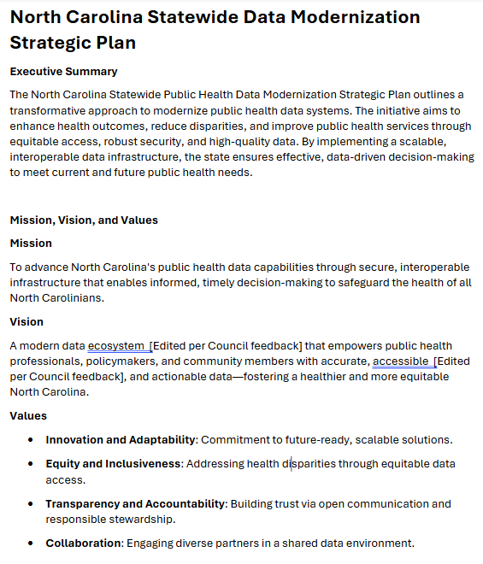
Data Modernization Strategic Plan
Plan drafted by DHHS Data Officer, Daniel Carnegie with support and TA from ASTHO/KAHUINA
Currently under review by DMC
Plan review and approval timeline anticipated to be complete early Fall 2025

Slide 15
Communications Plan
Increase awareness of the NC Division of Public Health (DPH) Data Office and Data Modernization efforts.
Highlight benefits and successes of the data modernization initiative.
Engage internal and external stakeholders through clear, tailored messaging and dissemination strategies.
Planning a DPH Data Office SharePoint

Slide 16
DHHS Enterprise Data Strategy
Data Infrastructure
Data Governance & Quality
Data Analytics, Visualization, & Use
Data Literacy & Training
High-quality, integrated, well-governed data available to DHHS & DPH data-driven strategic and operational decisions
Notes:
Overarching departmental data strategy. The focus of our presentation today

Slide 17
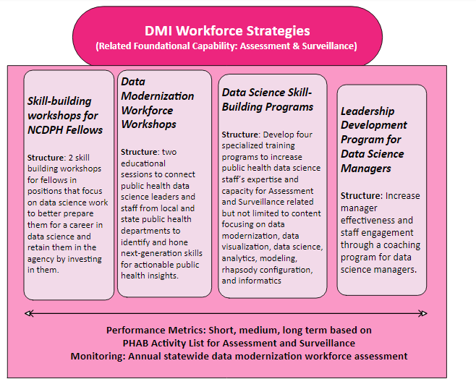
Data Literacy & Training – Collaboration With DPH Workforce
DMC provided input into 2 workshop ideas that will be developed by A&T. These workshops will be offered virtually to state and local health department staff on proposed topics of data flow automation and APIs.
The Data Office is collaborating with the DPH Workforce Development to create a plan for increasing data literacy and workforce development efforts related to data modernization, including programs such as Lunch and Learns
Notes:
These are the programs that are being built for local and state public health data science staff in 2025 and more specifics will come when we have data from the assessment

Slide 18


Slide 19

NC Statewide Public Health Data Modernization Strategic Plan
Notes:
Today, I will provide an overview of the work completed for the NC Statewide Public Health Data Modernization Strategic Plan, including progress, challenges, and next steps.

Slide 20
Data Modernization Plan Vision and Mission
Vision
A modern data ecosystem that empowers public health professionals, policymakers, and community members with accurate, accessible, and actionable data—fostering a healthier and more equitable North Carolina.
Mission
To advance North Carolina's public health data capabilities through secure, interoperable infrastructure that enables informed, timely decision-making to safeguard the health of all North Carolinians.
Extracted from V2 DPH DM Strategic Plan

Slide 21


Slide 22
Data Modernization Goals and Objectives
Goals/Objectives (Draft) Goal 1: Connect and Integrate Key Public Health Data Objective: Make it easier to combine and share important public health data. Goal 2: Make Data Easy to Access and Use Objective: Create a user-friendly platform that allows health professionals and community partners to easily find and use public health data. Goal 3: Support Data-Driven Public Health Decisions Objective: Use integrated data to help public health professionals make informed and timely decisions. Goal 4: Build Strong and Sustainable Data Infrastructure Objective: Establish a reliable and scalable system to support current and future data integration needs. Goal 5: Ensure Transparent and Secure Data Management Objective: Maintain clear, secure, and legally compliant practices for managing and sharing public health data.
Extracted from V2 DPH DM Strategic Plan

Slide 23

Goals/Objectives
How do you see your priorities in this goal?
What do you need for us to move forward together in this?

Slide 24


Slide 25
Appendix

Slide 26
Data Office & Modernization High Level Updates (July 2025)
Enterprise Data System/Data Lake - POV nearing completion and identifying additional use cases
Sharing a demo of POV in July
Workforce Development
Lunch and learn series in planning phase
Two DM workshops in planning phase
Communications Plan
Proposal received from Neimand Collaborative
SharePoint site development
Staff recruitment – 3rd round interviews for Data Analyst and Informatics Specialist
Data Governance Council – planning phase
Division wide assessment and Enterprise Data Catalogue
Strategic Plan – Review process and timeline

Slide 27
Next Steps
ITGB Step 2 (in process by ITD)
Proof of Value Effort
Strategic Plan
Communications Plan
Discussion on implementation and sustainability

Slide 28
PHIG Funding Until November 2027: Strengthening Public Health Infrastructure, Workforce, and Data Systems

