Slide 1

ARPA
Public Health Workforce Initiative:
Looking Back & To the Future
NCALHD November 19,2025

Slide 2

Acknowledgements
Health Directors & NCALHD
10 Lead LHDs & Directors
NC DHHS/DPH
Partners
ARPA Regional Leads

Slide 3
AA 621 Regional Workforce Spending – Cumulative FY24-25 July
LHD Regional Leads | Budgeted Amount FY '24-25 | Total Spent FY 24-25 | Total Remaining | Percent Spent
Region 1-Transylvania County Department of Public Health | $163,389.00 | $163,388.88 | $0.12 | 100%
Region 2-Foothills Health District | $135,060.00 | $119,598.85 | $15,461.15 | 88%
Region 3-Appalachian District Health Department | $225,097.00 | $225,097.00 | 0 | 100%
Region 4-Cabarrus Health Alliance | $324,283.00 | $324,283.00 | 0 | 100%
Region 5-Guilford County Division of Public Health | $306,221.00 | $306,085.59 | $135.41 | 99%
Region 6-Cumberland County Health Department | $276,373.00 | $276,373.00 | 0 | 100%
Region 7-Granville-Vance Public Health | $305,209.00 | $305,209.00 | 0 | 100%
Region 8-Duplin County Health Department | $485,704.00 | $461,266.30 | $24,437.70 | 94%
Region 9-Albemarle Regional Health Services | $151,623.00 | $151,604.08 | $18.92 | 100%
Region 10-Pitt County Health Department | $423,454.00 | $423,036.18 | $417.82 | 99%
Grand Total | $2,796,413.00 | $2,755,941.88 | $40,471.14 | 99%
Data: July ATC Report & LHDs Expenditure Reporting

Slide 4
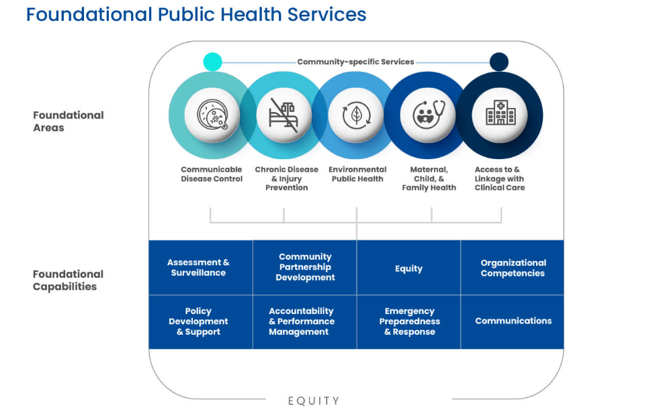

Slide 5
Regions | Foundational Capability | Regional Illustration of Capabilities
1 | Communications | Region I: Regional Communications
2 | Emergency Preparedness & Response | Region II: Point of Distribution (POD) kits were purchased for each of the region’s 9 health departments. The kits provide handheld radios, reflective vests, signs, traffic tape, flagging, and command boards for off-site operations. Additionally, Region 2 purchased Plum Case portable Wi-Fi units, which convert cellular tower signals into Wi-Fi for up to 25 iPads, laptops, and smartphones. These units are critical for off-site operations like flu shot clinics, POD activities, and emergency temporary sheltering.
3 | Policy Development & Support | Region III: New positions adopted (environmental health technicians) resulting in pipeline success in one district in region
4 | Assessment & Surveillance | Region IV: Partnered with the N.C. Division of Public Health and University of Missouri CARES to create the N.C. Data Portal, which provides data, maps, and tools to support community health assessment
5 | Organizational Competencies | Region V: In response to staff needs, Region 5 also sourced and developed several legal trainings on various topics, including environmental health, public health director considerations, N.C. contracts and records, and communicable disease law.
6 | Community Partnership Development | Region VI: Region 6 is proud to have established a Historically Black Colleges and Universities and Minority Serving Institutions (HBCUs/MSIs) Internship Program to build a strong and inclusive workforce.
7 | Equity | Region VII: Partnership with NCCU
8 | Accountability & Performance Management | Region VIII: Partnered with the North Carolina Division of Public Health to create a shared services model of care for the local health departments supporting the Care Management for High-Risk Pregnancies (CMHRP) and Care Management for At-Risk Children (CMARC) programs
9 & 10 | Sustainability | Region 9 and 10 worked together to create a Careers in Public Health campaign, geared toward high schoolers, college students and young adults, titled “Careers 2 Make a Difference.”

Slide 6
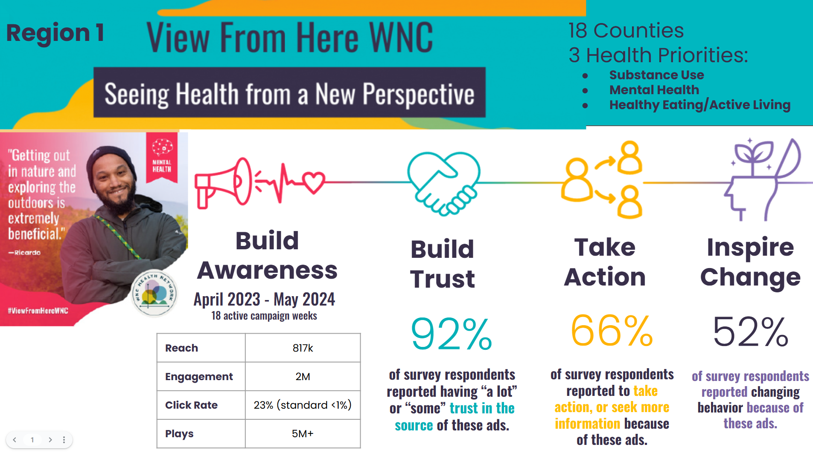
FC: Communications

Slide 7
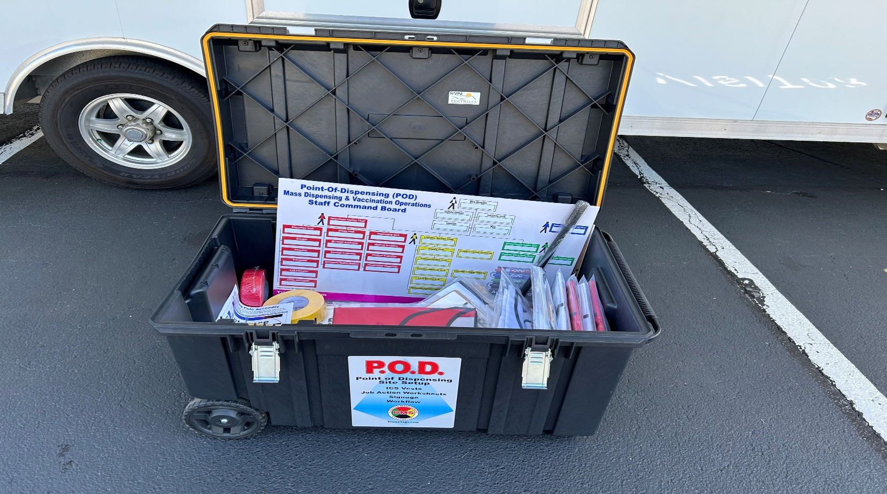
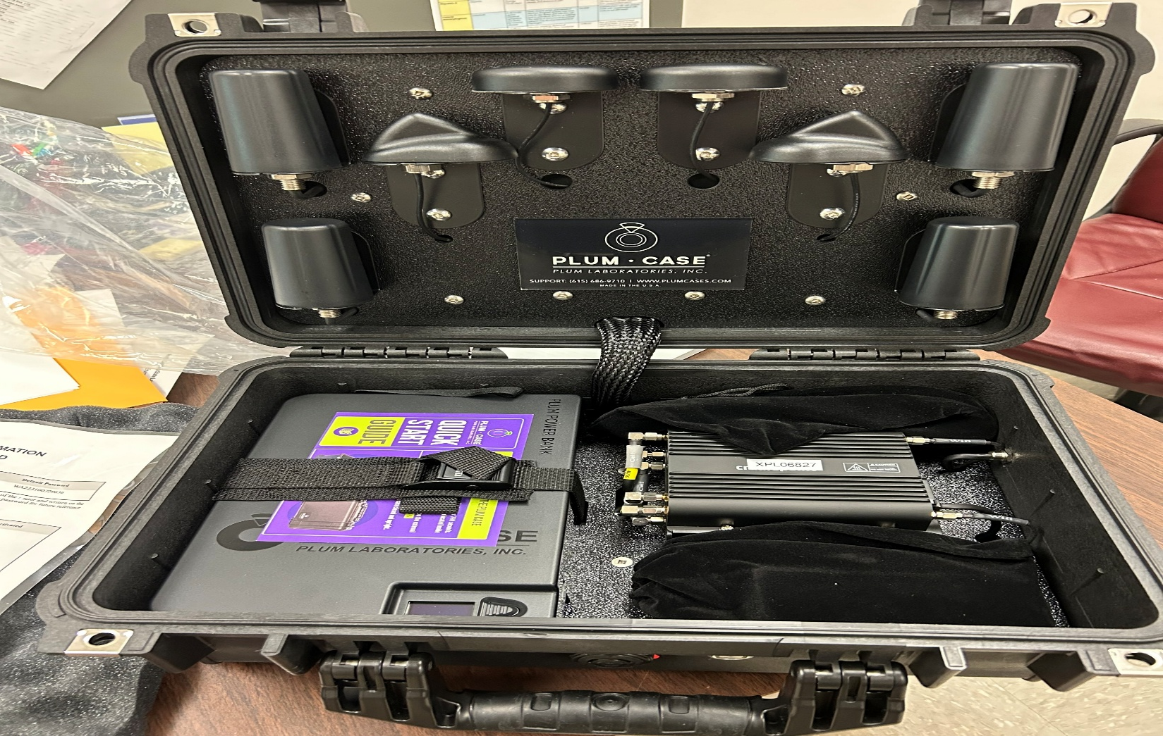
FC: Emergency Preparedness
Region 2 dedicated ARPA funds to purchase Point of Distribution (POD) kits and Plum Case portable Wi-Fi units.
POD kits incorporate materials needed to manage public health emergencies including reflective vests, signs, and command boards
Plum Cases convert signals from cellular towers to functional Wi-Fi capable of operating up to 25 iPads, computers, and smartphones at one time.
This equipment proved to be critical to the mission of conducting off-site emergency operations at medical shelters and command centers throughout our 11-county area after the devastation caused by Hurricane Helene.

Slide 8
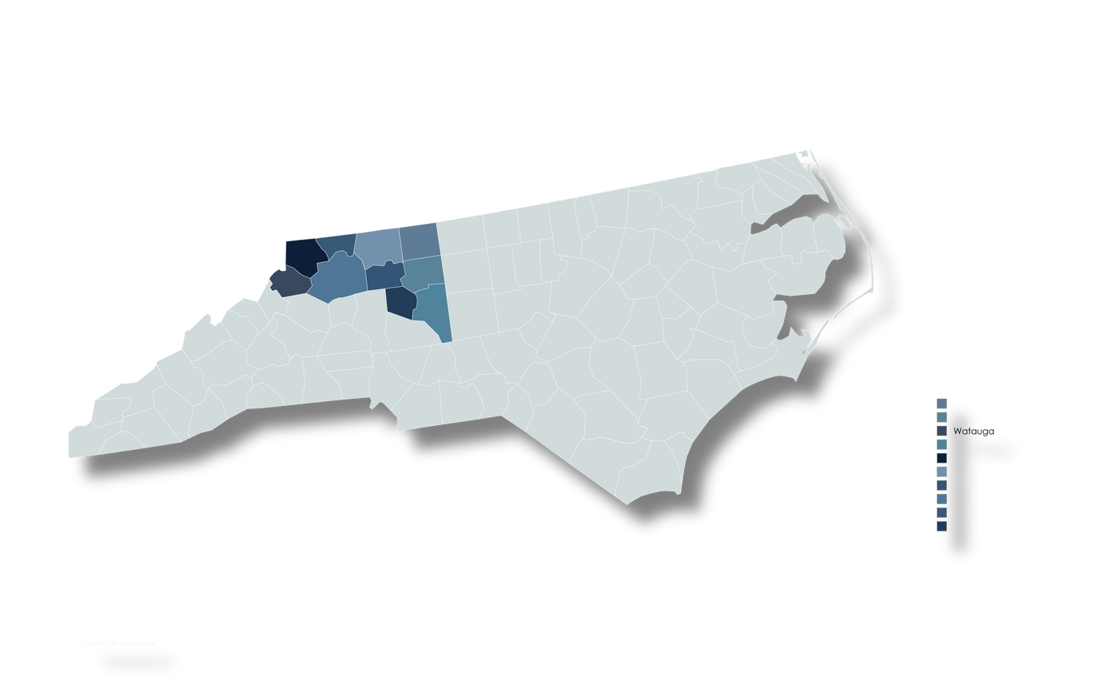
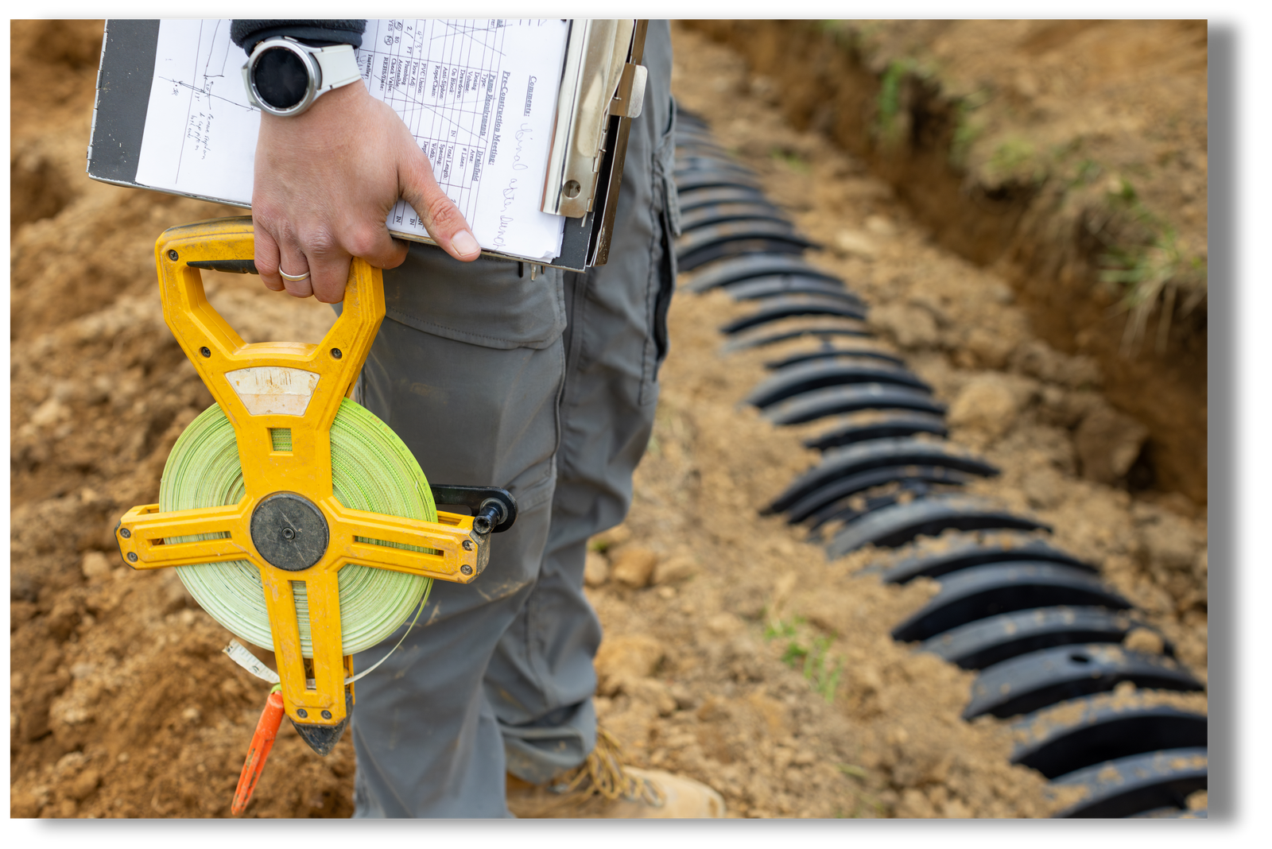



Region 3
Policy Changes to Improve EH Recruitment & Retention
CHALLENGE:
FC:
Policy Development & Support
  Recruitment and retention of Environmental Health staff was a major pain point.
  Policy Change
Funding
  Hiring
Expanded EH qualifications
Used ARPA dollars to create & fund EH Tech positions
LHDs filled gaps by hiring EH Techs
OUTCOME:
  EH Technicians trained to become REHS
  Built a sustainable EH workforce pipeline
  Increased recruitment pool & strengthened capacity
Notes:
Challenge:
Region 3 was experiencing challenges in recruiting and retaining Environmental Health staff, especially Registered Environmental Health Specialists. This created gaps in our ability to maintain core services effectively.
Action Taken:
To address this, health directors advocated for expanding the qualifications for EH positions. This widened the recruitment pool. We also leveraged ARPA funding to create EH Technician positions to fill immediate staffing gaps and support ongoing work while staff gained the experience needed to become Registered Environmental Health Specialists.
Outcome:
As a result, we successfully hired EH Technicians who were just shy of REHS certification. We provided them with targeted training and mentorship, enabling them to achieve REHS status in about a year. This approach strengthened the Environmental Health workforce across several Local Health Departments.
Impact:
This strategy increased our recruitment pool, filled critical staffing gaps, and established a sustainable pipeline for future REHS staff, ensuring long-term stability for our Environmental Health programs.

Slide 9

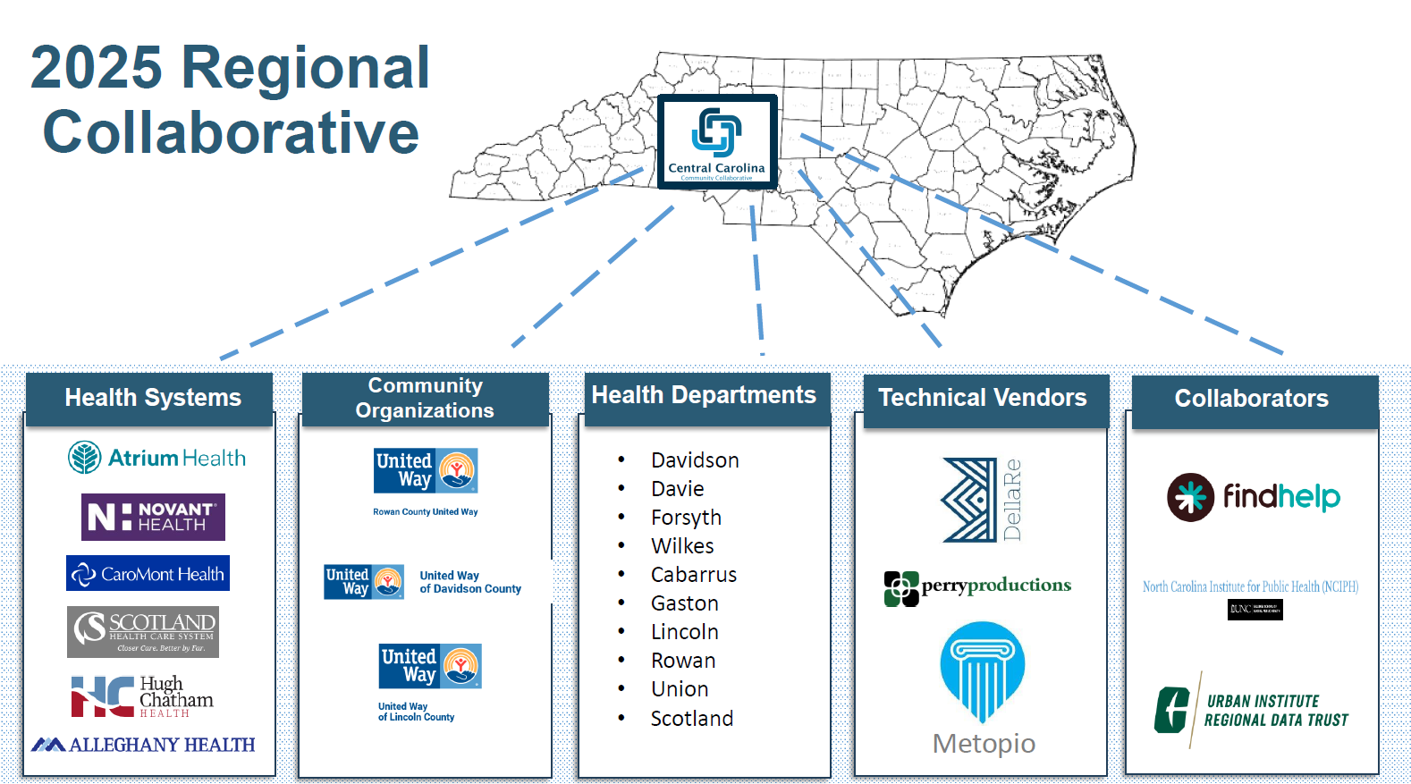
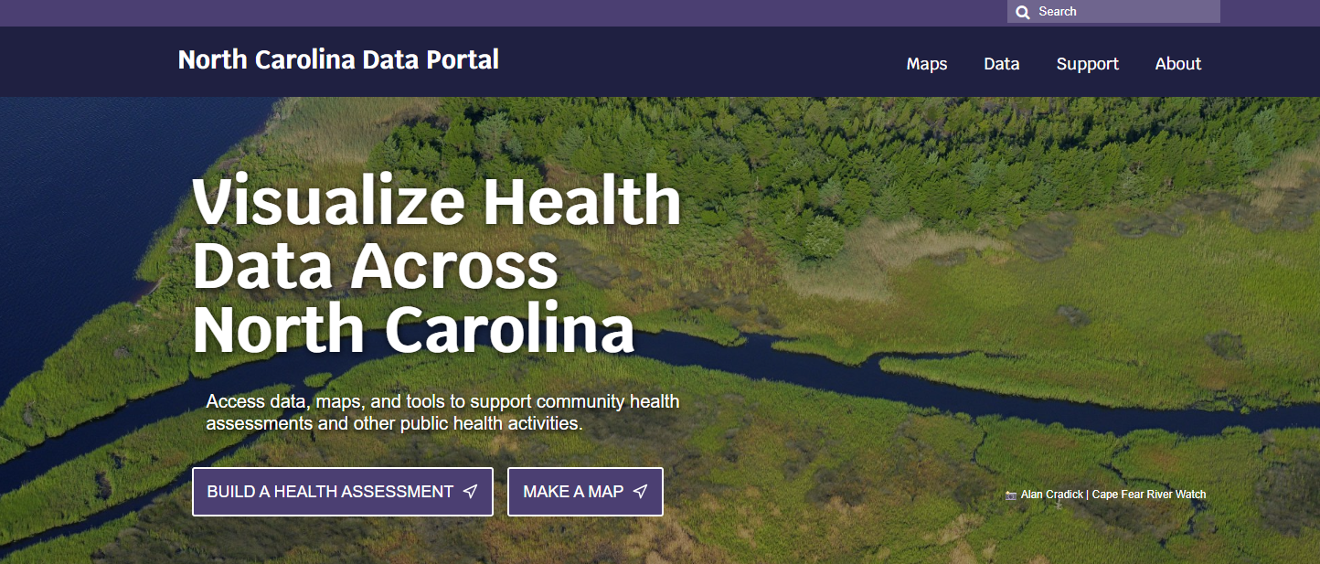
FC: Assessment
Regional Community Health Needs Assessment
NC Data Portal

Slide 10
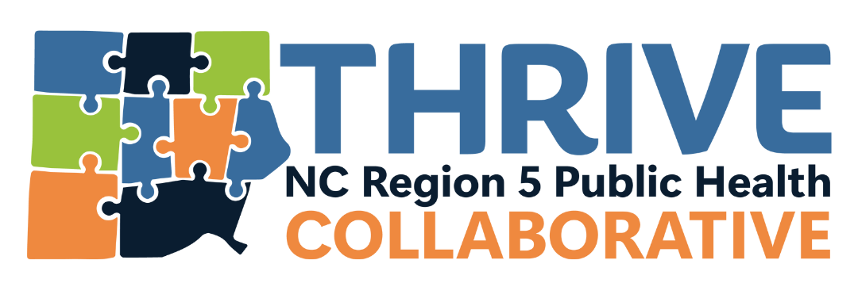


FC: Organizational Competencies
Region 5
Health Director Playbook
Health Director retreats
Retreats, events, leadership series-all centered on leadership skills and culture change
Sharing of resources and org. development best practices (i.e. internal communications, recruiting, onboarding, interviewing,
Notes:
Notes:
Our focus in region 5 has been aligning our counties with organizational development best practices.
We have gathered many resources in various topics (i.e. internal communications, recruiting, onboarding, interviewing). We created a playbook that contains all of these topics and links to resources.
We have a website to gather resources by topic to share with all counties. The more consistent we can get across departments within counties with the same language and templates and guides to make implementing these best practices easier, the more standardized these practices will become.
We held retreats, trainings and events for various staff in order to teach these best practices in leadership and organizational development.
QR code links to playbook. We would love to talk about how to keep this playbook updated and continue to add pieces relevant to PH and being a health director specifically. Email Erica Thomas to contribute to that or if you have ideas.

Slide 11

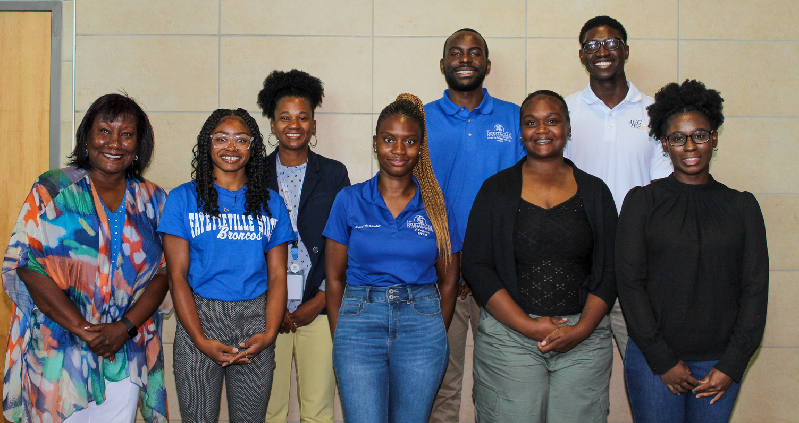
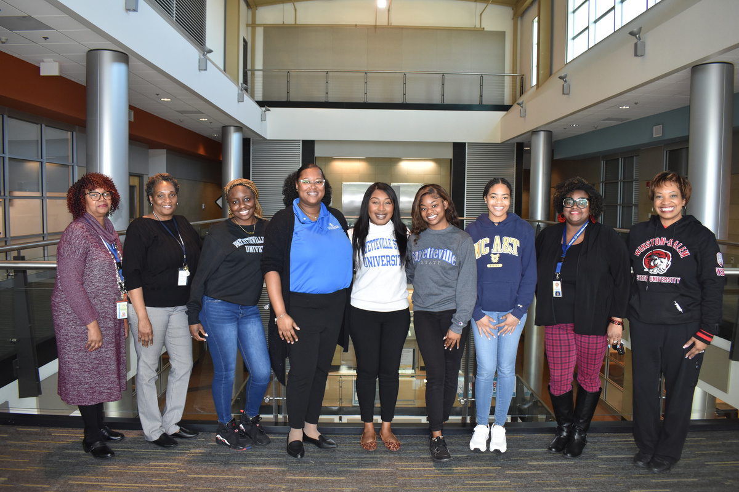
FC: COMMUNITY PARTNERSHIP DEVELOPMENT
10
NC HISTORICALLY BLACK COLLEGES AND UNIVERSITIES
Region 6 is proud to have established a Historically Black Colleges and Universities and Minority Serving Institutions (HBCUs/MSIs) Internship Program to build a strong and inclusive workforce. The program fosters workforce development and increases access for HBCU/MSI students, including rural students to learn about public health careers.
4
NC MINORITY SERVING INSTITUTIONS
12
INTERNSHIP OPPORTUNITIES
76
APPLICATIONS
$28,000
TOTAL STIPENDS AWARDED
The program fosters workforce development and increases access for HBCU/MSI students, including rural students to learn about public health careers.
SOUTH-CENTRAL
REGION
Anson | Cumberland | Harnett | Hoke | Lee | Montgomery Moore | Richmond | Scotland
Amichia Gainey-Jones, MHA NCCM
Workforce Development Director
Notes:
Discussion Points:
- Health Directors from the South-Central region initiated an internship program aimed at promoting workforce development and enhancing access for rural and minority students to explore careers in public health.
- By collaborating with career services representatives, department chairs, and professors across 10 NC HBCUs and 4 MSIs, the region successfully received 76 impressive student applications.
- Throughout an 8-week period, students engaged in various development opportunities, including:
- An introductory course on public health in North Carolina
- Job interviewing skills
- Group engagement and team-building exercises
- Health promotion activities, among others
- Local Health Department staff, who are graduates of HBCUs/MSIs, served as mentors, providing valuable insights into their public health careers.
- The South-Central region is fortunate to maintain a strong relationship with local colleges and will continue to collaborate with them to offer students opportunities to learn about public health at the community level.

Slide 12


REGION 7
FC: Equity
Organizational Competencies
Analyses of recruitment and retention competitiveness in the N.C. economy; quantified N.C. labor force projections; and interactive tool to project costs and staffing needed to provide public health services
Six-day Leadership Training for
approximately 60 staff across the region’s seven LHDs
Provided 150+ staff members with more than 50 conference, training, and certification opportunities to support LHD capacity-building across all foundational capabilities
Academic Health Department Partnerships
Six fellows, six scholars and four interns were supported via new university partnerships
Partnered on FC projects including communications (UNC Gillings), assessment and surveillance (NCCU) and communities of practice (Duke).
Two campaigns launched to advertise and support the local public health workforce
Two university pilots launched to continue public health research and implementation
Data Modernization
Working across programs to modernize and automate data collection, reporting and visualization
Developed a GIS-based decision-making tool created for use in determining LHD equity-assessment and surveillance, accountability performance, and policy development FCs

Slide 13
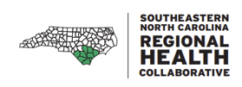
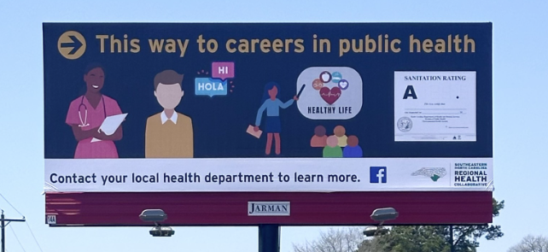
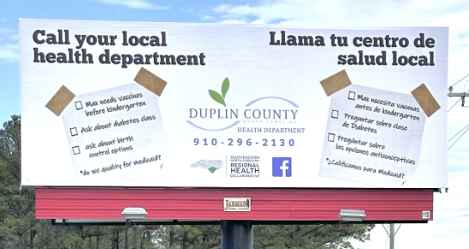
Region 8
Workforce Development
Promoting Public Health Careers & Services
Quality Improvement related to Public Health Services
CMARC & CMHRP
Collaborations to support regional CM services
Participation in the Care Management Demonstration Project
FC: Accountability & Performance Management

Slide 14

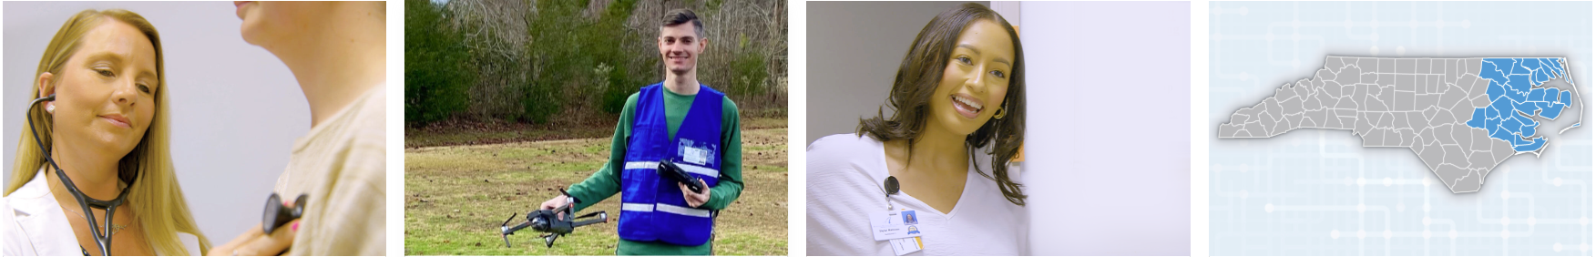
Careers 2 Make a Difference:
Inspiring the Next Generation of Public Health Professionals
Region 9 & 10 Collaboration
• Jointly launched Careers 2 Make a Difference, a public health career awareness campaign for high schoolers, college students, and young adults.
• Funded through the American Rescue Plan Act (ARPA) in partnership with local health departments and NENCPPH.
What the Campaign Offers
• Introduces what Public Health is, why it matters, and the wide range of career paths close to home.
• Highlights internship opportunities through county health department contacts.
• Features real public health workers sharing their stories and career journeys.
• Showcased on CBS17’s My Carolina Show, with leaders from Beaufort & Lenoir counties.
Impact of Internships
• Interns gain real-world experience in:
– Substance use prevention & coalition engagement
– Tobacco-free policy efforts & advocacy
– School outreach and community presentations
– NENC Connect updates & the Regional Get Moving Challenge
– Implementing CATCH My Breath, newsletters, and partnership building
• Helps students understand career paths and cross-county collaboration.
Learn More:
careers2makeadifference.com
FC: Sustainability
Notes:
Talking Points:
Region 9 and Region 10 came together to build a dedicated campaign that introduces youth and young adults to meaningful careers in public health.
The website helps visitors understand what public health is, the variety of careers available, and why this field is so rewarding—especially for people who want to serve their communities and work close to home.
Public health staff across the region contributed personal testimonials, helping viewers connect with real stories and real career journeys.
There was also had a segment on CBS17’s My Carolina Show, where two leaders shared how they found their way into public health.
Internships have been a major part of the campaign’s success. Our interns worked on substance use initiatives, tobacco prevention, school outreach, regional campaigns, policy advocacy, and more.
The site directs students to the county health departments for internship inquiries—making it easy to connect with local opportunities.
Overall, this campaign supports a pipeline of future public health professionals and builds awareness about the rewarding careers that exist right here in our region.

Slide 15

Looking Ahead

Slide 16
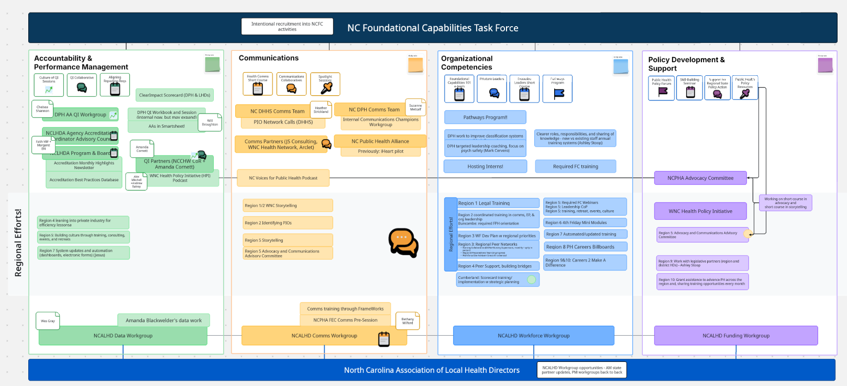

Slide 17

Thank You!

