Slide 1

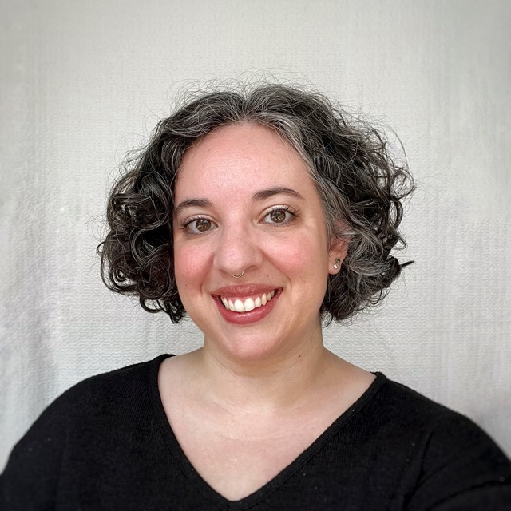
NC STATE UNIVERSITY
60-Minute Interview
WHO SHOULD PARTICIPATE?
Individuals involved in convening a group to decide how to spend opioid settlement funds
WHEN & WHERE?
Flexible scheduling (9am-6pm, M-F) through June
Conducted via Zoom
WHY PARTICIPATE?
Study findings will be shared and may be useful for other counties during and after the opioid settlement period
Nina Blau
Ph.D. Candidate
Public Administration
NC State University
NYOLEN@NCSU.EDU

