Slide 1
Defining Regional Community Health Assessments
Data and Performance Management Work Group
NC Association of Local Health Directors
Wednesday, August 19, 2026

Slide 2
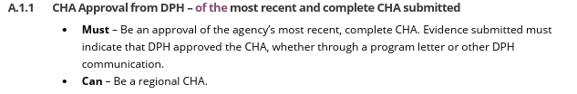
Background
10A NCAC 48C. 0102(7) defines CHA as a process to identify through the collection and analysis of data and to document in a written report the public health needs within an LHD's jurisdiction
The 2026 NC LHD Accreditation Interpretation Document introduces a new option - Regional CHA (A.1.1)

Slide 3
Issue/Ask
Regional CHA is not defined in the Administrative Code nor is it defined in the Interpretative guidance
NC DPH is requesting input from the NCALHD to define and set parameters

Slide 4
Current CHA Submissions
(2021-2025)
NC has 86 LHDS
69 County Health Departments
5 Health Districts
ARHS (8 counties)
Toe River (2 counties)
Foothills (2 counties)
Granville-Vance (2 counties)
MTW (3 counties)
Granville-Vance is the only health district submitting one CHA for both counties

Slide 5
Is there a difference between a multi-county CHA within a health district and a Regional CHA?
Granville-Vance Health District is its own jurisdiction; it would not be considered a regional CHA – it conforms to the current definition of a CHA in the administrative code.
But what if multiple local health departments decided to work together on a CHA, what would that look like?
What if Hyde, Dare, and MTW wanted to conduct a Regional CHA?
Would they need to do anything differently?

Slide 6
A process to identify through the collection and analysis of data and to document in a written composite report the public health needs of a multi-county jurisdiction.
Proposed Regional CHA Definition

Slide 7
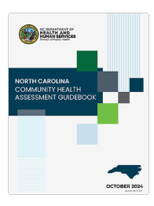
Guidance
Guidance is the same for Regional CHA as a traditional CHA, but the expectation is that the process must be explained to assure that each jurisdiction is represented equitably.

Slide 8
Proposed Expectations
  Multi-county process across multiple LHD jurisdictions
  Adhere to same guidance for traditional CHA (12 Step Process)
  Describe process used to establish Budget, Steering Committee, Advisory Committee, Framework, Partner Engagement, Identification of Health Problems, Prioritization Method
  Describe process for the Asset Inventory
  Describe the method and process for Secondary Data Collection and Analysis
  Describe the method and process for Primary Data Collection and Analysis
  Describe method for sharing results with community

Slide 9
Community Health Improvement Plan
Each jurisdiction (local health department/health district) would have its own Scorecard, but the Scorecards could be shared through Partner Connect

Slide 10
Related Changes to the CHA-CHIP-SOTCH Process
Consolidated Agreement (proposed)
Annually, in January, LHD will inform the DPH Director CHA and Improvement:
Name/contact information of person who leads the CHA/CHIP initiative in each health department
The calendar year that the LHD intends to conduct its next CHA
Submitted by Smartsheet

Slide 11
Related Changes to the CHA-CHIP-SOTCH Process
Explore interest in reverting to original timeline now that secondary data are available through the NC Data Portal
Conduct CHA January through December.
Submit by January 30 of the year following the CHA.
Submit SOTCH in Clear Impact Scorecard by January 30 if not submitting a CHA.
Submit CHIP in Clear Impact Scorecard by March 30.
Advantage: Reduce confusion!!!
Reduce ½ hear lag time between CHA submission and improvement plans

Slide 12
Action Items
Seek committee recommendation for pursuing the changes as outlined in this presentation.
Thank you.
Kathy Dail

