Slide 1

We are NC Public Health – Everywhere, Every Day, Everybody
Take a moment and think about what inspired you to go into public health.
Notes:
Notes: Presenter to ask for shout outs. Then, summarize the top themes to transition to next slide. The purpose is to connect data to the values that inspire people in their work.
Invite everyone to reflect on what brought them into public health.
Add a brief personal or observed example if helpful.
Reiterate that Data Forward supports that same mission of healthier, safer communities.
My work with the Department really inspired my awe of public health. I saw how public health touched everything in ways I never thought about. And I saw how the work had immediate impact on people's everyday lives and their long-term health and wellbeing. Public health exemplifies public service.

Slide 2
From Silos to Seamless: Modernizing Public Health Data in North Carolina for a Connected, Data-Driven Future
Terra Ankrah, MBA, Assistant Division Director, Data and Opportunity
Sharon E. Loza, PhD, IMHM-P©, Chief Data Modernization Officer
May 18, 2026

Slide 3
Table of Contents
Our Public Health Mission & the Role of Data
Why Modernizing Data Matters
Building Data Forward Together and Governing Well
Data Forward in Action: The DPH Data Lake
Workforce Development and Training
What Success Looks Like & How We Move Forward
Notes:
Overview of what the deck will cover

Slide 4
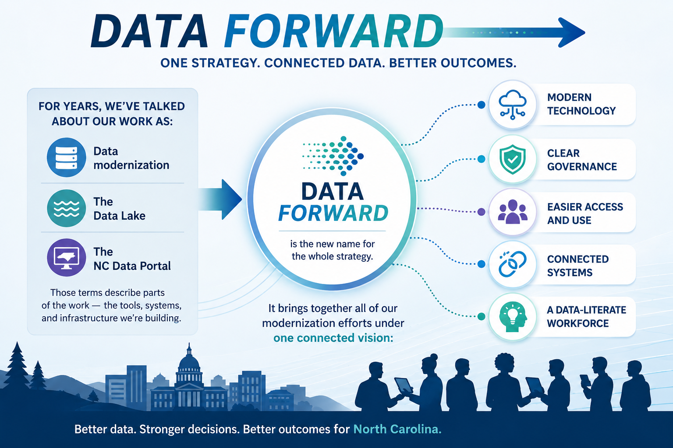
Moving Public Health Data Modernization Forward
Notes:
Why the shift?
To give us a clearer, unified way to talk about the work — not as separate projects, but as one coordinated effort across DPH.

Slide 5
Connecting the Dots
You’ve already been hearing and doing the work of:
• Strengthening interoperability
• Improving data quality
• Transitioning systems to the cloud
• Developing the Data Lake
• Using dashboards and analytics
• Advancing data governance
These are Data Forward.
Data Forward:
• Is the umbrella for our statewide, multi‑year data strategy
• Builds on the modernization work already underway
• Adds structure, language, and clarity for staff, partners, and communities
• Helps us tell a more cohesive story about our progress and direction
What’s not changing:
Our goals, our work, or our commitment.

Slide 6
Data Forward for Public Health
If data modernization describes the upgrades, and Data Lake / Data Portal
describe the tools, then Data Forward describes the movement - our shared
vision for connected, secure, and usable public health data in NC.

Slide 7
Meeting Our Mission Starts With Public Health Data
Together, we:
  Help make the air we breathe, the food we eat and the water we drink safer;
  Prevent injuries and disease;
  Issue and keep the records for our major life events like birth, marriage and death certificates;
  And make it easier for each of us to live healthier lives.
  To produce the best outcomes for North Carolinians' health and wellbeing, we need data fast, consistently and equitably.
Notes:
We can see how much we all rely on the work you do. No matter where you sit in public health, you are contributing to helping make the air we breathe, the food we eat and the water we drink safer; preventing injuries and disease, issuing and keeping the records for our major life the birth of a new baby, a marriage, and when someone dies, and making it easier for us all to live healthier lives.
Every one of these things starts with data. And it generates data that can be analyzed to help us act with confidence.
Prevent injuries and disease;
Issue and keep the records for our major life events like birth, marriage, and death certificates;
And make it easier for each of us to live healthier lives.
Data powers nearly every part of public health. It includes safety, prevention, vital records, disaster preparedness planning and much more.
Data helps us see what’s happening, understand needs, and act with confidence.
Encourage participants to think of a time when having (or not having) data affected their work.

Slide 8
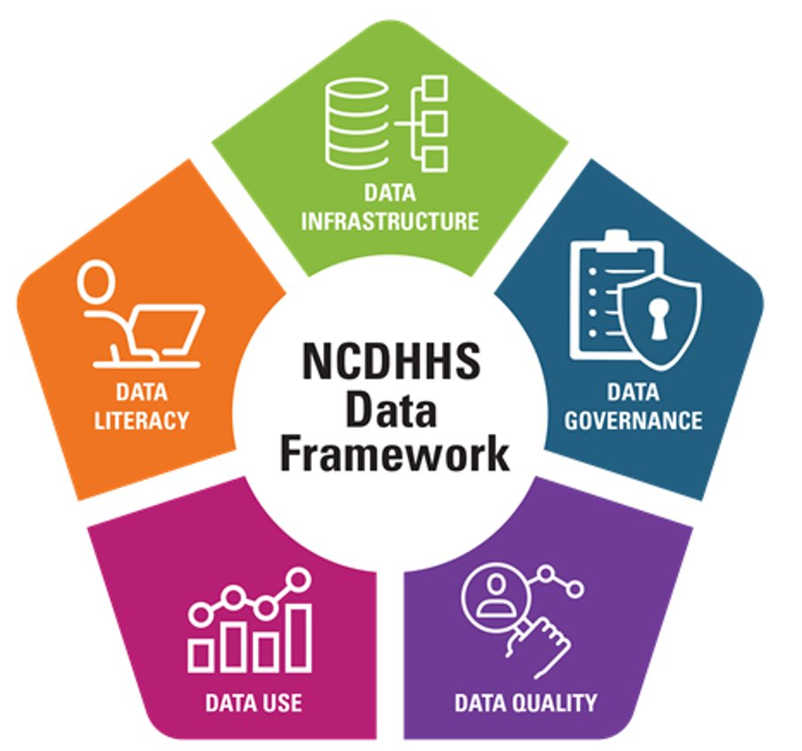
Modernizing Public Health Data is a Journey
Data modernization isn’t a single moment—it’s continuous improvement. Each success strengthens our statewide system to help us be ready for today and tomorrow.
We all contribute to the statewide picture of health and data modernization helps connect those efforts across programs like the State Laboratory of Public Health, the State Center for Health Statistics and the Immunization Branch, among many others.
Whether you work in communicable disease, maternal health, environmental health or chronic disease prevention, data is
what links your work to outcomes.
Modernization allows us to use information more efficiently and meaningfully.
No matter your role, your data helps tell a bigger story.
Notes:
Ensuring the way we can access and understand that data to meet the moment is a continuous process – not a single point in time. We've been working on data modernization and we will continue to. Each of you is part of that and your successes are strengthening our system and our ability to meet our mission to support North Carolinians' health and wellbeing. So when you hear data modernization, that's all of us. And together – across our divisions and partners – we want to be able to leverage our collective data to see the bigger picture so we have better understanding of what is happening, where it's happening and what we can do.
Modernization is not static. It is an ongoing process that evolves over time. This work builds on years of progress already underway across DPH — it does not replace or erase past investments.
Every division contributes to the statewide picture: State Lab, SCHS, Immunization, communicable disease, chronic disease, environmental health and many more.
Connecting our efforts helps us see the full story.
Encourage participants to consider how their own data fits into the statewide picture.

Slide 9
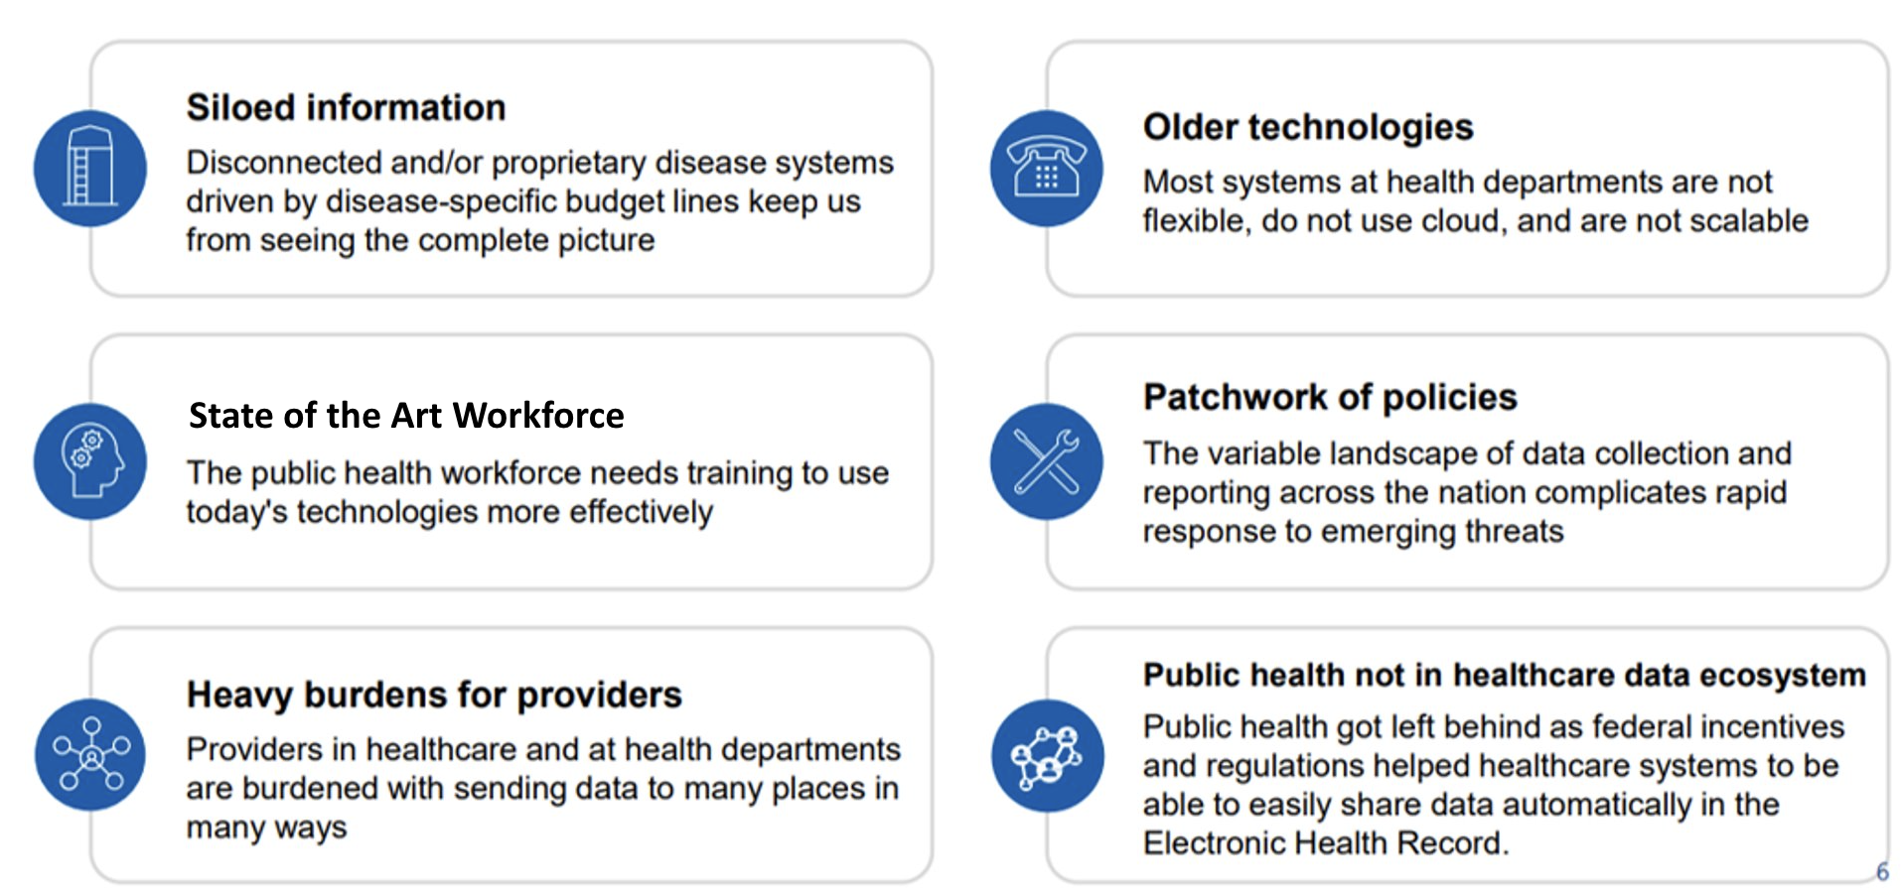
Why Data Forward
Data Forward is about providing the right tools so that staff spend less time working around outdated and siloed systems and more time using data to best serve communities.
Connected Information
Moving away from disconnected and/or proprietary disease systems driven by disease-specific budget lines that keep us from seeing the complete picture.
Newer Technologies
Adapting so that systems at health departments are flexible, use cloud and are scalable.
Skills for the Future
Supporting the public health workforce with the training they need to use today's technologies more effectively.
Aligned Policies
Ensuring data collection and reporting in our state follows set guidelines, reducing barriers to rapid response to emerging threats.
Ease Burdens on Providers
Supporting providers in healthcare and at health departments so they can more efficiently share data.
Integrated public health and health care data
Bringing together crucial data needed to support the health and wellbeing of North Carolinians.
Notes:
Data Forward is about continuing to connect information so we see a more complete picture. It's about investing in our public health workforce with skills for the future. It's about easing burdens on providers by allowing them to more efficiently share data. It's about newer technologies that are scalable. It's about aligning our policies and reporting to reduce barriers to rapid response. It's about integrating public health and healthcare data in service to the health and wellbeing of North Carolinians.
We are working every day to move from siloed, outdated and heavy-lift systems toward connected, modern and easier to use systems.
This helps staff work more efficiently and helps programs coordinate more effectively.
Ask participants which challenges on this slide feel most familiar to them.

Slide 10
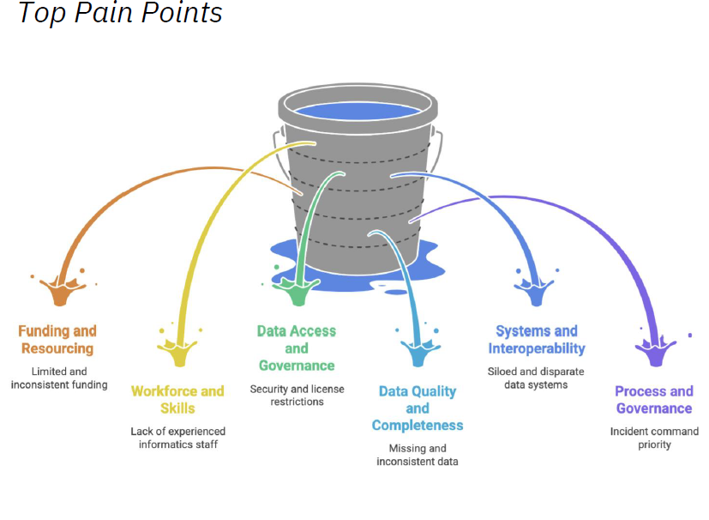
Current State Assessment – Key Findings

Slide 11
Building on Our Progress: Data Forward
With additional funding from the CDC through programs like the Epidemiology and Laboratory Capacity (ELC) initiative and the Public Health Infrastructure Grant (PHIG), we are continuing our journey with Data Forward.
VISION
A healthier North Carolina where clear and accessible public health data helps professionals, policymakers and communities take timely action to protect and improve lives.
MISSION
To strengthen North Carolina’s public health with secure and connected data systems.
Data Forward supports and builds upon the work you are doing.
Notes:
Now we have another opportunity to build on our progress. Data Forward is part of our current data journey. It is being funded CDC through programs like the Epidemiology and Laboratory Capacity initiative and the Public Health Infrastructure Grant.
The vision of Data Forward is a connected North Carolina where trusted data drives timely action for healthier lives.
And its mission is to strengthen NC Public Health with secure, connected and trusted data systems that serve every community.
Read the vision and mission statements.

Slide 12
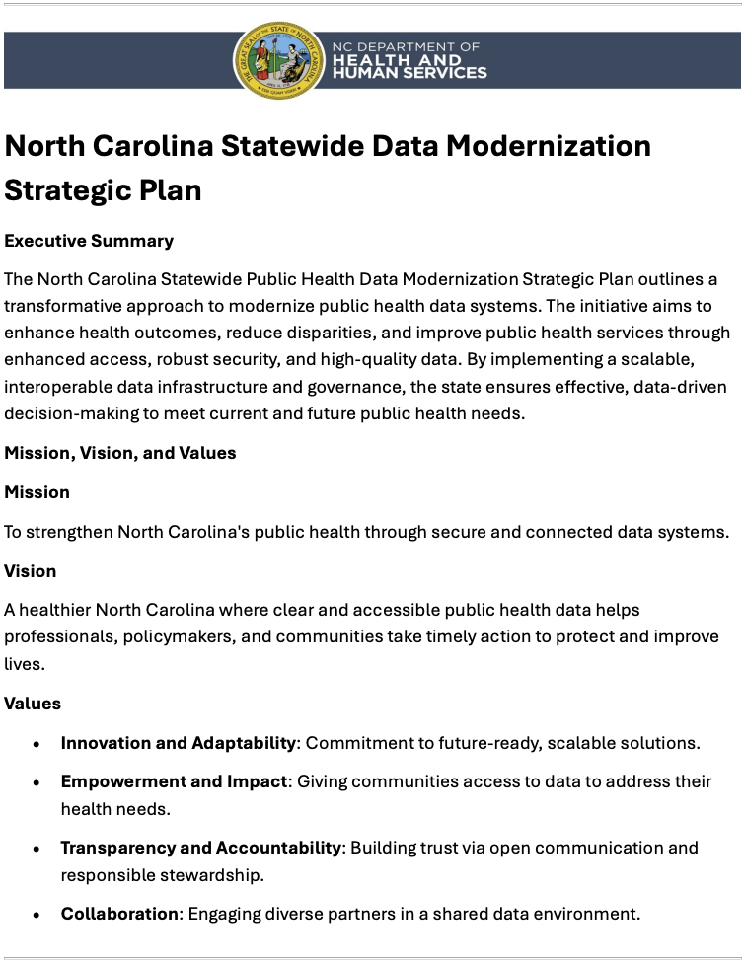
Guided by a Strategic Roadmap
Goals:
Connect and Integrate Key Public Health Data
Make Data Easy to Access and Use
Support Data-Driven Public Health Decisions
Build Strong and Sustainable Data Infrastructure
Ensure Transparent and Secure Data Management
This work will happen in phases, with priorities informed by readiness, impact and capacity.
Notes:
Our work is guided by a strategic framework that was developed through a collaborative process that started with listening. The goals reflect what was heard from teams that they needed.
Connect and Integrate Key Public Health Data
Make Data Easy to Access and Use
Support Data-Driven Public Health Decisions
Build Strong and Sustainable Data Infrastructure
Ensure Transparent and Secure Data Management
Our strategic roadmap keeps all of us aligned and focused on the same goals.
These goals reflect what staff asked for: easier access, stronger systems, better decisions and secure processes.
Reinforce that progress is already happening and will continue over time.

Slide 13
Strategic Goals - Guided by a Strategic Plan
Connect and Integrate Key Data Systems
Link siloed program systems through shared standards, interoperability, and integration pilots to enable cross-program analysis and collaboration.
Improve
Improve Data Accessibility and Use
Develop a user-friendly statewide data platform with interactive dashboards and training to help staff and partners use data more effectively.
Enable
Enable Data-Driven Decisions
Provide analytical tools and forums for data-informed policy, program design, and performance evaluation.
Build
Build a Sustainable Data Infrastructure
Transition legacy systems to modern, cloud-based infrastructure to ensure scalability, reliability, and adaptability for future needs.
Ensure
Ensure Transparent and Secure Data Management
Strengthen governance, compliance, and privacy protections while maintaining public trust.
Connect and Integrate
Notes:
Our work is guided by a strategic framework that was developed through a collaborative process that started with listening. The goals reflect what was heard from teams that they needed.
Connect and Integrate Key Public Health Data
Make Data Easy to Access and Use
Support Data-Driven Public Health Decisions
Build Strong and Sustainable Data Infrastructure
Ensure Transparent and Secure Data Management
Our strategic roadmap keeps all of us aligned and focused on the same goals.
These goals reflect what staff asked for: easier access, stronger systems, better decisions and secure processes.
Reinforce that progress is already happening and will continue over time.

Slide 14
Strategic Plan – Implementation Phases (2024-2027)
Phase 1: Assessment and stakeholder engagement
1
Phase 2: Infrastructure modernization and governance frameworks
2
Phase 3: Training and statewide onboarding
3
Phase 4: Full implementation and evaluation
4
Phase 5: Ongoing implement and Quality Improvement
5

Slide 15
Security and Accountability Are Built In
We protect data because data protect people.
  Governance ensures the right people have the right access for the right purpose.
  Safeguards are built into every step and are guided by state and federal laws (HIPAA, CDC agreements, NC statutes).
  Ethical and compliant data use is a shared responsibility across all teams.
We are intentional about:
  Creating clear, consistent rules so people know what they can use and why.
  Setting defined permissions to protect both staff and the people whose data we steward.
  Conducting regular audits and documentation.
  Being transparent in how datasets are populated, maintained and used.
Notes:
We can't talk about data without talking about security. Protecting data protects people. Our data governance ensures that the right people have the right access for the right purpose. We are intentional about permissions and oversight, about conducting regular audits and documentation, and being transparent about how datasets are populated, maintained and used.
Protecting data protects people.
We’ve built into this process role-based access, oversight, audits and clear data rules to ensure we’re being responsible stewards of data.
As you engage in this effort, you can feel confident knowing safeguards are intentionally designed.

Slide 16
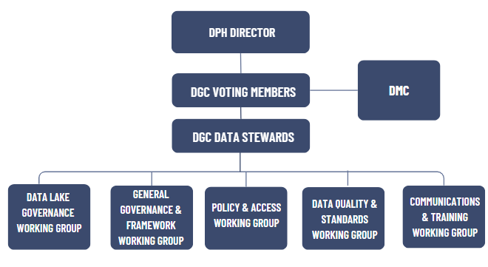
Governance & Accountability

Slide 17
Operationalizing the Strategic Plan
PAST 18 MONTHS
NEXT 18 MONTHS
FUTURE
Data governance structures established. Enterprise data system (DPH Data Lake architecture) developed. Proof of Value and initial use case executed.​
DPH Data Lake implementation and expansion and additional data sets and use case development.​
Sustainable funding, continuous improvement and expanded integration and usage by partners.​
Notes:
We are at an important inflection point in our Data Forward journey. We've spent the last 12 months building the data office, getting data governance structures in place and finalizing the strategic plan. We've also marked our first milestone with the development of an enterprise system – a Data Lake. We'll be expanding the reach of the Data Lake over the next six months and continuing to build toward sustainable funding and expanded partnerships.
Give a brief overview of the progress so far: Data Office formation, governance structures, Data Lake architecture and development of early use cases.
Next steps include Data Lake expansion and additional use cases.
Long-term work focuses on sustainability and deeper program integration.

Slide 18
Starting Point: The DPH Data Lake
A data lake is a secure, central place where information from many different systems is stored together so it can be easily accessed, combined and analyzed.
The DPH Data Lake is a new tool created under Data Forward. It is a secure, central place where data from many different systems is stored together so it can be easily accessed, combined and analyzed. You can use the DPH Data Lake to:
Answer bigger questions, faster
Spend less time chasing data and manipulating spreadsheets
Identify problems earlier and act sooner
Better protect data
Our goal is a sustainable, adaptable data infrastructure that supports real-time decision-making.
Notes:
The Data Lake that I just mentioned is a starting point. A data lake is a secure, central place where information from many different systems is stored together so it can be easily accessed, combined and analyzed. It supports consistency, faster reporting, less duplication and less manual reporting. Ultimately, it's a tool that an improve and drive real-time decision-making – and that means better outcomes for North Carolinians.
The Data Lake is a secure place to bring data from different systems together.
It supports consistency, faster reporting, less duplication and clearer information.
It lays the foundation for our larger Data Forward vision.

Slide 19
What the DPH Data Lake is NOT
🚫 Not a Replacement for Transactional Database or a Data Warehouses
Data lakes complement—not replace—database or data warehouses; each serves different needs.
🚫 Not a Data Swamp
Without proper metadata, cataloging, and quality controls, a data lake becomes unusable—often called a “data swamp.”
🚫 Not Only for Raw Data Storage
While it stores raw data, a true data lake also supports processed, curated, and analytics-ready datasets.
🚫 Not Without Governance
A data lake requires strong data governance (security, access control, lineage, quality standards).
Notes:
DL is not Data Warehouse- A) Structure- DL stores raw, messy data (unstruct or semi-struct). A datawarehouse only stores highly structured,cleaned and processed data. B) Schema- DL uses “Schema-on-read” (you define the structure when you are ready to use it). Date warehouses use “Schema-on-write” meaning data must fit a strict, predefined model before it can even be saved.
DL- are for exploration, Machine Learning, and data science. Datewarehouses are for BI, Standardized reporting and dashboards.
DL- Not a standard Transactional database. They are not same as databases used to run day to day apps.
Data bases are built for OLTP- fast, real time updates like processing a online store or a bank transfer etc.
Volume- DBs typically store “current” data for specific apps, where as DL store massive amounts of current and histrorical data from many different systems at once.
DL- NOT a data swamp- It should not be disorganized “dumping ground” where data is lost or unusable.
Governance: Without proper metadata and management, a data lake becomes a data swamp, where finding useful information is nearly impossible.
Utility: A true data lake requires data observability to ensure the data remains accurate and reliable as it scales.
MORE Info:
DL & DLH sound similar but DLH is a hybrid.
Standard DL often lack features like ACID transactions (which ensures data integrity) and data versioning. DLH adds these warehouse-like features directly onto a datalake.
A lakehouse is a data architecture that combines a data lake (DL) and a data warehouse (DW).
A lakehouse deploys both DL and DW on the same data platform, preferably on one instance or tenant of a DBMS
Point — A lakehouse converges platform and refinement components for greater efficiency and governance.
When a DL and DW are on separate platforms, this is not a lakehouse. It is a form of the logical data warehouse

Slide 20
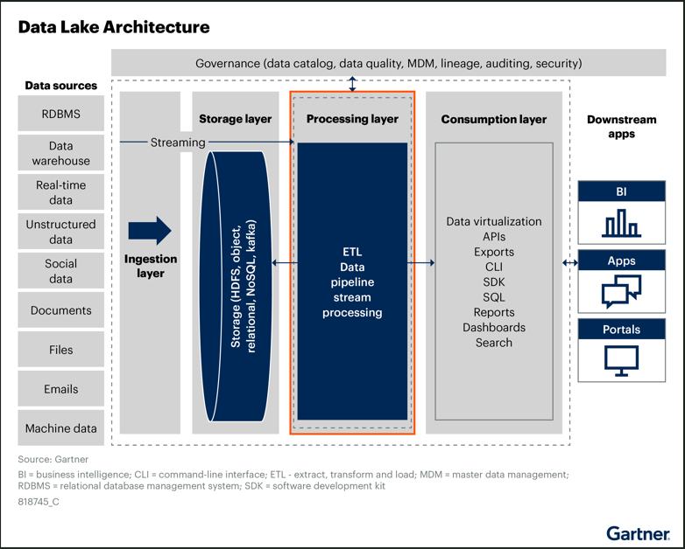
DPH Data Lake Concept
Notes:
A high-level data lake architecture, along with the key functional capabilities and major components needed to build a data lake, is shown in figure.
Ingestion-Before the data lake becomes useful for data analysis, the data lake needs to connect to various data sources and acquire data from them. The ingestion layer in the data lake enables the functionalities to achieve this. Data ingestion lays the foundation for data extraction from source data systems and the orchestration of different ingestion strategies in a data lake.
Storage: Following data ingestion, the data needs to be stored. Data storage within the data lake is the most critical component. Data storage choices and architecture determine the performance, scalability and accessibility of the data in a data lake.
With myriad complex data types, growing data volumes and data variety, there is no single storage platform or choice that can suffice all storage requirements across different selection criteria.
Data lakes will typically have storage across any or many of these types of data stores: NoSQL data stores, Relational data stores, Streaming message/event stores, New SQL data stores, In-memory data stores, Distributed file systems, Object data stores.
Depending on the consumption use cases, either the existing storage can be used or data can be moved to another form of storage like NoSQL data stores based on use cases and read and write patterns.
Most organizations use HDFS (Hadoop Distributed File System (HDFS) is a core component of the Apache Hadoop framework designed to store massive datasets (petabytes) reliably across clusters of inexpensive commodity hardware. It enables high-throughput streaming access to data, optimized for batch processing rather than interactive use, making it ideal for big data analytics) — on-premises and cloud or object store on cloud, for storing the data postingestion and postprocessing.
Object stores such as Amazon Simple Storage Service (Amazon S3) and Google Cloud Storage are overtaking HDFS deployments rapidly. Data lake architects must understand the nuances of replacing a file system with an object store. Object stores have a different architecture than file
systems.
Data Processing: data lakes provide value only when the data that has been ingested and stored can be processed to build data-driven applications. DL support different data processing workloads for example like: Batch, stream workloads, ML workloads, Graph Processing workloads, BI workloads- SQL query processing.
challenge with data processing in a data lake is in the variety of available data processing engines. Each of the different data processing engines has a different goal and is best suited for different use cases. The criteria for selecting processing engines depend on the internal architecture of the engines, the best use case fit for these engines
Consumption: Data lakes can ingest and process volumes of data, but the real value of a data lake is realized only when the processed data is consumed to build data-driven applications. Making the data available to downstream applications and consumers in the data lake lays the foundations
for innovation and building data-driven applications.
Easing the process of accessing the data lake allows business transformations to come from anyone in any line of business, not just your data scientists. One of the main requirements from a data lake is to cater to a variety of consumers. Each consumer has different requirements regarding the attributes they want and in what format.
A data lake is successful only when it allows rapid access and consumption with the right governance onboarding of users, irrespective of
their location and which tools they use. Data lakes should support a wide variety of users from data scientists, data engineers, data and business analysts, and product teams. These consumers should be able to point their tools and access the data without development or operational skills.
Data Governance: Data governance gives the right control and trust in the data within the data lake. This gives confidence to the consumers of data in the data lake to make sound business decisions. Data governance is a set of formal processes that ensure that data within the enterprise meets
expectations, such as:
Data is acquired from reliable sources. Data meets quality standards. Data conforms to well-defined business rules. Data is accessed and modified with the right policies, guidelines and access controls. Data follows a well-documented change control process. Trustworthiness of the data remains intact as the data flows through the data lake.

Slide 21
Proof of Value (POV) Use Case – Newborn Screening & Birth Records
Proof of Value: a pilot of a small prototype solution to develop a better understanding of resources requirements and cost estimates, data integration and entity resolution solutions to advance data modernization efforts within the Division.
Allow NC to determine and report on the number of newborns eligible for screening and the number screened. Currently, the target calls for a 95%+ screening rate within 5 days of birth, but NC does not currently know the number of newborns missing. Offers a solution to better understand the scope of this issue and inform programmatic improvements to improve screening rates.
Offer NCDHHS the opportunity to be a leader in this space and compare with other states implementing similar studies to define a gold standard.
Help DPH determine the resources required to establish the proposed architecture/ centralized data repository
Facilitate understanding what other technological solutions would be needed to establish the final data lake architecture
Notes:
POV is about linking NB screening and birth data
Challenge
Newborns must be screened in a certain number of days after birth. The items screened for are not only NC requirements and standards but are national best practices and standards too. Infant mortality has been a tenacious scourge in the US and NC.
Goal
The ability to more quickly identify which babies have been born and thus reconcile which have not received the screening, is one tool in the toolbox of reducing infant mortality, while possibly increasing quality of life for those babies and families due to discovering ailments in time for adequate treatment.
Potential Solution
Include birth and newborn screening data in the data lake/warehouse foray to establish the ability to link data.
Benefits
The use case would:
Allow NC to determine and report on the number of newborns eligible for screening and the number screened. Currently, the target calls for a 95%+ screening rate within 5 days of birth, but NC does not currently know the number of newborns missing. The use case would offer a solution to better understand the scope of this issue and inform programmatic improvements to improve screening rates.
Offer NCDHHS the opportunity to be a leader in this space and compare with other states implementing similar studies to define a gold standard.
Help DPH determine the resources required to establish the proposed architecture/ centralized data repository
Facilitate understanding what other technological solutions would be needed to establish the final data lake architecture

Slide 22
Proof of Value(POV) – Deliverables & Accomplishments
Project Deliverables:
A cloud-based data lake capable of storing and processing newborn screening and birth data.
A connected layer building AWS Data pipelines to facilitate data ingestion, transformation, and loading.
Linkage for accurate data matching between newborn screening and birth data.
A Power BI dashboard for real-time data visualization and analysis.
A Data Governance Framework to ensure compliance with security, privacy, and regulatory standards.
Proof of Value Report, summarizing lessons learned and providing a roadmap for scaling the solution.
Success Criteria:
Successful integration of newborn screening and birth data in the cloud data lake.
Full compliance with all data governance and security protocols.
Delivery of the Power BI dashboards with actionable insights for public health officials.
Positive feedback from key stakeholders on the usability and effectiveness of the data integration and analysis.
What specific metrics visualized in Power BI?
    Screening rate within 5 days
    Number of unscreened newborns
    Screening compliance by hospital/region
    Time lag between birth and screening

Slide 23
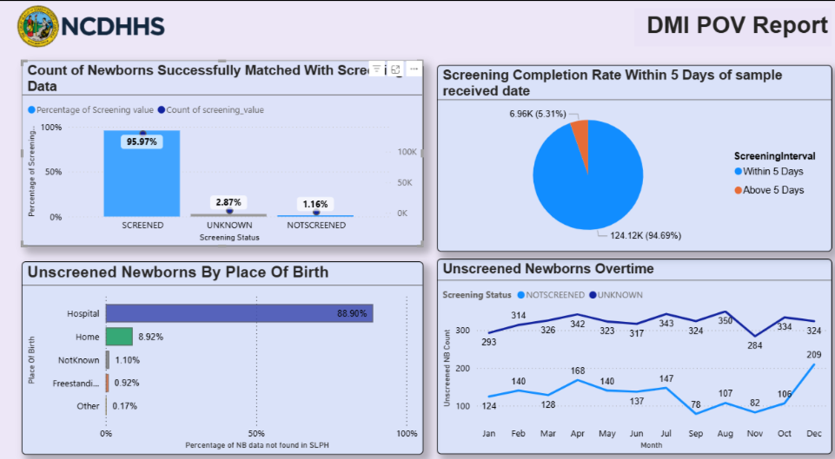
DPH| Data Modernization Proof of Value(POV) – Power BI Reports
Matching logic of VR & SLPH:
Outer Join of SLPH with VR data, matching below list of fields:
Child MRN#
OR( Mother’s Last Name (or)
Child Last Name (or)
Address)
And
MomFirst Name
OR (mom address (or) zip or city or county)
And DOB

Slide 24
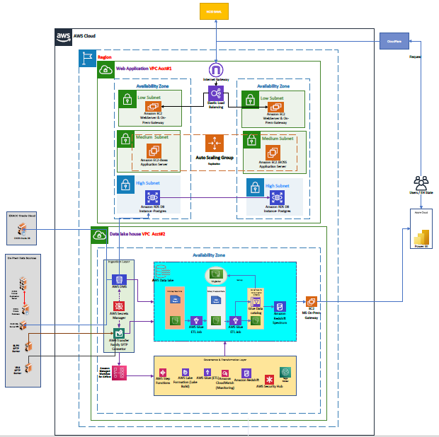
DPH Data Lake – Draft Blueprint of our Architecture

Slide 25
Data Forward in Action: Environmental Health
Problem:
North Carolinians need to know if they may be exposed to unsafe conditions and need fast responses to community health risks.
Need:
A faster, more reliable way to manage food inspections, sanitation grades, water quality and other environmental data in one place for faster action and public safety.​
What can Data Forward do?
Move Environmental Health data into the secure Data Lake to connect systems, automate reporting and replace outdated databases.​
What would improve?
Staff can easily access, analyze and share accurate data statewide which will reduce manual work and reporting delays.​
What is the expected impact?
Our food, water and environments are safer because issues are detected and resolved faster.
Notes:
Here's another example. We want North Carolinians to know if they may have been exposed to unsafe conditions. We need a faster, more reliable way to manage food inspections, sanitation grades, water quality and other environmental data in one place. We will be moving Environmental Health data into the secure Data Lake to connect systems, automate reporting and replace outdated databases. That will allow staff to easily access, analyze and share accurate data which will reduce manual work and reporting delays. And most importantly, that means our food, water and environments are safer because issues are detected and resolved faster.
Outdated systems can delay how we respond to food, water and sanitation issues.
Moving this data into the Data Lake will improve speed, accuracy and coordination.
Faster insights lead to safer environments for communities across our state.

Slide 26
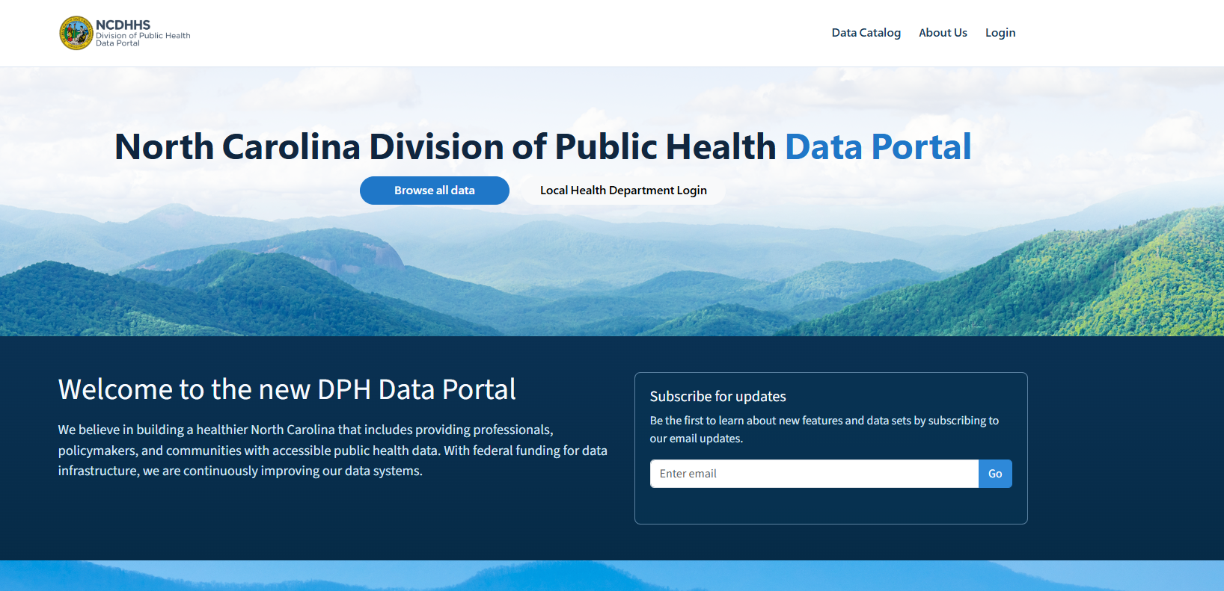
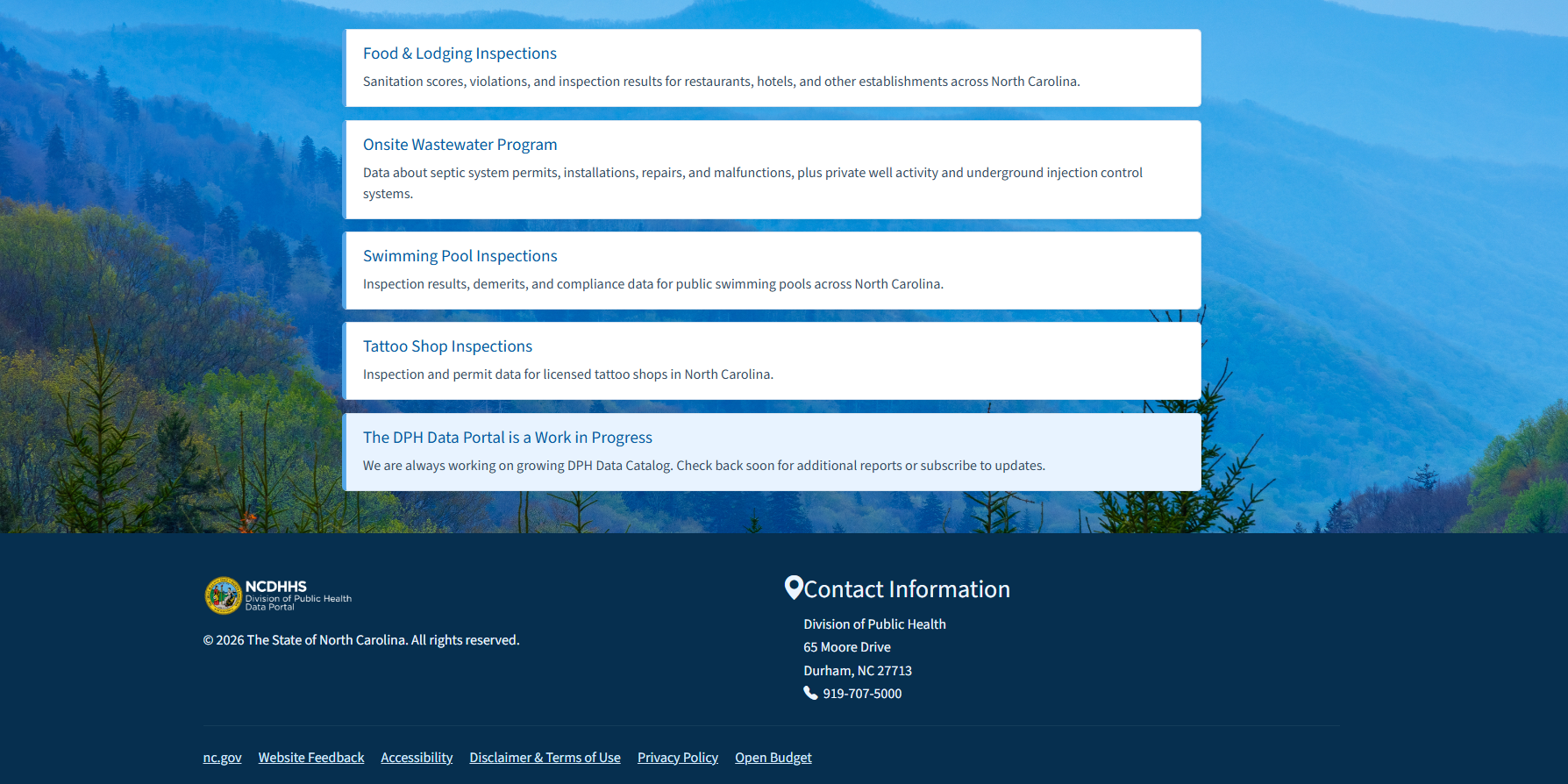
DPH Data Portal
NCDPH Data Portal

Slide 27
Data Forward in Action: Birth & Death Data Replication
Problem:
There isn’t a unified, real-time way to integrate and share birth and death data across systems, limiting timely analysis and decision-making.
Need:
A secure, efficient way to share birth and death data across public health systems while protecting privacy and responding more quickly to health challenges.​
What can Data Forward do?
Create a secure pipeline from NCDAVE to the DPH Data Lake to replicate birth and death data and connect it with other public health datasets.​
What would improve?
Staff can monitor birth and mortality trends and causes more accurately, strengthen coordination across divisions and use real-time dashboards for decision-making.​
What is the expected impact?
North Carolinians benefit from earlier interventions and prevention, helping promote healthy births and reduce preventable deaths.
Notes:
One more. We face challenges in identifying patterns in causes of death which impacts our prevention efforts. We need a secure, efficient way to share death data across public health systems while protecting privacy and responding more quickly to health challenges. We plan to create a secure pipeline from NCDAVE to the Data Lake to replicate de-identified death data and connect it with other public health datasets. Then staff can monitor mortality trends and causes more accurately, strengthen coordination across divisions and use real-time dashboards for decision-making. And ultimately, we can intervene earlier and help reduce preventable deaths.
Siloed death data slows analysis of important trends like overdoses and chronic diseases.
Including de-identified death data to the Data Lake will speed up insights and supports prevention work.
Better data means earlier interventions and healthier communities.

Slide 28
North Carolina’s Data Science Workforce: Equipped, ready, together
Equipped
Access systems and analytic tools
Ability to use systems and analytic tools for public health planning
Ready
Grow the data science workforce
Train the data science workforce
Together
Local & State staff assessment and development opportunities
Communication, alignment, statewide preparedness
Notes:
This is the WF framework we use and how we are applying it to DM Workforce development. Our overall vision is to have a data science workforce equipped and ready to mitigate and combat public health threats.
Equipped: Ability to access and use systems and tools to perform assessment and surveillance foundational capability.
Ready: Growing and training the data science workforce through pathway program opportunities, educational resources, peer development opportunities.
Together: Local and state partners working together to bridge gaps in competencies, aligning in most urgent data modernization workforce priorities.

Slide 29
Workforce Development and Trainings at DPH
Trainings
Monthly Brunch and Learns
Hot Topic Videos (YouTube)
Public health fellowship program
Peer to Peer Connections​
Partners & Collaborators

Slide 30
What Does Success Look Like?
Staff can easily find and use reliable public health data.
Local and state systems align using shared standards.
Data move quickly and securely.
Every program can measure and communicate its impact clearly.
In the long-term, Data Forward reduces burden and builds value for everyone.
For staff: More efficient work, fewer bottlenecks, and increased knowledge and capacity in data science.
For leadership: Clearer, faster insights for decision-making.
For partners: Easier collaboration, alignment, and access to critical public health data.
For communities: Better outcomes for all North Carolinians.
Notes:
So I just shared some examples of success. As we look across our work, Data Forward is about reducing burden and building value for everyone.
For staff that means more efficient work and fewer bottlenecks.
For decisionmakers that means clearer, faster insights
For partners that means easier collaboration and alignment.
And for communities that means better, more equitable outcomes.
Success means easy-to-find data, aligned systems and faster insights.
It reduces burdens on staff and enhances outcomes for communities.
Encourage participants to reflect on which improvements would make the biggest difference in their jobs.

Slide 31
NC Public Health is Data Forward
Data Forward is a shared effort. Together, we’re building a connected, secure and ready public health system for today and tomorrow.
When we all participate, we all benefit and we get better at helping North Carolinians live healthy lives.
We hope you join us as we move Data Forward.
Contact us at dphdata@dhhs.nc.gov
Notes:
This is a shared effort. Today's presentation is just a taste of what Data Forwards is all about. We hope that it inspires you to learn more, to engage and share feedback, to use and share data responsibly within governance guidelines, to celebrate small wins and communicate progress milestones and to partner with us on how can leverage our existing data to improve the lives of North Carolinians
Data Forward works when everyone participates.
Staff input, responsible use and celebrating small wins all help us build momentum.
This work ultimately helps North Carolinians live healthier lives.

Slide 32
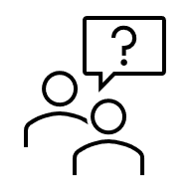
Questions

Slide 33
