Slide 1



Maintaining a healthy community
What the research shows about the benefits
and safety of community water fluoridation
A presentation by Dr. Johnny Johnson for
the Live Oak City Council Workshop, January 23, 2024

Slide 2

Benefits vs Risks of water fluoridation
The safety and effectiveness of fluoride at levels used in community water fluoridation have been thoroughly reviewed by multinational scientific and public health organizations (U.S., Canada, Australia, New Zealand, Great Britain, and the World Health Organization) using evidence-based reviews and expert panels.
These panels include scientists with expertise in various health and scientific disciplines, including medicine, biophysics, chemistry, toxicological pathology, oral health, and epidemiology.
(Sources: CDC’s “Community water fluoridation faq’s” webpage accessed July 14, 2023)

Slide 3
Benefits vs Risks of water fluoridation
Experts have weighed the findings and quality of available evidence and concluded that there is no association between water fluoridation and any unwanted health effects other than dental fluorosis, a condition that causes primarily cosmetic changes in the appearance of tooth enamel
(Sources: CDC’s “Community water fluoridation faq’s” web page accessed July 14, 2023)

Slide 4
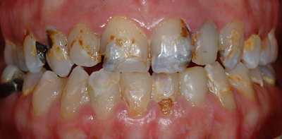
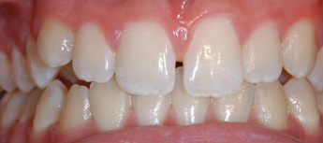
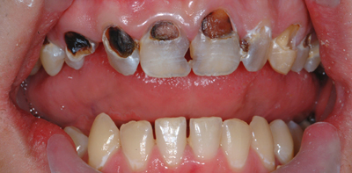
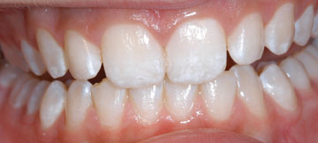
Critics distort the facts about dental fluorosis*
Can you spot the teeth with cavities?
Mild dental fluorosis?
Which would you rather have?
(Photos used with permission Dr. Jay Kumar)

Slide 5

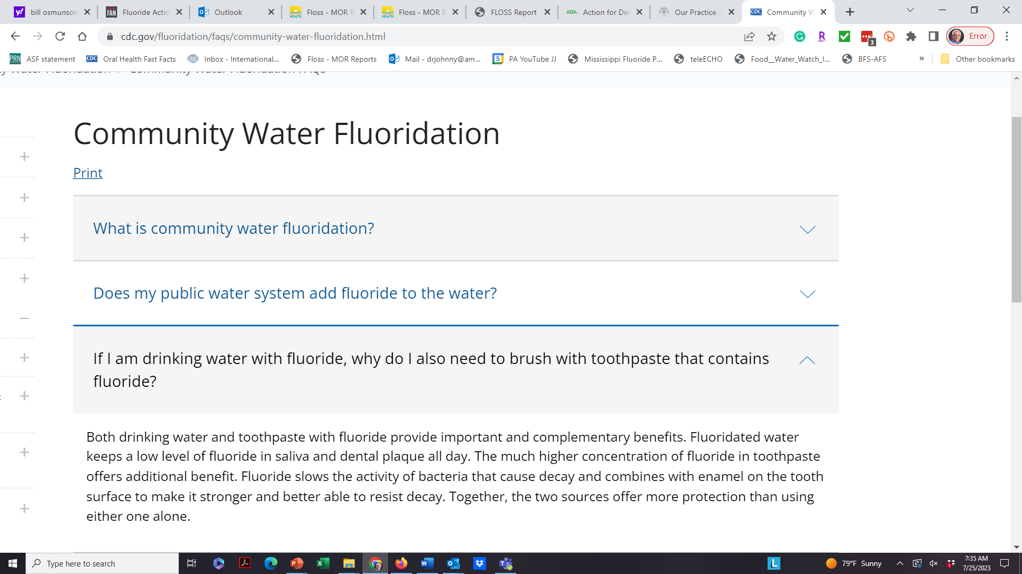
Both forms of fluoride are needed
“If I’m using fluoride toothpaste, do I still need to drink fluoridated water?
(Source: Centers for Disease Control and Prevention, “Community Water Fluoridation” web page, July 25, 2023.)

Slide 6
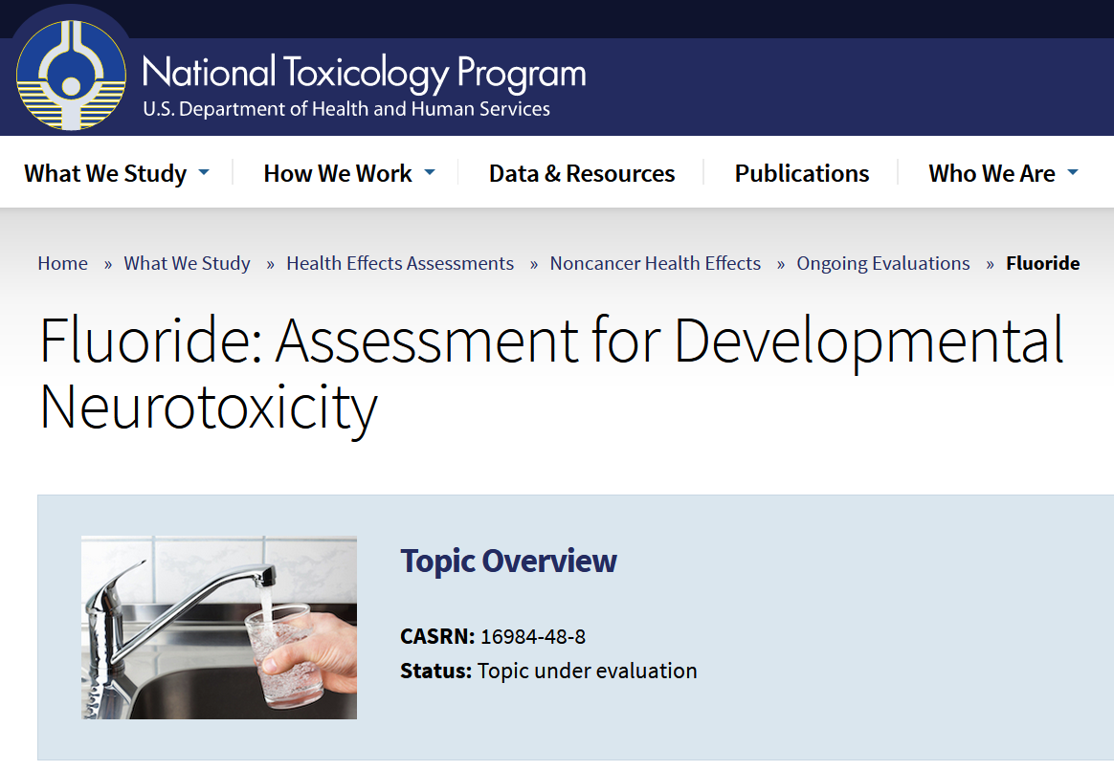
The National Academies of Sciences weighs in
The National Academies was asked to peer-review a report that described fluoride as harmful to cognitive development (IQs).
The National Academies gave it a negative review and said the findings do not apply to low fluoride exposures such as those “typically associated with drinking-water fluoridation.”
Fluoride at levels in water fluoridation (0.7 ppm) and below 1.5 ppm = no IQ changes
“Based on the NASEM review, the NTP removed the hazard classification of fluoride..”
(Source: National Academies of Sciences, Engineering & Medicine. Review of the Revised NTP Monograph on the Systematic Review of Fluoride Exposure and Neurodevelopmental and Cognitive Health Effects: A Letter Report, Feb 2021; the hazard classification was removed in March, 2023)

Slide 7



Personal choice?
Public policy exists for the greater good of the entire community’s health, safety, well-being

Slide 8
Personal choice = democratic society
Public policy can’t be tailored to those that don’t want it

Slide 9

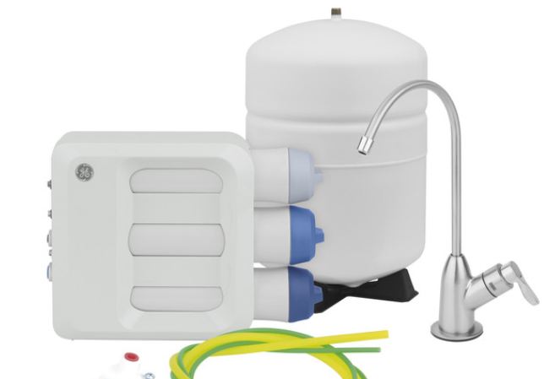
Public health vs individual choice
Water fluoridation is a public health measure that prevents at least 25% cavities for adults and children
Reverse osmosis benefits those opposing fluoridation*
Fluoridation benefits everyone, regardless of age, income, or education
(*GE Reverse Osmosis – Removes 96.5% fluoride; NSF/ANSI certified)

Slide 10
Leading health & scientific groups that SUPPORT fluoridation
American Water Works Association – over 51,000 active members
American Academy of Pediatrics – approximately 67,000 active members
American Dental Association – over 159,000 active members
Centers for Disease Control and Prevention
American Academy of Family Practitioners – over 129,000 active members
American Nurses Association – 4 million active members
American Medical Association – over 270,000 active members
American Dental Hygienists Association – over 226,000 active members
Department of Defense – Memo regarding fluoridation of military bases around the world
World Health Organization*
( *WHO Global oral health status report - Towards universal health coverage for oral health by 2030; Water fluoridation, section 3.3.2)

Slide 11
Leading health & scientific groups that OPPOSE fluoridation
0

Slide 12

Dr. Johnny Johnson
E: drjohnny@americanfluoridationsociety.org
AmericanFluoridationSociety.org
Please keep
fluoridation
Follow AFS on Facebook, on Twitter (@AFS_fluoride)

