Slide 1
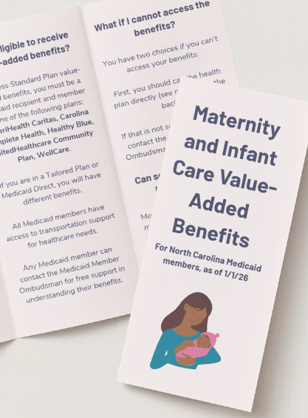
Nurture NC Value-Added Benefits Initiative
NC Association of Local Health Directors

Slide 2
Overview of Nurture NC
The Problem: A Crisis in Maternal and Infant Health
Preventable Deaths, Poor Outcomes, Coordination Gap
A Piece of the Solution: Nurture NC—A Collective Impact Backbone
“Nurture NC is a backbone organization dedicated to advancing collective impact initiatives that improve maternal and infant health across North Carolina."
Focus Areas: Where We Drive Action
Maternal Health Workforce, Rural HealthCare Access, Public Policy Optimization
Notes:
Preventable Deaths: The state's maternal mortality rate is 78% higher than the national goal and continues to worsen. 87% of deaths are preventable.
Poor Outcomes: The March of Dimes 2025 Report Card assigned North Carolina a D+ grade for preterm birth prevention, ranking it among the worst states for pregnant women and infants.
Coordination Gap: Despite significant work by numerous partners, efforts across NC are fragmented, lacking the statewide coordination and alignment needed for a collective impact solution.
Nurture NC will achieve impact by:
Coordinating Effort: Amplifying, connecting, and aligning existing initiatives and funding streams.
Filling Gaps: Identifying opportunities, partners, and community-based solutions where current efforts are lacking.
Driving Change: Catalyzing Action in the Identified Focus Areas and supporting non-partisan strategic policy changes.

Slide 3
Value-added benefits (VAB’s) in Medicaid are extra, non-medical services offered by managed care organizations (MCO’s) beyond the standard Medicaid benefits. They are designed to improve health outcomes and well-being.
What Are Value-Added Benefits?
Maternal and Infant Care benefits include:
- breast pumps
- pack-n-play
- car seats
- community baby showers
- doula services
- baby formula
- diapers and wipes
- educational services
and more!

Slide 4
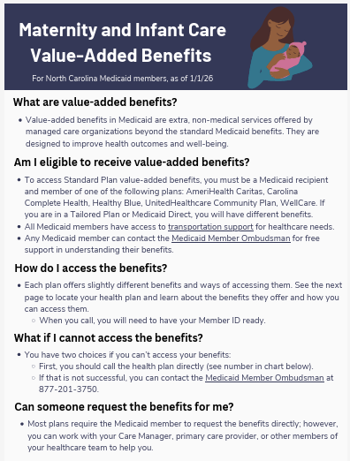
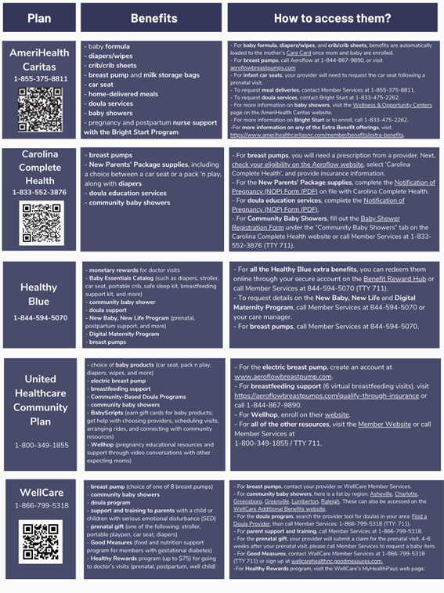
Medicaid Value-Added Benefits PDF One-Pager
www.nurturencnow.org/resources

Slide 5
Bringing all managed care plans together to create healthy competition to ultimately result in increased benefits. Actively engaged in a communication initiative that launched in late January that includes social postings weekly on all platforms for 6 weeks. Long term goal is transparent tracking of provision of VAB by health plan with quarterly updates housed on the Nurture NC website. Partnering with provider organizations to promote this resource through dissemination of our VAB one-pager. Encouraging plans to fund a formal communication campaign.
Nurture NC’s Value-Added Benefit Initiative

Slide 6
Check out our website: https://www.nurturencnow.org Follow us on socials: LinkedIn: Nurture NC Instagram: @nurturencnow Facebook: Nurture NC X (Twitter): @NurtureNCNow Use our resources! Promote VABs to your clients and patients and partners Share our VAB one-page document Report back when the system fails with real examples
What Can You Do?

Slide 7


