Slide 1
Financial REporting
5/20/2026

Slide 2
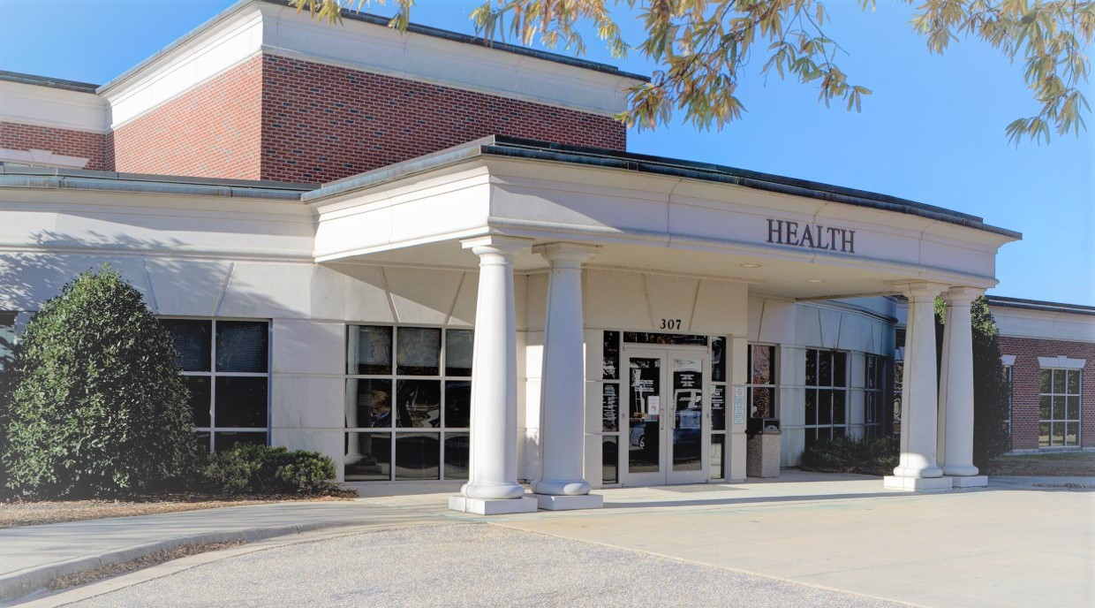
Met February 24
Harnett County Health Department

Slide 3
Participants
EHR Systems –
Craven, ARHS, Cabarrus, and Wilson on CureMD
Pitt on EPIC
Harnett on Patagonia

Slide 4
Initially Selected Reports
1 – First Pass Pay Rate
2 – Financial Summary Report (monthly)
3 – Accounts Receivable Report (Current, 30, 60, 90, 120+)
For these, we are looking to develop “how to” guides for departments to create similar reports. This includes where to pull data from EHR’s (CureMD, Patagonia, EPIC, Athena), Munis, or other programs and pop it into a report format.

Slide 5
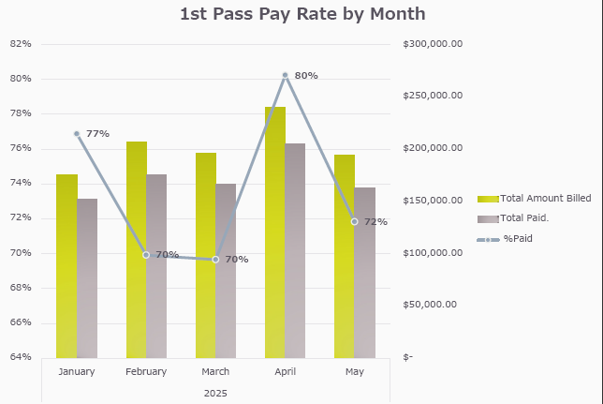
Notes:
Onslow

Slide 6
Financial Summary Report

Slide 7
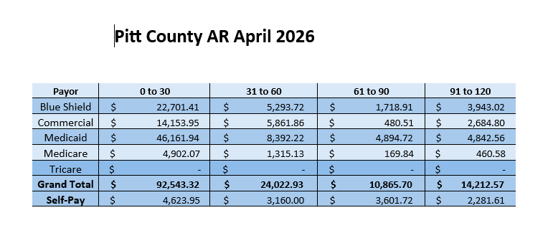
Accounts Recievable

Slide 8
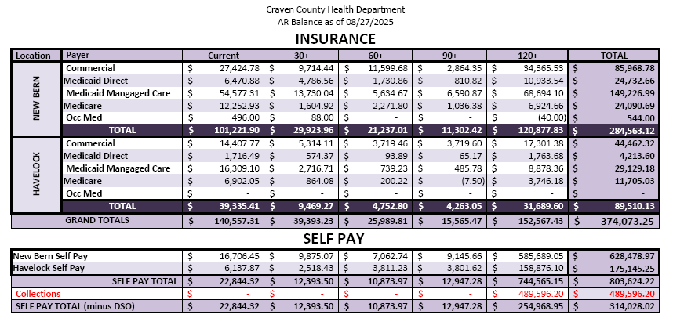
Notes:
Craven County

Slide 9
Other Reports of Interest
Snapshot reports for programs (green, yellow, red dot, etc. Are we spending too much too early?, are revenues less than anticipated?, etc.)
4 year lookback on Monthly Financial Summary
Summary of Provider goals
  Clinical Reporting group is working on this, but Financial Reporting can tie in billing
Quarterly reports of total charges
County dollars spent as a percentage of each program (i.e. Environmental Health, CD, WIC, etc.)

Slide 10
Annual Financial Survey
Best time to send is October
Ask for Actual, not Approved numbers for true end of year picture (include period 13)
Data this provides:
  Local funding as a percentage of total budget
  Dollars per county resident (once Amanda ties in population)

Slide 11
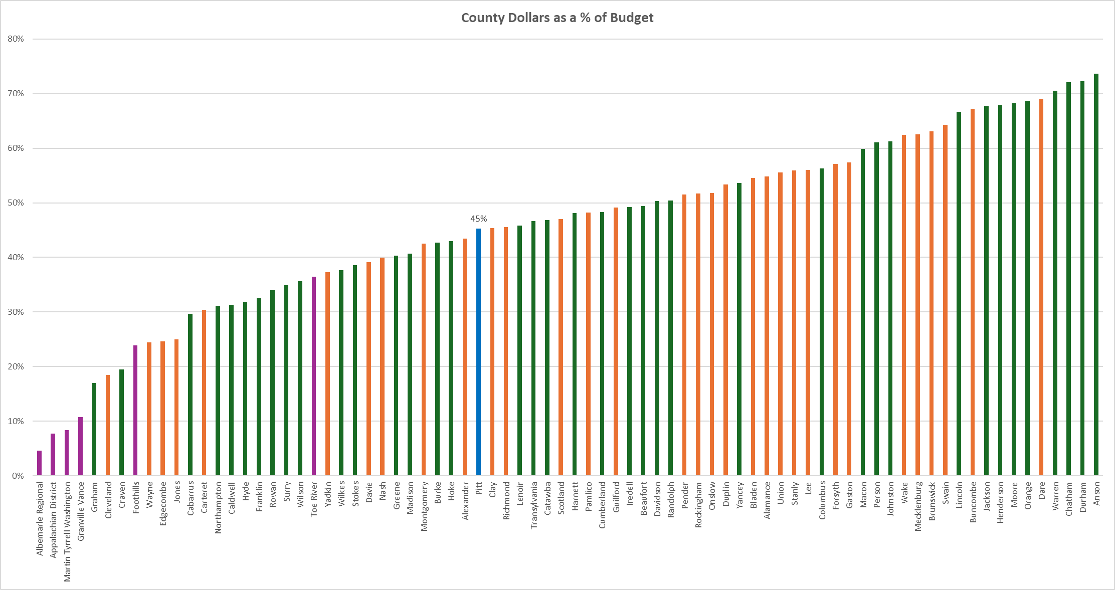
Local Dollars
FY 24-25 Survey of Local Health Departments
Districts
Consolidated Counties
Single County HD’s
Pitt County

Slide 12
Thanks

