Slide 1
Foundational Public Health Course
North Carolina Association of Local Health Directors
June 17, 2026

Slide 2
Agenda
Agenda
The Need
The Course
The Next Steps

Slide 3
The Need
22% of the public health workforce nationally does not have a degree in public health
Training = Application
Notes:
Why is a course like this needed. Well, we know that nationally 22% of the public health workforce does not have a degree in public health. So, creating an onboarding course that provides consistent content for an onboarding process is important, in fact, a strong onboarding program is one of the recommendations for staff retention from the NC public health foundations.
We focus on performance and how people will learn what they use in the course. Do you know how much learning from a typical training transfers back to job? 10 – 15% . Consider how the content will be used following the course is critical for an effective trainings. I am going to share a bit about how we did this for the Buncombe Course.

Slide 4

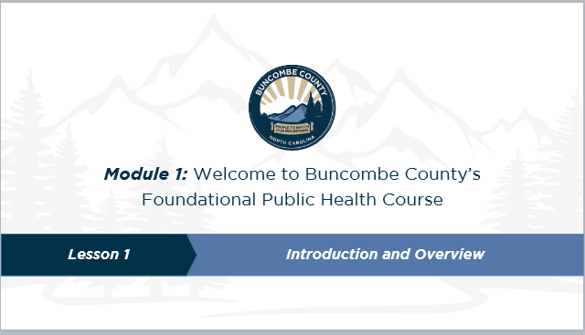
Learning Transfer
Learning Transfer
What you learn in training
Is applied to the workplace

Slide 5
Learning Transfer
Learning Transfer
Provide valid, relevant, credible content
Training

Slide 6



Learning Transfer
Comprehend the key concepts and procedures
Be motivated to apply what they learn
Remember and retrieve the concepts and procedures when they need them
Remain resilient and overcome obstacles

Slide 7



Learning Transfer
Apply what they learn on the job

Slide 8
The Course

Slide 9
The Course
Six online modules
Self-paced
Real-world scenarios
Supervisor guide
Aligned with existing onboarding

Slide 10
Foundational Public Health Course
The Course
Goal:
Staff who complete this course will demonstrate the
competence and confidence to contribute to the mission of Buncombe County Public Health.

Slide 11
The Course
Affective Outcome:
Staff who complete this course will feel connected to the mission of Buncombe County Public Health.

Slide 12

Connect the work of the agency with state and federal agencies
Connect the training to the daily work of agency staff
Buncombe County Foundational Public Health Course
Connect the work of each public health professional to the mission of the agency​

Slide 13

Who is the Learner?
The Course
New Employee
3-6 months after starting their new role
Notes:
The first thing we needed to decide was who is our learner? We decided they were new employees of the agency who had been in their role for at least one month prior to the taking the course.

Slide 14




The Course
Use real world examples
Provide formative learning assessments throughout the learning experience
Allow for self-direction and regulation
Connect back to
NC public health practice

Slide 15
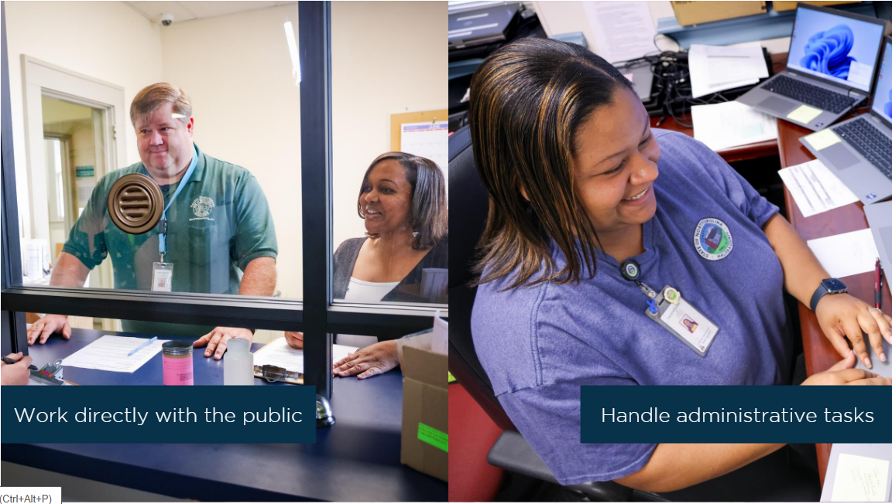
The Course
Notes:
1: Data Analytics & Assessment Skills
2: Policy Development & Program Planning Skills
3: Communication
4: Health Equity Skills
5: Community Partnership Skills
6: Public Health Practice Skills
7: Management and Finance Skills
8: Leadership and Systems Thinking Skills

Slide 16
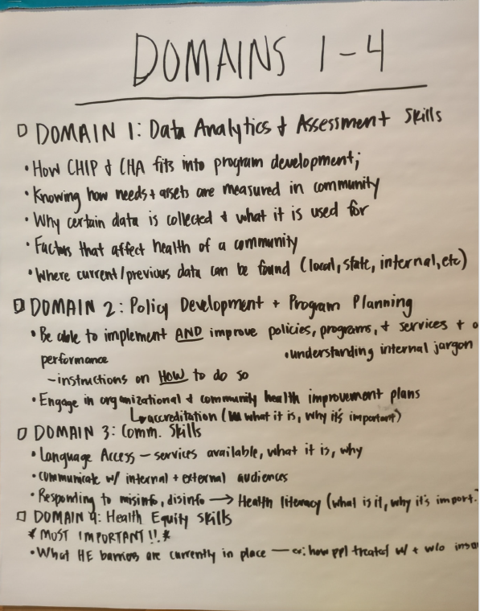
The Course
What does a new staff at your agency NEED to do in the first year of their job?
Notes:
1: Data Analytics & Assessment Skills
2: Policy Development & Program Planning Skills
3: Communication
4: Health Equity Skills
5: Community Partnership Skills
6: Public Health Practice Skills
7: Management and Finance Skills
8: Leadership and Systems Thinking Skills

Slide 17
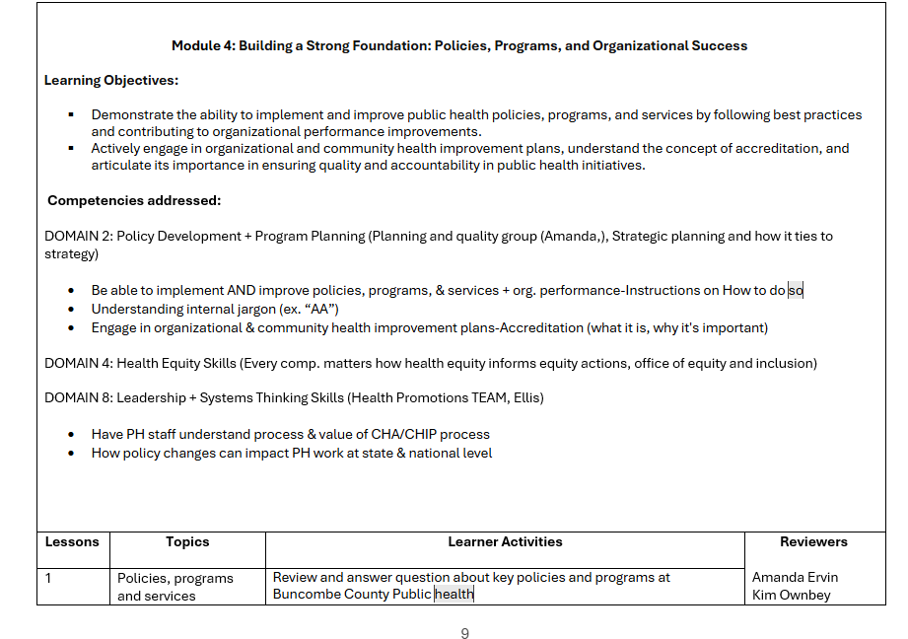
The Course

Slide 18
The Course
Do the learning objectives seem relevant? Is anything missing per section?
What do you like about what you see?
What concerns you about what you see?
What is missing?
Please provide examples of specific things you think that learners should be able to know/do for each of these modules/ lessons – for example, are there specific AA’s that should be included, specific organizational policies and plans (e.g., strategic plan)
What overarching efforts do we need to connect this content to – e.g., Buncombe One, Shadowing, etc.

Slide 19
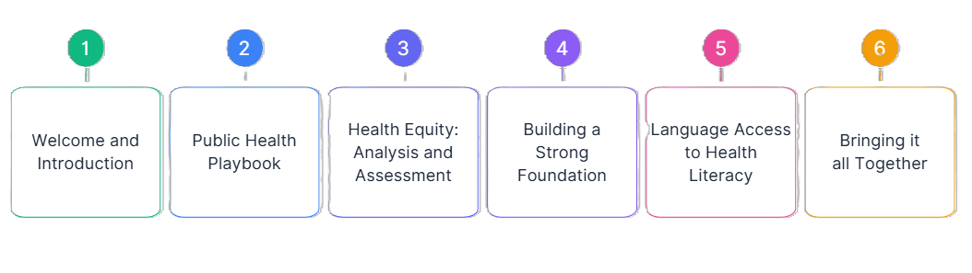
The Course

Slide 20
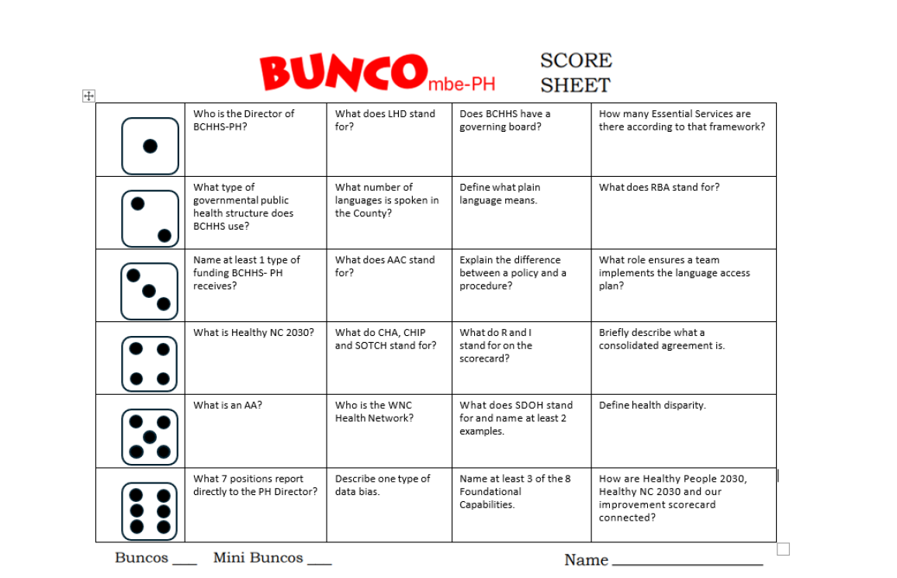

Slide 21
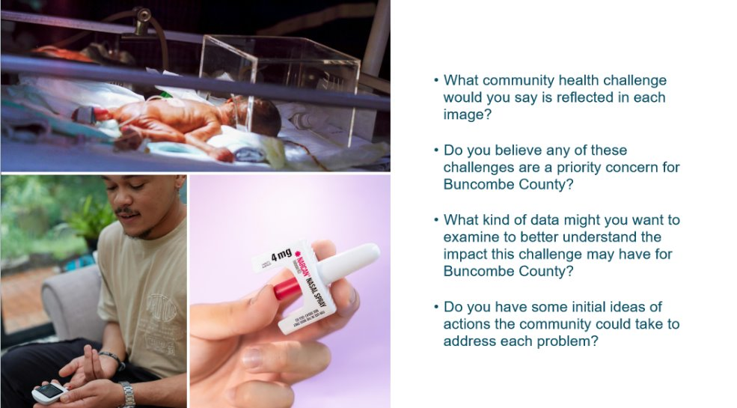
The Course

Slide 22
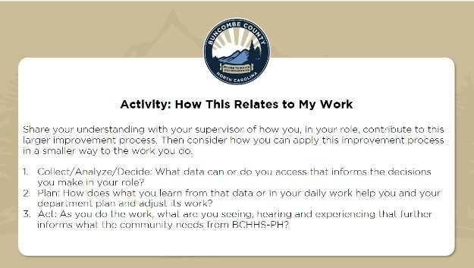
The Course

Slide 23

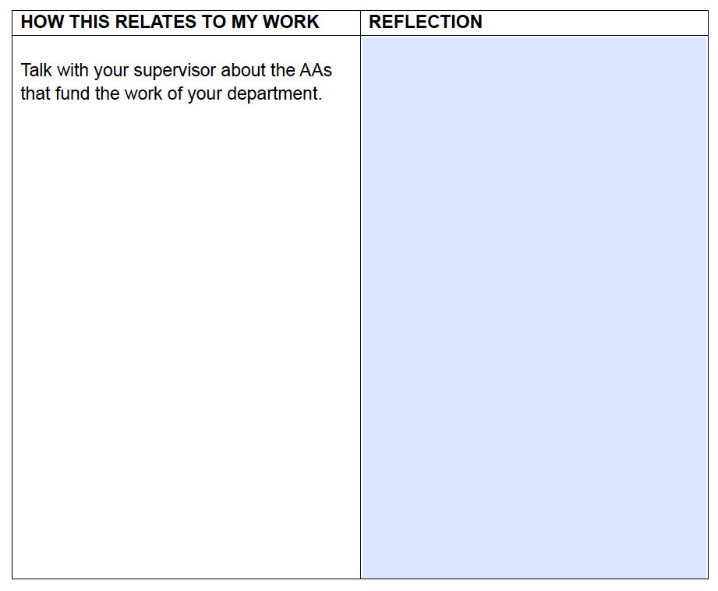

Slide 24

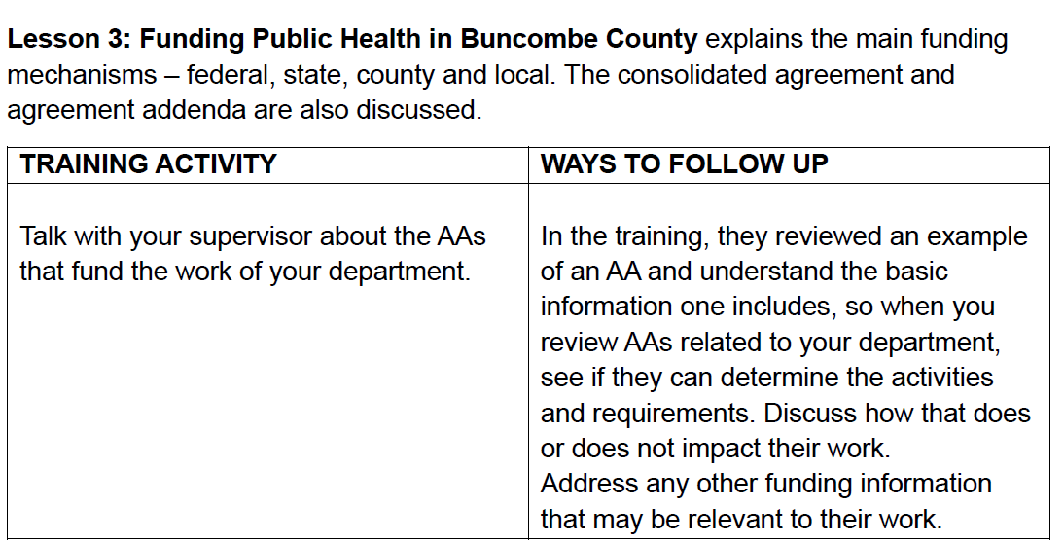

Slide 25
Pilot Feedback
What part of this module was most helpful to your learning?
The explanations and definitions understanding more about social determinates of health and actions/partnerships gained to aid in prevention
Breaking down the topics into small sections
The CHIP and CHA information
Information and examples of data collection and our current partnerships.
I found it helpful to have links to community partnerships to be able to explore the work that they do.

Slide 26
Pilot Feedback
General Comments
I think this is a great training for a new employee very informative and appropriate
I thought it was a thorough and well laid out course that supported the other NEO activities.
The CHIP and CHA information
This was an important contribution to the new employee orientation. I have a background in public health so it was helpful to refresh my knowledge.
I thought the course was great. As someone who worked for public health before and is returning, this is a great addition to orienting a new employee to what PH is and specifically how things work here at BC. It is very comprehensive and well thought out.

Slide 27
Pilot Feedback
What is the most valuable thing you learned in this course?
Making the connection about my everyday work and how they help improve health and wellness of the community.
I think it just gave me a better understanding of where my position fits in the big picture.
Team effort to create a healthy community.
I enjoyed reviewing the different functions of the Health Dept. and the different groups.

Slide 28
Customization
Customization
Appalachian District Health Department
Burke County Health Department
Catawba County Public Health
Forsyth County Department of Public Health
Gaston County Health and Human Services, Public Health Division

Slide 29
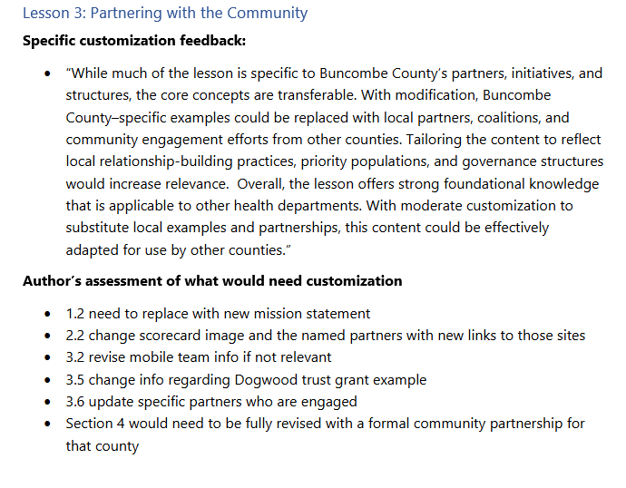
Customization

Slide 30






Why this course?
Cost-Effective
Time Effective
Increased Productivity
Consistency and Standardization
Knowledge Retention
Flexibility and Accessibility

Slide 31

Learn More
https://canva.link/1p3cusco97gu5e3

Slide 32
Learn More
Lori Rhew, MA
FullScope Learning Lab Director
North Carolina Institute for Public Health
Lori.Rhew@unc.edu

