Slide 1
North Carolina Department of Health and Human Services
Occupational and Environmental Epidemiology Branch
NCDHHS Climate and Health Program: Heat Safety Week and Heat-related Activities
Nikhil Kothegal, MPH, PhD Candidate
Climate and Health Program Lead
Nikhil.Kothegal@dhhs.nc.gov
Local Health Directors Call
May 20, 2026

Slide 2




NCDHHS Climate and Health Program
Builds community resilience against climate change and its impact on public health
Funded through CDC’s Climate and Health Program:
  Building Resilience Against Climate Effects (BRACE)
Partnerships within NCDHHS, other state agencies, academia, non-governmental and community organizations
Notes:
I want to start with some background on our program
The NCDHHS Climate and Health team aims to build community resilience against climate change and its impact on health.
We’ve been funded by CDC since 2010.
Historically, our work has been focused on Eastern North Carolina, but we have expanded to additional parts of the state.
We also work across NCDHHS and with other stage agencies to support Executive Orders 80, 246, and 292.

Slide 3
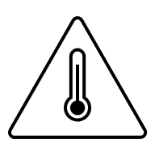
Heat Safety Week
May 18 to 22, 2026
Notes:
National Integrated Heat Health Information System (NIHHIS)
-Have called for several levels of engagement:
Amplify heat safety on social media
Enact a local proclamation

Slide 4
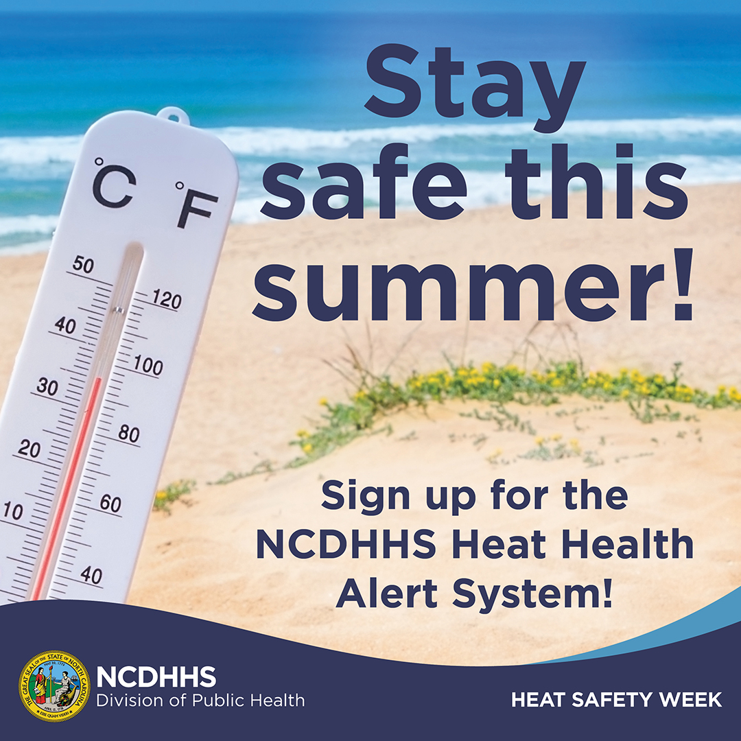
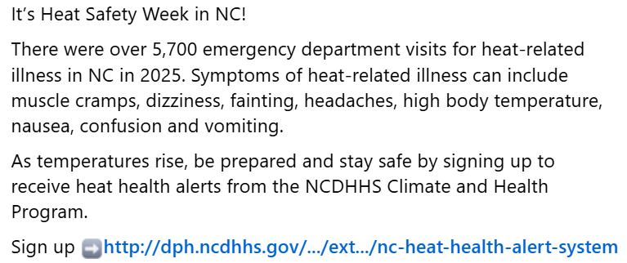
NCDHHS Social Media Posts
Twitter
Facebook
Notes:
Social media posts scheduled for this week with different heat guidance each day, in line with the Heat Safety Week themes

Slide 5
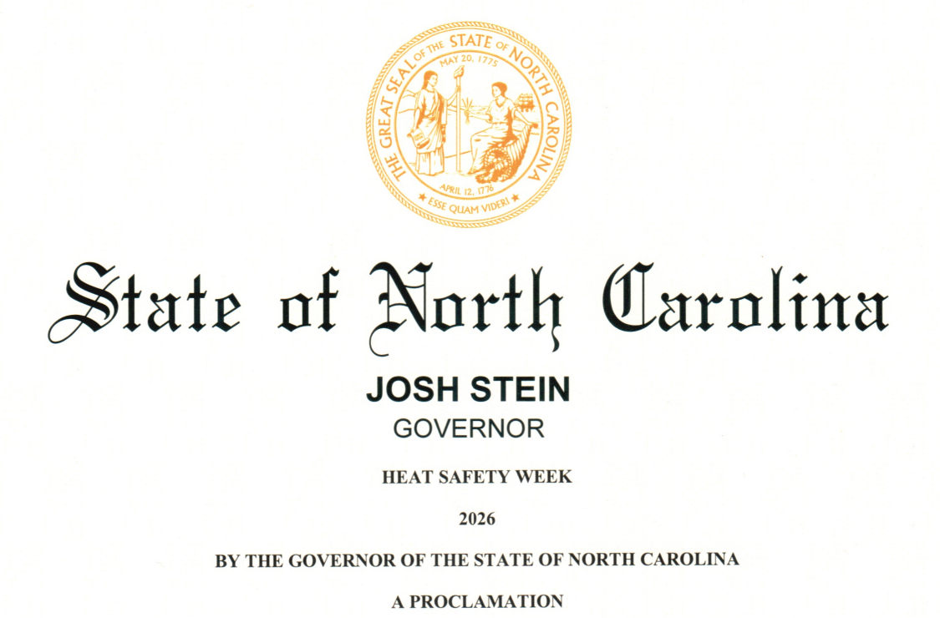
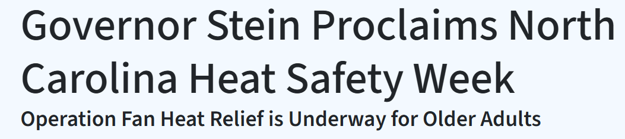
Governor’s Proclamation: Heat Safety Week
https://governor.nc.gov/governor-stein-proclaims-heat-safety-week;
https://governor.nc.gov/news/press-releases/2026/05/18/governor-stein-proclaims-north-carolina-heat-safety-week
Notes:
-Collaboration between DEQ’s State Resilience Office, State Climate Office, and NCDHHS
-Recognizes the impacts of heat on the population of NC
-Mentions populations most vulnerable to heat-related illness and number of ED visits for HRI in 2025
-Highlights activities of our program (HHAS) and of the State Resilience Office, like the Heat Action Plan Toolkit and Planning for Extreme Heat Cohort

Slide 6

Heat Health Alert System
Notes:
Now we’ll tell you about our heat-health alert system.

Slide 7
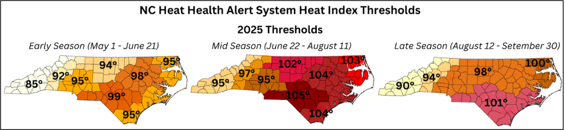
Heat Health Alert System (HHAS)
  Heat alerts sent via email when forecast is projected to reach unhealthy levels during the Heat Season (May 1st to September 30th)
  Subscribers to a county will receive email heat alerts when the daily maximum heat index is forecasted to meet or exceed the heat index threshold for that county’s region
  Many subscribers amplify the alerts by sharing with susceptible populations and using them for planning purposes
Notes:
The NCDHHS Climate and Health team operates the Heat Health Alert System to send out heat alerts via email when the forecast is projected to reach unhealthy levels. NCDHHS checks the forecast for the upcoming 3-4 days twice weekly, on Mondays and Thursdays.
Subscribers receive heat alerts when the daily maximum heat index in their county is forecasted to meet or exceed the heat index threshold for their region, and they amplify these alerts by sharing among their networks.
The thresholds are region-specific, and counties are grouped into 8 climatologically-derived regions across the state.
Importantly, these heat thresholds are health-based and calibrated to location-specific health outcomes. They were developed in partnership with the Duke University Nicholas Institute’s Heat Policy Innovation Hub. Researchers analyzed 15 years of North Carolina emergency department visit records and mortality data alongside historical weather data to determine when each region experiences increased heat-related emergency department visits and deaths. This makes our thresholds

Slide 8
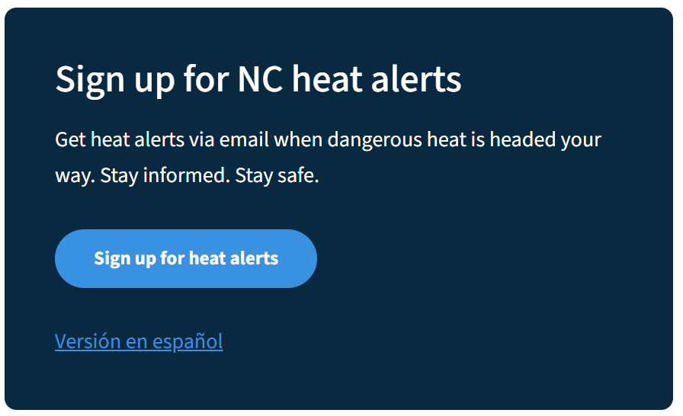
Register on our website
Register for heat alerts: https://survey.dph.ncdhhs.gov/surveys/?s=J3M84LKNAPN838AA
  Receive email alerts for selected counties in NC
Heat Health Alert System Communications Toolkit: Fact sheets, flyers, social media and more

Slide 9

Heat-related illness (HRI) surveillance
Notes:
Ou Climate and Health Program monitors and reports on heat related illness, or HRI, each summer. And shares these reports with our partners and the public. ​

Slide 10

HRI Surveillance reports: combining climate and health data
NC Climate Office weather
Heat-related illness by keyword and ICD code
data
All civilian
hospitals in NC
NC DETECT
data
Weekly heat-related
illness report sent to partners
Notes:
Our heat-related illness data is from the NC Disease Event Tracking and Epidemiologic Collection Tool (NC DETECT), which is our statewide public health syndromic surveillance system
It includes Emergency Department (ED) visits for all civilian hospitals in NC, please note that some North Carolina counties do not have hospitals.
Includes heat-related illness line list data with triage notes, chief complaints, diagnosis codes, and patient demographics (age, sex, race, county and zip code) for all HRI ED visits.
NCDETECT also now include Emergency Medical Service data and we our working on incorporating HRI EMS data into our weekly HRI reports.

Slide 11
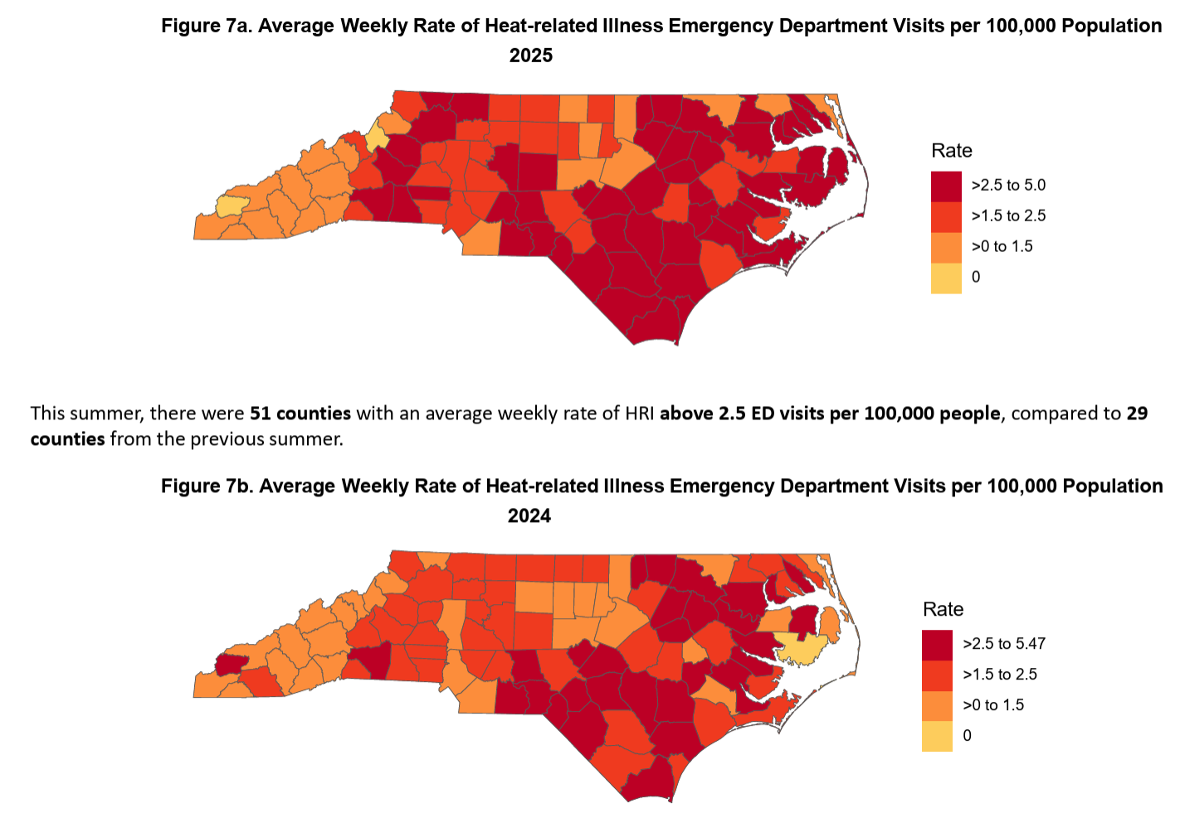
Weekly Heat-related Illness (HRI) Surveillance Reporting
  HRI rates by region and county
  Severity types
  Demographic groups impacted
Notes:
Our weekly HRI reports summarize HRI rates by region and county, severity, and demographic data. The figure to the right compares the average weekly rate of HRI by county in 2025 against the average weekly rate by county in 2024. You can see more counties in the dark red color in the figure for 2025 as compared to 2024, indicating a higher burden of HRI than the previous summer.

Slide 12
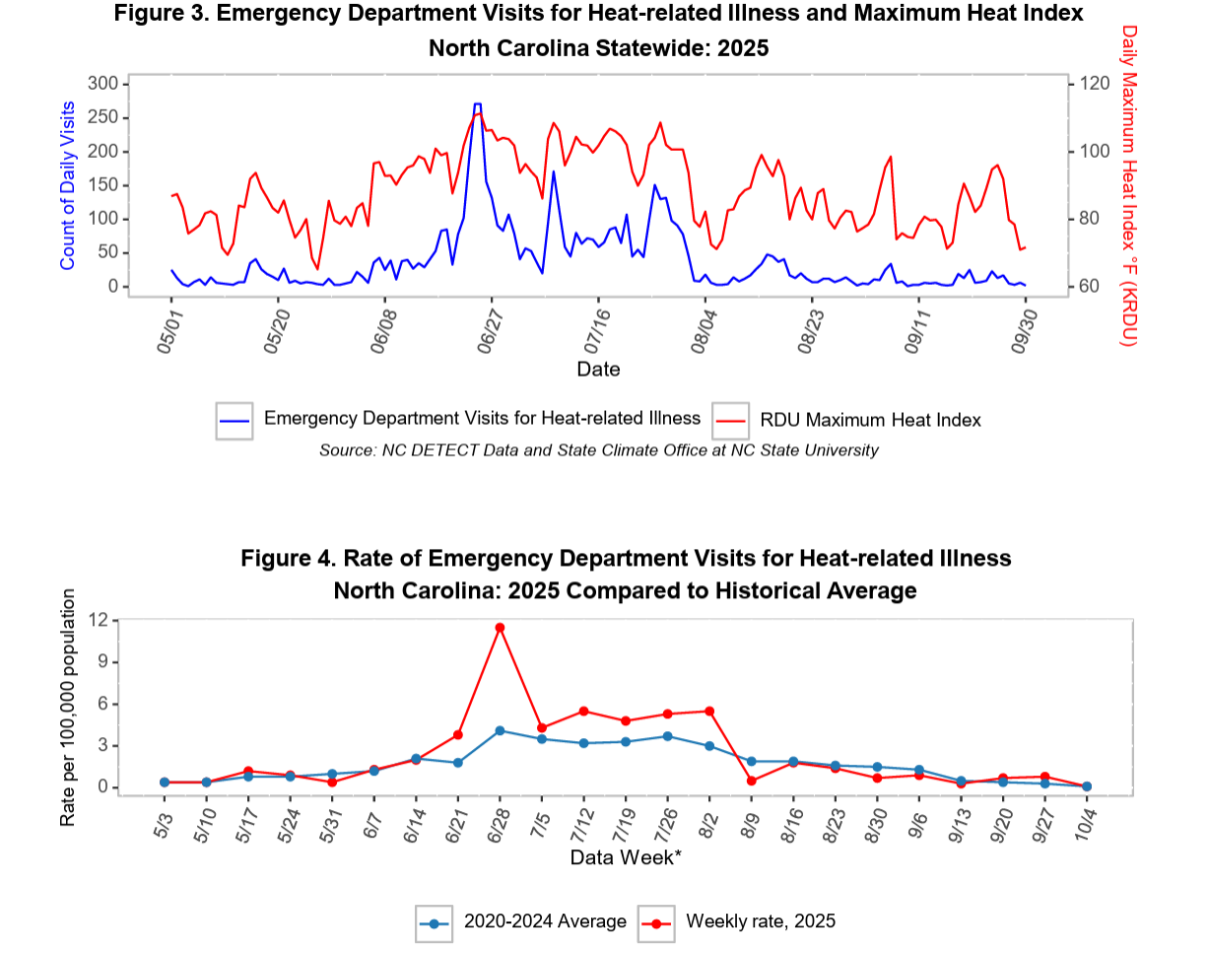
Heat-related Illness (HRI) Surveillance Reporting
  Daily max. temperature and counts of daily HRI emergency department visits
  Statewide rates of HRI emergency department visits
Notes:
Figure 3 displays the daily counts of heat-related illness on the blue line alongside the daily max heat index on the red line. You can see higher counts of HRI on days where the heat index is the highest.
And figure 4 compares the weekly rates of HRI in 2025 on the red line against the historical average for each week from 2020-2024 on the blue line. We saw the last week of June in 2025 had a mush higher rate than the historical average of that same week.

Slide 13
PHPR Symposium Presentation
Heat Preparedness Planning in NC: Connecting State and Local Health Departments
Presented on state agency activities to address extreme heat
Interactive poll questions:
Negative effects of heat
Top priorities when preparing for heat events
Thresholds/alerts used
Local heat planning
Resources provided during heat events

Slide 14
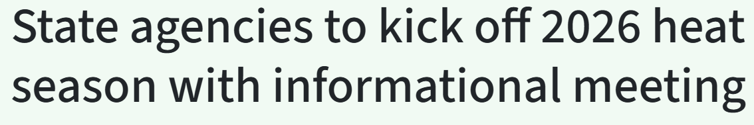
Heat Season Kickoff: May 11
Participants:
National Weather Service
State Climate Office of NC
NC Department of Health and Human Services
NC Department of Environmental Quality’s State Resilience Office
Attendees (N=92):
Local and state government, nonprofit, academia, private
Notes:
With North Carolina’s heat season beginning May 1, the N.C. Department of Environmental Quality’s State Resilience Office, in partnership with N.C. Department of Health and Human Services, the North Carolina State Climate Office and the National Weather Service will host a virtual Heat Season Kick-Off Meeting on May 11, 2026, from 1 to 3 p.m. The event is open to the public, but targeted to local government staff, particularly emergency managers, public health personnel, planners and administrators.
This briefing will provide county emergency managers, public health preparedness coordinators, and local government partners with the latest information and resources for the 2026 heat season. The National Weather Service will deliver the summer heat outlook, and the State Climate Office will review recent extreme heat trends and introduce a new decision-support tool. The NC Department of Health and Human Services and the Department of Environmental Quality’s State Resilience Office will share actionable resources and tools to help local officials keep their residents safe from the health impacts of hot days and nights.

Slide 15
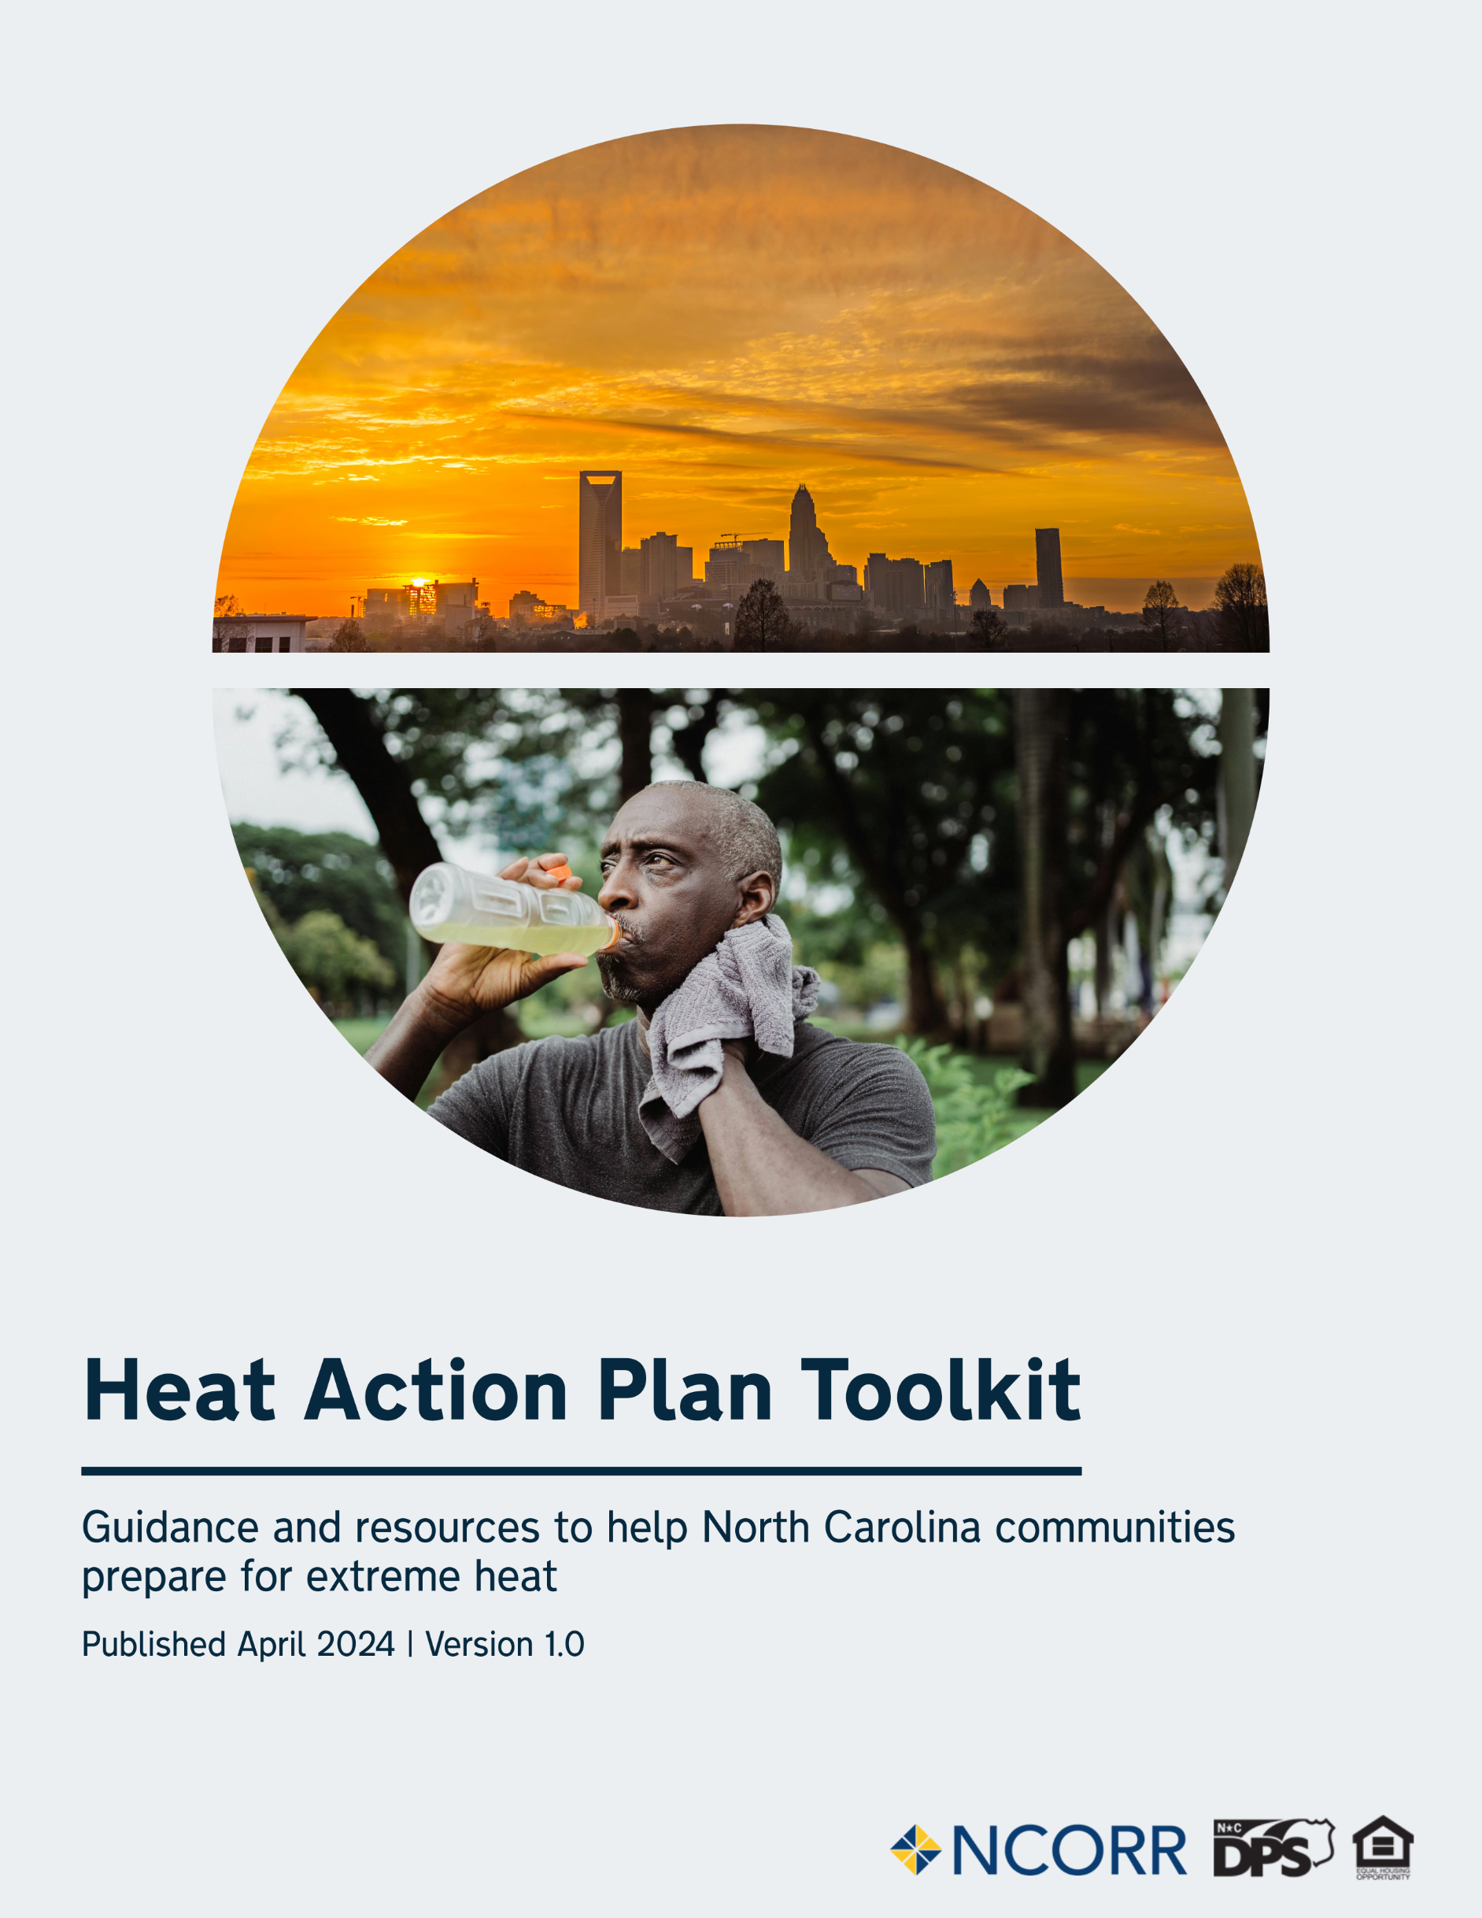
Statewide activities to address heat
NC Heat Action Plan Toolkit
Guide for community planning for extreme heat
Designed for communities in North Carolina, the Heat Action Plan Toolkit includes:
Background information on the importance of addressing extreme heat
A heat action plan template for communities
Guidance on how to identify groups most at risk to extreme heat in local jurisdictions
Recommendations for when to activate different parts of your heat action plan locally
Sample messaging and graphics for communicating with residents
  Resources:
  Cooling Center Checklist
  Heat Relief Supplies Checklist
Source: https://www.deq.nc.gov/energy-climate/state-resilience-office/resilience-resources-local-communities/heat-action-plan-toolkit
Notes:
-The state's Heat Action Plan Toolkit aims to help communities adapt and build resilience to extreme heat. Primarily targeted for use by local governments, including health and emergency management departments, the toolkit focuses on approaches to reduce the human health impacts of increasing temperatures and heat waves.

Slide 16
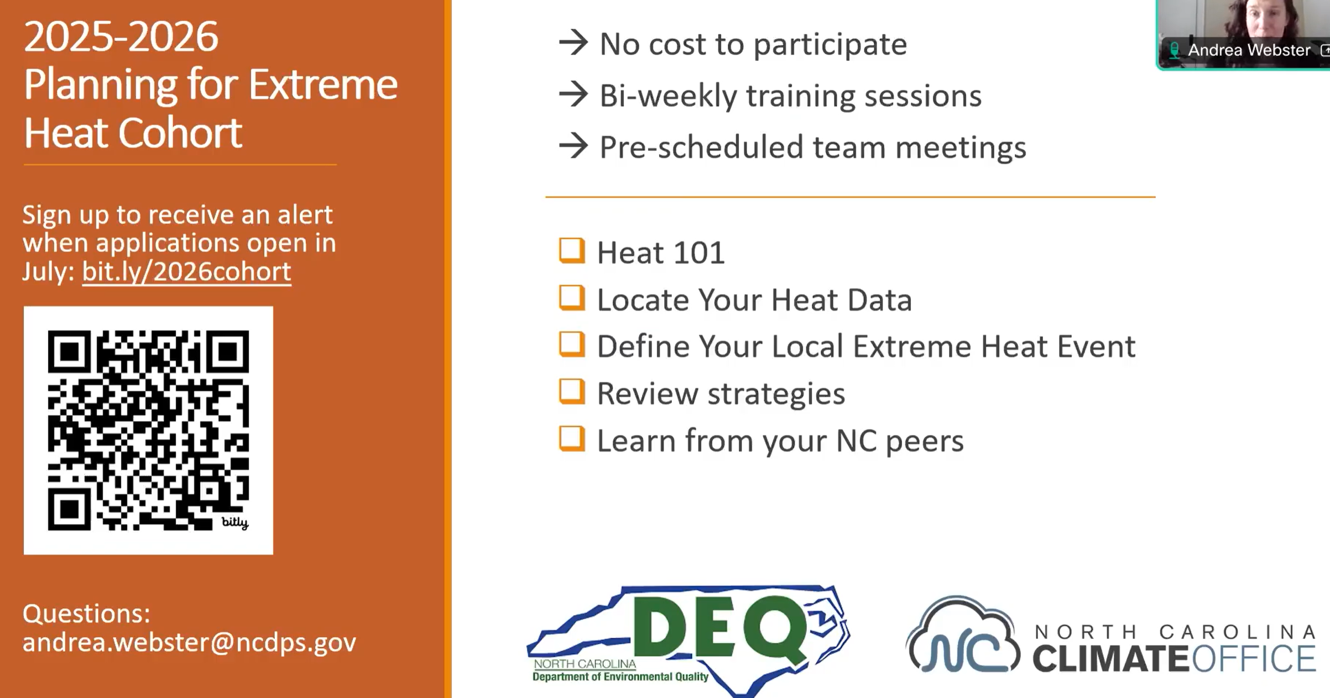
Statewide activities to address heat
Heat Action Plan Toolkit
  Guide for community planning for extreme heat
Planning for Extreme Heat Cohort
  Guided meetings to help local leaders create heat action plans for communities
  Led by State Resilience Office and State Climate Office
Source: https://www.deq.nc.gov/energy-climate/state-resilience-office/resilience-resources-local-communities/heat-action-plan-toolkit/planning-extreme-heat-cohort-program
Notes:
-The state's Heat Action Plan Toolkit aims to help communities adapt and build resilience to extreme heat. Primarily targeted for use by local governments, including health and emergency management departments, the toolkit focuses on approaches to reduce the human health impacts of increasing temperatures and heat waves.
-Local leaders can play a key role in helping residents stay safe in high temperatures. Supporting communities starts with monitoring local conditions, identifying those most at risk, and understanding how to reduce heat-related risks to public health and household budgets. To help local leaders protect health and safety, the State Resilience Office and the State Climate Office of North Carolina offer the NC Planning for Extreme Heat Cohort annually. There is no cost to participate in this program.

Slide 17
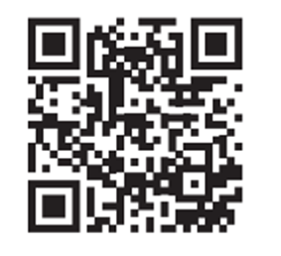

Contact information:
Nikhil.Kothegal@dhhs.nc.gov
919-368-1288
NCDHHS Climate and Your Health
Extreme Heat Webpage
https://www.dph.ncdhhs.gov/programs/epidemiology/occupational-and-environmental-epidemiology/climate-and-your-health/extreme-heat
NCDHHS Occupational and Environmental Epidemiology Branch
https://www.dph.ncdhhs.gov/programs/epidemiology/occupational-and-environmental

