Slide 1
Health Services Analysis
A data system supporting DPH programs to collect data from LHD EHRs to satisfy state and federal reporting requirements
Kathy Dail
Local Data and Analysis Branch
DHHS/DPH/LCAS
November 2024

Slide 2
What we will cover today…
A Short, Short, Short Background about HSA
Respond to Your Questions

Slide 3
HSA: A Legacy System
Health Services Information System (HSIS)
Paper reports mailed/faxed to state (pre-2007)
Health Information System (HIS)
Billing and Clinical Services Electronic Health Record system (2007-2018)
Health Services Analysis (HSA)
Data collection system for clinical cervices supported by DPH programs to satisfy state & federal reporting requirements (2018 to present)

Slide 4
What is HSA? The Technical Answer
Description courtesy of Bruce Nawrocki , SAS Developer LHD-HAS 2023

Slide 5
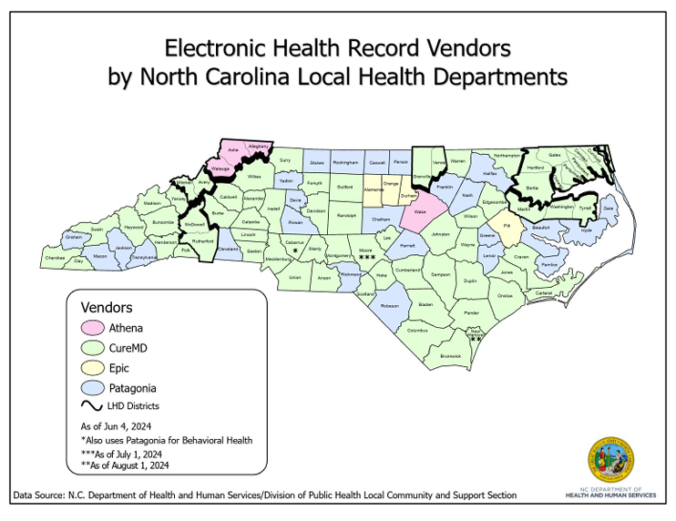
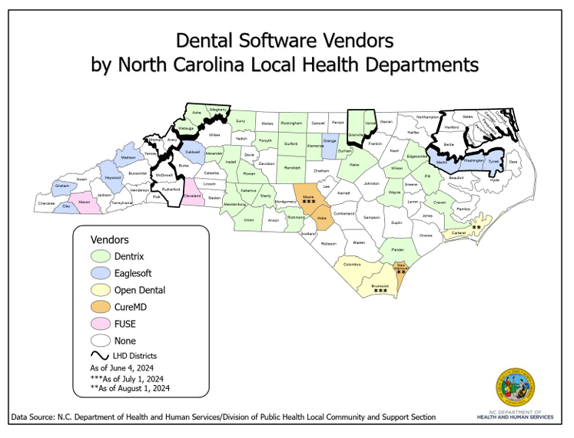
HSA staff work with the EHR vendors serving local health departments.
HSA surveys health directors twice annually for changes to their EHR/Dental software vendors.
Updated vendor maps are posted on the LHD-HSA website
https://schs.dph.ncdhhs.gov/units/ldas/lhdhsa.htm

Slide 6
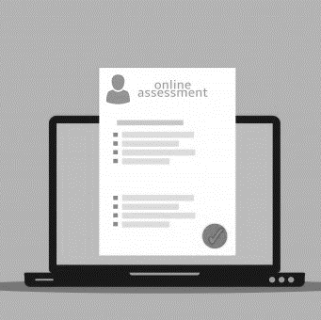
Semi-Annual, Three Question Survey (July & January)
What is your current EMR?/Dental Software Vendor?
Have you changed vendors in the last 6 months?
If yes, who are your current vendors?
What vendor do you use for the following?
Medical
Dental
Behavioral Health
Other

Slide 7
Responsibilities of DPH HSA Technical Support
Update Record Layouts – Work with DPH Program Managers to identify federal reporting requirements and consider new requests or data elements that need to be retired
Update Vendors – Assist the local health department’s vendor with understanding changes to reporting requirements
Update County User – Inform local health department users about reporting changes through DPH program managers, consultants, and consultations with HAS technical support
Crush SFTP access – Approve Crush Secure File Transfer Protocol (SFTP) access to local health department users

Slide 8
HSA Data: Encounters, Services by DPH Clinical Program
# of client visits to a DPH clinical program
# of unduplicated (unique) clients seen by DPH clinical program
# of unduplicated (unique) clients seen in all DPH clinical programs
Frequency counts of service codes by DPH Clinical Program

Slide 9
HSA Reporting
Quarterly/Annual Report
Insurance Summary
Patient Detail Report
Program Reports
Missing Data by agency
Files to Process
Provider report

Slide 10
Remember:
HSA is not an EHR.
HSA receives data files that the LHD vendor creates.
Vendors KNOW the requirements.
Vendors test their extract with HSA support before generating live files.
LHD staff are notified when files are processed.
LHD staff receive an email that there are files with errors that need to be reviewed.
If errors are detected, the LHD staff must correct the errors or that data will never be captured.

Slide 11
Questions/Comments/Discussion Julie Walker – Julie.walker@dhhs.nc.gov Kathy Dail – Kathy.dail@dhhs.nc.gov Eric Lai – Eric.Lai@dhhs.nc.gov

