Slide 1
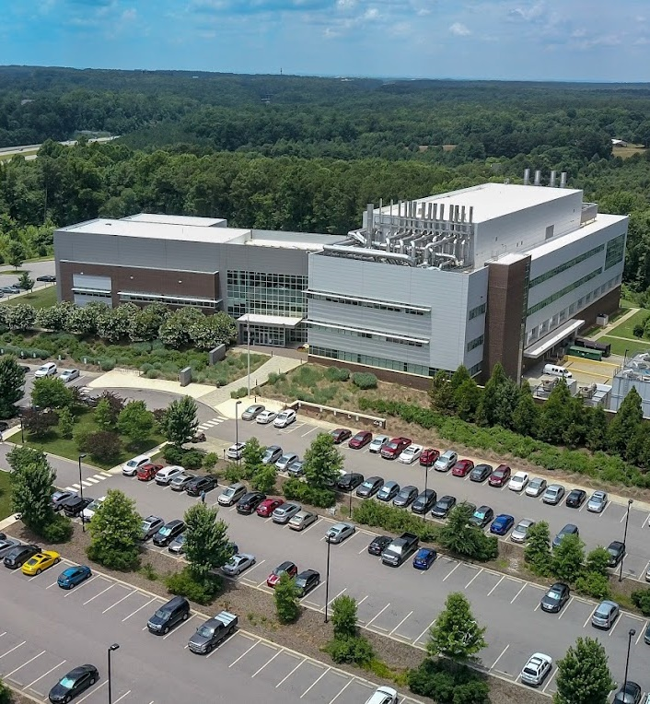

Laboratory Web Portal Update
Scott M. Shone, PhD, HCLD(ABB)
North Carolina State Laboratory of Public Health
August 19, 2026

Slide 2
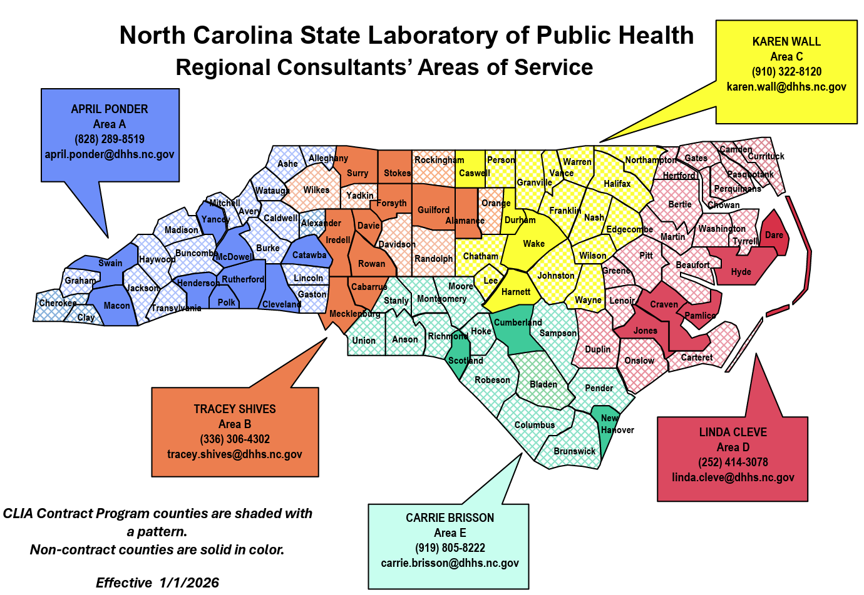
LWP Rollout
Phase I: January 13 – January 21
  LHDs that participated in the LWP pilot
Phase II: January 26, 2026 – February 6, 2026
  Area B
Phase III: February 11, 2026 – February 20, 2026
  Area C
Phase IV: February 25, 2026 – March 6, 2026
  Area D
Phase V: March 10, 2026 – March 19, 2026
  Area E
Phase VI: March 23, 2026 – March 27, 2026
  Area A
All Areas are LIVE!

Slide 3
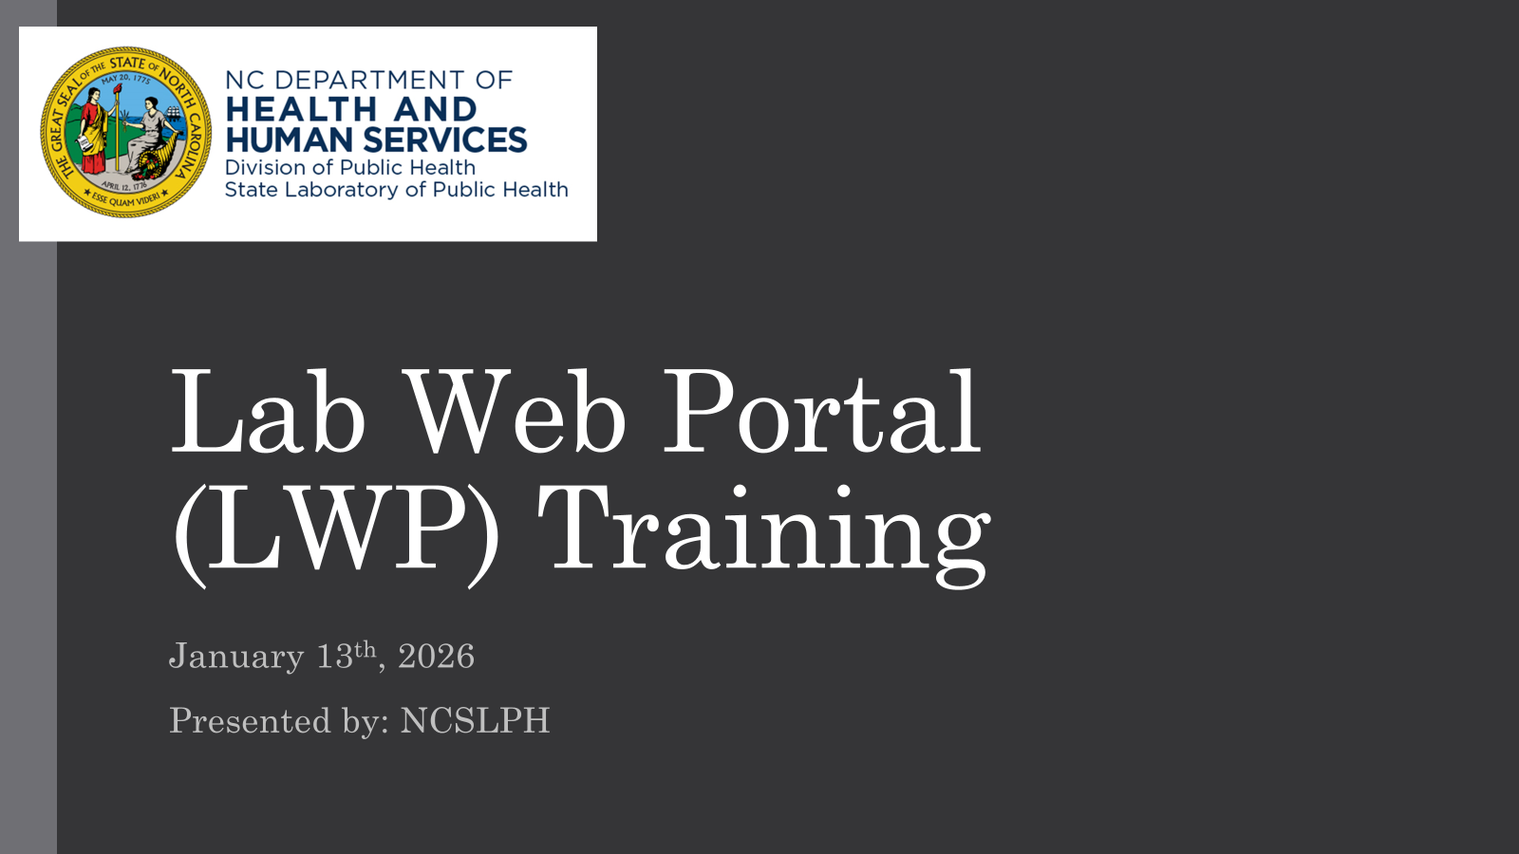
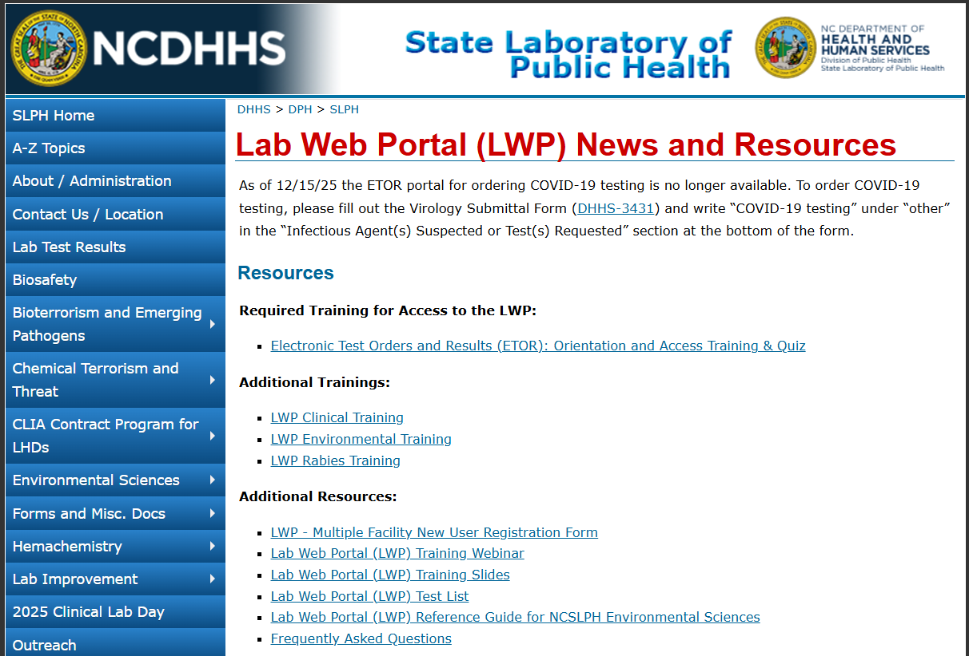
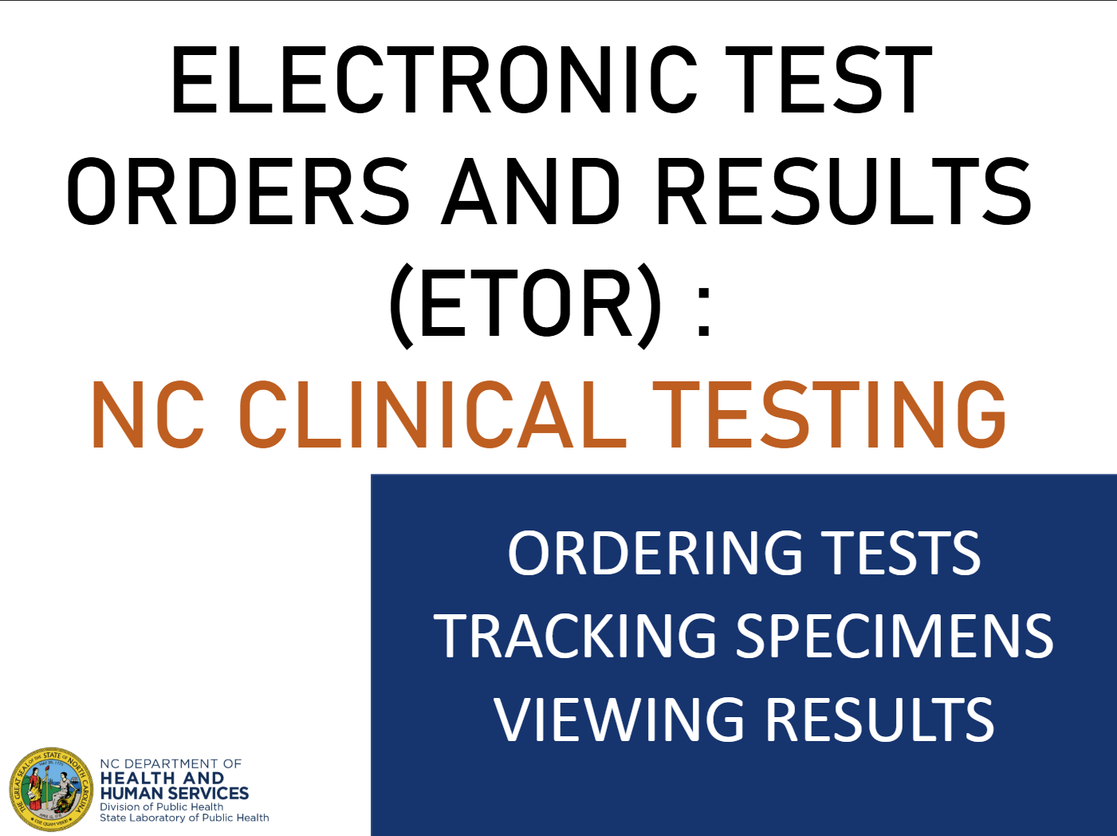
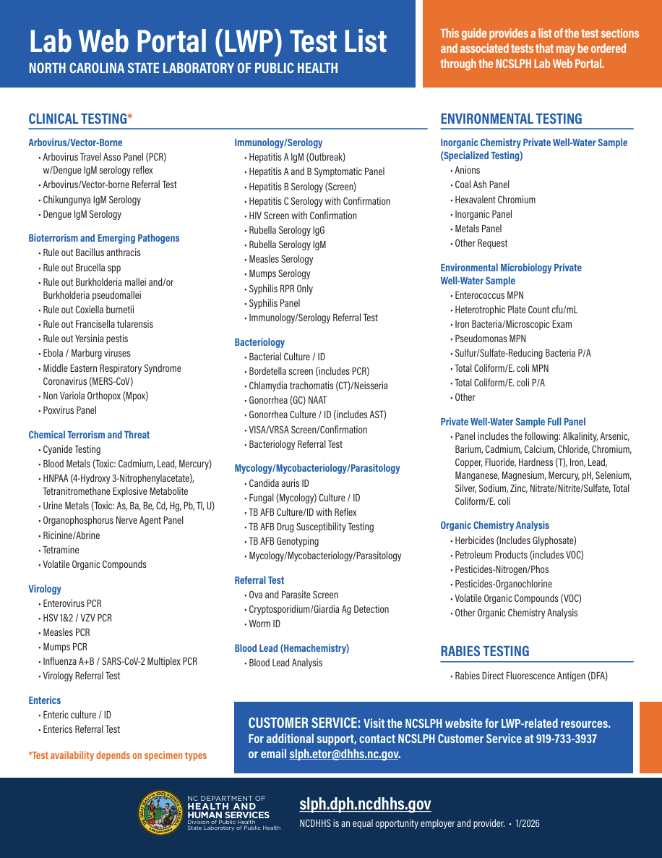
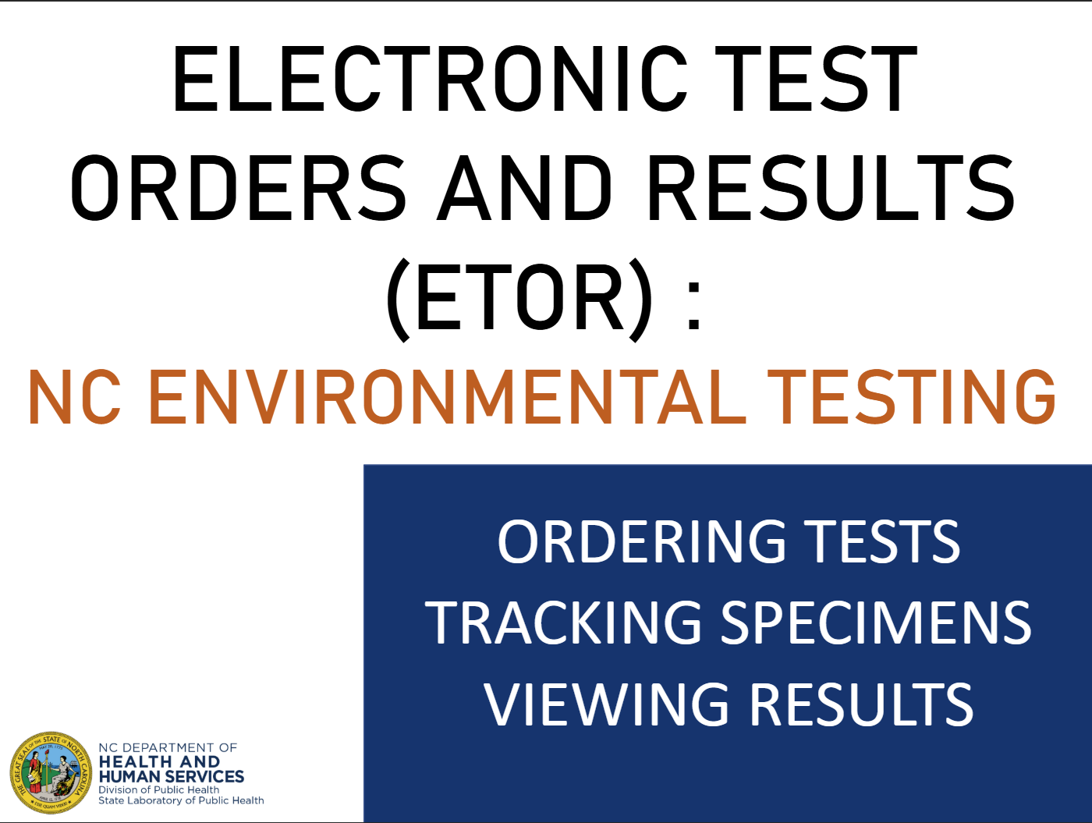
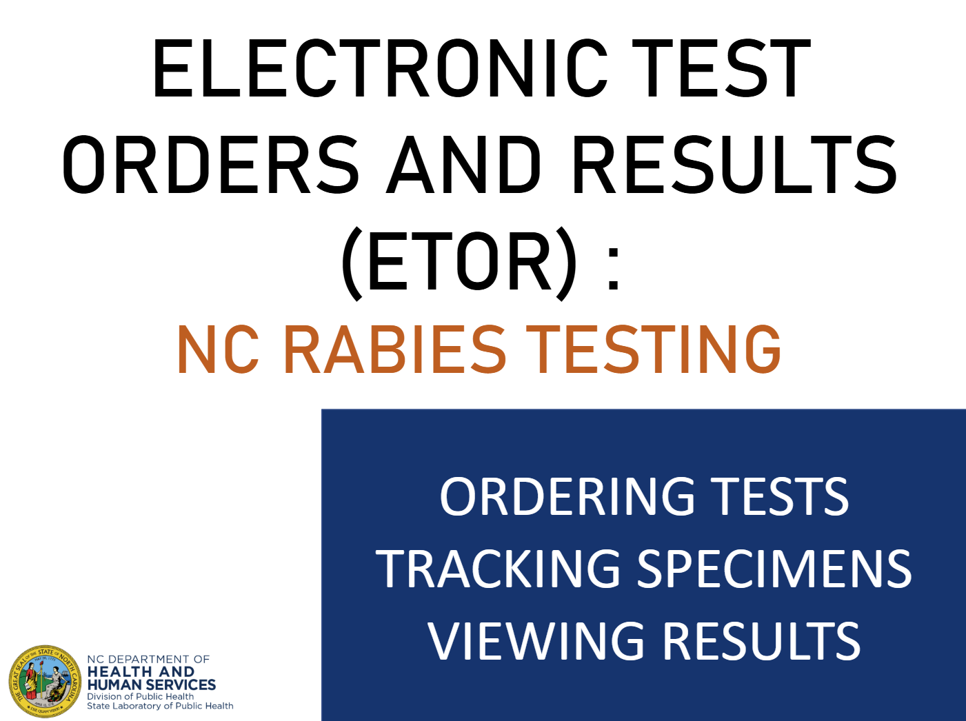
LWP Training & Resources
Web: https://slph.dph.ncdhhs.gov/
Email: slph.etor@dhhs.nc.gov
Customer service: 919-733-3937

Slide 4

Success Post-Launch
May 2026 – July 2026
Total Clinical Tests Ordered by Local Health Departments: 67,315

Slide 5
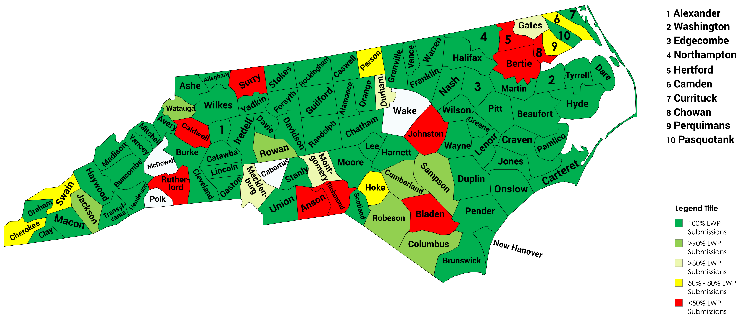
Partnership Opportunities
NEXT STEPS:
  What can SLPH do to help increase electronic submissions?
  Planning to onboard hospitals, clinicals, physicians, pediatricians, non-LHD network

Slide 6
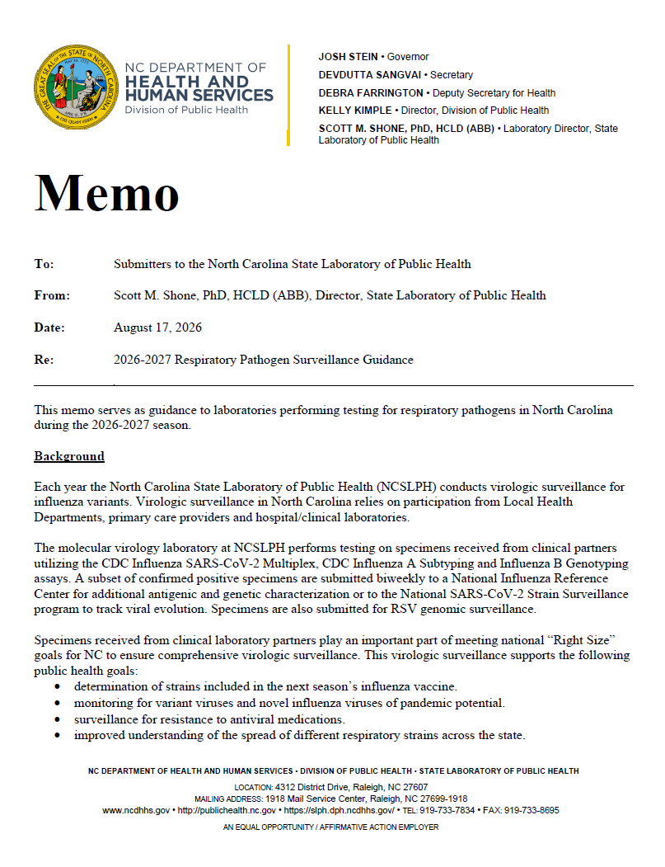
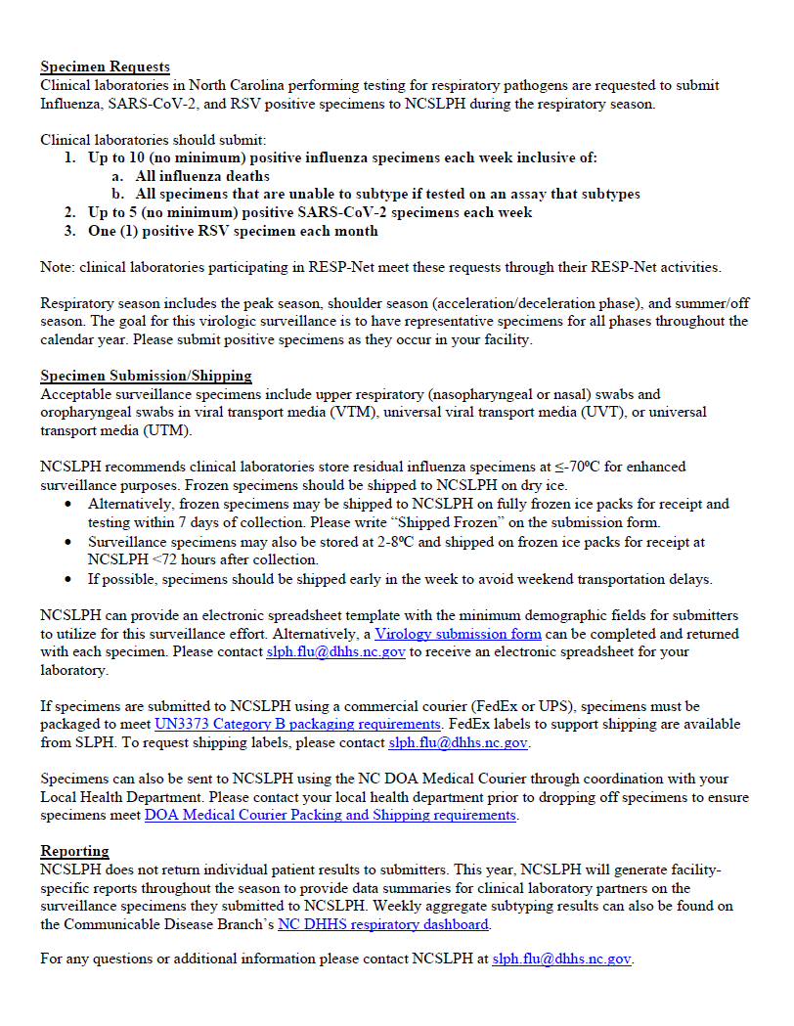

Slide 7


Slide 8

SLPH ETOR Inbox: slph.etor@dhhs.nc.gov
Customer Service: 919-733-3937
Questions?

