Slide 1


Slide 2
School Nurse Updates
SL2025-60 An Act To Improve Health and Human Services For The State of North Carolina
16 NCAC 06C .0110 Qualifications of School Nurses
Requires school nurses to be a RN and have at least two years of experience in a hospital or health clinic or have certification.
School nurses who meet these requirements to be paid under the certified school nurse pay scale (Salary Schedule).

Slide 3
16 NCAC 06C .0110 Qualifications of School Nurses (orig)
(a) Any person employed by or contracted to serve as a school nurse in a North Carolina public school shall meet all qualifications established by the State Board of Education. At minimum, the person shall:
(1) Be licensed as a registered nurse under Chapter 90, Article 9A of the General Statutes and have at least two years of experience serving as a nurse in a hospital or health clinic; or
(2) Be certified by the American Nurses Credentialing Center or the National Board for Certification of School Nurses or obtain certification within three years.
(b) A school nurse who meets either of these qualifications shall be paid under the certified school nurse pay scale as established by the SBE.

Slide 4
16 NCAC 06C .0110 Qualifications of School Nurses (revised)
(a) Any person employed by or contracted to serve as a school nurse in a North Carolina public school shall meet all qualifications established by the State Board of Education. At minimum, the person shall:
(1) Be licensed as a registered nurse under Chapter 90, Article 9A of the General Statutes and have at least two years of experience serving as a nurse in a hospital or health clinic; or
(2) Be certified by the American Nurses Credentialing Center or the National Board for Certification of School Nurses. or obtain certification within three years.
(b) A school nurse employed by a public school unit who meets either of these qualifications shall be paid under the certified school nurse pay scale as established by the SBE. A Nurse employed by a local health department, shall be paid according to the local pay schedule established by the county.

Slide 5
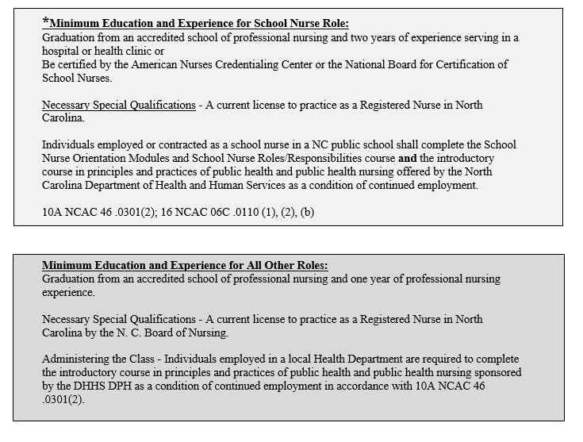
PHN II

Slide 6

Classification Updates
Clear Clutter:
Remove outdated specs / language
Refresh:
Review and update all current specs
Organize:
Make it easier to match spec to needs

Slide 7
Training through June
Class schedule through June is out now.
03/17/26 – Candidate Qualifications – covering DSS job titles
03/30/26 – Candidate Qualifications– covering PH job titles
04/20/26 – Awareness, Inclusive Management and Workplace Sensitivity
04/30/26 – Leading at all Levels – Supervisory Track: Leading Teams (In-Person)
05/20/26 - 05/21/26 - Employee Relations
06/22/26 – Effective and Inclusive Communication: Skills for the Workplace
https://oshr.nc.gov/lg-training-schedule-jan-jun-2026/open

