Slide 1
Epi Section Updates

Slide 2
Immunizations

Slide 3
E.O. 14420 Overview and Key Messages
Directives:
  HHS to conduct full assessment of timing, sequence, and risks/benefits to recommended childhood vaccine schedule
  Removal of Hep A, Hep B, rotavirus from list of routinely recommended vaccines
  Separation of combination vaccines into single antigen vaccines administered at separate appointments
  Develop alternative adjuvants to aluminum
  Revise state laws to allow for medical and religious exemptions to vaccine requirements, emphasizing parental choice; directs DOJ to pursue legal action against states whose laws do not align.
Not based on any new scientific evidence
Remarks around this E.O. focused strongly on association between vaccines and autism, despite decades of high-quality research finding no association.

Slide 4
E.O. 14420 Overview and Key Messages
What it is: sets direction and asks HHS to develop plans for implementation
What it is not: legislation; does not replace state or federal law
NCDHHS Press Release reaffirms importance of vaccines to protect children, encourages parents to consult health care providers (8/10/2026)
Key Message: all AAP-recommended vaccines are still widely available, covered by insurance, and should continue to be offered and recommended by providers.

Slide 5
Communicable Disease
Cyclosporiasis
West Nile Virus
Ebola

Slide 6
North Carolina Tuberculosis Control and Prevention Program
Medication Price Increase and Funding Shortage

Slide 7
Pharmaceutical Funding Shortfall FY26
Anti-TB medications are purchased through a dedicated state fund
The TB medication budget is $414,412 for each fiscal year and has not changed in years
The funding is used to pay invoices as they come in and is not allocated to local health departments
Increases in drug prices primarily led by INH resulted in a $180,000 shortfall in the TB medication budget for FY26
Federal funding cannot be used for purchasing TB medications

Slide 8
NC General Statutes require LHDs to provide TB testing and treatment free of charge
NCGS §130A-144(e)
“… The local health department shall provide, at no cost to the patient, the examination and treatment for tuberculosis disease and infection and for sexually transmitted diseases designated by the Commission.”
This does NOT preclude 3rd party billing

Slide 9
Medication Cost Changes in FY26
Drastic price hikes of isoniazid (INH) starting in September 2025 increased overall TB medication cost per month with INH accounting up to half of the costs.
Medications in the other category includes: Rifapentine, Rifabutin, Moxifloxacin, Levofloxacin, Pretomanid, Linezolid, Vitamin B6, Tubersol, Dexamethasone, and
Sodium Chloride solution

Slide 10
Pharmaceutical Funding Shortfalls FY26
Active TB Treatment
LTBI Treatment
Before September 2025
Before September 2025
Per case - $329.82
Per year (n=250) - $82,455
3HP Per case - $1,368.36
4R Per case - $59.70
After September 2025
After September 2025
Per case - $675.22
Per year (n=250) - $168,805
3HP Per case - $1,988.28
4R Per case - $79.60
Based on >90kg child/adult on RIPE for 6 months
Price of medications vary throughout the year and is calculated based on average cost
Based on >50kg child/adult
Price of medications vary throughout the year and is calculated based on average cost
Notes:
Three months of once-weekly isoniazid plus rifapentine (3HP)
The 3HP regimen is recommended for:
People 2 years of age and older
People with HIV who are taking antiretroviral medications that have acceptable drug-drug interactions with rifapentine
The 3HP regimen is not recommended for:
Children younger than two years of age
People with HIV who are taking antiretroviral therapy with clinically significant or unknown drug interactions with once-weekly rifapentine
People presumed to be infected with isoniazid- or rifampin-resistant TB bacteria
Pregnant women or women expecting to become pregnant during the three-month regimen
Four months of daily rifampin (4R)
The 4R regimen is recommended for:
Children and adults of all ages who are HIV-negative
People who cannot tolerate isonaizid
People who have been exposed to isoniazid-resistant TB bacteria
The 4R regimen is not recommended for people with HIV taking some combinations of antiretroviral therapy (ART).

Slide 11
Cost Saving Options for LHDs*
Update billing practices to ensure private insurance and Medicaid are billed for TB evaluation and TB and LTBI treatment
Encourage local providers to treat LTBI
Refer eligible active TB disease clients living with HIV to the HIV Medication Assistance Program (HMAP)
Consider use of four months of daily Rifampin (4R) for LTBI treatment when medically appropriate
Consider substituting levofloxacin for isoniazid in standard TB treatment when medically appropriate
If resources to treat TB are limited, prioritize treatment of active TB cases and high-risk latent TB infection
*Developed in coordination with NC TB Medical Consultants and TB Medical Advisory Committee

Slide 12
Choices must be made on what parts of the TB program continue to be supported by state and federal funding

Slide 13
State TB Program Priorities
Reduce burden of TB disease in North Carolina
Meet CDC’s Cooperative Agreement requirements
Support local TB nurses / health departments

Slide 14
Hard Choices
Options to address increased cost of purchasing TB medications
Option 1
Option 2
Option 3
Reallocate state funding from LHDs to cover the shortfall
Reallocate state funding from LHDs to cover the shortfall
Cut nurse consultant position and reallocate federal money to counties
Allocate pharmaceutical funding to LHDs
State will no longer assist in TB medication purchase

Slide 15
Option 1
Reallocation of $180,000 from the state county funding to cover future shortfall in the state pharmaceutical funding
  Median loss to counties: $532
Top 5 | Bottom 5
Mecklenburg $35,069 | Perquimans $70
Wake $24,472 | Tyrrell $70
Guilford $10,611 | Graham $69
Durham $9,612 | Gates $69
Robeson $6,793 | Washington $67

Slide 16
Option 2
Eliminate nurse consultant position ($129,908) and reallocate the federal amount decreasing the loss to counties across funding sources to $50,092
  Median loss to counties: $148
Top 5 | Bottom 5
Mecklenburg $9,759 | Perquimans $20
Wake $6,810 | Tyrrell $19
Guilford $2,953 | Graham $19
Durham $2,675 | Gates $19
Robeson $1,890 | Washington $19

Slide 17
What Nurse Consultants Do
80% of the time nurse consultants spent on:
20% of the time nurse consultants spent on:
Case consultation with local health departments
Directly Observed Therapy dose count verification
National Tuberculosis Surveillance System Case Reporting
Nurse Tips/Office Hours
NC Electronic Disease Surveillance System TB workflows
Refugee/Immigrant case reviews
New nurse orientation
Virtual and in-person training
Aiding in contact investigations
Annual Cohort review
Planning for Annual TB conference
CDC Division of Global Migration and Health notifications
Introduction to TB Management course
Office of Refugee Resettlement – unaccompanied minor notifications

Slide 18
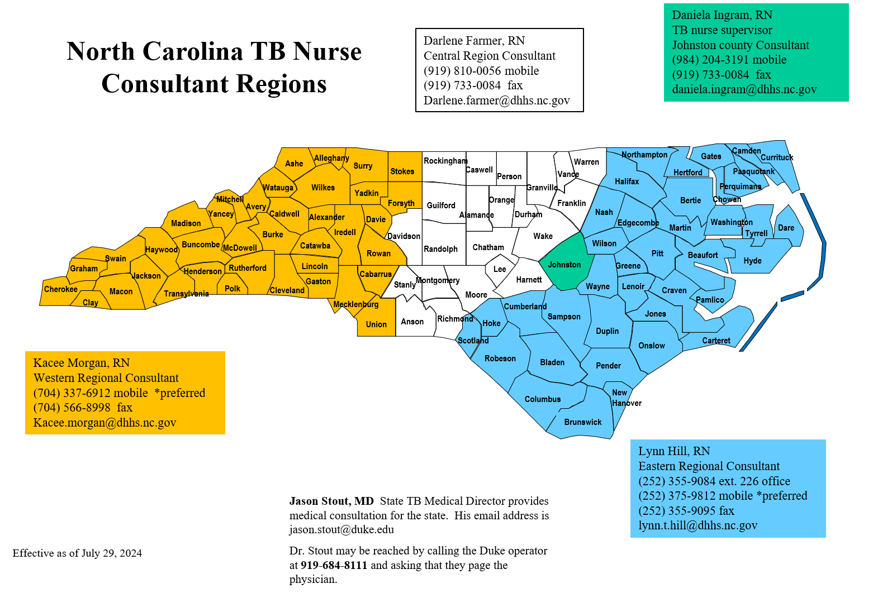
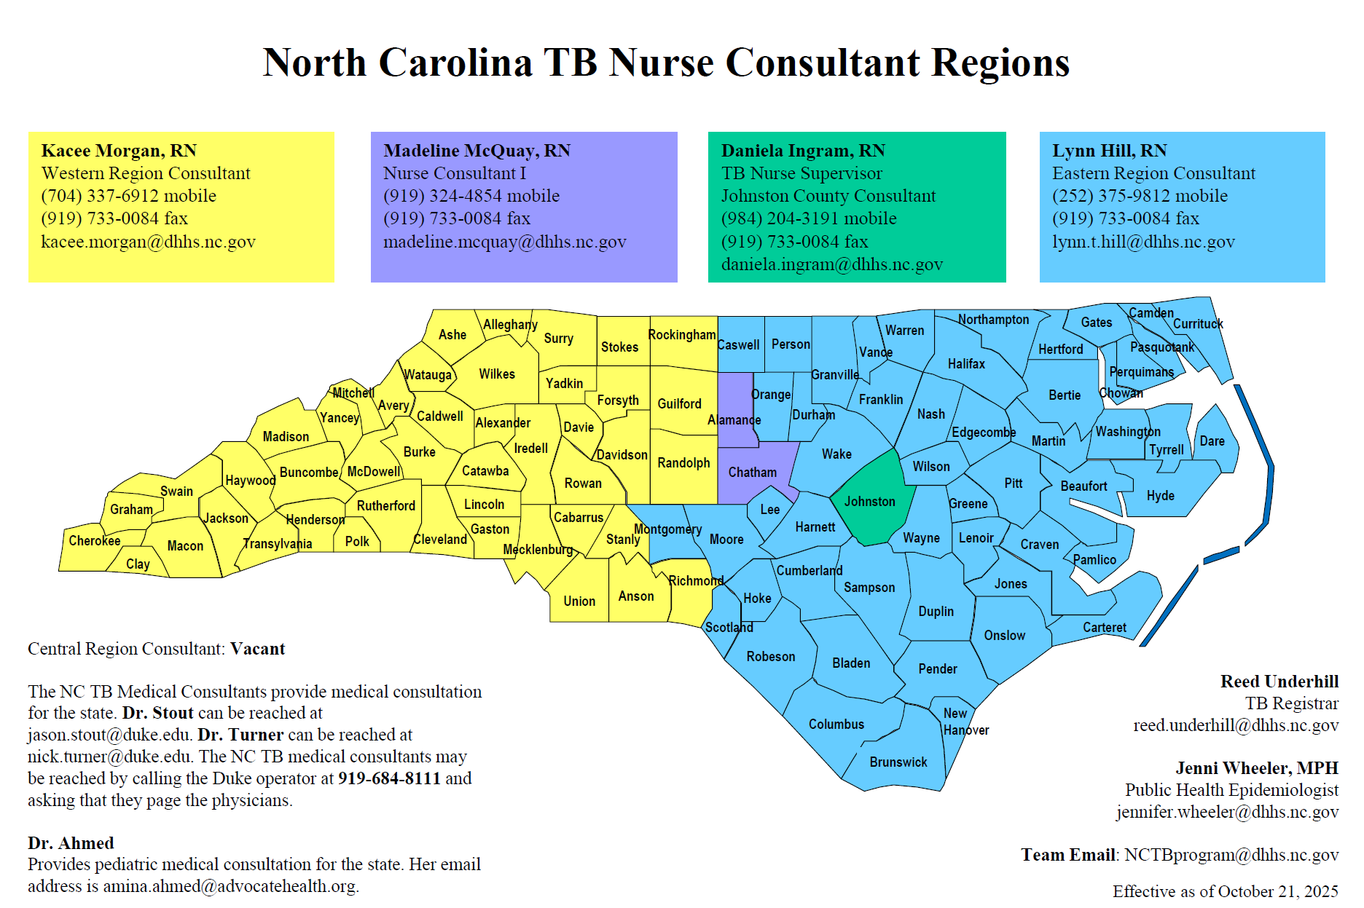
Changes in Workload
 | 3 Nurse Consultants | 2 Nurse Consultants
Average number of counties per nurse consultant | 33 | 49
Average cases per nurse | 438 | 1,026
Number includes all case types (confirmed, suspected, under investigation, and does not meet criteria)
Notes:
Consequences of decreased TB nurse consultant support:
Lack of capacity to aid counties in entry of TB reporting data required by Cooperative Agreement, which could lead to decrease in federal funding
Elimination of assistance with data entry for large contact investigations
Decreased workforce training and education
Decrease of in-person annual assessments
Loss of state staff due to stress and burn out

Slide 19
Option 3
Allocation of $414,412 of the state pharmaceutical funding to the state funding to the counties; no further state medication support
  Median gain to counties: $1,224
  Could be through existing or new AA
Top 5 | Bottom 5
Mecklenburg $80,740 | Perquimans $162
Wake $56,342 | Tyrrell $161
Guilford $24,431 | Graham $159
Durham $22,129 | Gates $159
Robeson $15,638 | Washington $154

Slide 20
Discussion of Options
Option 1
Option 2
Option 3
Reallocate state funding from LHDs to cover the shortfall
Reallocate state funding from LHDs to cover the shortfall
Cut nurse consultant position and reallocate federal money to counties
Allocate pharmaceutical funding to LHDs
State will no longer assist in TB medication purchase

Slide 21
Treatment Costs for Active TB
6 months of isoniazid, rifampin, ethambutol, pyrazinamide
6 months of isoniazid, rifabutin, ethambutol, pyrazinamide
4 months of isoniazid, rifapentine, pyrazinamide,
moxifloxacin
Per case - $675.22
Per case - $2,211.30
Per case - $3,121.16
Based on >90kg child/adult
Price of medications varies throughout the year and is calculated based on average cost

