Slide 1
North Carolina Technical Assistance Center (NC-TAC)
Supporting Programs for People at Risk of Incarceration and Overdose
June 18, 2025

Slide 2
What is NC-TAC?
The North Carolina Technical Assistance Center (NC-TAC) is a statewide initiative to provide technical assistance to programs that support individuals at risk of incarceration and overdose.
Collaboration between NC FIT Program, North Carolina Harm Reduction Coalition (NCHRC), North Carolina Association of County Commissioners (NCACC), and the Wilson Center for Science and Justice at Duke Law
Funded by NC DHHS Division of Mental Health, Developmental Disabilities, and Substance Use Services (DMHDDSUS).

Slide 3
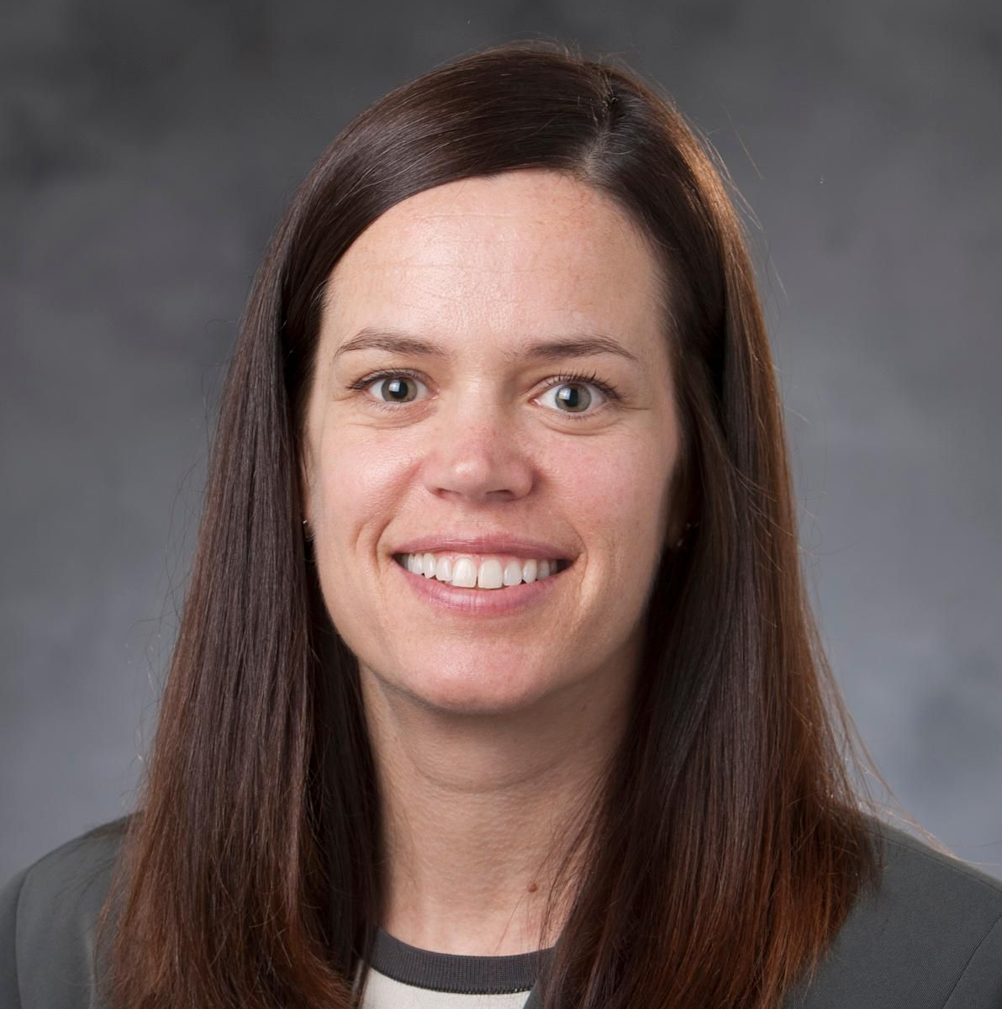
Meet the Core Team
Evan Ashkin
Andrea Des Marais
Alicia Brunelli
Lars Paul
Shuchin Shukla
Anna Wallin
Nidhi Sachdeva
Donnie Varnell
Tommy Green
Amy O’Regan
Allison Gilbert

Slide 5
Areas of expertise
Priority interventions
Skills and Guiding Principles
Reentry from incarceration and connections to essential health services
Diversion/deflection, including Law Enforcement Assisted Diversion (LEAD)
Jail-based medication for opioid use disorder (MOUD)
Naloxone access and distribution in jails
Harm reduction
Evidence based addiction treatment
Ethical program evaluation
Practical data management
Opioid settlement funding planning, implementation, reporting, and compliance

Slide 6
How NC-TAC can Support you with Free Services
Improving post release care
Navigating connections to care for formerly incarcerated individuals
Implementing and enhancing reentry councils
Building partnerships
Working with law enforcement
Creating space for lived experience
Training and supporting staff
Educating people on opioid overdose and settlement work
Guiding program evaluation and data management

Slide 7
services and Learning opportunities
Ongoing Connection
Events calendar
Online resource library
Monthly newsletter
Resource Development
Pre-arrest diversion handbook (Summer 2025)
Reentry policy guidebook (2026)
Webinars
Live webinar every other month with on demand library on website
Navigating Family Crisis in an Imperfect World (June 2025)
Three-part series on reproductive health in the justice system (Fall 2025)

Slide 8
Connect with US!
Email:
nctac@unc.edu
Join our mailing list, request TA and browse resources
go.unc.edu/nctac

