Slide 1
Immunization Update
NCALHD Meeting
July 23, 2026

Slide 2
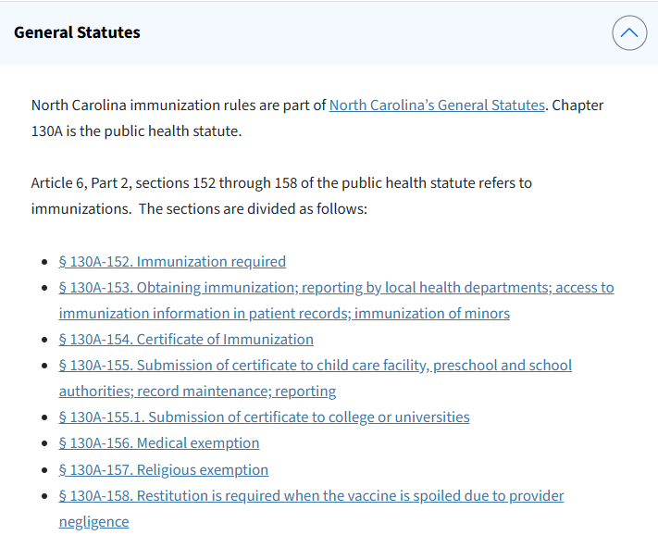
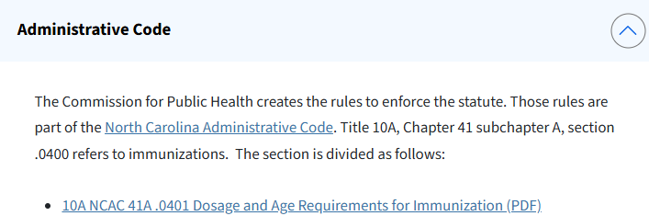
NC Immunization Law
NC Rules and Laws on Immunizations: https://www.dph.ncdhhs.gov/programs/epidemiology/immunization/schools/rules-and-laws#Resources-3059
Notes:
Reminder – the Commission for PH creates the rules (Administrative Code) to enforce the statutes.
These rules apply to all children, not just children in school – the AC is age-based but enforced through school attendance.

Slide 3
Key Points
Immunization required: No child may attend school (Pre-K–12), whether public, private, or religious, or a licensed childcare facility without a certificate of required immunizations.
Students have a grace period of 30 days from the first day of school to submit a record or exemption, or they face exclusion.
Enforcement: exclusion after 30 days of non-compliance
  School Principal or Administrator:
    Responsible for enforcing immunization laws for school entry and exclusion.
    Annual Reporting
  Local Health Director:
    Responsible for enforcement in accordance with NC G.S. 130A-41.
Annual Reporting: Schools must submit an immunization report to the Department by November 1.
Two allowable exemptions in NC: medical and religious. Philosophical exemptions are not permissible.
NC Rules and Laws on Immunizations: https://www.dph.ncdhhs.gov/programs/epidemiology/immunization/schools/rules-and-laws#Resources-3059
Notes:
Reminder: annual reporting is based off of student data at the end of the 30 day grace period. It serves as a snapshot at that point in time – i.e. if changes to immunization status occur after that 30 day period, the data doesn’t show that. We know that exclusion after day 30 typically results in immunization, which isn’t captured through annual reporting.

Slide 4
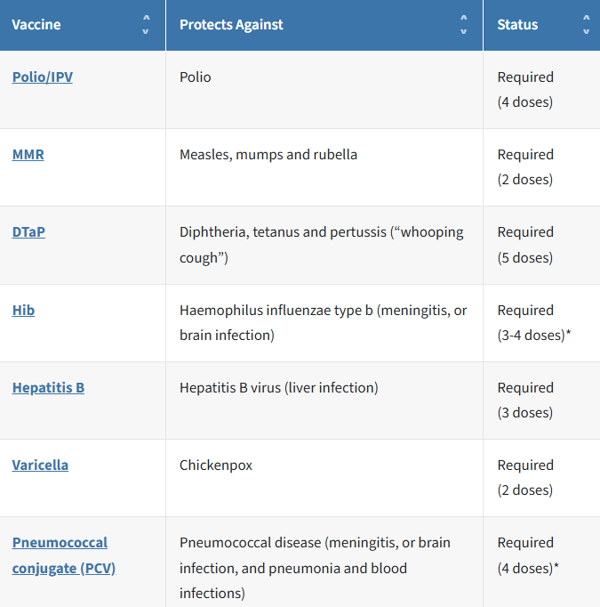
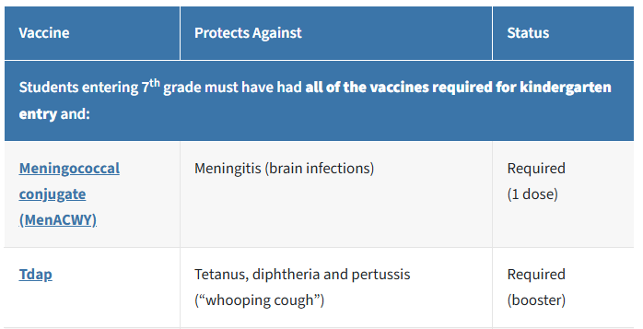
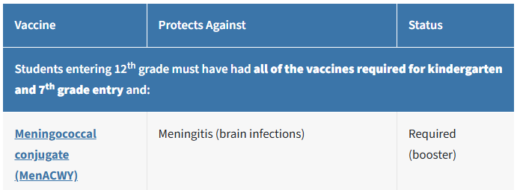
NC K-12 Immunization Requirements
Kindergarten
7th Grade
12th Grade
10A NCAC 41A.04.01: http://ncrules.state.nc.us/ncac/title%2010a%20-%20health%20and%20human%20services/chapter%2041%20-%20epidemiology%20health/subchapter%20a/10a%20ncac%2041a%20.0401.html
Notes:
Note: refer to the law for specific caveats to each vaccine. For instance, Hib or PCV is not required if child is beyond 5th birthday when initiating the series; some vaccines allow for proof of immunity.
Alternative schedules do not excuse or exempt children from the minimum imm. requirements

Slide 5
NC Immunization Compliance Reporting
Before school starts
Students submit vaccination records
Before 11/1 or Day 60
Schools, colleges and universities submit a report to DHHS
November - March
Data is cleaned and analyzed, schools with errors are contacted
March – April
Kindergarten data is reported to CDC
April – July
Immunization data is shared with LHDs and community, and published on the Kindergarten dashboard
Annual Report Submission:
School nurses (preferred) or administrators record student status on calendar day 30 following the first day of school. We provide worksheets, or a facility’s own internal systems can be used.
Reports are submitted online. Memos are emailed out to principals, registrars, and school health personnel each fall and include the link for reporting. Reporting information is also posted on our website.
No late submissions are accepted. Local Health Departments are responsible for enforcement of the reporting requirement.
Annual Required Immunization Reports for K-12 schools: https://www.dph.ncdhhs.gov/programs/epidemiology/immunization/schools/partners/school-reports

Slide 6
HHS/CDC/ACIP Updates
June 2025: RFK Jr. terminated all 17 members of CDC’s ACIP
July 2025: initial lawsuit filed by AAP, APHA and other key medical orgs; challenged unilateral changes to COVID vaccines recs and ACIP dismissals (lawsuit amended in January 2026)
January 2026: RFK Jr. announced an end to broad recommendations for all children to be vaccinated against flu, rotavirus, Hep A, Hep B, MenACWY, and RSV.
March 2026:
  federal judge ruled that RFK Jr. violated federal procedures
  Froze all recommendations that the group had made
  Concluded that 13 tapped by RJK after he fired all 17 previous ACIP members had zero vaccine-related expertise and not qualified under ACIPs original charter
Currently:
  New ACIP Charter (6/24/26):
    Broader focus on safety data and shifted committee governance to the CDC director, does not commit to a meeting schedule, and alters membership criteria
  HHS says ACIP cannot meet because of the court injunction. Impacts include:
    Insurance Coverage
    VFC program coverage - for new vaccines, ACIP rec precedes VFC resolution
      Flu and COVID have evergreen VFC resolutions (already FDA approved, strain change only),
    Some polices or rules are dependent on the actual ACIP rec.
  HHS is seeking expedited appeal, but for now injunction remains in place
Notes:
Insurers have up to a year to implement ACIP changes
AHIP (America’s Health Insurance Plans) – May 2026 statement – AHIP member health plans will continue covering all ACIP-recommended vaccines with no cost-sharing through 2027. (https://www.ahip.org/news/press-releases/ahip-statement-on-vaccine-coverage)
-VFC resolution: the operational guidance and contracting agreement needed to offer certain vaccines through VFC program

Slide 7
SY26-27 Immunization Guidance for LHDs
NC immunization requirements have not changed; no plans to revise.
NC law aligns with AAP recommendations.
Reporting process remains unchanged; specific instructions and details are forthcoming (via memo and website).
Business as usual.

Slide 8
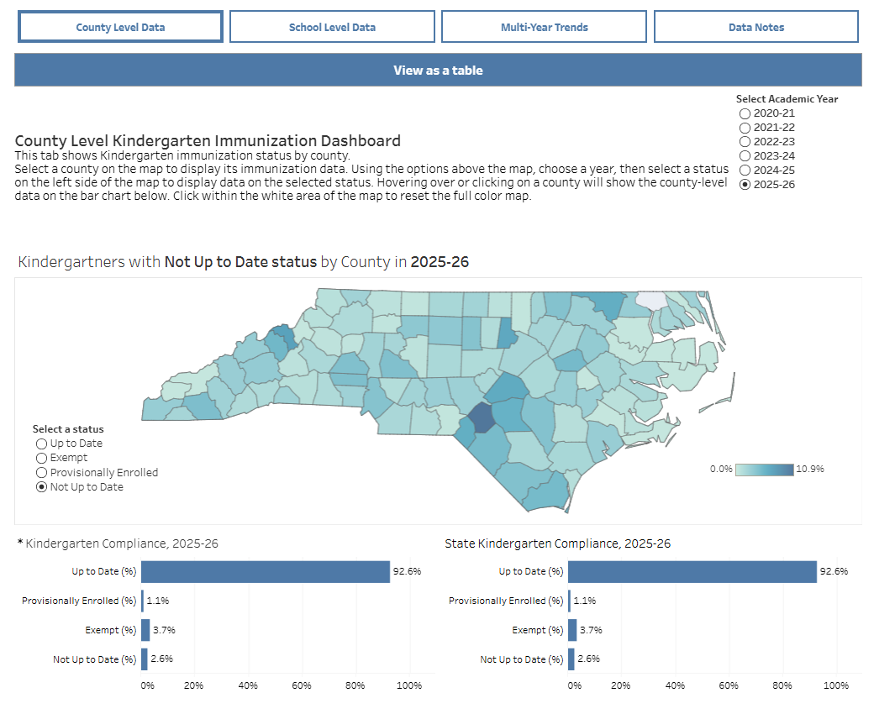
Immunization Resources
NC Immunization Branch Website
  NC School and Child Care Immunization Requirements
  NC Immunization Laws and Rules
  Annual Required Immunization Reporting for K-12 Schools
  NC Kindergarten Immunization Dashboard
  Immunization Resources for NC Schools and Child Care Facilities
    Garrett’s Law
    Materials for parents
    Materials for schools
Questions:
  IB Nurse On-Call (law or clinical questions): 919-707-5575
  NCIP Help Desk:
    Phone: 1-877-873-6247
    Fax: 1-800-544-3058
    Email: ncirhelp@dhhs.nc.gov
  ServiceNow Ticket

