Slide 1
Activity 117 LHD Workforce and Infrastructure Support
NCALHD May 2026
LHD Support Team
Doug Urland, Chelsea Shannon, Parris Drakeford

Slide 2
Agenda
1
AA 117 Overview
2
T-minus Information
3
Health Departments with Less than 10% Spend
4
Health Departments Under-Reporting Performance
5
Success Stories from the Field
6
What Makes a Great Success Story
7
Wrapping Up the Fiscal Year
8
Appendix — Regional Spending Detail

Slide 3
AA 117 Overview
Public Health Infrastructure: Local Workforce Development
5-YEAR FUNDING THROUGH OCTOBER 31, 2027
THE PURPOSE OF THIS FUNDING IS TO HELP MEET SHORT-TERM CRITICAL INFRASTRUCTURE NEEDS AND TO MAKE STRATEGIC INVESTMENTS WHICH WILL HAVE LASTING EFFECTS ON LOCAL PUBLIC HEALTH DEPARTMENTS IN NORTH CAROLINA.
FUNDING IS DISTRIBUTED TO EACH INDIVIDUAL LOCAL HEALTH DEPARTMENT BASED ON COUNTY POPULATION, SOCIAL VULNERABILITY, AND EQUITY INDICES.
•
75 COUNTIES HAVE UTILIZED FUNDS
(COUNTIES WITH > $0 EXPENDITURES IN FY26 TO DATE)
•
TOTAL AMOUNT ALLOCATED TO LHDS: $21,893,402.00
•
TOTAL AMOUNT SPENT (JUL 2025 – MAY 2026): $5,856,207.70
•
PERCENTAGE SPENT: 26.75%
•
REMAINING BALANCE: $16,037,194.30
•
LHDs IN COMPLIANCE FOR FISCAL REPORTING: 53

Slide 4
T Minus Plan APRIL 2026 – OCTOBER 2027
Strategic Objective
100% Expended | 0% Unobligated | 100% Reimbursements Submitted
How We Get There:
Early Activation
Continuous Monitoring
Mid-Cycle Correction
Formal Reallocation Decision
Structured Closeout

Slide 5
PHASE 1: LAUNCH (APRil- June 2026)& MONITOR (July–SEP 2026)
Launch April–June 2026 - Goal of at least 10% spend
• Initiate approved projects and allowable activities
• Execute contracts and procurement actions
• Begin obligating and encumbering funds
• Establish internal tracking for spending progress
Monitor July- September 2026
• Continue project implementation
• Identify total allocated, obligated, encumbered, and expended funds
• Identify funds at risk of not being spent
• Submit updated expenditure projections
• Underperforming LHDs submit a Spending Plan

Slide 6
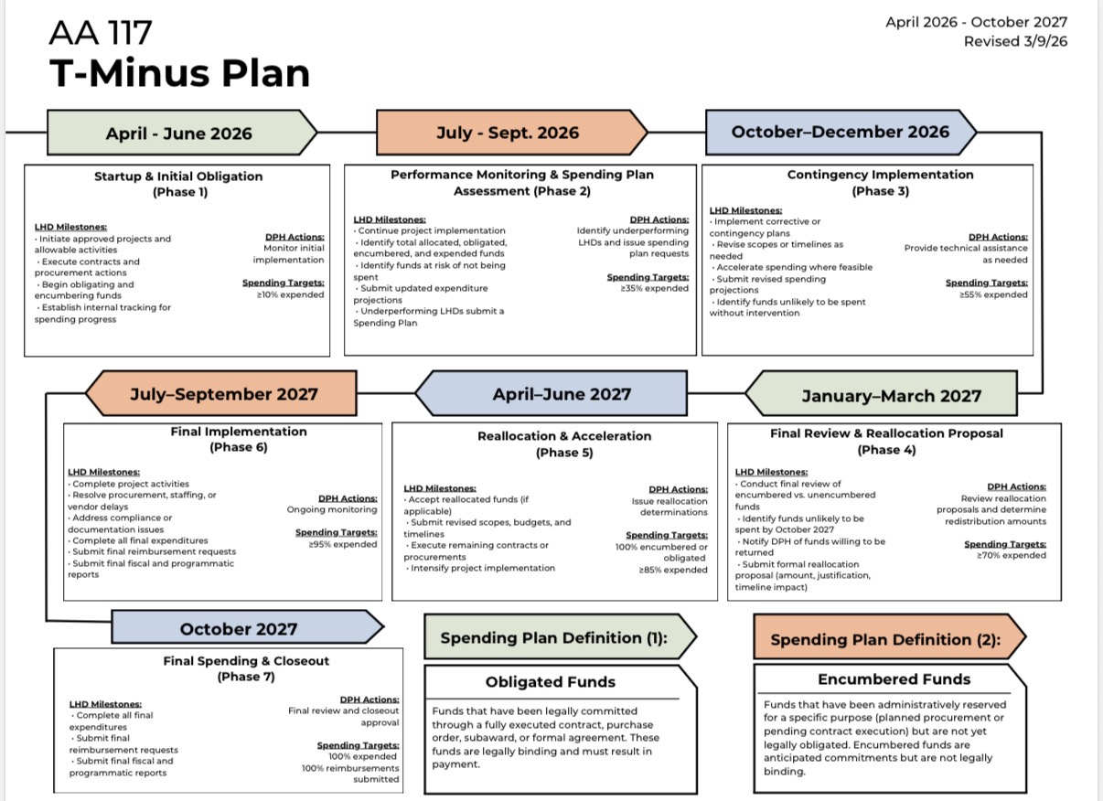

Slide 7
Health Departments with Less than 10% Spend
This is a review of health departments with less than 10% spend of original funding, not including new funding added recently.
LHD
BUDGET
SPENT
% SPENT
12 LHDs
Union
$568,902
$0
0.0%
under 10% spent on original funding
Sampson
$287,860
$539
0.2%
Pender
$200,818
$1,437
0.7%
$3.69M
Haywood
$147,580
$1,100
0.7%
Nash
$320,561
$8,333
2.6%
remaining on original funding
New Hanover
$499,728
$25,735
5.1%
Forsyth
$991,706
$67,472
6.8%
Northampton
$16,935
$1,166
6.9%
Hoke
$202,059
$15,155
7.5%
Wilson
$335,419
$25,197
7.5%
Scotland
$207,301
$17,646
8.5%
Caldwell
$80,462
$7,816
9.7%

Slide 8
Health Departments Missing Performance Reports-Low Reporting
Appalachian
Hoke
Pender
Burke
Hyde
Pitt
Columbus
Jones
Robeson
Craven
Lee
Rowan
Forsyth
Macon
Sampson
Franklin
Montgomery
Transylvania
Haywood
Nash
Wayne
Henderson
Pamlico
Wilson

Slide 9
Success Stories from the Field
Examples of effective reporting and impactful use of funds
CUMBERLAND COUNTY
ORANGE COUNTY
Adolescent Parenting Program
Culturally Responsive Lactation Support
AA 117 funds a Social Work position supporting the Adolescent Parenting Program, which served more than 40 pregnant and parenting teens in 2024. Teens receive individualized case management, childbirth education, parenting classes, and connections to WIC, high school graduation support, and employment resources.
AA 117 funded Certified Lactation Counselor training for a Care Management Social Worker and a Breastfeeding Support Specialist, one African American, one Latinx, closing a representation gap identified by the Family Home Visiting Team. Lactation counseling is now incorporated into their routine home visits.
STANLY COUNTY
HALIFAX COUNTY
Clinical Capacity and Cross-Training
Retaining Institutional Knowledge
Grant funding expanded clinical service capacity by adding trained staff and dedicated clinic time, reducing wait times and improving continuity of care. A structured training initiative cross-trained staff for backup roles and specialized clinical competencies, improving operational resilience during absences and vacancies.
Used AA 117 funds to retain two veteran Communicable Disease staff members part-time after retirement, to train new CD staff on their roles.

Slide 10
What Makes a Great Success Story
Help us share the impact of AA 117. Here is what to include in your story.
1
Show Real Results
2
Use Numbers
Share what changed because of the work. Did wait times drop? Were more clinic days added? Were more staff trained? Specific changes are best.
Numbers tell the story. How many clients did you serve? How many positions did you fill? How many staff did you train?
3
Connect to the Funding
4
Who You Helped
Show how AA 117 money made it happen. What did you hire, train, or buy that would not have happened without it?
Name who benefits. Pregnant teens, WIC families, rural residents, people getting septic permits, or people exposed to a disease.
5
Lasting Impact
6
Share!
What stays after the funding ends? Staff you kept? New ways of working? Skills your team gained? Stronger systems?
Share what was hard and what you learned. Honest stories build trust and help other health departments.
6

Slide 11
Wrapping Up the Fiscal Year
What we need from each LHD
$
Q
→
All SFY26 Financial Reports
All SFY26 Performance Reports
Confirm Your T-Minus Plan
Every monthly financial report from July 2025 through May 2026 must be submitted. April 2026 reports were due May 24. May reports are due June 24.
Q1, Q2, and Q3 performance reports for SFY26 must be submitted. Q4 (March–May 2026) will be due shortly after the quarter closes.
Review your remaining balance against your multi-year plan. If pacing has slipped, reach out to the LHD Support Team for technical assistance.
DPH leadership will receive a comprehensive AA 117 update in June. Reports submitted after that report is generated will not be reflected in what leadership provides to CDC.

Slide 12
APPENDIX
Regional Spending Overview
FY 2025-2026 (July 2025 – May 2026) | Combined original and supplemental funding

Slide 13
Regional Spending Comparison
AA 117 Spend grouped by 118 Regions
REGION
% SPENT
BUDGET
LEADING
1
Region 9
45.3%
$1.12M
Region 9
2
Region 10
40.8%
$1.78M
45.3% spent
3
Region 1
30.0%
Lead: Albemarle Regional
$440K
4
Region 5
28.5%
$4.44M
LAGGING
5
Region 2
28.3%
$1.40M
Region 7
6
Region 4
26.3%
$3.22M
16.2% spent
7
Region 6
25.9%
Lead: Granville-Vance
$1.87M
8
Region 8
22.7%
$2.91M
Statewide
26.7%
spent through May
9
Region 3
19.0%
$2.59M
10
Region 7
16.2%
$2.13M

Slide 14
Region 1 | Lead LHD: Transylvania
Regional Spending Overview
Total Reported
$132,012
FY 2025-2026 (July 2025 – May 2026)
Macon
$42,963 rem.
54.6%
of $440,201 budget
$51,774
Transylvania
$49,709
$51,426 rem.
49.2%
30.0% spent through May
Cherokee
100.0%
92% of fiscal year complete
$16,023
Swain
$9,907
$5,871 rem.
62.8%
Clay
$3,332
$3,691 rem.
47.4%
Haywood
$1,100
$170,921 rem.
0.6%
Graham
$166
$10,581 rem.
1.5%
Jackson
$0
$22,737 rem.
0.0%
Spent YTD
Remaining Budget
Bar length proportional to each LHD's total budget. Includes original (20G0216001) and supplemental (20G0216002) funding through May 2026.

Slide 15
Region 2 | Lead LHD: Foothills Health District
Regional Spending Overview
Total Reported
$397,246
FY 2025-2026 (July 2025 – May 2026)
Buncombe
$331,645 rem.
37.0%
of $1.40M budget
$194,587
Foothills
$65,715
100.0%
28.3% spent through May
Polk
$34,879 rem.
56.6%
92% of fiscal year complete
$45,482
Burke
$42,598
$146,322 rem.
22.5%
Henderson
$40,993
$333,158 rem.
11.0%
Caldwell
$7,816
$106,295 rem.
6.8%
Madison
$56
$17,812 rem.
0.3%
Toe River
$0
$22,680 rem.
0.0%
Yancey
$0
$12,815 rem.
0.0%
Spent YTD
Remaining Budget
Bar length proportional to each LHD's total budget. Includes original (20G0216001) and supplemental (20G0216002) funding through May 2026.

Slide 16
Region 3 | Lead LHD: App Health
Regional Spending Overview
Total Reported
$490,984
FY 2025-2026 (July 2025 – May 2026)
App Health
$60,403 rem.
70.1%
of $2.59M budget
$141,478
Davidson
$69,466
$472,841 rem.
12.8%
19.0% spent through May
Forsyth
$1,057,451 rem.
6.0%
92% of fiscal year complete
$67,472
Surry
$63,966
$110,938 rem.
36.6%
Wilkes
$50,533
$208,761 rem.
19.5%
Davie
$50,082
$75,417 rem.
39.9%
Yadkin
$47,988
$90,461 rem.
34.7%
Stokes
$0
$18,457 rem.
0.0%
Spent YTD
Remaining Budget
Bar length proportional to each LHD's total budget. Includes original (20G0216001) and supplemental (20G0216002) funding through May 2026.

Slide 17
Region 4 | Lead LHD: CHA
Regional Spending Overview
Total Reported
$845,934
FY 2025-2026 (July 2025 – May 2026)
Rowan
$324,282 rem.
33.5%
of $3.22M budget
$163,147
Gaston
$162,465
$379,969 rem.
30.0%
26.3% spent through May
Catawba
$271,884 rem.
32.4%
92% of fiscal year complete
$130,328
Stanly
$102,362
$129,869 rem.
44.1%
Iredell
$100,940
$121,493 rem.
45.4%
Alexander
$84,854
$84,022 rem.
50.2%
Cleveland
$62,516
$126,293 rem.
33.1%
Lincoln
$39,323
$218,137 rem.
15.3%
Cabarrus
$0
$72,374 rem.
0.0%
Union
$0
$643,993 rem.
0.0%
Spent YTD
Remaining Budget
Bar length proportional to each LHD's total budget. Includes original (20G0216001) and supplemental (20G0216002) funding through May 2026.

Slide 18
Region 5 | Lead LHD: Guilford
Regional Spending Overview
Total Reported
$1.27M
FY 2025-2026 (July 2025 – May 2026)
Guilford
$847,796 rem.
33.9%
of $4.44M budget
$433,960
Durham
$246,088
$670,208 rem.
26.9%
28.5% spent through May
Alamance
$384,694 rem.
31.2%
92% of fiscal year complete
$174,567
Randolph
$115,147
$386,188 rem.
23.0%
Orange
$83,700
$225,473 rem.
27.1%
Person
$79,864
$123,224 rem.
39.3%
Rockingham
$75,254
$219,135 rem.
25.6%
Chatham
$46,819
$201,062 rem.
18.9%
Caswell
$12,397
$118,028 rem.
9.5%
Spent YTD
Remaining Budget
Bar length proportional to each LHD's total budget. Includes original (20G0216001) and supplemental (20G0216002) funding through May 2026.

Slide 19
Region 6 | Lead LHD: Cumberland
Regional Spending Overview
Total Reported
$482,594
FY 2025-2026 (July 2025 – May 2026)
Cumberland
$451,902 rem.
28.6%
of $1.87M budget
$181,052
Moore
$90,346
$178,584 rem.
33.6%
25.9% spent through May
Richmond
$107,301 rem.
38.7%
92% of fiscal year complete
$67,713
Harnett
$40,320
$115,290 rem.
25.9%
Hoke
$36,658
$197,630 rem.
15.6%
Lee
$30,434
$50,556 rem.
37.6%
Montgomery
$18,427
$41,072 rem.
31.0%
Scotland
$17,646
$218,766 rem.
7.5%
Anson
$0
$22,688 rem.
0.0%
Spent YTD
Remaining Budget
Bar length proportional to each LHD's total budget. Includes original (20G0216001) and supplemental (20G0216002) funding through May 2026.

Slide 20
Region 7 | Lead LHD: Granville-Vance
Regional Spending Overview
Total Reported
$344,847
FY 2025-2026 (July 2025 – May 2026)
Gran-Vance
$281,200 rem.
32.6%
of $2.13M budget
$135,912
Warren
$77,971
$100,481 rem.
43.7%
16.2% spent through May
Johnston
$492,973 rem.
11.0%
92% of fiscal year complete
$60,781
Franklin
$36,653
$196,699 rem.
15.7%
Wilson
$25,197
$354,851 rem.
6.6%
Nash
$8,333
$357,146 rem.
2.3%
Spent YTD
Remaining Budget
Bar length proportional to each LHD's total budget. Includes original (20G0216001) and supplemental (20G0216002) funding through May 2026.

Slide 21
Region 8 | Lead LHD: Duplin
Regional Spending Overview
Total Reported
$659,256
FY 2025-2026 (July 2025 – May 2026)
Onslow
$277,045 rem.
53.0%
of $2.91M budget
$312,360
Bladen
$98,372
$55,594 rem.
63.9%
22.7% spent through May
Robeson
$141,853 rem.
34.6%
92% of fiscal year complete
$74,995
Duplin
$74,395
$207,379 rem.
26.4%
Brunswick
$47,841
$416,814 rem.
10.3%
New Hanover
$25,735
$552,084 rem.
4.5%
Sampson
$17,651
$309,192 rem.
5.4%
Columbus
$6,470
$59,471 rem.
9.8%
Pender
$1,437
$226,736 rem.
0.6%
Spent YTD
Remaining Budget
Bar length proportional to each LHD's total budget. Includes original (20G0216001) and supplemental (20G0216002) funding through May 2026.

Slide 22
Region 9 | Lead LHD: Albemarle Regional Health Services
Regional Spending Overview
Total Reported
$507,680
FY 2025-2026 (July 2025 – May 2026)
Albemarle Reg
$389,872 rem.
43.0%
of $1.12M budget
$294,130
Hyde
$90,608
$15,454 rem.
85.4%
45.3% spent through May
Edgecombe
$53,840 rem.
58.0%
92% of fiscal year complete
$74,338
Halifax
$39,904
$60,162 rem.
39.9%
Northampton
$8,699
$28,533 rem.
23.4%
Dare
$0
$14,448 rem.
0.0%
Mar-Tyr-Wash
$0
$50,204 rem.
0.0%
Spent YTD
Remaining Budget
Bar length proportional to each LHD's total budget. Includes original (20G0216001) and supplemental (20G0216002) funding through May 2026.

Slide 23
Region 10 | Lead LHD: Pitt County
Regional Spending Overview
Total Reported
$727,859
FY 2025-2026 (July 2025 – May 2026)
Pitt
$267,538 rem.
48.5%
of $1.78M budget
$251,971
Craven
$100,000
$45,502 rem.
68.7%
40.8% spent through May
Carteret
$57,702 rem.
58.7%
92% of fiscal year complete
$81,865
Wayne
$79,861
$72,466 rem.
52.4%
Greene
$79,278
$109,702 rem.
42.0%
Beaufort
$65,282
$115,887 rem.
36.0%
Lenoir
$31,613
$269,648 rem.
10.5%
Jones
$30,299
$97,721 rem.
23.7%
Pamlico
$7,689
$18,558 rem.
29.3%
Spent YTD
Remaining Budget
Bar length proportional to each LHD's total budget. Includes original (20G0216001) and supplemental (20G0216002) funding through May 2026.

Slide 24
Questions?
Local and Community Support
LHD Workforce and Infrastructure Support Team

