Slide 1
NC Department of Health and Human Services
AA/Smartsheet Project
Will Broughton, MA, MPH, CPH
Director of Public Health Evaluation and Quality Improvement
NC Division of Public Health
May 20th, 2026

Slide 2

How we got here
FY 2021 Audit
Identified need to develop and track subrecipient reports
FY 2026
24 Activities using Smartsheet
23 Activities not using Smartsheet
Starting SFY 2027, LHDs will use Smartsheet for AA performance and financial reporting
(expect for HIPPA protected data)

Slide 3
What driving the transition
FC Accountability and Performance Management: Increase ability to track and manage performance and financial reporting – ensure meaningful
Standardize AA language to reflect transition and specify specific reports expected to be submitted via Smartsheet along with standard due dates
Changing federal landscape – Increased need to communicate how federal funds are being spent and impact of funds
Collect “Impact Story” question for all AAs starting in SFY 2027 as part of performance reporting
LHDs need to be able to access data submitted to DPH as part of AA reporting

Slide 4
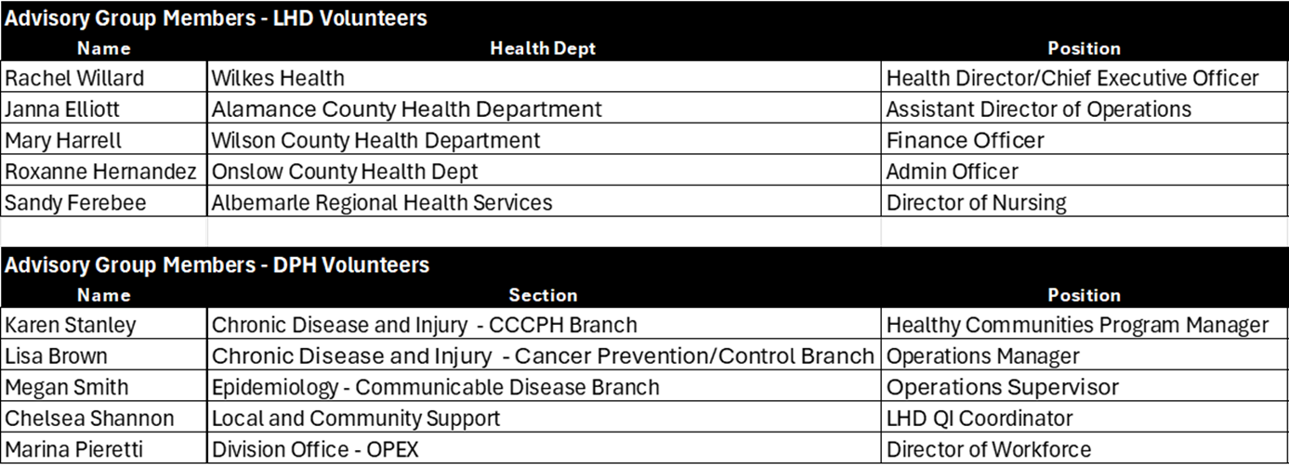
Project Advisory Group

Slide 5
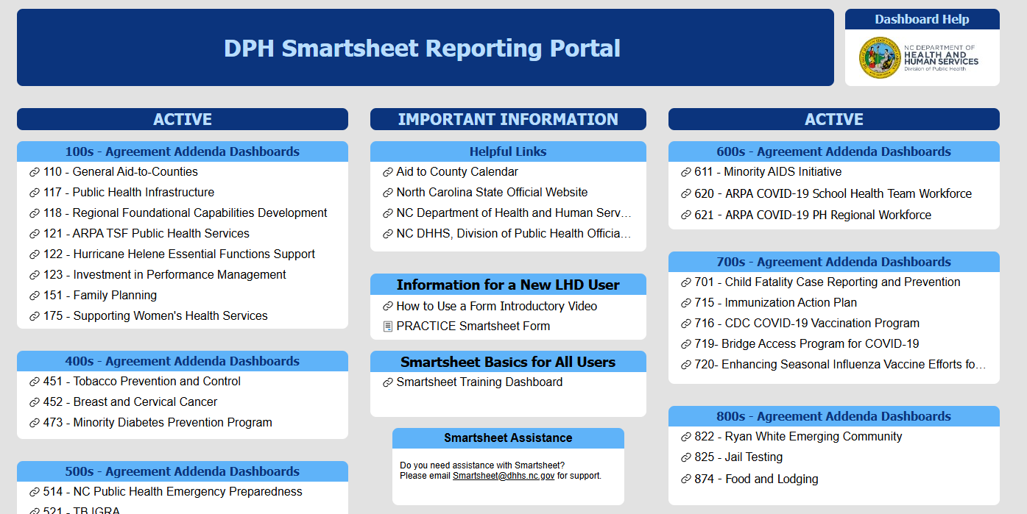

Slide 6
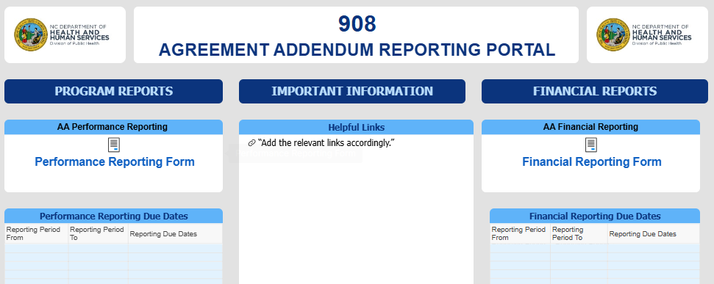
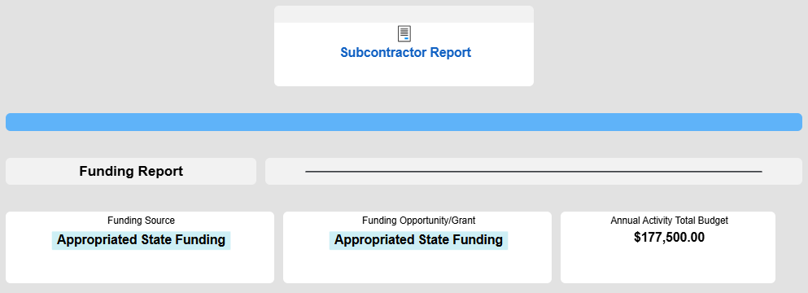
AA Reporting Dashboard:
External View - LHDs submit performance and financial reports

Slide 7
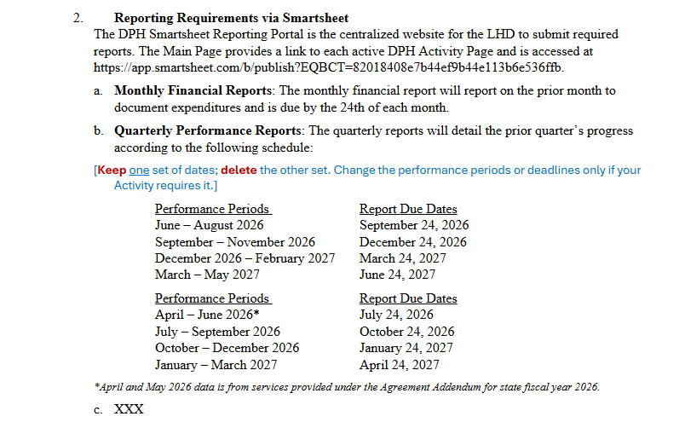
AA Language:
Push towards standardizing due dates

Slide 8
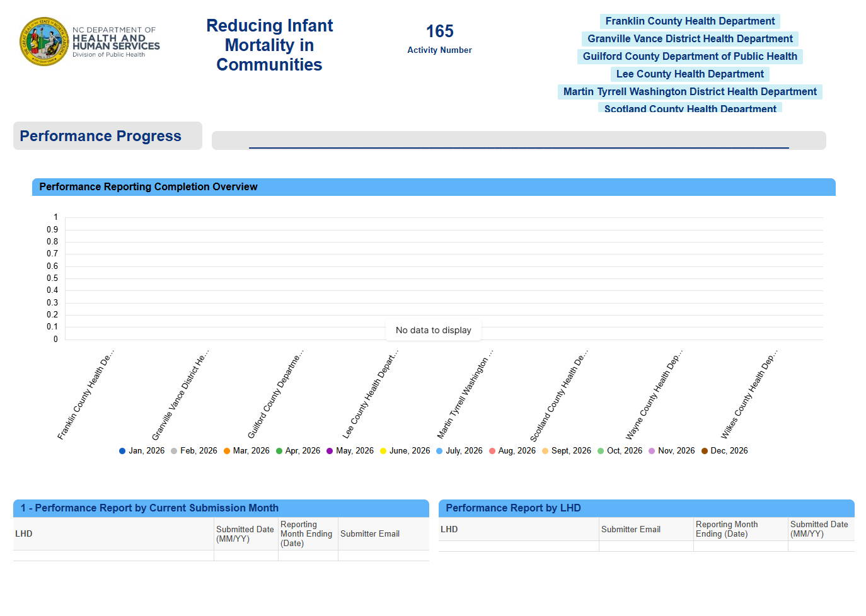
Activity Monitoring Dashboard:
Internal View – Activity Owners (DPH Staff) can see submitted performance and financial reports
Eventually display performance and financial metrics for Activity

Slide 9
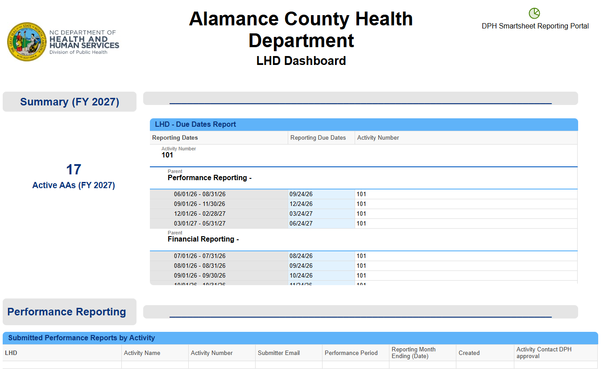
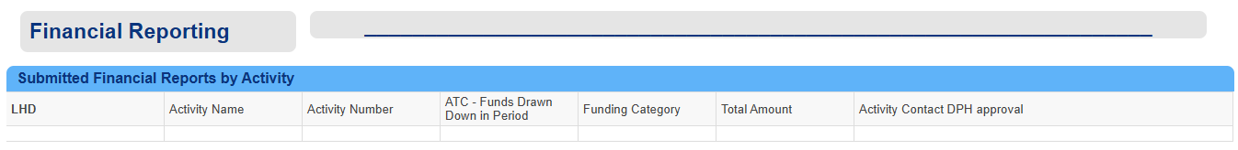
LHD Dashboard:
LHDs can see/download submitted reports for each AA they as well as upcoming due dates

Slide 10
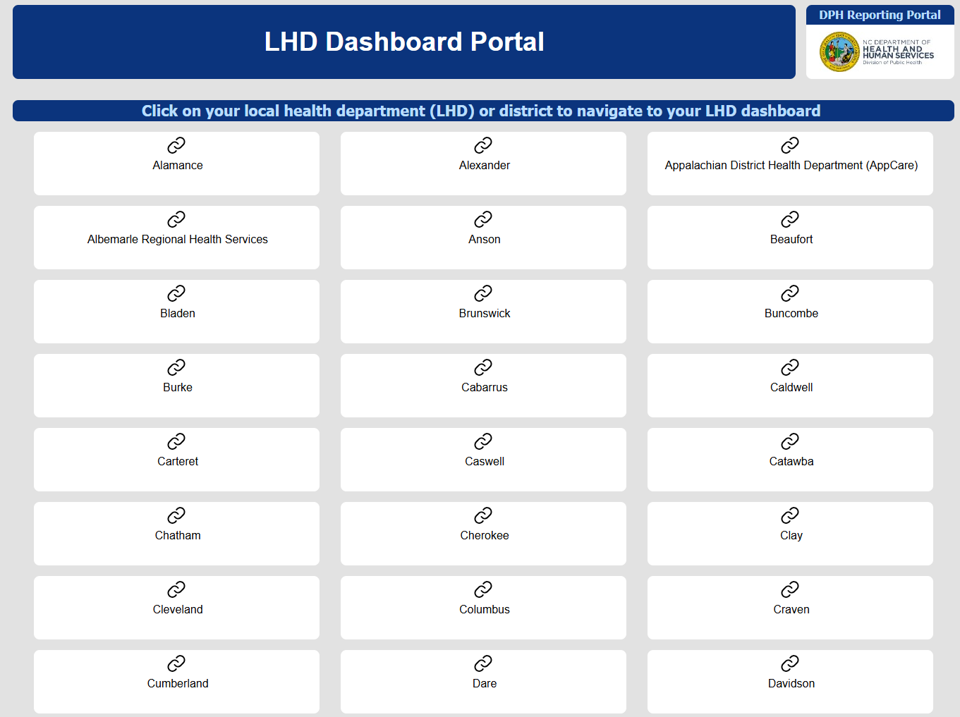

Slide 11
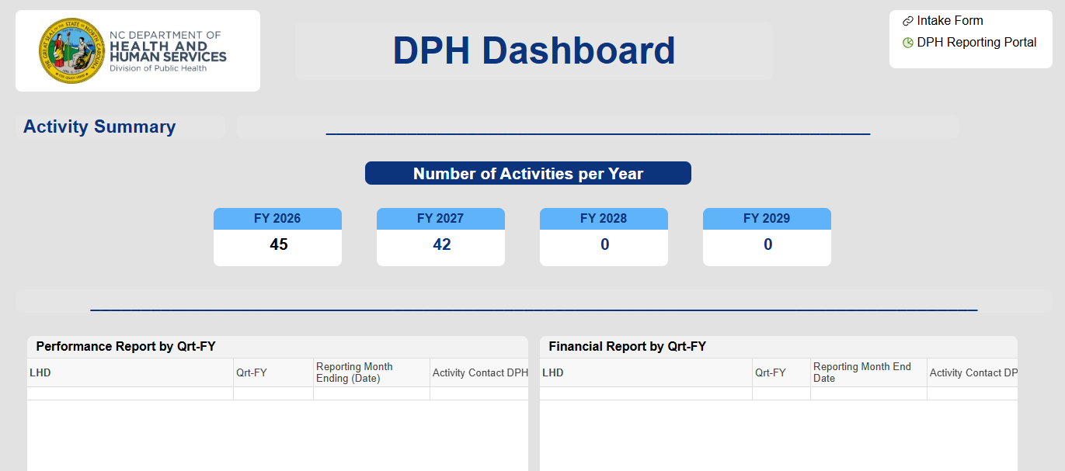
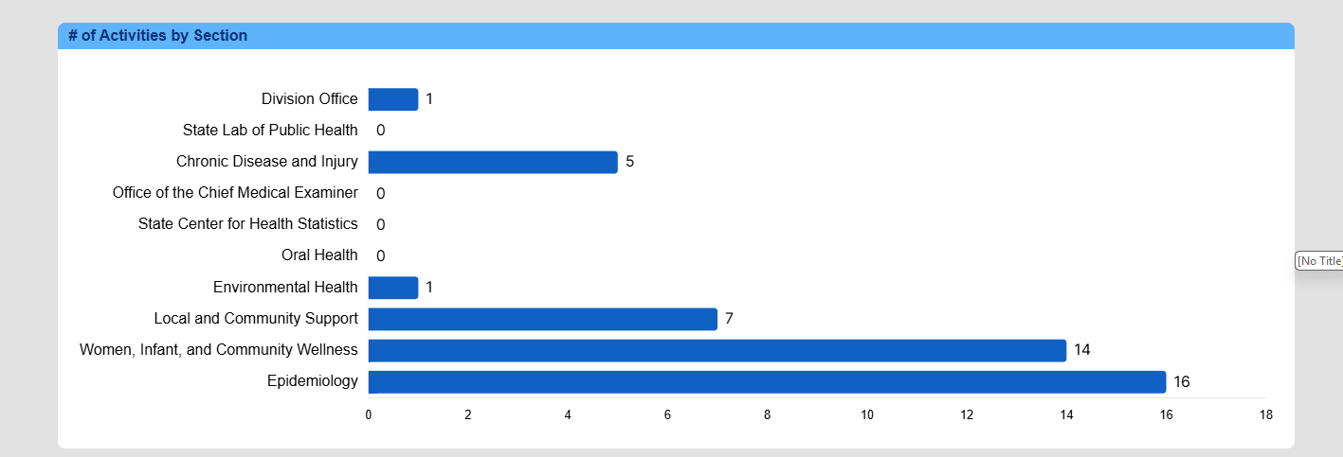
DPH Dashboard:
High level view – data pulled from Intake Form and any standardized questions across all Activity reporting

Slide 12
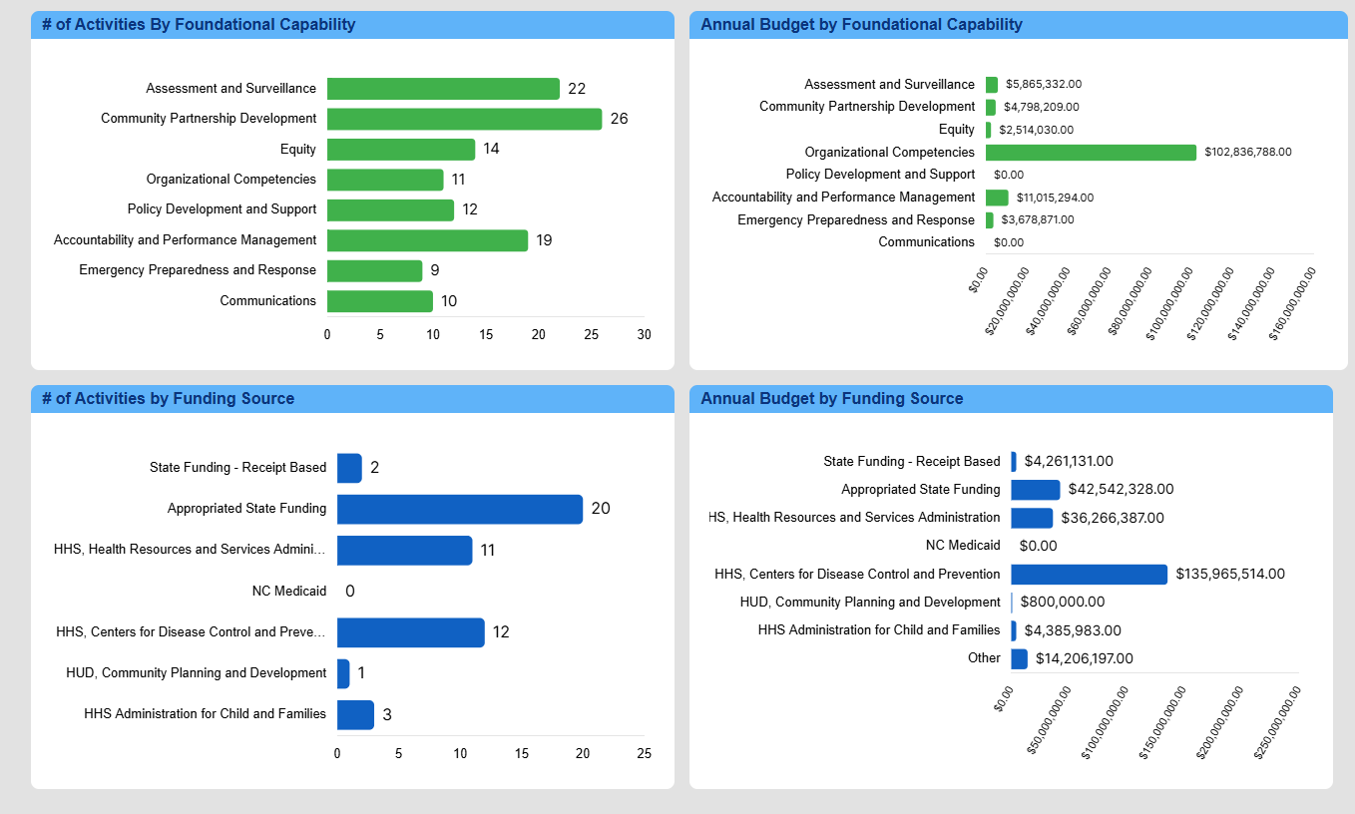

Slide 13
Smartsheet Training for LHD Staff
Training Sessions (1hr, all virtual)
  Wednesday, May 27 at 10:00 AM – 54 registered, FULL
  Wednesday May 27 at 2:00PM – 36 spots available
  Thursday, May 28 at 2:00 PM – 51 registered, FULL
  Tuesday, June 2 at 11:00 AM – 52 registered, FULL
  Monday, June 8 at 3:00 PM – 22 spots available
Purpose
Walk staff through the general reporting process in Smartsheet
Demonstrate how to navigate dashboards,
Show users how to access previously submitted reports and data—a new and much‑requested feature.
Please share information to appropriate staff so they can “save the date” for these sessions.
To sign up for a training, LHD staff can email Claire Atherton (claire.atherton@dhhs.nc.gov) with the specific date they would like to attend.

Slide 14
Next steps
Workspaces to be complete by June 1st, 2026
Review of Performance Reporting Forms (FY 2028)
Share update in 2-3 months
Iterative process, Feedback welcome

