Slide 1
NC Department of Health and Human Services
Keeping Communities Safe
Changes re: Cigar Bars in NC
Sally Herndon & Jim Martin
With Kaycee Deen, Agency Legal Specialist
Tobacco Prevention and Control Branch
October 16, 2024
November 20, 2024

Slide 2
We will cover
Changes in the Cigar Bar Laws in NC
REMINDER: cigar bars can be in mixed-used buildings only if they don’t serve food and their smoke does not migrate to a business protected by SF laws. LHDs can prevent these cigar bars from locating in a strip mall if one of those things is met.
Plans to Assist LHDs: Cigar Bar Toolkit – Coming Soon
Meanwhile, contact your Regional Manager and Agency Attorney Kaycee Deen kaycee.deen@dhhs.nc.gov about permitting folks when new cigar bars are in the formation stage.
Plans to Assist LHDs with complaints about migrating smoke
Air Quality Monitoring at LHD request for Cigar Bars in Strip Malls
Two Action Items
1. Local Health Directors – You are the responsible party for compliance to the Smokefree restaurants and bars law. If you want to add a designee, please submit by name and title to TPCB@dhhs.nc.gov
2. Should we purchase 2 air quality monitors in anticipation of their being needed?

Slide 3
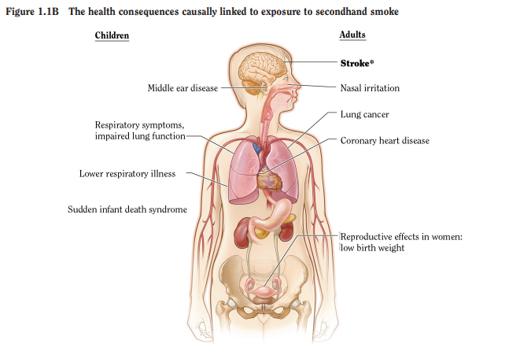
US Surgeon General: There is no safe level of exposure to secondhand smoke.
Sources: 2006 & 2014* SGR: The Health Consequences of Smoking—50 Years of Progress

Slide 4
Ventilation
Does not protect from exposure to SHS
ASHRAE’s position statement reaffirms:
There is no safe level of exposure to secondhand smoke.
Ventilation and other air filtration technologies cannot eliminate all the health risks caused by secondhand smoke exposure.
Tobacco smoke does not belong in indoor areas.
Notes:
The Board of Directors for the American Society of Heating Refrigerating, and Air Conditioning Engineers (ASHRAE), the international standard-setting body for indoor air quality, unanimously adopted an important new position statement on secondhand tobacco smoke at its Summer 2005 conference in June.

Slide 5
Plans to Assist LHDs Complaints about migrating smoke

Slide 6
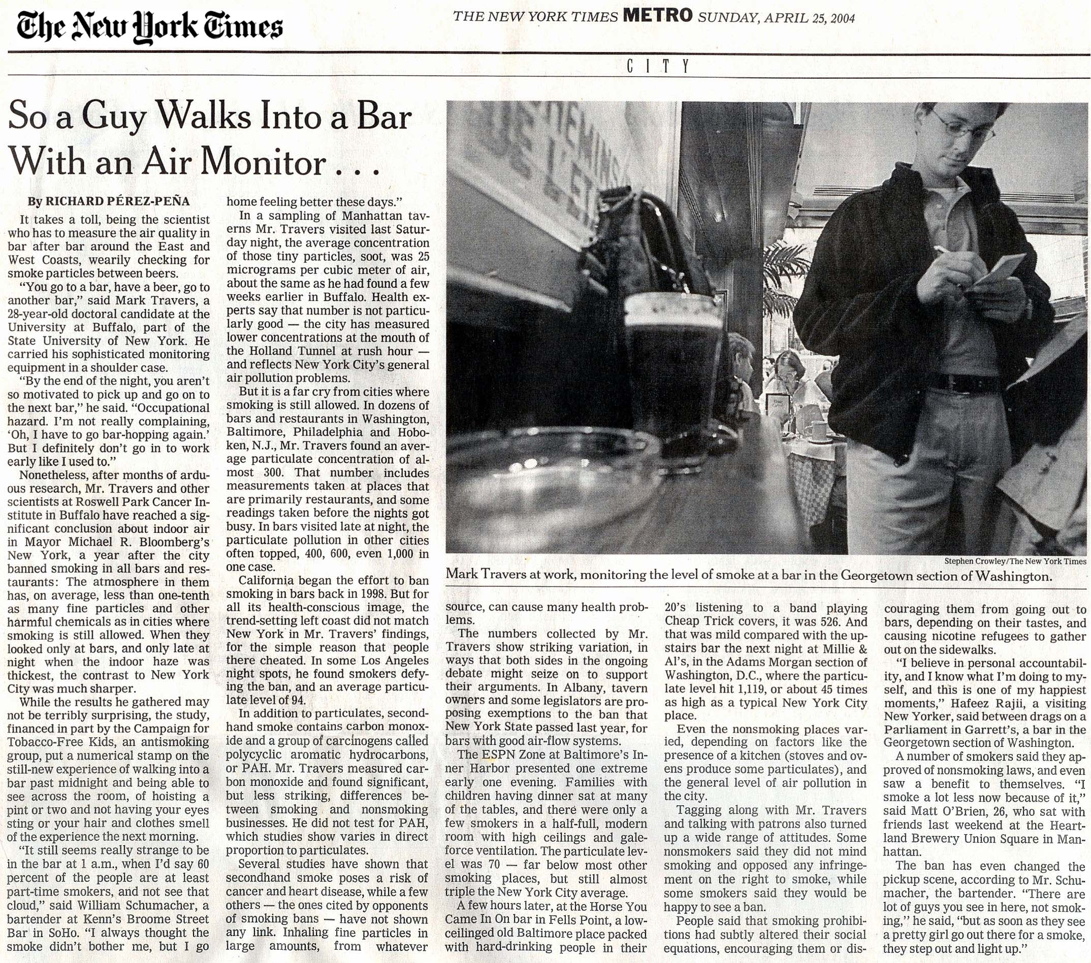
Air Quality Monitoring
First, a quick little history lesson
2004-2008
That helped build support for NC smoke-free restaurants and bars
2009-2010
Notes:
The Roswell Park Cancer Center in New York developed the protocol to monitor air quality used by NC tobacco prevention and cessation specialists.
A team from North Carolina was trained in this technology.

Slide 7
Notes:
This is what NC and the nation was facing at that time. NCGA leadership wanted data to show that the Tobacco Industry’s request for accommodation through designated smoking areas did not protect customers or workers.

Slide 8
Air Quality Monitoring
Particulate Matter 2.5 (PM 2.5) tracks secondhand smoke and e-cig aerosols in the updated models
PM2.5 measured with TSI Sidepak
Measurements taken outdoors before and after and between venues provide background levels of PM2.5
PM2.5 levels plotted over time
Average PM2.5 levels averaged in each venue as well as all background readings

Slide 9
Methods
Monitoring performed between 5PM and 9PM, Oct 12, 2005 in Raleigh, NC
12 bars/restaurants, >30 minutes in each
3 groups of operatives deployed to measure…
# people
# burning cigarettes and cigars
Room volume
Results averaged across multiple observations
Operatives acted as normal patrons

Slide 10
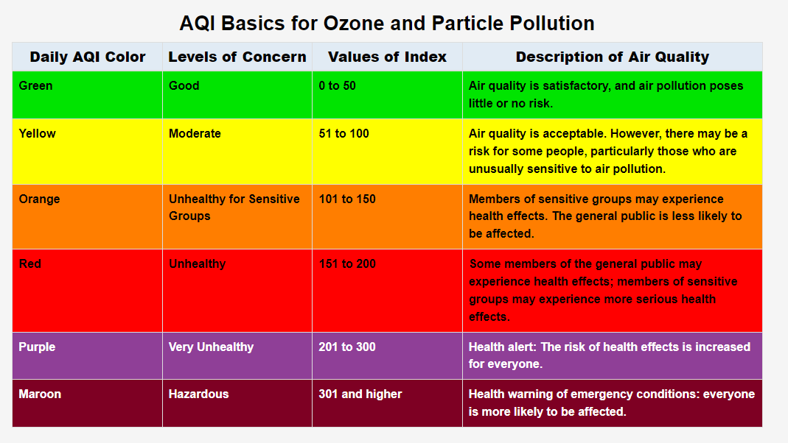
EPA Air Quality Index

Slide 11
Pilot in Raleigh
Outdoor
Average =6
Venue A
Average = 12.5
Venue B
Average = 656
Venue C
Average = 56
Venue D
Average = 793
24-hour PM_{2.5} standard (65μ/m³)
Credit: Scott Proescholdbell 2005-2006
Notes:
Venue B allows Smoking everywhere
Venue D has Smoking room and Nonsmoking Room - Monitor sat in Nonsmoking Room!!
Venue A is nonsmoking
Venue C allows smoking but few lit cigarettes

Slide 12
Action Items

Slide 13
What Can You Do?
If you want to protect employees, clients and businesses from migrating secondhand smoke from cigar bars:
Educate and inform your county and city attorneys
Educate the public and business owners – there is no safe level of exposure to secondhand smoke
Show rates of SHS exposure “too high” showing air quality monitoring in real-time
Compare rates of illness (sick days) to smoke-free places
Demonstrate strong public support and support from neighboring businesses

Slide 14
Tell us what you need from us?
Air Quality monitoring to respond to complaints on secondhand smoke/e-cig aerosol exposure
Guidelines on how to use air quality monitoring to protect clients, employees and businesses
Guidelines on how not to use air quality monitoring (e.g. a personal dispute between two parties in a multi-unit housing complex)
Information on how to purchase air quality monitoring equipment at the regional or local level.
What else?

Slide 15
Action Items Requested
Ask the TPC Branch to purchase at least 2 updated Air Quality Monitors to be used by Regional Manager and/or LHD designee and provide training on its proper use.
If you choose to add a Designee in addition to yourself on compliance, Please provide the Tobacco Prevention and Control Branch (TPCB@dhhs.nc.gov) with designee’s name, title and contact information.

Slide 16
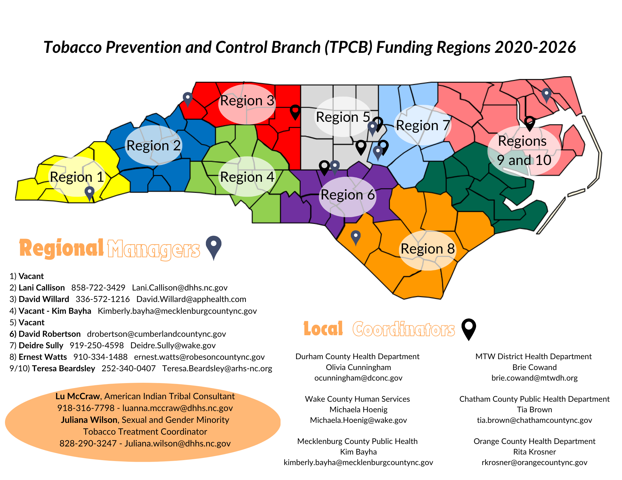
For TA on Cigar Bars:
Engage your Regional Manager
Who can access:
Kaycee Deen,
Agency Legal Specialist
Kaycee.deen@dhhs.nc.gov
Jim Martin
Director of Policy and Programs
Jim.martin@dhhs.nc.gov

