Slide 1
Epidemiology Section Updates
June 17, 2026

Slide 2

New NCIR Update
Recent Communications:
  New NCIR: Implementation Update (4/2/2026)
  NCIR Implementation: Readiness Checklist (5/19/2026)
  Data Exchange Onboarding Pause (5/22/2026)
Reminder: Last day for vaccine orders is 6/30/2026
Coming soon: Provider Training Registration
**Visit the NCIR website for updates / subscribe to NCIR Replacement emails to stay informed**

Slide 3
Ebola Traveler Monitoring
30 counties are conducting active monitoring
134 NC residents have returned from countries of concern since May 21st
No high‑risk travelers have returned to the United States, and no U.S. cases associated with this outbreak have been confirmed
https://www.cdc.gov/ebola/situation-summary/index.html

Slide 4
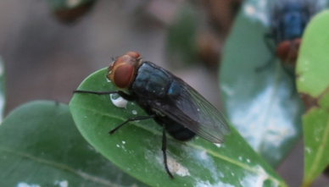
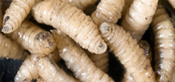
New World Screwworm
Larvae (maggots) of the fly Cochliomyia hominivorax
Hominivorax = “man eater”
Adult female fly lays eggs near a wound or mucosal surface
Larvae (maggots) feed on living tissue
Content from NCDA&CS

Slide 5
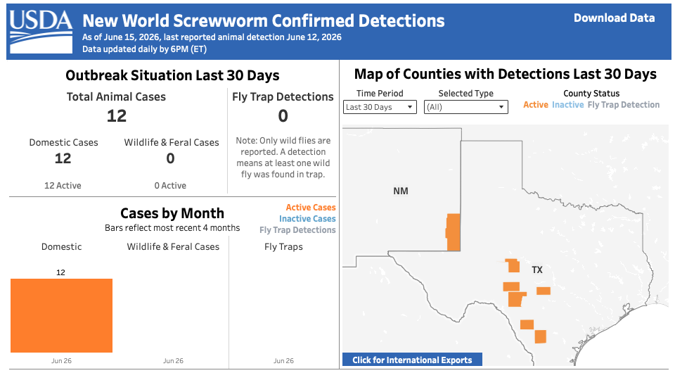
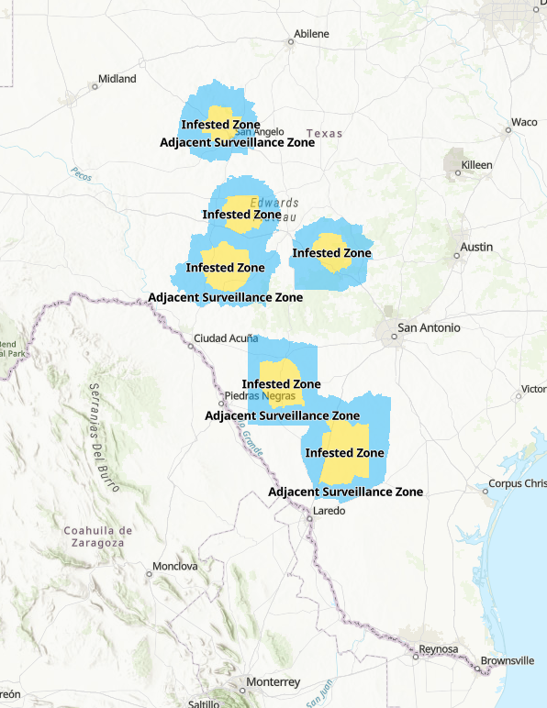


TAHC Zone Map
USDA Dashboard

Slide 6


New World Screwworm
NCDA&CS is lead response agency in NC
  See website and sign up for email alerts here:
See NC DPH memo for more information for healthcare providers:

Slide 7
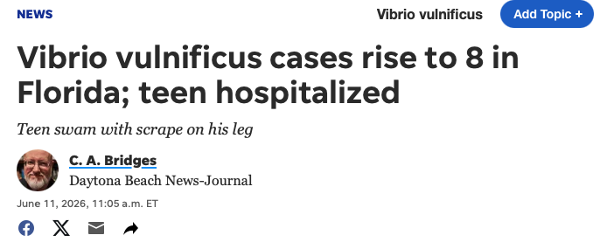

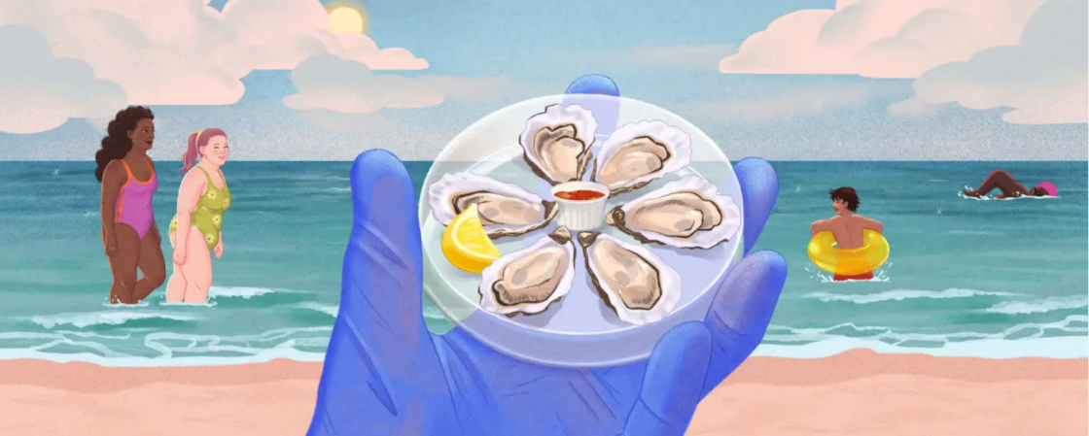
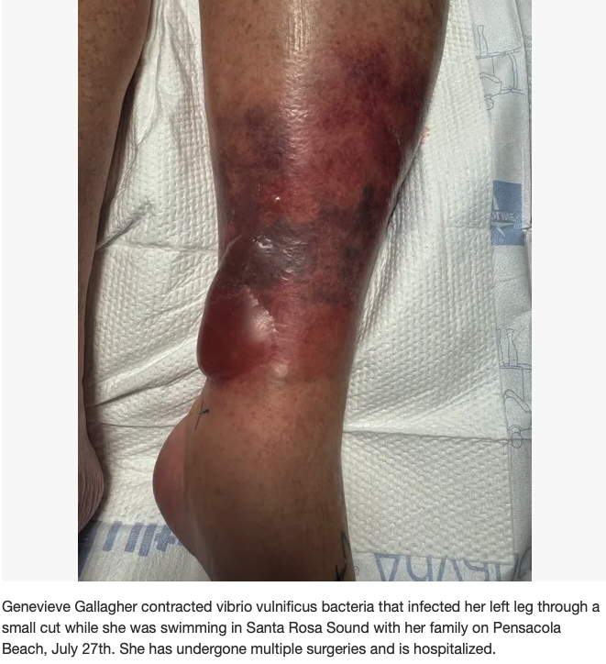
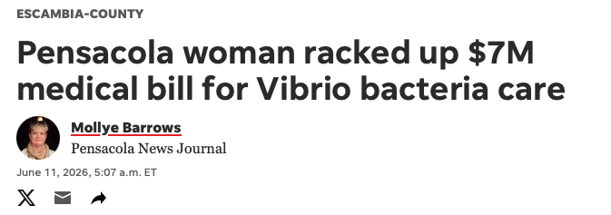
Vibrio vulnificus in the News

Slide 8
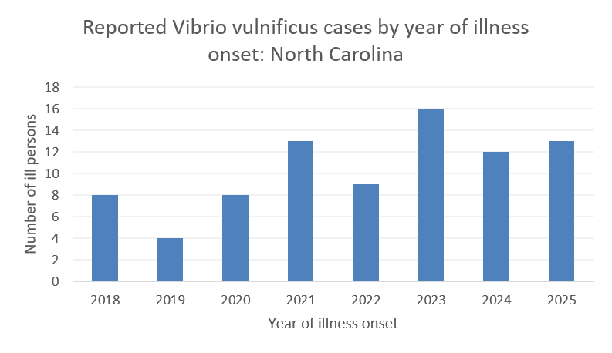
Vibrio vulnificus: NC Surveillance Data
Less than 20
Vibrio vulnificus cases are reported annually in NC. Vibrio vulnificus is a low volume pathogen.

Slide 9
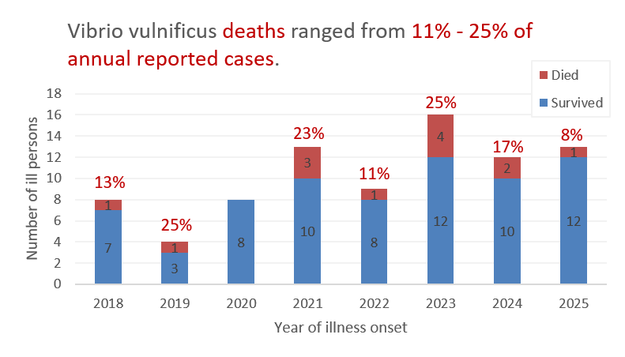
Vibrio vulnificus: NC Surveillance Data
Vibrio vulnificus is among our more severe foodborne / waterborne pathogens

Slide 10
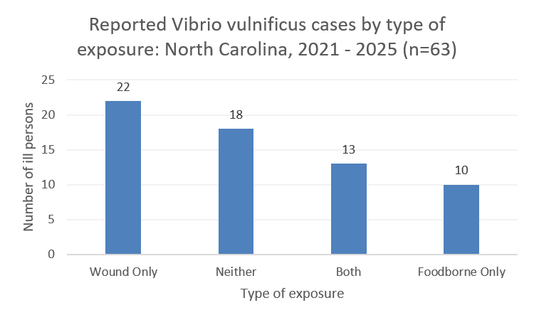
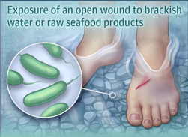
Vibrio vulnificus: NC Surveillance Data
Most Vibrio vulnificus cases were exposed from a wound
https://jamanetwork.com/journals/jama/fullarticle/2801603

Slide 11
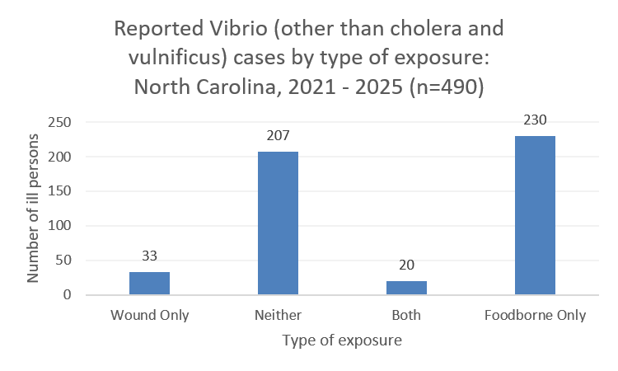
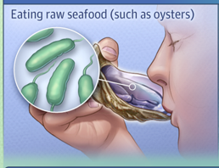
Vibrio (other): NC Surveillance Data
Most Vibrio (other) cases were exposed from food
https://jamanetwork.com/journals/jama/fullarticle/2801603

Slide 12
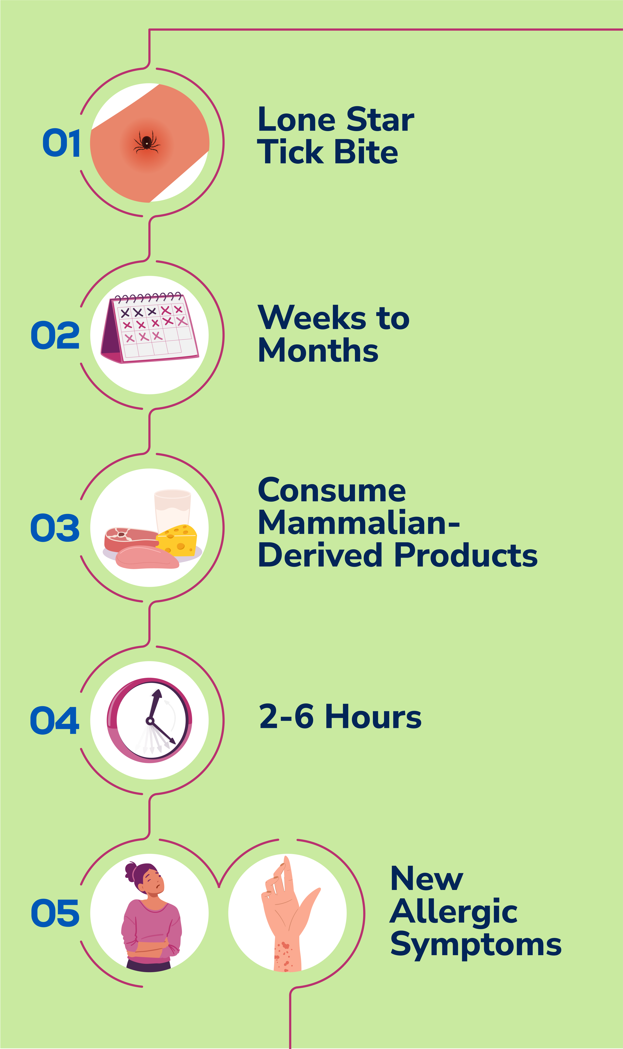
Alpha Gal Syndrome
Unique Non-infectious Tick-Borne Disease
A serious, potentially life-threatening allergy to the alpha-gal carbohydrate that can develop after a tick bite
Alpha-gal is present in the tissues of most mammals but not in humans
People with AGS can have an allergic reaction after eating red meat or being exposed to products containing alpha-gal
  Beef, pork, rabbit, lamb, venison
  Dairy products, gelatin, heparin, cetuximab
Arkansas was the first state to make AGS a reportable disease in September 2023
  Not reportable in North Carolina
Notes:
Weeks to months after a tick bite, new allergic symptoms will present following exposure to mammalian products, most commonly mammalian or "red" meat, such as beef and pork, but some people also react to things like dairy and gelatin.
People with alpha-gal syndrome can eat non-mammal meats, like fish or turkey.

Slide 13

Alpha Gal Syndrome Annual Meeting
You are invited to join the Vectorborne Team in Raleigh, NC to dive into all things Alpha-gal Syndrome!
This meeting will bring together experts on the clinical implications of the syndrome, patient advocacy, epidemiology and entomology.
Use the QR code to the right for more details and to sign up if you plan to attend (no registration fee).

Slide 14
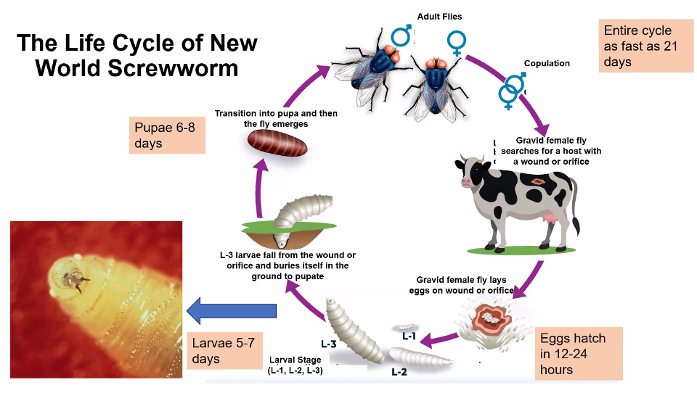
Notes:
•Female only breeds one time
•Fly activity between 64 °F and 91 °F
•Peak fly activity around 85 °F
•Pupal stage can extend up to 57 days (cool climate)
•Pupae are killed if soil temp consistently below 46 °F
•Prefer wooded areas but will seek out hosts in pastures
•Generally: fly within 2-mile range
•High host density, suitable environment
•Fly 2.5 – 12 miles
•Good weather, high host density
•Have flown 186 miles (300 km) when looking for favorable environment

Slide 15
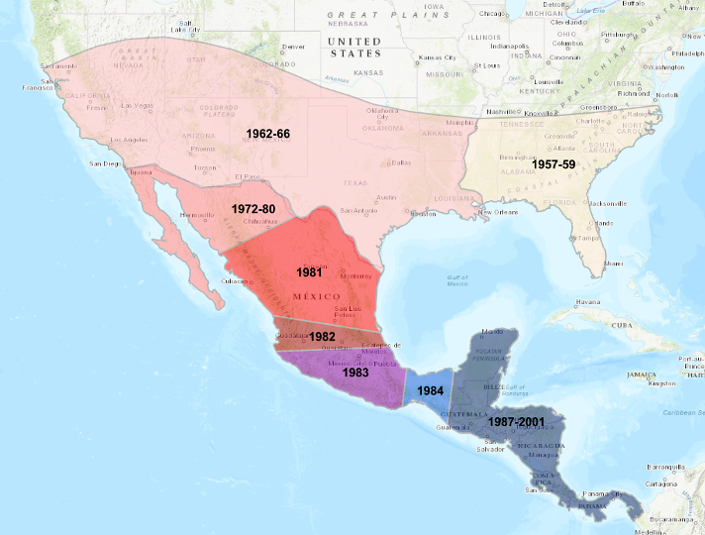
Eradication was Previously Achieved

Slide 16
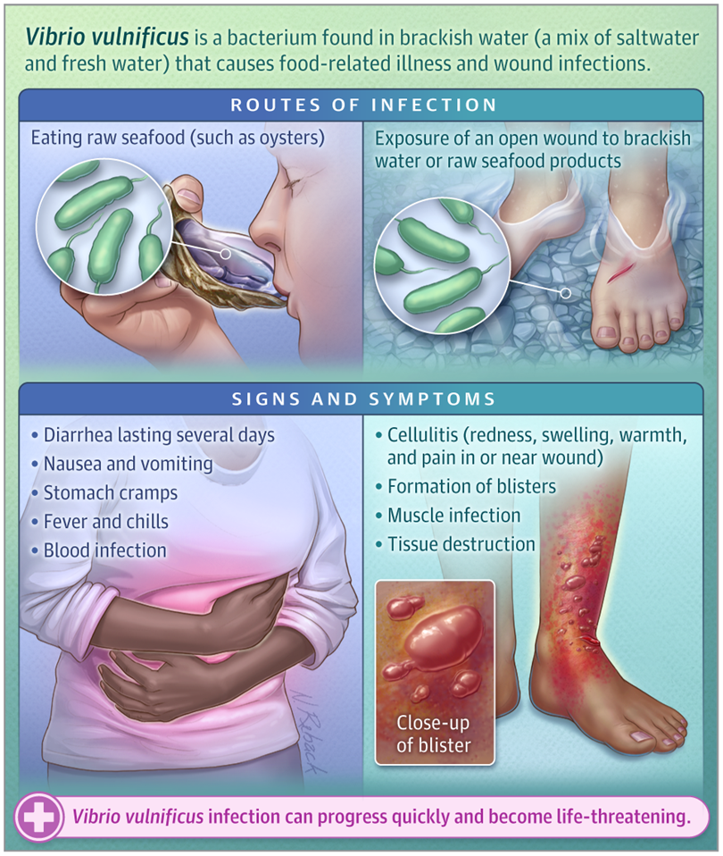

Who Is at Risk of Severe V vulnificus Infection?
Individuals at increased risk of developing severe V vulnificus infection include those with liver disease (such as cirrhosis), cancer, HIV infection, diabetes, or a certain blood disorder (thalassemia), and those who take immunosuppressants or medications to decrease stomach acid levels.
Infection Prevention
Food-related V vulnificus infection can be prevented by not eating raw or undercooked seafood and by use of gloves or careful handwashing after handling raw shellfish. Patients with open wounds (including recent surgery, skin piercings, or tattoos) should avoid contact with brackish water (no swimming or fishing) and should not handle raw seafood. Wounds or cuts that have been exposed to brackish water or uncooked seafood products should be washed thoroughly with soap and water to decrease the risk of infection.

Slide 17
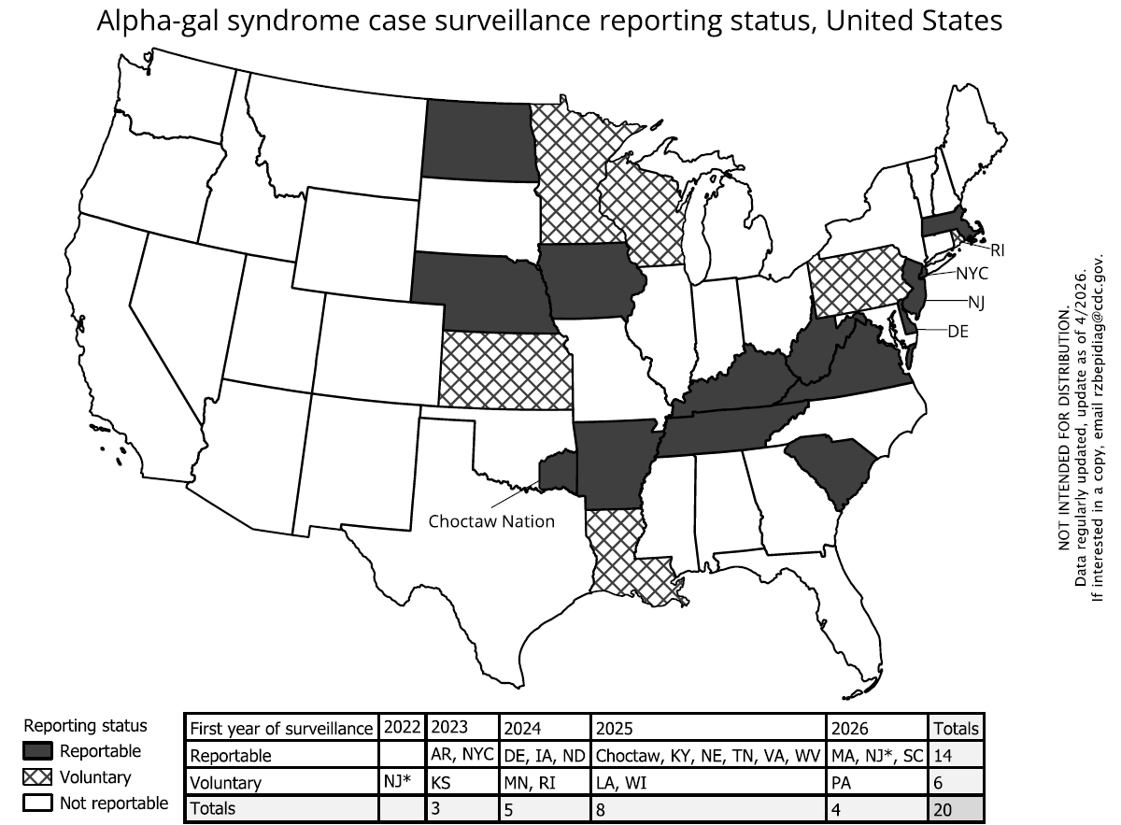
Jurisdictions with AGS surveillance
20 jurisdictions:
  14 reportable:
  12 states, 1 local (NYC), 1 tribe (Choctaw Nation)
  6 voluntary

