Slide 1
North Carolina Association of Local Health Directors (NCALD)
Monthly Association Meeting
Raleigh, NC
June 19, 2025
Lori Tremmel Freeman
Chief Executive Officer
NACCHO

Slide 2
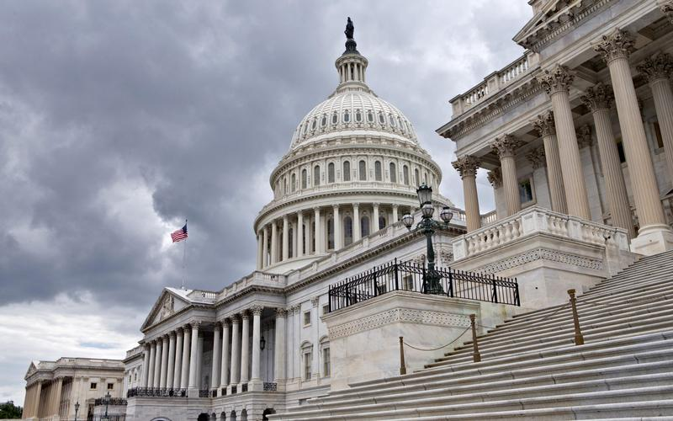
The Federal Landscape

Slide 3
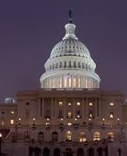
The Voice of Local Public Health at the Federal Level of the U.S.
Highlight the role of local health departments with members of Congress and the Administration
Increase understanding of role of local health departments in communities
Obtain federal funding to support local programs
Inform legislation that establishes and continues key (authorizing) federal programs
Nominate local health officials to federal advisory committees
Submit regulatory comments
Work in coalition to achieve mutual goals
@NACCHOAlerts
Notes:
NACCHO GA is your voice within Congress and the Administration. It is our job to amplify your message and the voices of 3,300 of your closest local health department friends on Capitol Hill.
You role in this is crucial. You are the subject matter experts to make sure we get things right. We want to make sure you’re receiving what’s most useful to you. Your work informs our work.
Highlight the role of local health departments with members of Congress and the Administration
Increase understanding of role of local health departments in communities
Obtain federal funding to support local programs
Inform legislation that establishes and continues key (authorizing) federal programs
Nominate local health officials to federal advisory committees
Submit regulatory comments
Work in coalition to achieve mutual goals

Slide 4
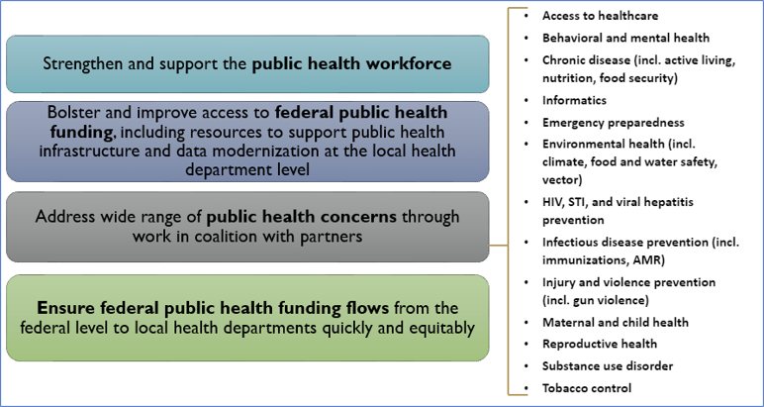
Why It Matters
External Affairs from Policy to Community
CDC Topline funding:
FY22:$8.4b
FY23: $9.269b
NACCHO 2025 Legislative Agenda
New Infrastructure fund: $550m
Public Health Loan Repayment Program
Congressional Language
Notes:
What guides us in our legislative work federally is a Board-approved yearly federal legislative agenda. This is 2024’s agenda and includes focus on:
Public Health Workforce
Public Health Funding to support infrastructure and data modernization AT YOU LEVEL of the governmental public health system.
Working in coalition on a range of public health topics that you see here.
Ensuring federal funding flows to local health departments quickly and equitably. It is NOT enough to fund the largest of our jurisdictions – they are critical but you leave out half the country and small, rural, medium, and even some of our largest cities.
TNACCHO and LHDs emphasized the needs of their local communities and called attention to three ways Congress can help:
Establish a public health loan workforce repayment program
Gained 15 new cosponsors and $25M included in FY23 House appropriations bill
Became law December 2022
Provide predictable, sustained, disease-agnostic funding to support core public health infrastructure
$200M appropriated in FY22 law; $350M in FY23
Ensure public health funding reaches local health departments equitably and efficiently
Directive language from Congress in FY22 appropriations about allocating funds to local health departments
hrough these efforts, we had success during the pandemic and CDC topline funding improved from $8.4b to $9.3b.

Slide 5
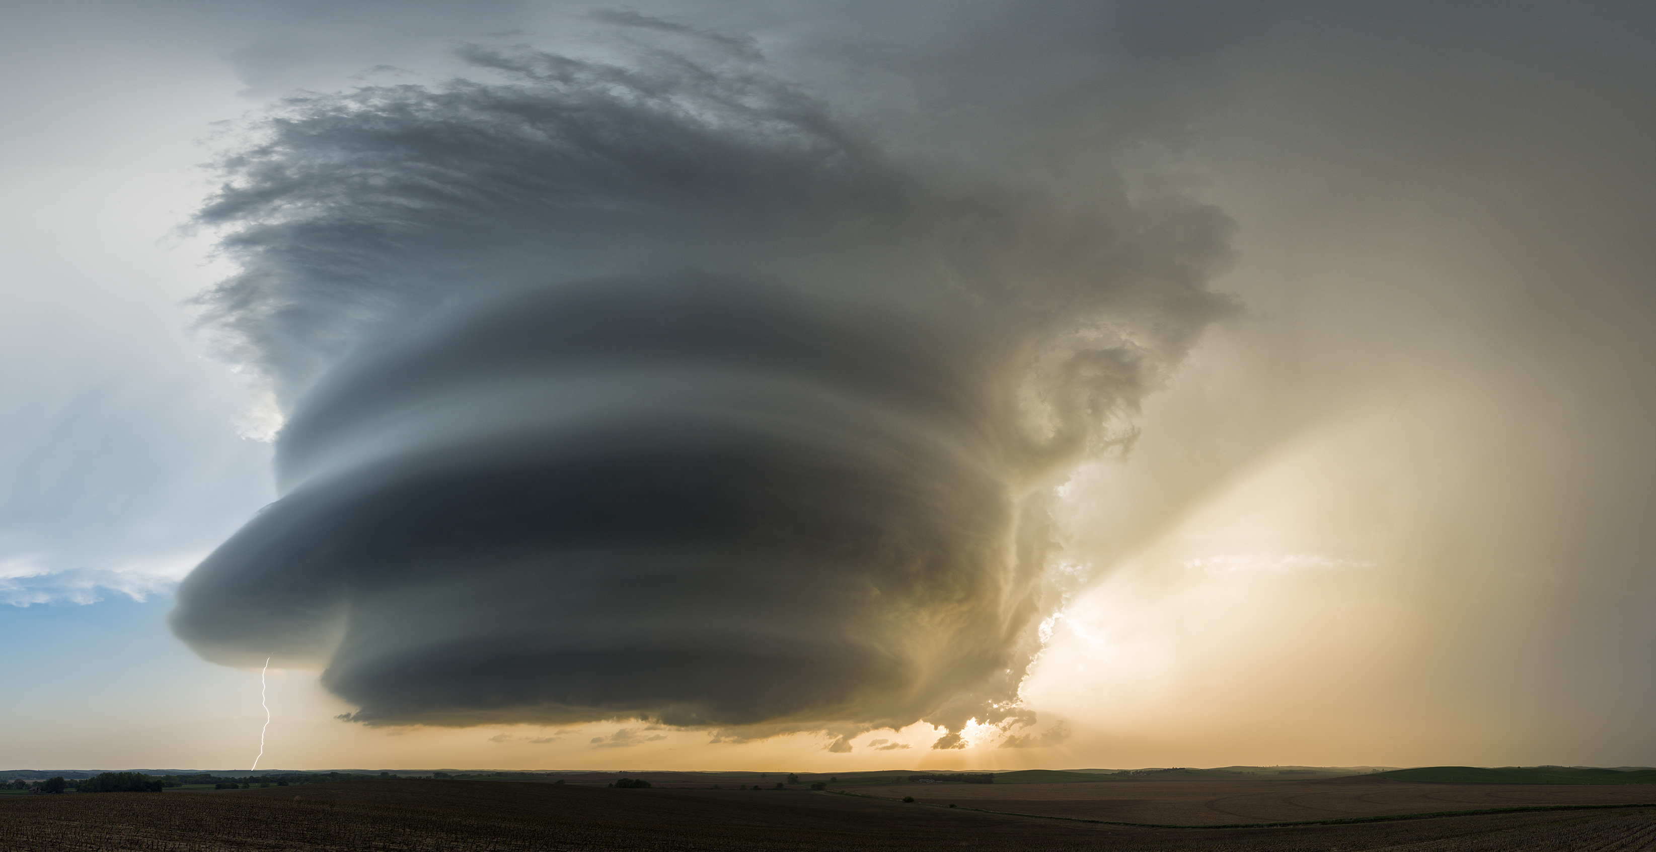
The Current Threat & Opportunity Environment in Public Health

Slide 6
Why It Matters
The Future (is NOW) – Active PH Threats
Federal Government/HHS/White House
HHS Reorganization
Workforce Reduction Impact
$11.4B COVID Recissions – Pocket Recission Tool by September?
Funding Uncertainty
Related agency impacts (FDA, EPA, CMS/Medicaid, DHS)
State and Local Health Department Impacts
Comprehensive, Widespread, Real Programmatic Impact
Ongoing Public Health Concerns
Measles – Over 1K US cases in 31 jurisdictions
Dengai Outbreak in PR
H5N1, MPOX, Oropouche, Screw Worm
Notes:
Federal Government/HHS/White House
HHS Reorganization
Workforce Reduction Impact
$11.4B COVID Recissions
Funding Uncertainty
State and Local Health Department Impacts
Comprehensive, widespread
Real Programmatic Impact
As of May 15, 2025, a total of 1,024 confirmed* measles cases were reported by 31 jurisdictions
Organized Response/Collective
24x7x360 Crisis Room / For Our Health / Protect Our Care / Coalition for Trust in Health and Science / Vaccine Integrity Project / PriorityONE / Americans for Healthy Communities
NACCHO Impacts – Reimagination of Local Public Health

Slide 7
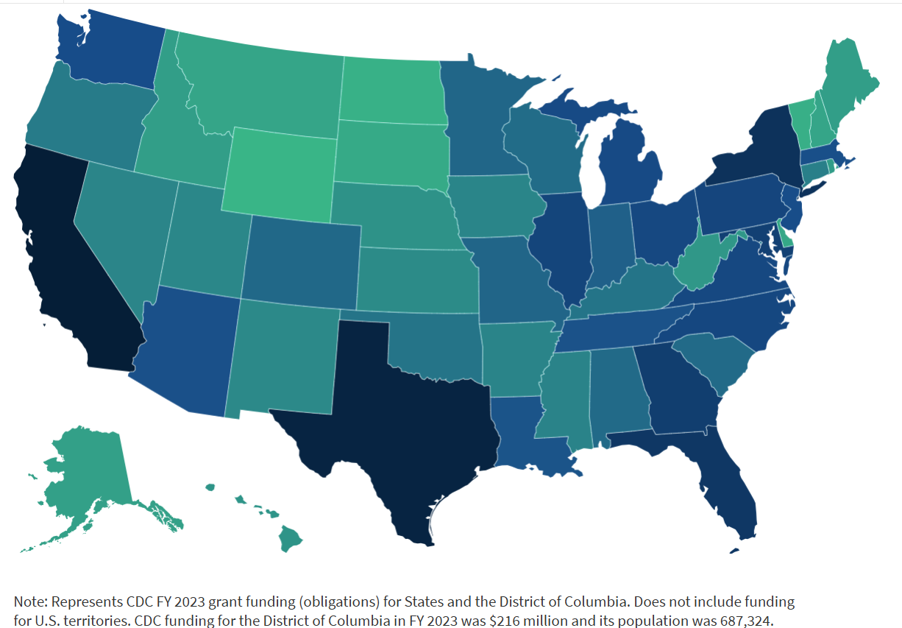
Why It Matters
The Current (NEW) Threat Environment

Slide 8
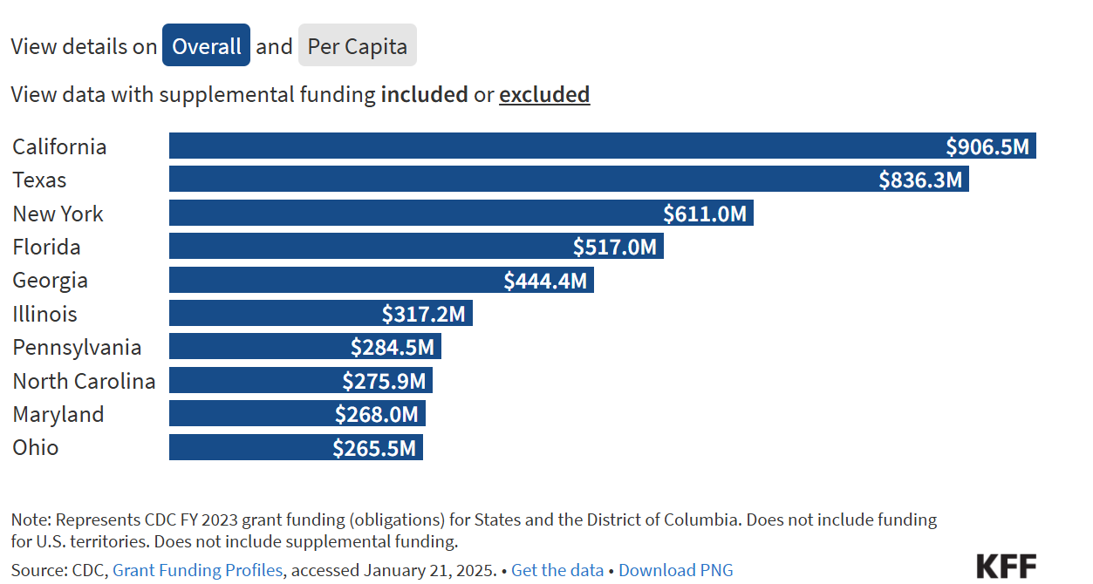
Why It Matters
The Current (NEW) Threat Environment
Notes:
By region, the South received the largest share of funding overall (43%) followed by the West (22%), Midwest (19%), and Northeast (17%). In per capita terms, the South remained the top funded region followed by the Northeast, West, and Midwest. With supplemental funding removed, the funding distribution is largely the same as is the per capita rank by region (see Figure 6).

Slide 9
Why It Matters
The Current (NEW) Threat Environment
Notes:
In FY 2023, the CDC discretionary budget was $8.28 billion, while mandatory budget totaled $6.97 billion. The exact amount of supplemental funding in CDC’s FY2023 budget is not clear.
However, CDC does report the amount of funds that it directs to state and local entities, which amounted to $14.9 billion in FY2023.

Slide 10
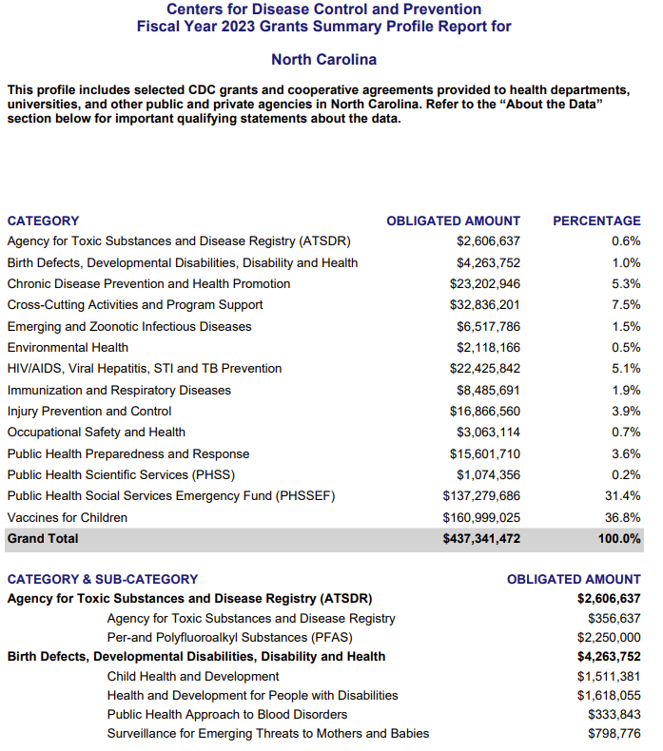
Why It Matters
The Current (NEW) Threat Environment

Slide 11
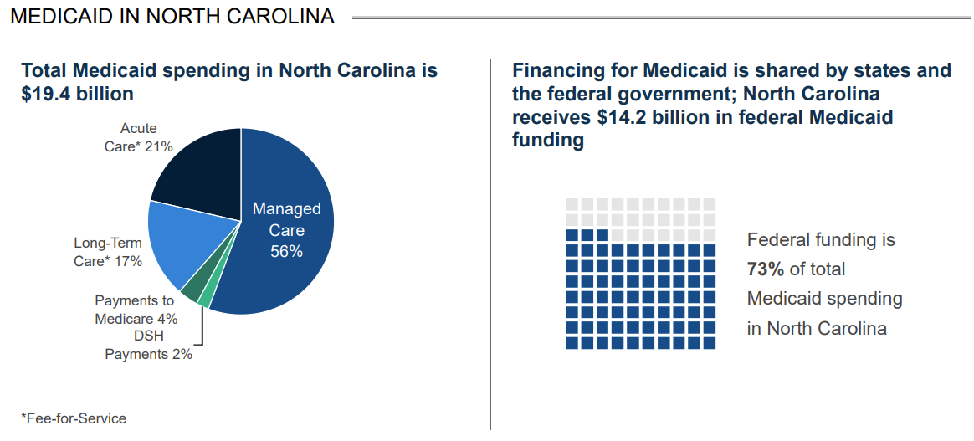
Why It Matters
The Current (NEW) Threat Environment
Notes:
Source: KFF analysis of 2024 Medicaid spending and enrollment data, U.S. Census Bureau 2024 Resident Population Data, U.S. Census Bureau 2023 Annual Survey of State Government Tax Collections, National Association of State Budget Officers (NASBO) 2024 State Expenditure Report, National Center on Education Statistics Digest of Education Statistics, K-12 Enrollment. See Methods of "Putting $880 Billion in Potential Federal Medicaid Cuts in Context of State Budgets and Coverage" for more information.Get the dataDownload PNG
This was a broad analysis of what proposed Medicaid funding impacts would be at the state level. On average, states would lose about 29 percent of their overall state Medicaid spending per resident – to the right is the data broken down by state and you can see that North Dakota would lose about $163M in federal funding equating to about $200 per resident or near that national average and 28% as a share of state Medicaid spending per resident.

Slide 12
Why It Matters
The Current (NEW) Threat Environment
Notes:
Row Labels North Carolina Grand Total RIF Notes** (RIF=RED)
Public Health Approach to Blood Disorders $ 389,104 $
Arthritis $ 1,210,000
Prevention Research Centers $ 1,000,000
Safe Motherhood/Infant Health $ 620,000 PRAMS; Hear Her, ART, Abortion Surveillance Report all eliminated
Social Determinants of Health $ 750,000
Tobacco $ 2,353,231
Tobacco - PPHF $ 533,334 $
Environmental and Health Outcome Tracking Network $ 710,000 $
Injury Control Research Centers $ 850,000 $
Injury Prevention Activities $ 116,401 $
Injury Prevention and Control Set-Asides $ 953,581 RIFed
Education and Research Centers $ 1,800,000 $
National Occupational Research Agenda (NORA) $ 678,163
Occupational Safety and Health Set-Asides $ 1,906,608
Other Occupational Safety and Health Research $ 1,101,426 $
Grand Total $ 336,068,666
Total RIF Impacts to North Carolina $ 12,111,659

Slide 13
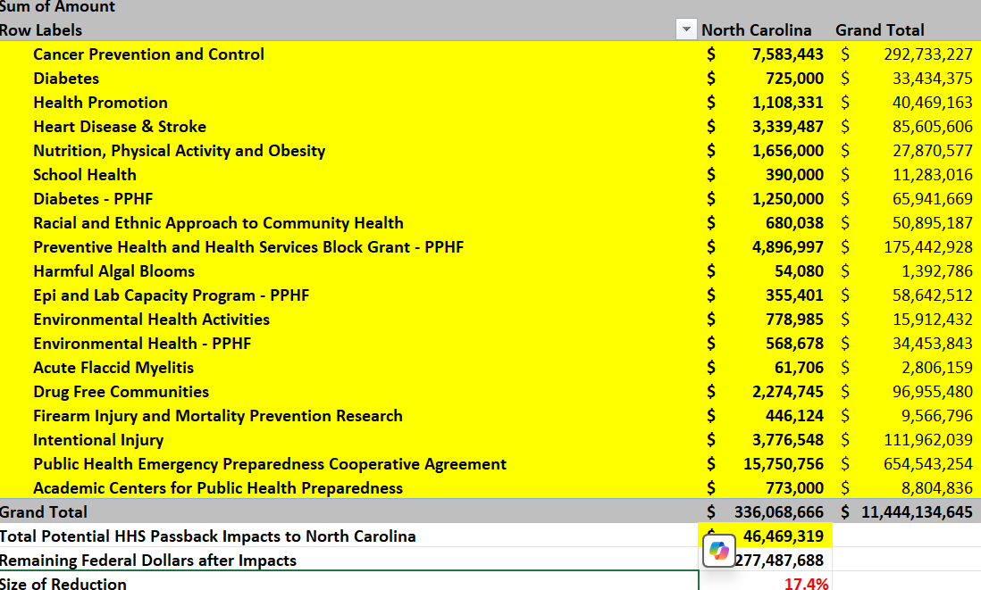
Why It Matters
The Current (NEW) Threat Environment
Notes:
Cancer Prevention and Control $ 7,583,443
Diabetes $ 725,000
Health Promotion $ 1,108,331
Heart Disease & Stroke $ 3,339,487
Nutrition, Physical Activity and Obesity $ 1,656,000
School Health $ 390,000
Diabetes - PPHF $ 1,250,000
Racial and Ethnic Approach to Community Health $ 680,038
Preventive Health and Health Services Block Grant - PPHF $ 4,896,997
Harmful Algal Blooms $ 54,080
Epi and Lab Capacity Program - PPHF $ 355,401
Environmental Health Activities $ 778,985
Environmental Health - PPHF $ 568,678
Acute Flaccid Myelitis $ 61,706
Drug Free Communities $ 2,274,745
Firearm Injury and Mortality Prevention Research $ 446,124
Intentional Injury $ 3,776,548
Public Health Emergency Preparedness Cooperative Agreement $ 15,750,756
Academic Centers for Public Health Preparedness $ 773,000

Slide 14
Why It Matters
The Current (NEW) Threat Environment
Notes:
The Data Project – Fired but Fighting

Slide 15
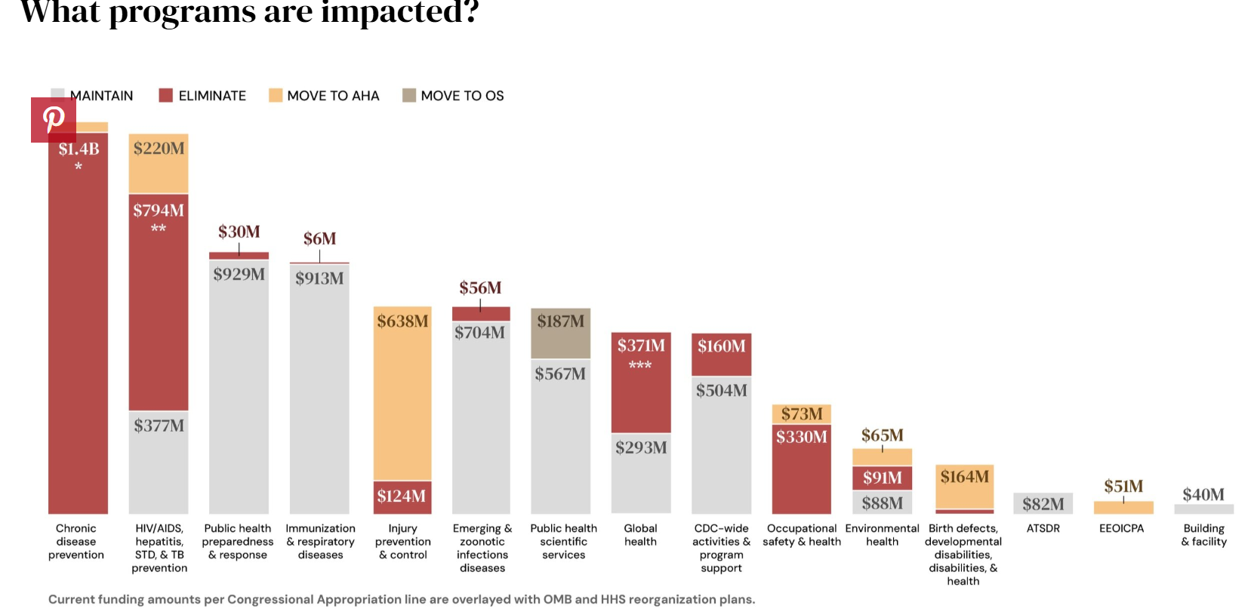
Why It Matters
The Current (NEW) Threat Environment
Notes:
The CDC Data Project
www.cdcdataproject.org
Former CDC Staff Members

Slide 16
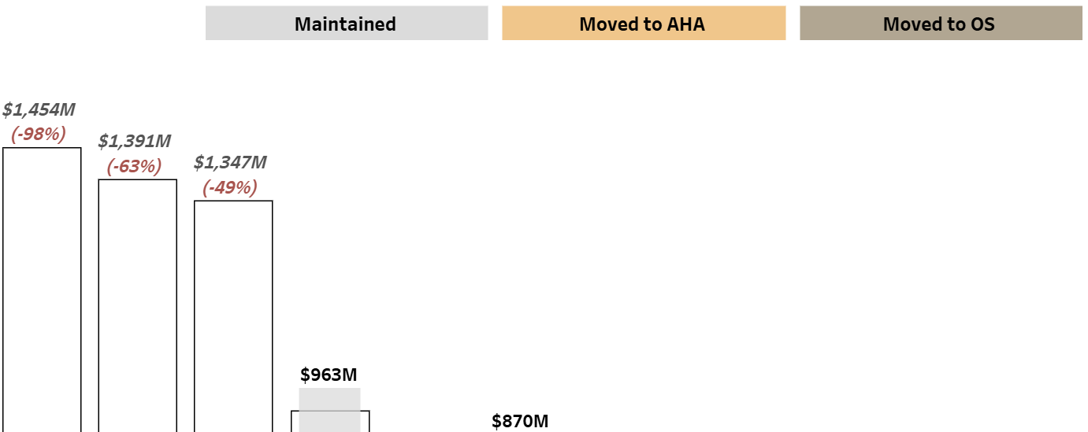
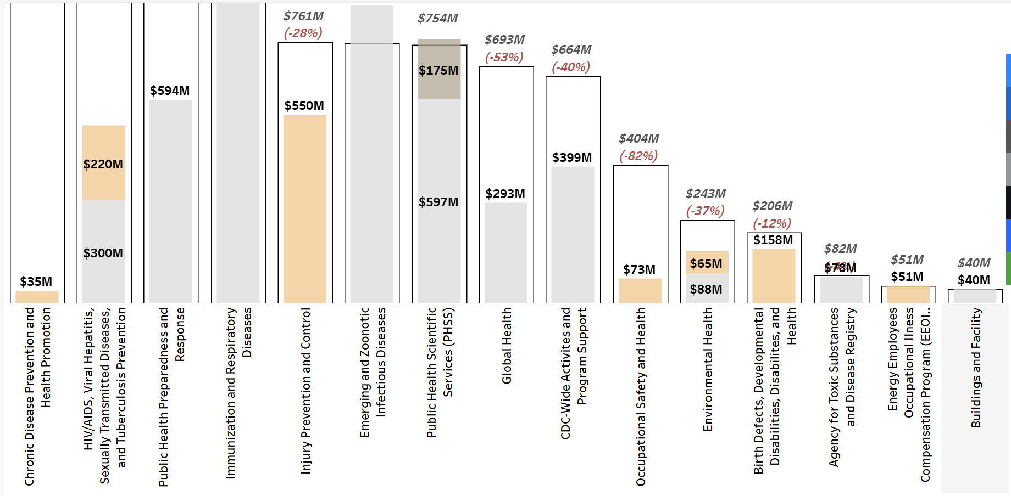
Why It Matters
The Current (NEW) Threat Environment
Notes:
Fired but Fighting – The CDC Data Project

Slide 17
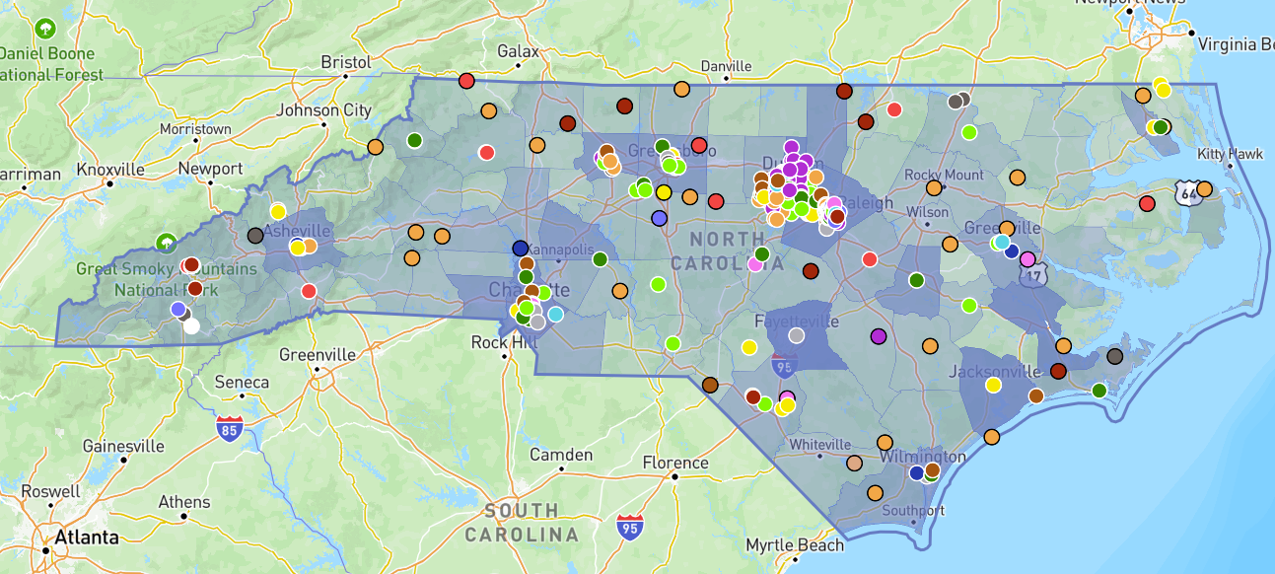
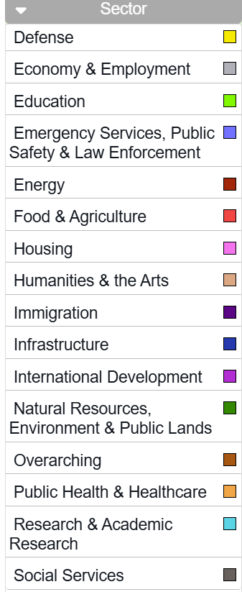
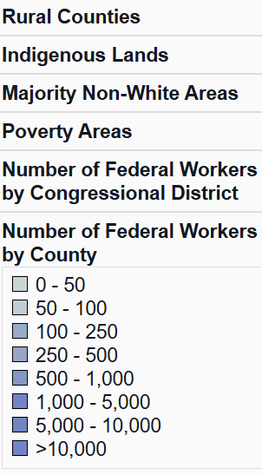
Why It Matters
The Current (NEW) Threat Environment
Notes:
Source – The Impact Map

Slide 18
Why It Matters
The Current (NEW) Threat Environment
Notes:
Source – The Impact Map

Slide 19
Why It Matters
The Way Forward
Organized Response/Collective
24x7x360 Crisis Room
For Our Health
Protect Our Care
Coalition for Trust in Health and Science
Vaccine Integrity Project / Northeast Public Health Collaborative
PriorityONE
Americans for Healthy Communities
Fired But Fighting
NACCHO
Coalition Work
Advocacy/Education
Funding to LHDs
Sharing of Information
Reimagining Local Governmental Public Health and Innovating in the Moment
Notes:
Organized Response/Collective
24x7x360 Crisis Room
For Our Health
Protect Our Care
Coalition for Trust in Health and Science
Vaccine Integrity Project /
PriorityONE
Americans for Healthy Communities
NACCHO
Coalition Work
Advocacy/Education
Funding to LHDs
Sharing of Information
Reimagining Local Governmental Public Health and Innovating in the Moment

Slide 20
Why It Matters
Watching…
Susan Monarez
ACIP this Week
AHA Conversations
NOFOs and NOAs
FY25 Funding Appropriated but Not Released – OMB Issue
POCKET RECISSIONS
A Note About Active Litigation
Notes:
Organized Response/Collective
24x7x360 Crisis Room
For Our Health
Protect Our Care
Coalition for Trust in Health and Science
Vaccine Integrity Project /
PriorityONE
Americans for Healthy Communities
NACCHO
Coalition Work
Advocacy/Education
Funding to LHDs
Sharing of Information
Reimagining Local Governmental Public Health and Innovating in the Moment

Slide 21
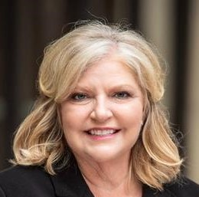
Thank you!
Lori Tremmel Freeman
Chief Executive Officer
National Association of County and City Health Officials (NACCHO)
1201 Eye St NW, 4th Floor
Washington, DC 20005
www.naccho.org
202.507.4271 Direct
lfreeman@naccho.org

