Slide 1

Perinatal Access to Care and Health North Carolina
Shannon Dowler, MD

Slide 2
What’s Old is New:
Shared Maternity Care
The “shared care” maternity care management model divides perinatal and postpartum care among two or more health care professionals.
Typically, the ambulatory care is separate from the inpatient component.
  An exception is when high risk pregnancy features require an earlier handoff to the delivering provider.
Historically, family physicians provided obstetrics care (this is an integral part of training) across geographies; as malpractice skyrocketed and rural hospitals closed and practices became hospital employed, this has become increasingly less common.

Slide 3
2026 March of Dimes Update
Maternity Desert and Low Access Counties
Low Access
Alexander
Bladen
Caldwell
Cherokee
Columbus
Davidson
Davie
Duplin
Edgecombe
Halifax
Harnett
Hoke
Johnston
Lincoln
Madison*
Pender
Person
Randolph
Rowan
Vance
Desert
Anson
Bertie
Clay
Currituck
Franklin
Gates
Graham
Greene
Hyde
Jones
Montgomery
Northhampton
Pamlico
Perquimans
Stokes
Tyrrell
Warren
Yadkin
In the 2026 data, there are 18 deserts, 19 low access and 1 moderate access counties.

Slide 4
July-December 2026
January-June 2027
December 2027-November 2028
December 2028- March 2029
July-November 2027
Project Mobilization
Implementation Phase 1
Implementation Phase 2
Evaluation & Dissemination
• Project leadership in place
• Baseline data completed
• Evaluation plan finalized
• Implementation infrastructure established
Subrecipient contracts executed
• 10 implementation sites selected
• Provider education launched
• Clinical infrastructure completed
• Sites prepared for implementation
Expansion and Sustainability
• Conduct comprehensive program evaluation
• Assess implementation success and barriers
• Evaluate maternal health outcomes, provider satisfaction, workforce development, and total cost of care
• Assess impact on maternity care deserts and low-access counties
• Develop implementation toolkit and sustainability roadmap
• Disseminate findings to funders, partners, policymakers, and health centers
• Launch Shared Maternity Care model at 10 FQHCs
• Launch ECHO learning collaborative
• Launch statewide communications campaign
• Coordinate Medicaid Managed Care outreach and value-added benefits
• Begin Family Medicine Residency Road Show and medical student outreach
• Implement patient engagement strategies and visit incentives
• Continue provider education and ECHO
• Continue communications campaign
• Continue workforce pipeline activities
• Expand patient incentives and care coordination
• Develop and launch Stage 1 postpartum innovations
• Launch Stage 2 postpartum interventions
• Expand mobile maternal health services where appropriate
• Launch virtual postpartum care and chronic disease management
• Continue quality improvement, data monitoring, and provider coaching
• Identify sustainability and enhanced reimbursement strategies
Track shared savings and value based arrangements

Slide 5
Your Partners for Success
 | Deliverable | Deliverable | Deliverable | What’s In It for You?
NCAHEC | FQHC Billing and Coding Guide | Host ECHO monthly x12 |  | Sustainability with early high integrity billing and coding. Optimizing Value Based Arrangements Supporting provider team with implementation and overcoming barriers
NCAFP | Launch a Residency Road Show to 18 programs x2 over 36 months | CME Session Winter meeting | Medical Student Workshop Session | Pipeline Development for the future Recruitment by making these opportunities more widely known.
AAFP | Develop CME Bundle | Develop Shared Care Deck | Award CME to member | Provider confidence to be updated with evidence based best practice
NNC | Coordination with Managed Care for members to receive perinatal value-added benefits without barrier | Launching consumer focused campaign | Launching CBO focused campaign | Optimizing all the “free things” your patients could benefit from but are not getting. Direct line to CMOs at managed care plans for issue resolution.
UNC Sheps | Design Evaluation | Research | Publish | Understanding what impact this model has and making it better and being part of it!

Slide 6
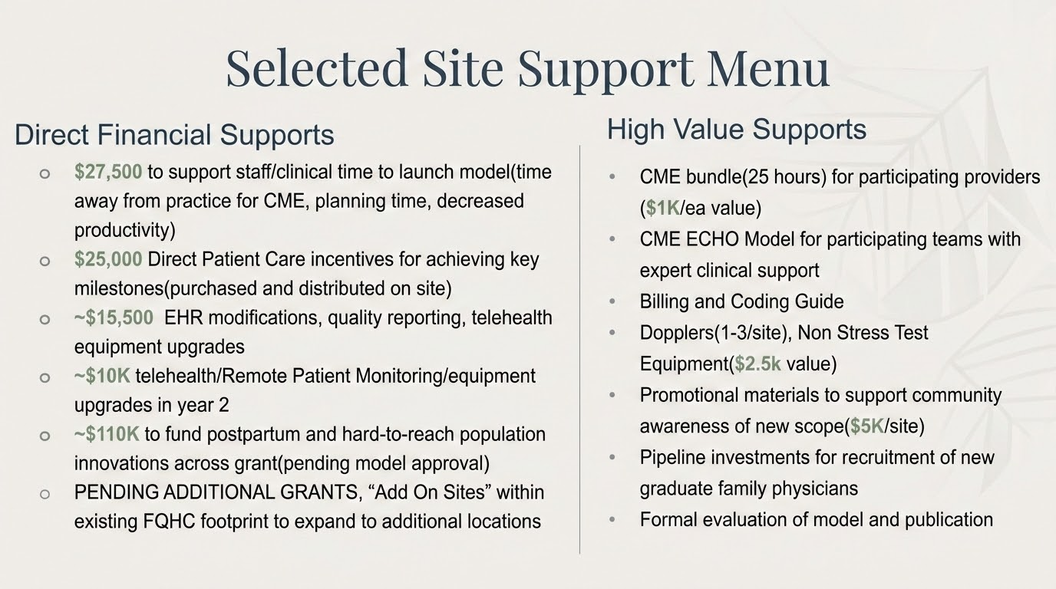
ELIGIBLE ENTITIES: Rural Health Center, Local Health Departments, FQHCs, FQHC-Look Alikes

Slide 7
Making it Bigger and Better:
NCCHCA Has Your Back
Public Funds
Private Funds
Working with NC DHHS and RHTP to shift dedicated IT/EHR/HIE funds to increase amount available to each site
Working with ROOT HUBs to fund coordinator positions to assist prenatal sites to coordinate with delivering partners
Several philanthropies have expressed interest in funding additional sites
NNC has asks out to use Community Benefit dollars to resource both hubs and spokes pending Medicaid approval
Menu of ‘enhancements’ being shopped to philanthropy to expand and reinforce sites

Slide 8
INTERSECTIONALITY
Linkage to existing maternity supports rather than creating new spend
Establishing solid relationships with community delivering hubs
Increase staff and provider satisfaction
Happy moms & babies
Incentive program
Ability to innovate
Expand your scope
Provide an unmet need for the community you serve
Increase earnings in shared saving and value based payments
More sustainable than ever with pending CMS billing changes 1/1/27
Strengthening your workforce knowledge base

Slide 9
Features of an ideal candidate for site selection:
A site in the low-access or desert counties where validated there is no or extremely limited access to prenatal care
Strong commitment to quality
Solid performance in value-based care and desire to mature your potential
Executive support and more importantly a modicum of enthusiasm
A physician champion excited to lead medically and champion excited to lead the effort operationally
potential sites in other counties and willingness to expand
A Delivering partner that is committed to shared success

Slide 10
So, what’s next?
The application is live at noon!
  https://www.ncchca.org/about-us/our-programs/patch-nc/
  20 questions in a survey monkey
  Teams should anticipate ~30 minutes to complete
  Executive sponsorship from your center happens BEFORE application
Application period August 14th-31st
Site Interviews will follow (mid-September)
Site Selection anticipated by September 30th
CME Resources Launch by November with rolling release of content through March
Goal for sites to start completing pregnancy visits Quarter 1 2027

Slide 11


