Slide 1

NC Local Reentry Councils (LRC)
Supporting successful reentry and barriers for the justice-involved and formerly incarcerated
Presented by:
Monica L. Artis, Transition Services Programs Manger
North Carolina Department of Adult Correction, Division of Rehab and Reentry

Slide 2
What is an lrc ?
Definition:
A Local Reentry Council (LRC) is a structured, community-based collaborative that supports individuals returning from incarceration by addressing barriers to successful reintegration.
Core Purpose:
Reduce recidivism
Increase public safety
Improve community stability
Connect individuals to coordinated services
Key Partners:
Community Supervision
Prisons
Workforce Development
Behavioral Health Providers
Housing Agencies
Community & Faith-Based Organizations

Slide 3
History of lrc’S in north Carolina
In 2010, the NC General Assembly created the Joint Select Committee on Ex-Offender Reintegration into Society, which designated NCDPS Reentry, Program and Services (RP&S) now known as NCDAC Rehabilitation and Reentry as the single state agency responsible for the coordination and implementation of formerly incarcerated reentry initiatives and the creation of Local Reentry Councils across North Carolina.

Slide 4
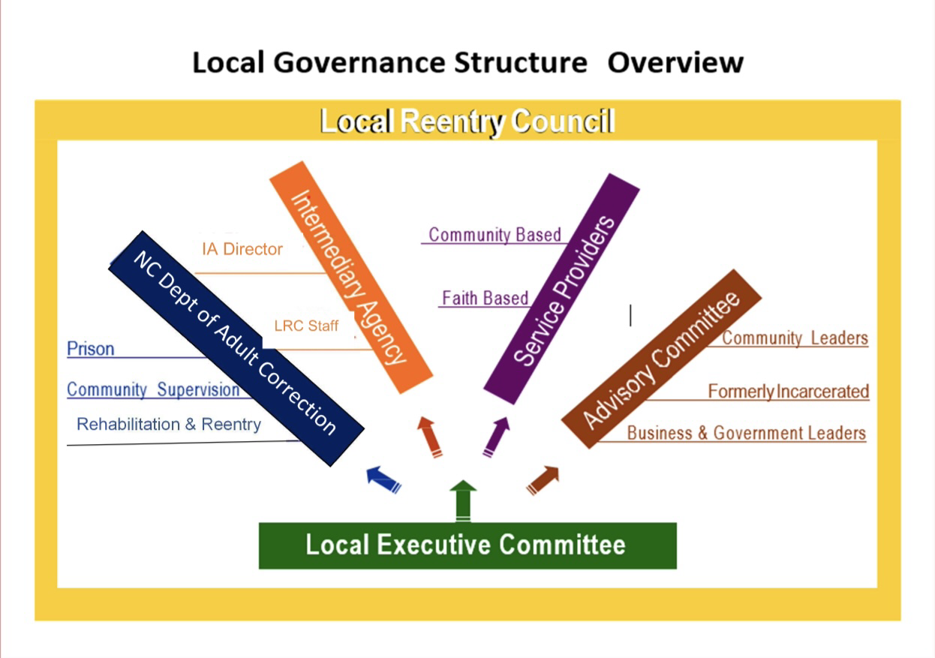
Components of the NC DAC
Local Reentry Council Model
Structured Governance
Standardized Case Management
Community-Based Intermediary Agency
Division of Community Supervision & Prison Collaboration
Data Tracking & Performance Monitoring
Regional Technical Assistance Support

Slide 5
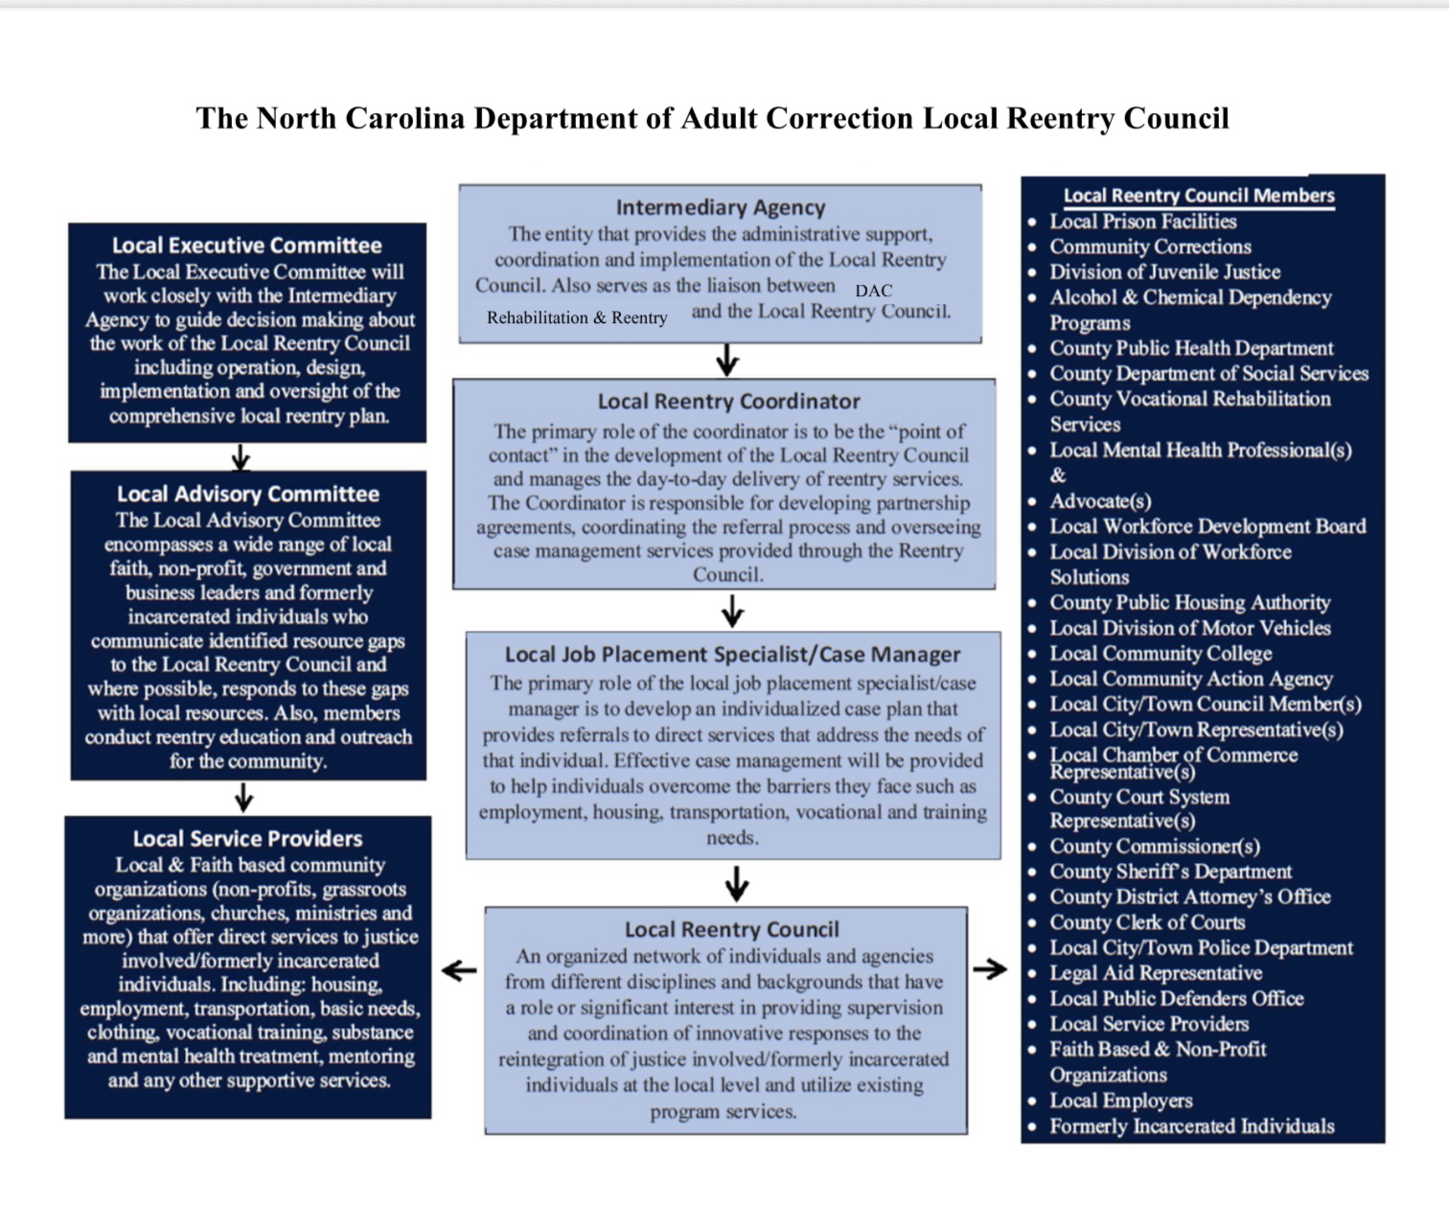
Local Reentry Council Model

Slide 6
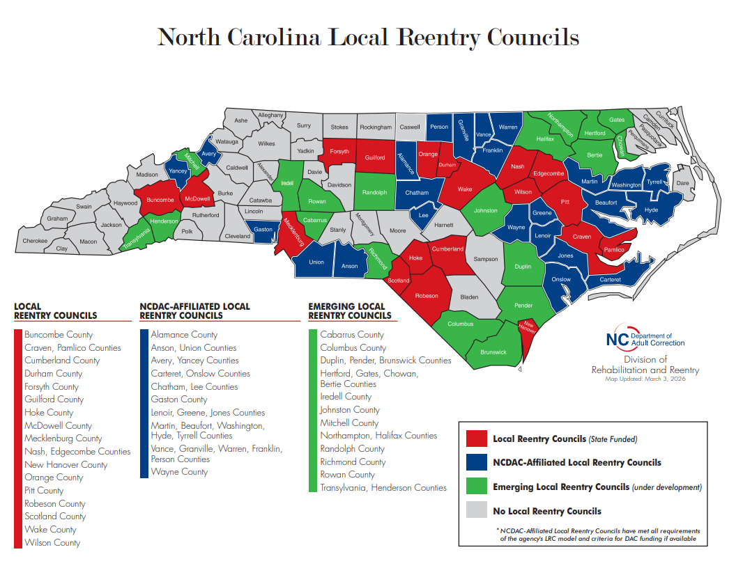

Slide 7
Reentry 2030
Executive Order 303 Government Goals
–Signed by Governor Roy Cooper January 2024 supported by Governor Josh Stein
  Improve economic mobility of formerly incarcerated people by increasing the number of local reentry councils and providing access to educational, technical training, apprenticeships, work-based learning and employment opportunities pre- and post-release.
  Improve mental and physical health by expanding access to behavioral health and substance use disorder service pre- and post-release
  Expand housing opportunities for formerly incarcerated
  Remove barriers to successful community reintegration, especially for those returning to underserved communities

Slide 8
Transition Services Plan to Support Reentry 2030 Expansion
Vision: Statewide LRC coverage across all 100 counties
Strategic Actions:
  Develop new LRCs in unserved counties
  Combine counties for regional resource-sharing
  Increase county-level engagement
  Strengthen sustainability planning
  Expand technical assistance capacity
  Build state agency collaborations
  Advocate for leverage funding within county and government agencies
Goal: Ensure every returning citizen has access to coordinated support, regardless of region.

Slide 9
How You Can Get Involved??
For State Partners:
Cross-agency collaboration through LRC participation/Memberships
Data-sharing partnerships
For Local Communities
Serve as the Intermediary Agency
Join an existing LRC
For National Partners
Share best practices
Participate in Reentry Events, Simulations and Conferences
Leveraging Funding
Attend NC DAC Joint Reentry Council Meetings
Provide workforce, housing, or other supportive services
Advocate for county-level support
Collaborare on evaluation and reserah
“Successful reentry strengthens public safety, families, and communities.”

Slide 10

Questions????

Slide 11
Contact OUR TEAM
Monica L. Artis
Reentry Services Programs Manager
Monica.Artis@dac.nc.gov
919-324-6411
Joseph Styles
Lead Technical Consultant, CDS II
Joseph.Styles@dac.nc.gov
919-866-3659
Shalishah Foster
Lead Technical Consultant, CDS II
Shalishah.Foster@dac.nc.gov
984-275-9343
Irene Lawrence
Community Development Specialist
Irene.Lawrence@dac.nc.gov
336-306-3587
Eric W. Haddock, Sr.
Community Development Specialist
Eric.Haddock@dac.nc.gov
919-866-3642
Tiffany Blackburn
Community Development Specialist
Tiffany.Blackburn@dac.nc.gov
(984) 255-6175
Ed Bonilla
Community Development Specialist
Ed.Bonilla@dac.nc.gov
984-220-8070

