Slide 1
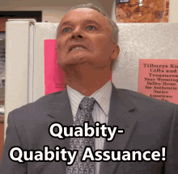
Environmental Health
Quality Assurance Committee

Slide 2
QA Committee
Section 4.7 of Session Law 2024-49
“All local health departments shall enter into an annual agreement with the Department to provide environmental health services in accordance with Chapter 130A of the General Statutes. The annual agreement shall include a requirement for quality assurance for all environmental health services.”
The “annual agreement” is interpreted as the Consolidated Agreement.

Slide 3
QA Committee
FY26 Consolidated Agreement:
By July 1, 2025, LHD will have developed a plan in partnership with the EH Section to develop QA plans for each of the following programs: Onsite Wastewater, Private Drinking Water Wells, Childhood Lead Poisoning Prevention, Tattoos, Public Swimming Pools, and Child Care and School Buildings.
By January 1, 2026, LHD shall submit these plans to the EH Section for review and approval.

Slide 4
QA Committee Formed
NCEHSA & NCALHD involved with choosing members:
Jon Fowlkes, DHHS
Brady Freeman, NCALHD, Iredell
Christine Rodite, NCEHSA, Gaston
Melissa Bennett, NCEHSA, Buncombe
Lisa Morgan, NCEHSA, Chatham
Dana Person, NCEHSA, Johnston
Ashley Blake, NCEHSA, Johnston
Paula Cox, NCEHSA, Guilford
Tracy Shinn, NCEHSA, Buncombe
Andrew Blethen, DHHS
Tammy Rodriguez, DHHS
Kimly Blount, DHHS
Chad Gambill, DHHS
Robert Pearsall, DHHS

Slide 5
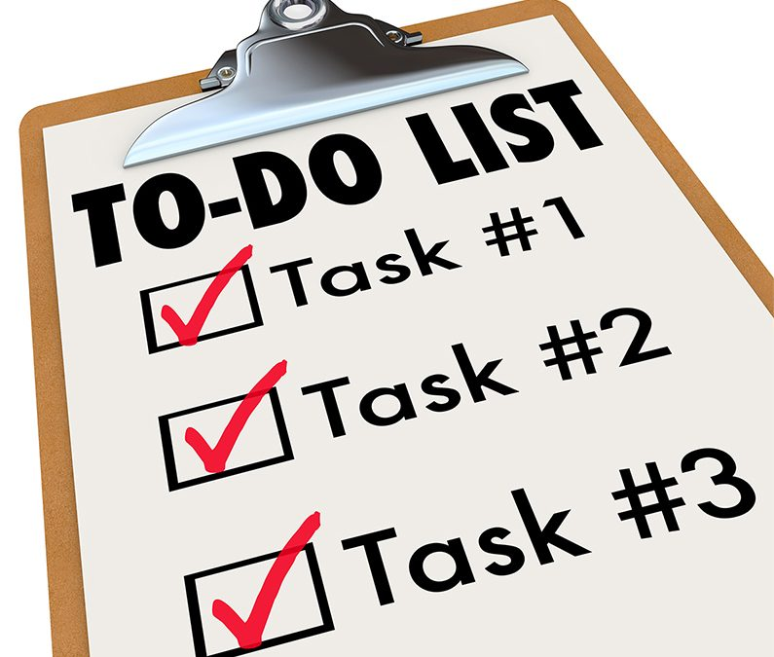
QA Committee
Tasks:
Form subcommittees for each EH area
Create timeline
Keep subcommittees on timeline
Review QA plans
Ensure consistency
Continuous review of plans and needed changes

Slide 6
QA timeline
At-a-glance
CREATION
SOFT ROLL OUT
Final edits
Hard roll out
FINAL REVIEW
Develop basic framework of QA policies and templates.
Present QA policies and templates to NCEHSA and NCALHD.
Make final edits to QA policies and templates based off feedback from NCEHSA and NCALHD.
Release QA policies and templates to LHDs. Provide any training as necessary prior to July 1.
Section review and approval of all LHD QA plans
Apr 1
May 1
May 31
June 2
JAN 1 2026

Slide 7
QA Committee
Goals:
Keep things simple
Keep similar templates for policies and plans for all EH areas
Work with our partners to ensure a good, solid product
Notes:
LHDs without QA plans in place currently can simply take our templates and use them. Or, any LHD can exceed what the QA Committee has proposed with their QA plans.

Slide 8
ON-SITE WATER PROTECTION QUALITY ASSURANCE

Slide 9
OSWP Program Policy Template
QA File/Field Assessment
III. Procedures
At least two (2) complete QA file/field assessments for both onsite wastewater permits ( Improvement and/or Construction Authorization Permits) and drinking water well construction permits shall be conducted of all staff that perform OSWP inspections annually. These file/field reviews should be conducted by a program specialist, supervisor or environmental health director, nothing prohibits the file/field review to include permits where both septic and well permits were issued for the same site to facilitate efficiency.
If the LHD has only one REHS authorized in the OSWP Program and there are no contract workers, or the LHD has no REHS authorized in either OSWP program and only utilizes one contract worker for the OSWP program, the regional SWIFT Team member may, upon their discretion, conduct the annual file/field assessments.
In addition to the “File/Field Assessments” field visits conducted with staff by the OSWP Program Specialist/Supervisor/EH Director for the purpose of assisting staff with difficult sites and to give second opinions can be used as QA and training activities to supplement the official File/Field Assessments.
Designate a QA Lead
QA File/Field Assessment
2 IP/CA & 2 Well Construction Permits/yr
QA File “Peer” Review
Daily review of permits, letters, documents
Goal is 100% reviewed
Can release w/o review if necessary
Regional Review
Will assist when there is only 1 REHS
Will review yearly submissions

Slide 10
OSWP Program Policy Template
III. Procedures
QA File/Field Assessment Cont.
Designate a QA Lead
QA File/Field Assessment
2 IP/CA & 2 Well Construction Permits/yr
QA File “Peer” Review
Daily review of permits, letters, documents
Goal is 100% reviewed
Can release w/o review if necessary
Regional Review
Will assist when there is only 1 REHS
Will review yearly submissions
Notes:
If a REHS authorized in the OSWP program does not conduct septic and well inspections (i.e. supervisor that does not perform inspections other than occasional inspections for training purposes) field assessments are not required for that REHS.
2) Contract workers are subject to the QA requirements of this policy

Slide 11
OSWP Program Policy Template
III. Procedures
“Peer” Review
Designate a QA Lead
QA File/Field Assessment
2 IP/CA & 2 Well Construction Permits/yr
QA File “Peer” Review
Daily review of permits, letters, documents
Goal is 100% reviewed
Can release w/o review if necessary
Regional Review
Will assist when there is only 1 REHS
Will review yearly submissions
OSWP, or “peer” QA file review is intended to provide a means for continual review of permitting activities to include the issuance of septic, well and ESA permits, denial letters, NOV’s, etc. Peer reviews can be completed by all OSWP staff authorized for those activities. The intent is to provide daily reviews of documentation to help ensure permits and correspondence are complete, meet laws and rules and provide all required information for the installation, construction and inspection of onsite wastewater systems and private drinking water wells. Site plans should be reviewed for completeness and that system components, facilities, well construction area(s), potential sources of contamination and other appurtenances are clearly shown, labeled and can be located off fixed points. Any concerns noted can then be addressed and corrected prior to issuance. The OSWP program needs to create and implement an internal means for tracking peer reviews, such as having the “reviewer” initial permits/documents, to ensure they are being conducted.

Slide 12
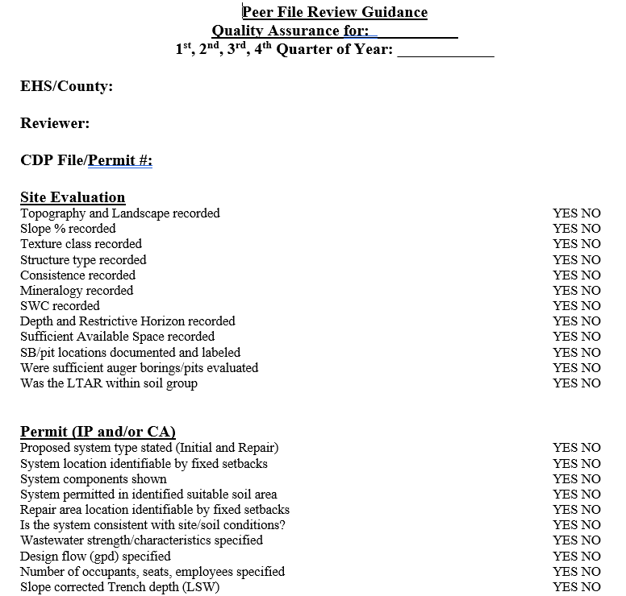
OSWP Program Policy Template
“Peer” Review Guide
Guidance when conducting “Peer” Reviews
IP/CA, ESA’s and Wells
“What to look for”
Not required to fill out form
LHD to “track” reviews
Can be used for training and QA
Staff engagement
Sharing of ideas & knowledge

Slide 13
OSWP Program Policy Template
III. Procedures
Regional Review
Designate a QA Lead
QA File/Field Assessment
2 IP/CA & 2 Well Construction Permits/yr
QA File “Peer” Review
Daily review of permits, letters, documents
Goal is 100% reviewed
Can release w/o review if necessary
Regional Review
Will assist when there is only 1 REHS
Will review yearly submissions
SWIFT Team Specialists with the NC Division of Public Health (DPH) OSWP Program will review the yearly submission of QA reports and documentation as required in Section V of this policy. SWIFT Team Specialists may also conduct periodic field assessments or file reviews in accordance with this policy and in accordance with DPH accreditation procedures.
Documentation of these assessments along with documentation submitted yearly by the LHD QA leader will become part of the LHD accreditation program review. The LHD may choose to incorporate file review and field assessment reports completed by the Regional Specialist as part of their required QA submission.

Slide 14
POOLS & TATTOOS QUALITY ASSURANCE

Slide 15
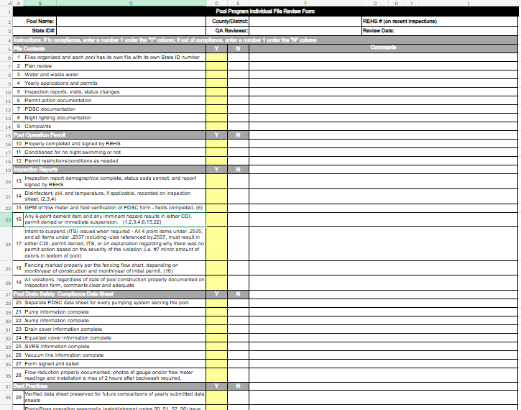
Pool Program QA Procedures
Designate a QA Lead
QA Field Assessment
1/yr on 50% of staff – max of 10/yr
QA File Review
Random selection
Focus is programmatic – not EHS
1 file year/10 permitted pools – max 10/yr
Regional Review
Will assist when there is only 1 REHS
Will review yearly submissions

Slide 16
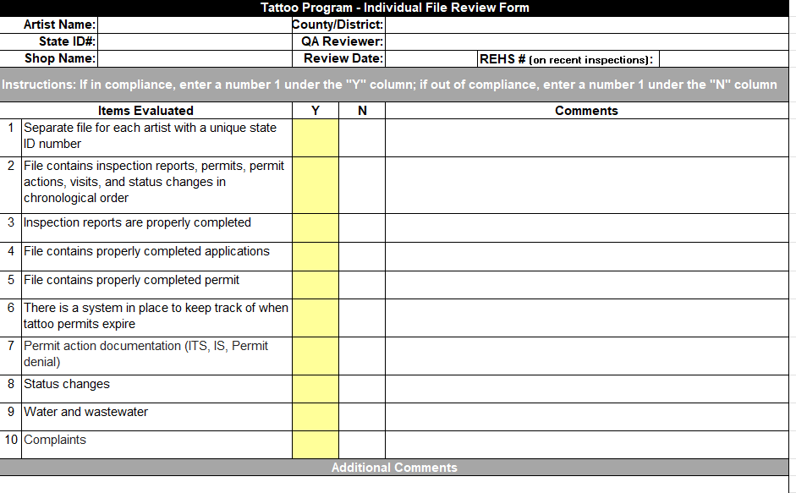
Tattoo Program QA Procedures
Designate a QA Lead
QA Field Assessment
Not required by policy template
May be conducted at the frequency determined by the LHD
QA File Review
Random selection
Focus is programmatic – not EHS
1 file year/10 permitted artist – max 10/yr
Regional Review
Will assist when there is only 1 REHS
Will review yearly submissions

Slide 17
LEAD & CHILD CARES QUALITY ASSURANCE

Slide 18
QA Development
CEH has been in the process of developing their QA Program. Created documents are being tested in the field during accreditation inspections and authorization inspections.
QA Committees for child care and school sanitation and the childhood lead poisoning prevention program have been formed to include CEH Staff county EHS supervisors and county EHS.
Counties: Buncombe, Chatham, Cumberland, Durham, Forsyth, Guilford, Haywood, Johnston, Mecklenburg, New Hanover, Wake,

Slide 19
QA Development
QA committees have created documents for Child Care and School Sanitation Program and the Childhood Lead Poising Prevention Program:
Policy Template
QA Summary Checklist
QA Field Assessment Form
QA File Assessment Form
Note: The LHD may choose to create polices or forms that include at least the minimum criteria as the policy/field assessment / file review forms provided by DPH. Submission of these forms to DPH Environmental Health Section is required.

Slide 20
QA Program for Child Care and School Sanitation Program
A CCSS quality assurance (QA) leader authorized and active in the CCSS Program shall be designated by the LHD. (“Active” is defined as an authorized REHS that inspects at least one child care and/or school during the QA period.)
At least one (1) QA field assessment shall be conducted per QA period on all authorized REHS actively conducting child care and/or school inspections during the year.
A file review shall be completed for each authorized REHS actively conducting child care and/or school inspections during the year.

Slide 21
QA Program for the Childhood Lead Poisoning Prevention Program
A CLPP Program quality assurance (QA) leader familiar with the CLPP program requirements shall be designated by the LHD.
At least one (1) QA field assessment shall be conducted for each REHS authorized in the CLPP Program and each REHS that is not authorized but conducting field program requirements within the CLPP Program.
At least one active file shall be randomly selected for file review for every 5 lead investigations completed with a maximum of 5 active files selected each year. (The lead investigation does not have to occur during the QA review period but shall be within the current accreditation cycle to be considered active.)

Slide 22
Thank you
Questions?
Jon K. Fowlkes, REHS
Deputy Environmental Health Section Chief
Division of Public Health
919 707-5875 office
919 538-5263 mobile (primary)
jon.fowlkes@dhhs.nc.gov

