Slide 1
Highly Pathogenic Avian Influenza A H5N1
February 19, 2025

Slide 2
Public Health Risk is Low
North Carolina has been managing Highly Pathogenic Avian Influenza (HPAI), aka H5N1 or “bird flu,” over the past several years
  Widespread in wild birds and has been causing outbreaks in poultry since 2022
  H5N1 has been detected in 24 species of wild mammal since May 2022
  U.S. dairy cows since spring of 2024
Current public health risk is LOW
  Low risk to general population
  Medium-high risk of exposure to commercial livestock workers and owners of backyard flocks
Monitoring closely with strong surveillance systems to detect H5N1 infections
Regular communication and partnership with state agencies (e.g., NC Dept of Agriculture and Consumer Services, NC DHHS) and federal agencies (e.g., USDA, CDC, and HHS)
Notes:
North Carolina has been managing Highly Pathogenic Avian Influenza (HPAI) or “bird flu” over the past several years.
Bird flu has been detected in birds –including commercial poultry – over the years and has been found to have spread to mammals.
While there is a threat of more widespread and severe impact on animal and human health, and other states have been affected more substantially, currently the threat to North Carolina and the general public is relatively low.
North Carolina is monitoring this closely and in regular communication and partnership with state agencies – including NC Department of Agriculture and Consumer Services, NC Department of Health and Human Services Public Health Division, Local Health Departments – and federal agencies including USDA, CDC, and HHS

Slide 3
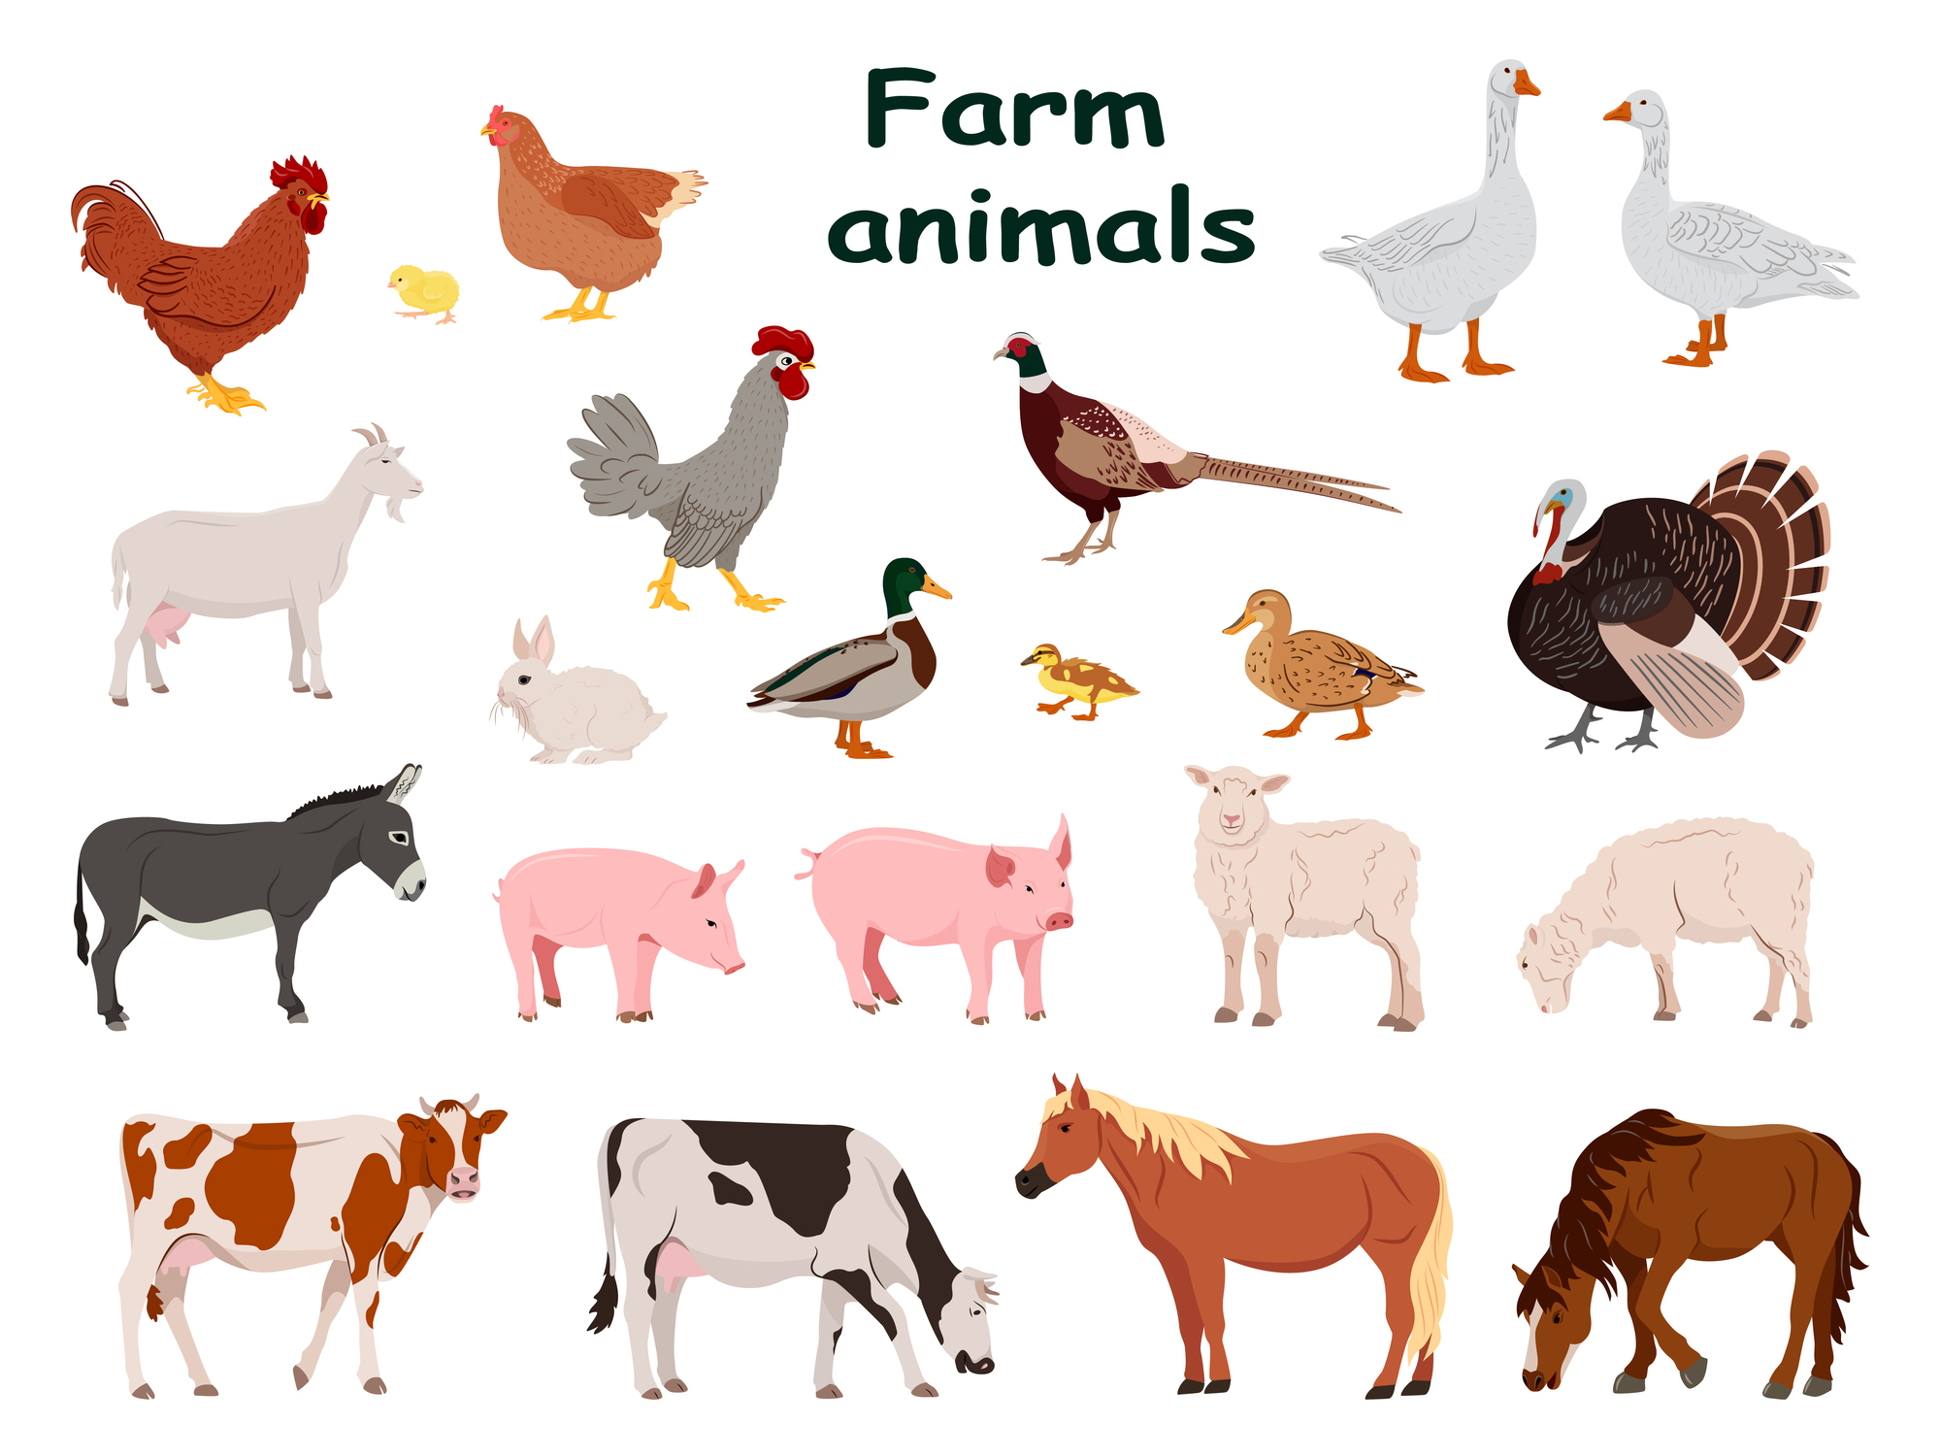

Human Infections in the US
National Landscape
41 cases associated with exposure to dairy cattle
1 Death
24 cases associated with exposure to poultry
No evidence of person-to-person spread
3 cases with unknown exposure (2 CA, 1MO)
https://www.cdc.gov/bird-flu/situation-summary/index.html
Notes:
CA – Large percentage of their herds and flocks positive – SOE in CA reflecting that. In NC, we have a much smaller presence of cows and no current positives. See slides in appendix for reference
LA – only death – associated with backyard flock – and a different variant than has been more widely circulating

Slide 4
H5N1 in North Carolina
2022—Present
14 commercial poultry operations
8 backyard flocks
5 bird rescues
1 commercial dairy herd
5 wastewater detections
No known human cases in NC
Notes:
Poultry – Hyde and Sampson are the latest. We had been deemed HPAI free in our poultry as of Thursday, April 25, 2024
Dairy cow – April 9, likely from Cow from TeXAs. HERD isolated. Serial Testing until all negative.
Wastewater detection – most recently in Durham this week, uncertain source. Other detections were last spring in Charlotte, Buncombe, Winston-Salem, and Greensboro
Bird rescue was a raptor rehabilitation center

Slide 5
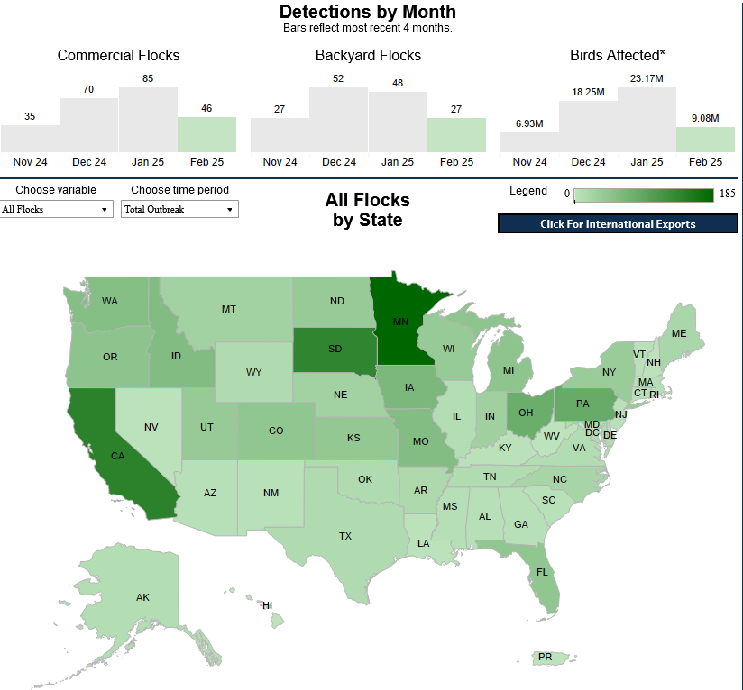
Updated February 18, 2025
50 Affected States + PR
30 states in the last 30 days
1,582 Confirmed Flocks
151 confirmed last 30 days
51 in OH last 30 days
>160M Birds Affected
https://www.aphis.usda.gov/livestock-poultry-disease/avian/avian-influenza/hpai-detections/commercial-backyard-flocks

Slide 6
H5N1 HPAI NC 2025 –
Positive Commercial Flocks
Jan 6, 2025 - Hyde 01
  3,314,894 birds, 13 houses, table egg layers/pullets various ages
Jan 24, 2025 - Sampson 01
  1,856 birds, 1 house, turkey breeder replacements, 30 wks
Jan 25, 2025 - Sampson 02
  24,441 birds, 11 houses, turkey breeders, 30 wks

Slide 7
Avian Influenza –
Peacetime/Outbreak Surveillance
Reasons for testing
  National Poultry Improvement Plan
    Meat birds prior to processing
    Breeders/layers periodically
    Category E (backyard/independent flocks – PCR)
  Shows/fairs/exhibitions/shelters
  Disease investigation – subsidized
After premises confirmed positive:
  Epi-linked poultry farms tested within 24 hours
  Commercial poultry farms within 3km tested within 24 hours
  Commercial poultry farms 3-10km radius tested within 48 hours
  Permitted movement only after ALL farms are tested
Additional surveillance may be implemented based on collaboration between USDA, state, and industry

Slide 8





Novel Influenza Surveillance
Emergency Department Surveillance
Hospital-based Surveillance
Wastewater Monitoring
Virologic Surveillance
Surveillance of Rabies Negative Cats
Elements of North Carolina’s Influenza Surveillance Program
Notes:
Just talk over highlights of each method e.g., we get a feed from all the emergency departments across the state to see trends in respiratory like illness to detect unusual trends –more details in the appendix of each surveillance element if interested

Slide 9
Other Capabilities for H5N1
Testing
NC State Lab of Public Health
Commercial - Labcorp, Quest Diagnostics, and Associated Regional and University Pathologists
Treatment
Oseltamivir (Tamiflu®)
Vaccine
No vaccine specific to H5N1 currently
CDC has developed H5 candidate vaccine viruses that could be used to produce a vaccine for H5N1, if needed
Seasonal flu vaccines do not provide protection against H5N1, but can potentially help in slowing genetic mutations of viruses

Slide 10
Monitoring of Individuals through 2024
Individuals Monitored 2022—2024 | Symptomatic Individuals Tested 2022—2024 | Individuals Positive for Influenza A H5 2022—2024
274 | 7 | 0
Individuals with known exposures to infected animals, including
    Commercial poultry operations
    Depopulation (and composting) NC crews deployed to other states
    USDA and NCDA&CS workers
    Backyard flocks
    Animal rescue
    Dairy herd
10-day symptom monitoring
Expedited testing if symptoms develop
  Home isolation
  If positive, treatment and guidance for contacts

Slide 11
2025 Commercial Poultry Responses
221 workers to be monitored. Reached 82%
23 workers reported symptoms determined to be consistent with novel influenza
20 workers with specimens collected
  20 workers with testing completed – negative for H5N1
  10 workers tested positive for Flu A
5 health departments tested (Hyde, Beaufort, MTW, Pitt, and Sampson)
Notes:
Of the 193 workers, some were from the Farm, others were contract workers to do the depopulation
4 health departments tested, but 6 were involved all together

Slide 12
What to Expect
Poultry Management
Testing
Specimen collection kits pre-positioned
Expedited transportation and testing at State Lab of Public Health
Medical Countermeasures
Rabies submitted cats
Enhanced Surveillance
Standing order template to assist with prescribing process
Worker Monitoring
SNS dispensed oseltamivir for last resort use
Subtyping of flu A positive wastewater results
Done by LHD or CCNC per LHD preference
Daily or intermittent monitoring
Depopulation of flock
Testing of surrounding and epi linked flocks
Notes:
Depopulation ended between 1/17 for Hyde and 1/26 for Sampson. Composting windrows complete in Hyde on 2/11 and 8 of 9 windrows completed in Sampson as of 2/12.
Testing. Several health departments offered night and weekend clinics for workers who needed testing.

Slide 13
Looking forward
Risk - Viral change
  Currently, per CDC, no concerning virologic changes actively spreading in wild birds, poultry, or cows that would raise the risk to human health
  However, could be a concern if virus changes to cause more severe illness, human to human spread, medications not effective, or significantly different than vaccine primer
  Seasonal influenza vaccination not protective of H5N1, but can prevent co-infection with novel and seasonal influenzas which could reduce chance of virus changes. Recommended for everyone 6 months and older

Slide 14
Outreach to Veterinarians
DPH is working jointly with NCDA&CS and the NCSU CVM
  Guidance on when and how to collect specimens for cat testing
  How to manage cats suspected of being infected
  Distribute through NCVMB to reach all veterinarians with a NC license
  Guidance will reinforce adherence to protective measures

Slide 15
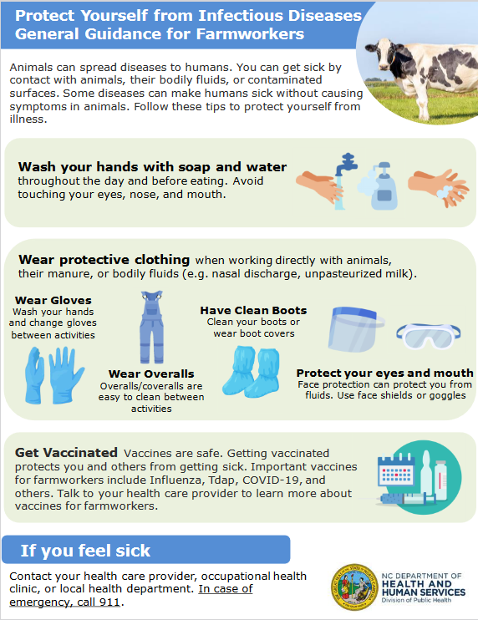
Information at flu.nc.gov
English and Spanish
Public Education
https://flu.ncdhhs.gov/HPAI/index.htm

Slide 16
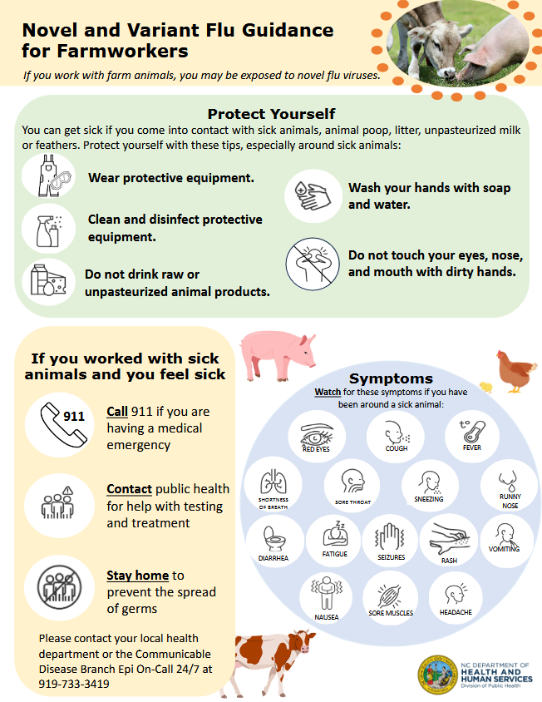
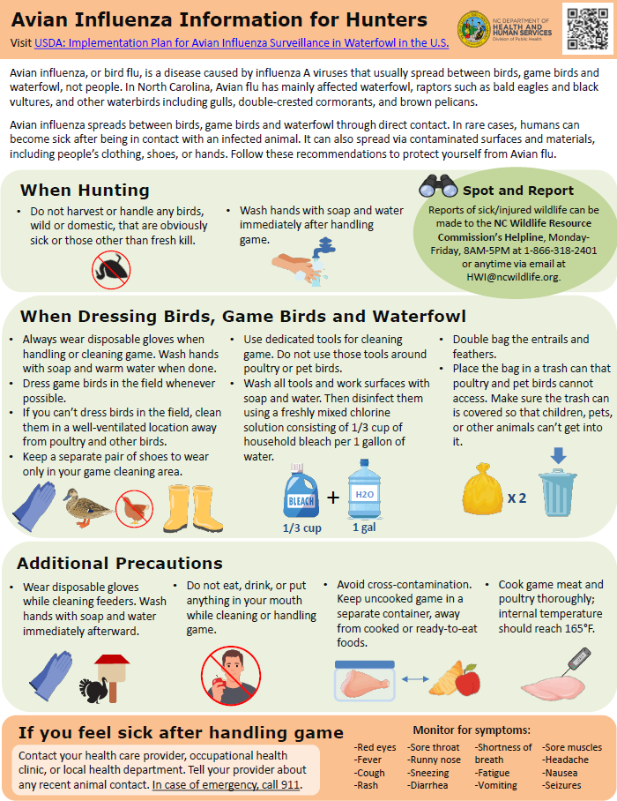
Public Education
https://flu.ncdhhs.gov/HPAI/index.htm
Notes:
https://www.ncwildlife.org/wildlife-management/hpai-web-update/download?attachment

Slide 17
Information for Backyard Flock Owners
NCDA&CS Protect Your Flock
CDC Backyard Flock Owner Guidance
Defend the Flock Resources

Slide 18
Additional Resources
NC DHHS Avian Influenza Webpage
CDC H5 Bird Flu Current Situation
Epidemiologist on Call 919-733-3419
RespiratorySurveillance@dhhs.nc.gov

Slide 19
Appendix Slides

Slide 20
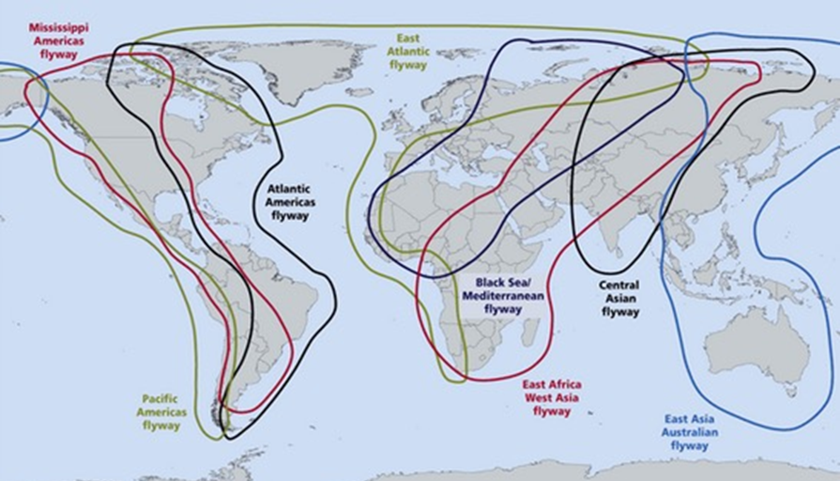
H5 Eurasian HPAI 2022 USA –
How It Started

Slide 21
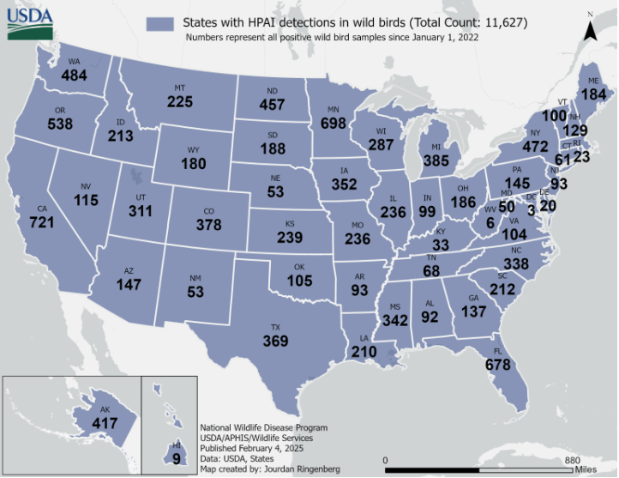
https://www.aphis.usda.gov/livestock-poultry-disease/avian/avian-influenza/hpai-detections/wild-birds
Updated February 10, 2025

Slide 22
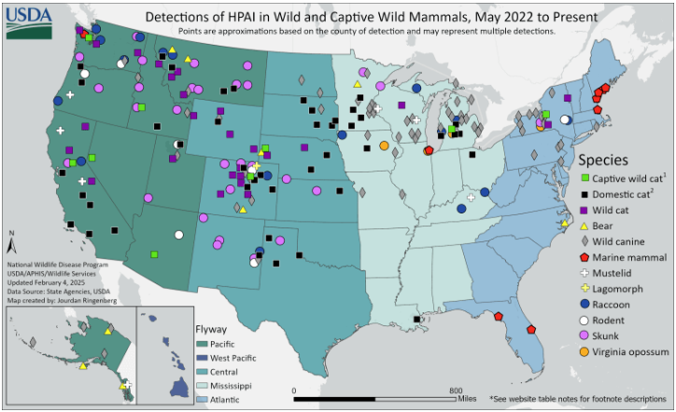
Updated February 10, 2025
https://www.aphis.usda.gov/livestock-poultry-disease/avian/avian-influenza/hpai-detections/mammals

Slide 23

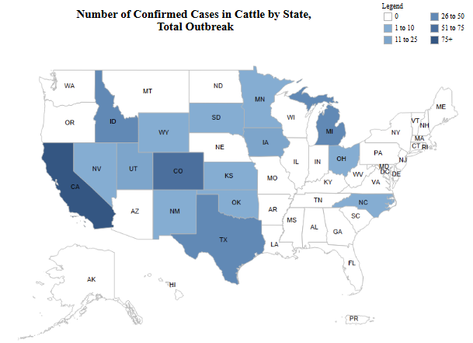
16 Affected States
2 states last 30 days
962 Confirmed Herds
36 confirmed last 30 days
30 in CA last 30 days
Updated February 10, 2025

Slide 24
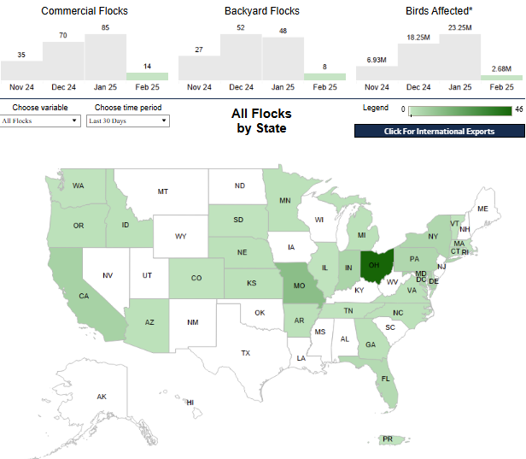
Last 30 days
28 states + PR
126 confirmed flocks last 30 days
88 Commercial Flocks
39 Backyard/Indep. Flocks
21.54M Birds Affected
46 flocks in OH last 30 days
Updated February 10, 2025

Slide 25
H5N1 HPAI NC 2022 –
2022 Positive Commercial Farms
9 commercial farms (all foam depopulation/composting)
  6 meat turkey, 3 broiler
Timeline
  1st farm identified 3/27/2022; last farm identified 4/11/2022
  End of virus elimination on 7/12/2022

Slide 26
H5N1 HPAI NC 2022-2024 –
Positive Independent Flocks
Eight independent flocks identified (WOAH non-poultry)
  October 19th, 2022 - Wake 01
  November 17, 2022 – Union 01
  November 23, 2022 – Durham 01
  December 01, 2022 – Union 02
  December 08, 2022 – Onslow 01
  January 23, 2023 – Rowan 01
  May 17, 2023 – Rowan 02
  March 26, 2024 – Guilford 01
All had either dead black vultures on premises or nearby
All flocks depopulated

Slide 27
H5N1 HPAI NC 2024 –
Positive Commercial Flocks
Two meat turkey flocks identified
  February 8, 2024 – Lenoir 01
    32,469 birds, 8 houses, 20-week-old male turkeys
  February 15, 2024 – Duplin 01
    20,888 birds, 6 houses, 11-week-old male turkeys
Both flocks depopulated within 24 hours of non-negative results

Slide 28
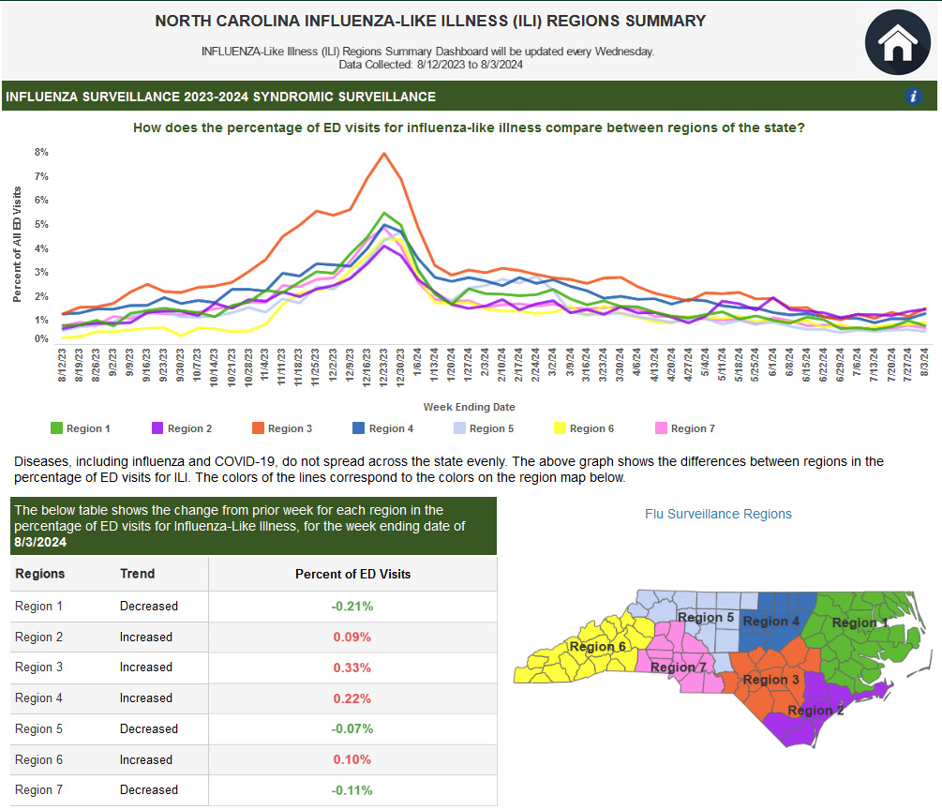





Novel Influenza Surveillance
Emergency Room Surveillance
Hospital-based Surveillance
Wastewater Monitoring
Worker Monitoring
Virologic Surveillance
Surveillance of Rabies Negative Cats
https://covid19.ncdhhs.gov/dashboard/respiratory-virus-surveillance

Slide 29

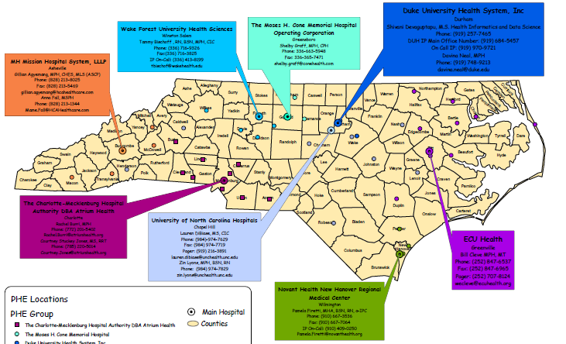
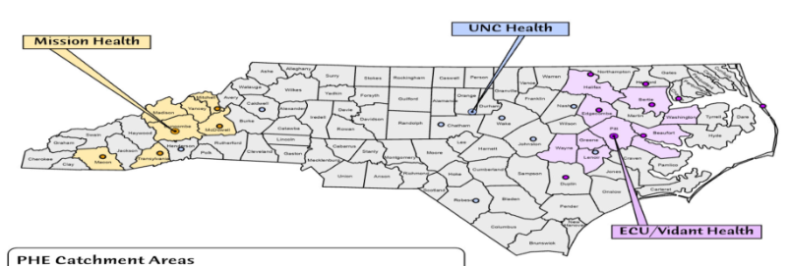
Novel Influenza Surveillance
Public Health Epidemiologist Program
Emergency Room Surveillance
Hospital-based Surveillance
Wastewater Monitoring
Worker Monitoring
Virologic Surveillance
Surveillance of Rabies Negative Cats
FluSurv-Net

Slide 30
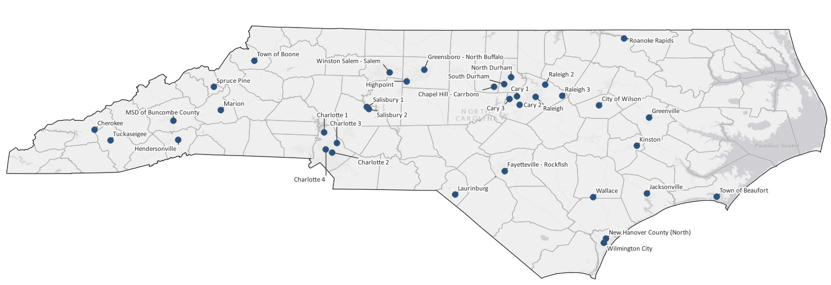
Novel Influenza Surveillance
Emergency Room Surveillance
Hospital-based Surveillance
Wastewater Monitoring
Worker Monitoring
Virologic Surveillance
Surveillance of Rabies Negative Cats
Influenza testing at 36 sites weekly
Subtyping (H1, H3, H5) at up to 22 sites weekly

Slide 31
Novel Influenza Surveillance
Influenza-Like illness Network (ILI Net)
FluSurv-Net
OCME
Commercial Laboratories
  Novel influenza is reportable under 10A NCAC 41A .0101
Emergency Room Surveillance
Hospital-based Surveillance
Wastewater Monitoring
Worker Monitoring
Virologic Surveillance
Surveillance of Rabies Negative Cats
Notes:
-Quest and Lab

Slide 32
Novel Influenza Surveillance
Cats submitted to SLPH for rabies testing, which test negative for rabies from:
  Counties with highest number of dairy cattle farms
  Counties with positive wastewater detections
  Counties with positive poultry flocks
Emergency Room Surveillance
Hospital-based Surveillance
Wastewater Monitoring
Worker Monitoring
Virologic Surveillance
Surveillance of Rabies Negative Cats
2024 Cat Testing
Cats submitted for rabies testing | Cats submitted for HPAI testing | HPAI positive cats
868 | 47 | 0
Notes:
Cross-species transmission from dairy
20 positive for rabies

Slide 33
Next Steps
If a human tests positive…
  Specimen will be sent to CDC for confirmation and sequencing
  SNS request for oseltamivir
  Increased virologic surveillance from Hyde and surrounding counties
  If severe illness or concerning mutations, consider testing of asymptomatic workers and close contacts

Slide 34
Milk Safety
HPAI can be found in the milk of infected dairy cattle
Pasteurization inactivates the virus
HPAI may be transmitted through raw (unpasteurized) milk and dairy products (e.g. cheese)
The sale of raw milk for human consumption is prohibited per NCGS 106-266.35
  Can be sold as animal feed
  Can be acquired through "cow shares"
https://www.fda.gov/food/alerts-advisories-safety-information/investigation-avian-influenza-h5n1-virus-dairy-cattle

