Slide 1
Jail Health Toolkit Overview
Notes:
Introduction
Definition
Intent
What’s included (Toolkit & Appendix)
Final tips & takeaways

Slide 2
Resources available to and about health services within local detention centers are few and not widely publicized.
This toolkit is designed to be a resource for jail administrators, local public health officials, community-based organizations and any other partners involved with healthcare delivery within North Carolina local detention centers.
It is hoped that this toolkit can generate conversation and information sharing among those providing health services to our justice-involved population.
The project was co-developed by Anna Stein, JD and Anita Wilson, MD.

Slide 3
General Information
~60 contributors from various divisions of DHHS and external partner agencies
11 topics covered over 37 pages
Sections formatted to provide key topic information, resources, and examples when possible
Available online and in print

Slide 4
Topics Covered
Legal Requirements
Infection Control and Prevention
Maternal and Reproductive Health
Persons with an Intellectual/ Developmental Disability IDD
Persons with a Brain Injury
Mental Health Resources
Suicide Prevention
Medications for the Treatment of Opioid Use Disorder
Opioid Overdose Prevention
Developing Medical Vendor Contracts – Requests for Proposals
Corrections Officer Health

Slide 5
95 Pages of additional resources

Slide 6
Appendix Contents
Select NC General Statutes pertaining to Jail Health (Chapter 153A)
NC Administrative Code Title 10A, Chapter 14, Subchapter 14J
Medical Plan Guide
Intake Screening Guide and Sample Form

Slide 7
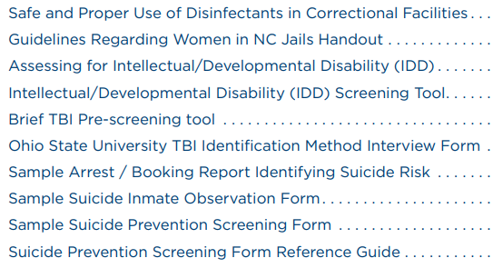
Appendix Contents

Slide 8
Appendix Contents

Slide 9
Can you help?
https://tinyurl.com/CorrectionsTeam

Slide 10
Contact for information
Anita Wilson, MD
919-608-0922
anita.wilson@dhhs.nc.gov
https://tinyurl.com/CorrectionsTeam

