Slide 1
Strategic Initiatives Fund Update
January 2026

Slide 2
Overview
Round 1
Impact of Session Law 2012-126
EH Leadership Training
ROR Program Extension
Region 1 EH Internship Program
Pitt Stop Dental
Round 2
Region IV Billing Optimization
Accreditation Dashboard Upgrade
Rapid EH Strike Team
ARHS Facility Renovation/Expansion
WNC Inclusive, Equity-Informed Health Data
Region 5 LHD Academic Partnership
Onslow Maternal Wellness Doula Pilot

Slide 3
Project: The Impact of Session Law 2012-126: Examining the Downstream Consequence of Changes in Public Health Governance Configurations in North Carolina
Description:
Research project exploring impacts of governance model changes in local public health.
Update:
As of right now the research project has been going well, and Karl does not anticipate any timeline changes.
They have been busy collecting data from accreditation datasets and analyzing that data for potential correlations between outcomes and governance models.
They are also compiling a list of BOH members and LHD directors who were present before/after governance model changes, and hope to survey and interview some of the individuals in the coming months.

Slide 4
Project: NCEHSA Leadership Training
Description:
Leadership training for local health department environmental health staff.
Update:
They are currently in the bidding process and have submitted a request for proposals from several leadership training groups across NC (the RFP went out early October).
Their goal is to identify the best partner to support their leadership development initiatives and ensure that the training aligns with their organizational goals and team needs.
Once proposals are received (deadline was November 10th), they will move forward with selecting a provider and finalizing the training schedule. In the request for proposal, they requested they consider hosting two leadership opportunities meetings in the west and the east.
As soon as they determine the partner to work with, they will schedule dates and times for 2026.

Slide 5
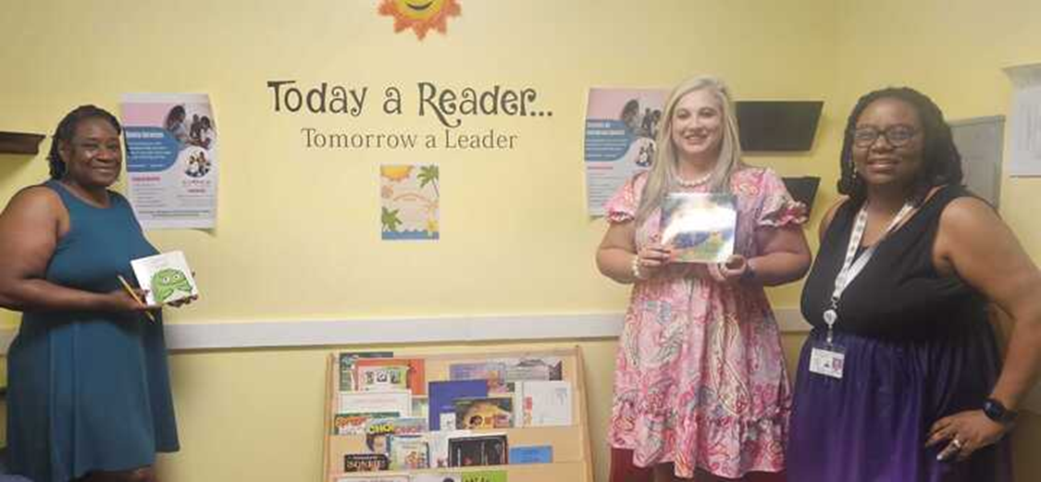
Project: Reach Out and Read- NC Public Health Initiative
Description:
Expansion of childhood literacy program in LHD clinics​.
Update:
They are planning for a parent survey in the Spring.
This funding is helping to keep high quality ROR implementation going strong in their existing health departments (especially key to keeping books on the shelves so the medical providers have what they need to “do ROR” in all their well visits - the child health teams are so grateful!) and it is catalyzing important conversations with new potential health department partners (and other funders!), particularly in the following areas: New Hanover, Scotland, Greene, Bladen, Pitt, Ashe, Yancey.
They wanted to highlight the Richmond County Health Department as they have worked diligently with the ROR team on Quality Improvement activities that has really moved the needle on quality and transformed their ROR program. They were excited to be asked by the Division of Child and Family Well-Being to present to the CMARC and Child Health staff at a virtual training in August.

Slide 6
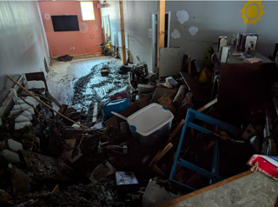
Project: Reach Out and Read- NC Public Health Initiative
Even though the Madison County Health Department is tiny for ROR numbers, the program support here is critical.
In the months following Helene, their clinic became a community distribution center for health information, emergency supplies, medical equipment, food, and baby items. Miraculously, they were able to continue their Reach Out and Read program throughout the emergency and in the recovery efforts that are still ongoing. Reach Out and Read was especially significant to young families after the floods claimed two of the three libraries in the county.
Pictured right: The Marshall Public Library Children’s Section after flood waters receded.

Slide 7
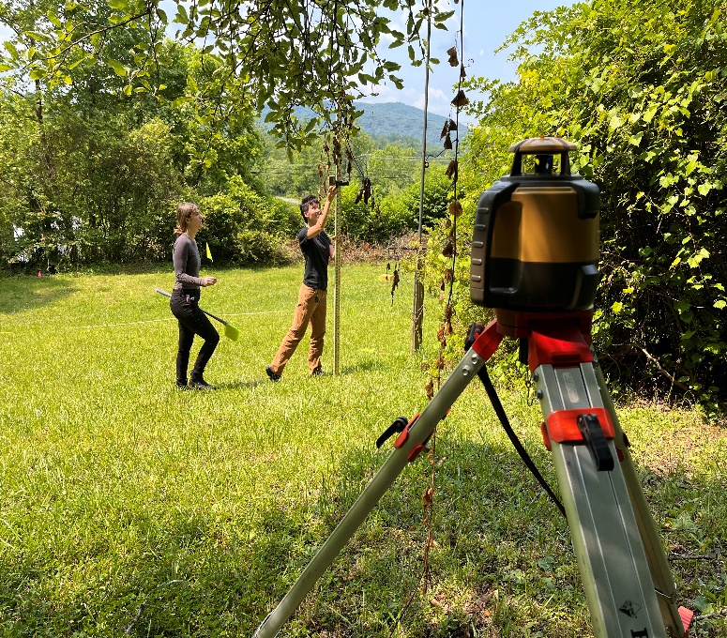
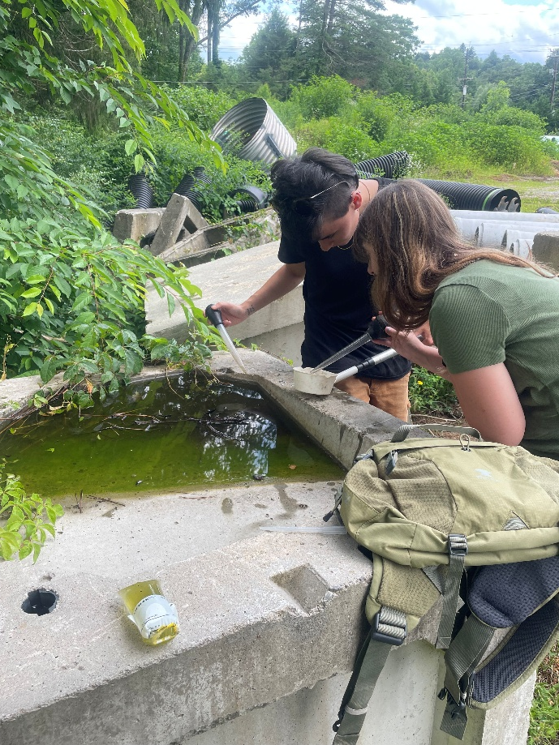
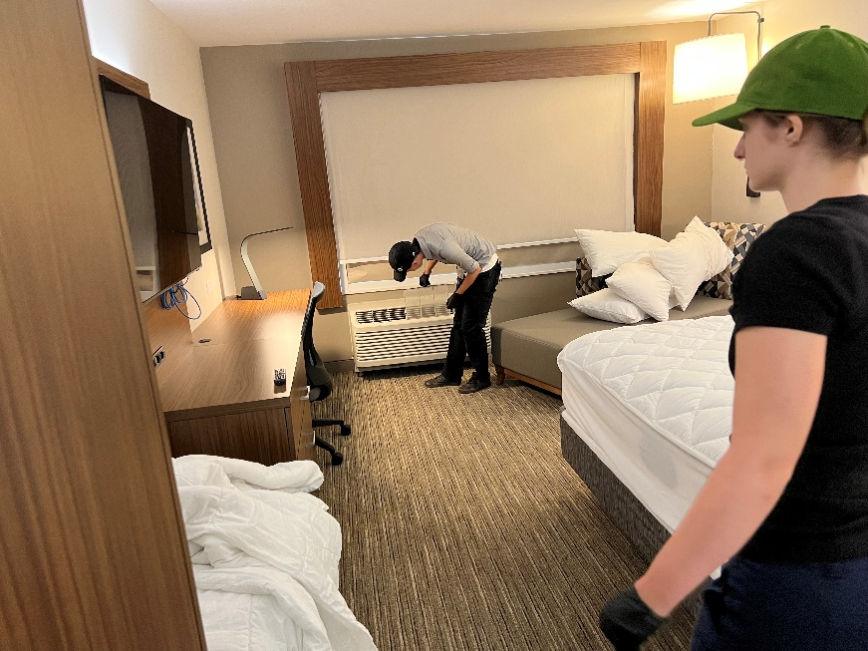
Project: Region 1 Environmental Health Internship Program
Description:
Environmental health internship placement program.
Update:
A $45,000 Strategic Initiatives grant from the NC Alliance of Public Health Agencies funded four paid environmental health internships during the 2025 summer semester. The Workforce Development Director posted the internship opportunities through WCU and organized group interviews with all participating agencies and qualified candidates.
Two students were placed in Haywood/Transylvania Counties, 1 student was placed in Swain County, and 1 student was placed in Cherokee/Clay and Graham Counties. Each student received a $6,000 stiped after completing the 400-hour internship requirement. Students had the opportunity to work with multiple mentors and different agencies and built skills related to developing and improving interpersonal relationships, leadership, administrative responsibilities, flexibility, as well as a general understanding of the field of environmental health.
A total of $24,000 (4 students x $6,000 = $24,000) was spent during the 2025 summer cohort with plans to use the remainder of the grant funds on the 2026 summer cohort.

Slide 8
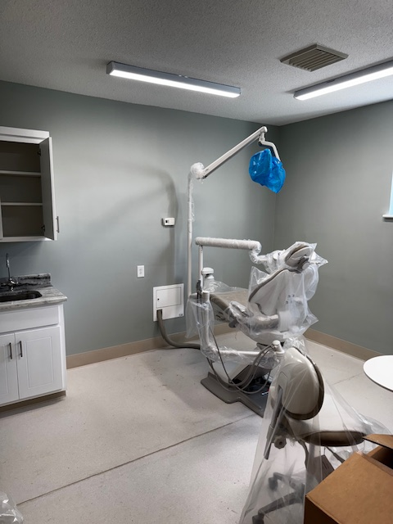
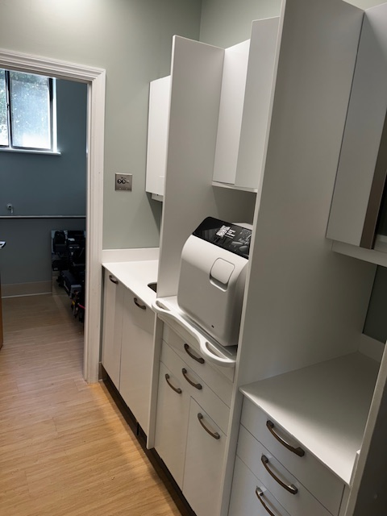
Project: Pitt Stop Dental Office
Description:
Startup funds for safety net dental clinic.
Update:
The dental suite is part of their larger renovation of a building in Bethel that will have 3 clinical exam rooms, 2 behavioral health rooms, and telehealth suite, offices, waiting room, large multimedia meeting room, lab, and dental suite.
The dental suite total cost was approximately $72k, with $30k from the Strategic Initiatives fund, $40k in county dollars, and $2k in N.C. DIT broadband infrastructure grant dollars.
They plan to have an opening in February.

Slide 9
Project: Region IV Billing Optimization
Description:
Region IV seeks to hire a consultant to conduct audits, assessments and service to build capacity of LHD finance and billing practices.
Update:
Their project is on the way! They had to bid the project out due to the cost and have one responsive bidder and are finalizing the contract with them.
The process will include billing audits for the 11 counties in region four. Every county has identified a point person for the project. Every health department will have the opportunity for an audit of clinical (medical) services, behavioral health, and dental services.
An on-boarding meeting will be held in February to explain auditing logistics.
All audits, reports, and statewide education sessions will be completed by May 2026 per the contract documents.

Slide 10
Project: Accreditation Dashboard Upgrade
Description:
The NCLHDA dashboard upgrade proposal will cover the costs to purchase a new NCLHDA online evidence submission dashboard Software.
Update:
Things are rapidly moving along. They were able to get a contract together with PowerDMS without any delays on the UNC side of things. They had a bit of a delay getting their materials set up on their end in November, but they’re now rapidly working together last month and this month to get everything arranged for LHDs to gain access to the new platform on January 28, with lots of training support planned for these next few months.
This includes a training for health departments with fall 2026 site visits on February 5 and another training open to all LHDs in April.
Faith and Margaret are meeting with the PowerDMS team multiple times a week right now, and are grateful for the SI funds each week for giving them the funding and time to pull off this big software transition!

Slide 11
Project: Rapid EH Strike Team
Description:
This project seeks to establish and deploy the first of a Rapid Environmental Health Stike Team (REHSt) for North Carolina’s public health. These teams will be equipped with a mobile environmental health office and staffed by trained, cross-credentialed EHS capable of operating independently in the first 72 hours of a disaster. The initiative will be supported by guidance and training from Orange County Emergency Management (OCEM) and NCDHHS-Public Health Preparedness and Response (PHPR), ensuring compliance with ICS, NIMS, and FEMA standards.
Update: Pending

Slide 12
Project: ARHS Facility Renovation/Expansion
Description:
Clinic renovations for Pasquotank County Health Department to prepare for expansion of behavioral health and primary care services.
Update:
They have had a slow start to the project due to the holidays. They had a meeting with their county and internal maintenance departments last week to discuss the scope of work and determine what work can be done in-house and what they will need to contract out. They have an anticipated completion date of May 1st.
They have done some initial prep to the rooms they plan to renovate to prepare for work to start as soon as the details are worked out.

Slide 13
Project: WNC Inclusive, Equity-Informed Health Data
Description:
WNC Health Network seeks to expand and scale the Survey Ambassador Program, an innovative initiative to strengthen foundational public health capabilities by training trusted community members to serve as survey ambassadors to engage underrepresented populations in local data collection, advancing equity-centered surveillance and community health assessment.
Update:
Year 1: Planning and Refinement
Engage Mountain DEEP in planning for Survey Ambassador recruitment and update training design
  Mtn DEEP met in Oct and November
  Mtn DEEP Webinar/ Discrimination and Health Risk (Oct)
  Finalizing the Communicating Back to Community Toolkit (animations and population specific one-pagers)
Update and pilot toolkit based on 2024 findings
  Survey Ambassador Report was finalized (late Spring)
  Presented on the findings with Mtn DEEP (late Spring)
  Plan to conduct review & planning based on report in ‘26
Convene LHDs to align survey plans with CHA/CHIP needs
  Plan to convene LHDs re: survey plans in Summer ‘26
  Continue to meet with LHDs regularly (next meeting next week)

Slide 14
Project: Region 5 LHD Academic Partnership
Description:
The project seeks to establish a Regional Academic Health Department (AHD), formed in partnership between all nine county health departments in Region 5 and the UNC at Chapel Hill (UNC-CH) Gillings School of Global Public Health’s (GSGPH) Department of Public Health Leadership and Practice (PHLP), which includes the North Carolina Institute for Public Health (NCIPH) academic health department
Update:
They are very excited about the Strategic Initiatives funding, which has been instrumental in establishing a novel regional academic health department (RAHD) in Region V, in partnership with UNC Gillings.
While they are still in early stages, they have met several times as a planning group to think through the RAHD model and develop plans, and have formed an advisory committee with LHD staff from the region and UNC partners that met in December. Their next advisory committee meeting in February will likely solidify a project or two to work on.
Leveraging these funds, they have created a student intern position that will join in summer 2026 and focus on regional communications work and sharing of best practices and resources across health departments. They are also finalizing the contract with UNC that will fund a coordinator position for the RAHD, and have funds going to a facilitator for an upcoming regional health director retreat.
They are putting together a list of UNC faculty and staff with their expertise to better line up needs at the local level with what they can offer, and/or research or projects they are working on.

Slide 15
Project: Onslow Maternal Wellness Doula Pilot
Description:
The Onslow County Health Department (OCHD) will pilot a labor doula program and grant funds will be used to cover the program’s operating costs, including doula reimbursement, childbirth course materials, and educational support tools.
Update:
They have had meetings with Health Department leadership to review details on what the relationship between the County and the doula will look like. They have chosen to pursue a route similar to what the insurance companies are doing where doulas have their own business, have documented certification, and operate as independent vendors. They will also interview applicants to determine if the doulas meet their standards of quality as related to their County values.
A doula job listing was posted last week and they have already reached out to local doulas to assess for interest and have one English speaking and one bilingual (English and Spanish speaking) doula ready to participate.

Slide 16
Project: Onslow Maternal Wellness Doula Pilot
Once they have the first doula onboard, they are using their Business Analyst software to query maternal health patients that are low income and at least 28 weeks in gestation to assess interest in the doula program. They are also utilizing their childbirth education classes, Maternal Health clinics, and Community Health workers as sources for referrals to the doula program.
Documentation has been created for this project in their electronic medical record, Cure MD, as well as hard copy forms for the doulas to complete at prenatal and post partum visits as well as during labor and delivery (interventions and outcomes). By utilizing their EMR they’ll be able to easily pull reports on count of patients, count of visits, and doula interventions in combination with patient demographics. They will also survey the patients post partum to gauge how successful their doula experience was.
They have a meeting scheduled with Jones County on Jan. 15th to discuss project updates and plans for expanding some of these programs to their health department, starting with childbirth education.
They have budgeted for 13 patients to be seen and are hoping to onboard at least 3 doulas to the project to assist with meeting those needs before the end of their fiscal year (June 30, 2026).

