Slide 1


NORTH CAROLINA
OFFICE OF STATE HUMAN RESOURCES
Local Government Update
February 2025
Dominick D’Erasmo, M.A. CPM
State Human Resources Manager

Slide 2
Local Gov’t Staffing Update
Dominick D’Erasmo, HR Manager
dominick.derasmo@nc.gov
Bailey Bruce, HR Consultant
bailey.hodgin@nc.gov
Tammie Dame, HR Technician
tammie.dame@nc.gov

Slide 3
Service Success: Training
Year | # Local County Employees Completing OSHR Local Gov't Training Classes
2024 | 681
3-year AVG = 577

Slide 4
Service Success: Classification
Year | Classification Actions
2024 | 330
3-year AVG = 400

Slide 5
Service Success: Applications
Year | Local County Employment Applications Screened
2024 | 2,847
2023 | 3,428
3-year AVG = 3,044

Slide 6
Updates
Jan – Jun Training Schedule
Local Classification Review
Environmental Health Associate May 2024
Admin Code / Statute Revisions
Updated Trainee Salary requirements
Updated NCGS 126-10

Slide 7
NCAC 01i .2310 Salary Rates
The salary rate for a trainee shall be no lower than 10 percent below the minimum of the position's salary range and no higher than the 25th percentile of the position's salary range.

Slide 8
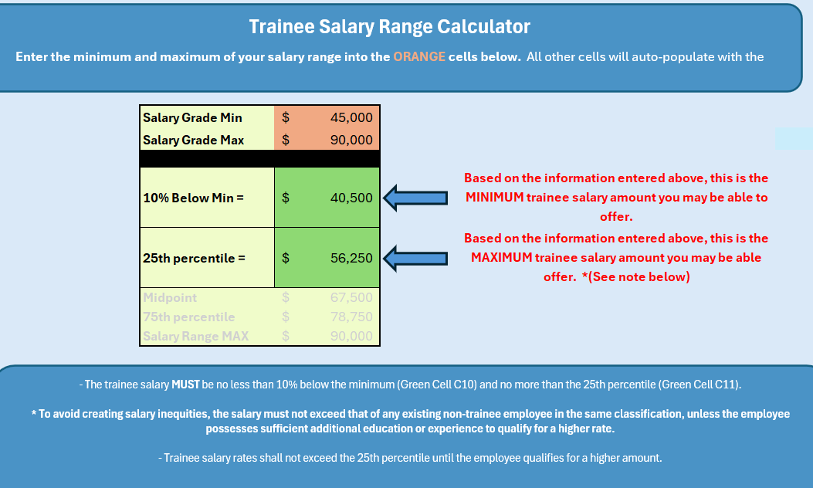
Trainee Salary Range Calculator

Slide 9
Trainee salary rate change requires a fiscal note.
Look for a survey to be e-mailed. If you are anticipating hiring Trainees- we need some data from you.

Slide 10
NCGS 126-10 (b)
Notwithstanding G.S. 126-22, 126-24, 153A-98, and 160A-168, when a local entity indicates that it will permanently appoint a person who does not meet the class specification's minimum qualifications for a position subject to the State Human Resources Act, except for trainee and work-against appointments, the Office of State Human Resources may contact any relevant members of the board supervising that local entity, the county manager and commissioners, and the Department of Health and Human Services. The message may identify the particular qualifications that the proposed appointee would need to meet to have the minimum qualifications of the class specification.

Slide 11
OSHR Local Gov’t Team
We only exist to support you.
Thank you for all you do!

