Slide 1

NCALHD
June 18, 2026

Slide 2
Who We Are
Our Mission
Impact Health leads innovative strategies that bridge community and clinical systems of care to ensure all Western North Carolinians can access the resources they need to thrive.
Our Vision
Western North Carolina is an innovative model for thriving, fully engaged communities where all people live healthy lives.

Slide 3







HOP by the Numbers
March 2022 – June 2025
59
13,968
401,653
organizations
HOP participants
HOP services
in HSO network
served
provided
$28.5M
898
$88.8M
in capacity building
full-time equivalent
reimbursement
income
funds distributed to
HSOs & CHWS
jobs supported
billed by HSOs
Notes:
In just over 3 years, HOP generated over $117M in direct income and $179M in total business activity (using $0.53 multiplier for every dollar invested in HOP).
Numbers reflect data from the first service delivered beginning March 2022 to the HOP pause on June 30, 2025.

Slide 4




NC HOP Statewide Outcomes
$164
monthly savings per member per month in reduced medical costs
$384M
total business activity generated by HOP in rural communities
55¢
additional economic activity generated for every HOP dollar invested
2,923
rural jobs created as a result of HOP investments

Slide 5
Our Approach to HOP
Asset-based
Community-centered
Transparency & trust
Telling the whole story
Protection of CBO missions
Cooperation over competition
Shared services & support
Deepening clinical partnerships

Slide 6











Impact Primary Care Network
IPCN practices
Haywood
Pediatrics
Blue Sky Pediatrics
Asheville

Slide 7
Impact Primary Care Network
Clinically Integrated Network
As of May 1st, 2026, IPCN provides care management support for
11 primary care practices and ECBI
more than 48,000 WNC residents
patients covered by Medicaid, Medicare, and the State Health Plan
In October of 2025, IPCN was awarded UnitedHealthcare's Healthcare Heroes Award for its outstanding work in HRSN initiatives.

Slide 8

Taking HOP Lessons into Rural Health Transformation

Slide 9

RHTP Key Strategies
Community-Rooted Care Networks
Prevention and Chronic Disease Management
Behavioral Health Expansion
Workforce Development
Financial Sustainability
Technology and Innovation

Slide 10
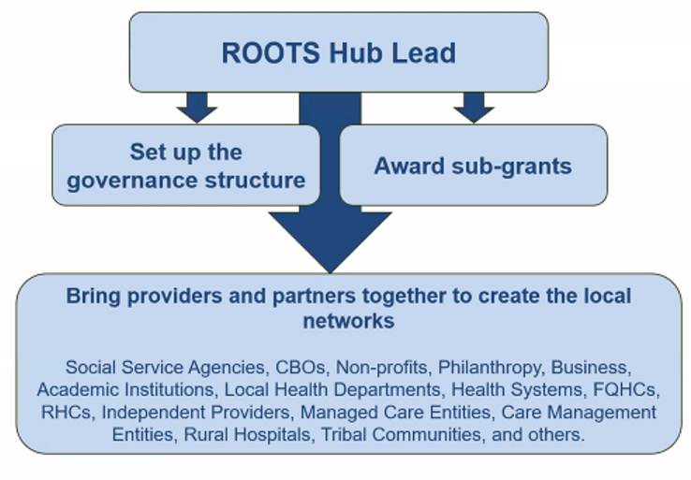
What is a ROOTS Hub Lead?

Slide 11
ROOTS Hub Key Responsibilities
Establish standards to ensure rural residents are effectively connected to physical health, behavioral health, and social supports.
Facilitate funding applications and awards aligned with regional needs and RHTP grant requirements.
Collect and analyze data to monitor program performance and outcomes against RHTP goals and key performance indicators.

Slide 12
First 90 Days in Region 1
Rapid needs assessment & focused community engagement
Outreach and confirmation of members of the Governance Committee
Meaning-making sessions and prioritization
Action plan submission
Implementation

Slide 13
Laurie Stradley
Impact Health
l.Stradley@impacthealth.org

