Slide 1
AA 621 Finances (FY 24)

Slide 2
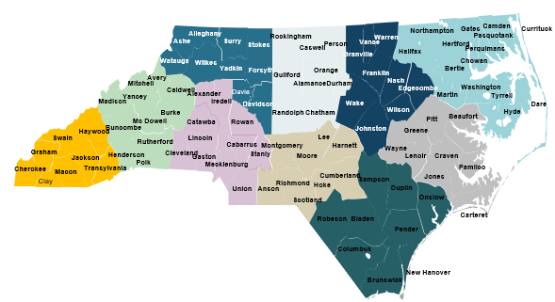
LHD by NCALHD region (proposed 2-year funding for AA 621)
Each region will receive the total funding amount in Year 1, but this is 2-year funding (ending June 30, 2023) with an anticipated no-cost-extension
Costs of assessment and state-provided trainings do not come from Region allocations
REGION: Regional Lead LHD | TOTAL FUNDING
Region 1: Transylvania | $1,000,000.00
Region 2: Foothills Health District | $1,550,947.32
Region 3: App Health | $1,678,839.41
Region 4: Cabarrus Health Alliance | $3,265,772.35
Region 5: Guilford | $2,350,272.24
Region 6: Cumberland | $1,997,254.42
Region 7: Granville-Vance | $2,756,453.14
Region 8: Duplin | $2,084,304.66
Region 9: Albemarle Regional Health Services | $1,843,345.88
Region 10: Pitt County | $1,773,116.26
TOTAL | $20,300,305.68
NCALHD Regions
Notes:
DOUG

Slide 3
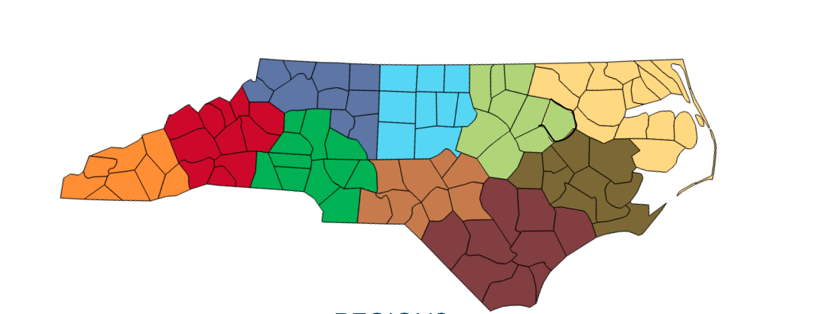
ARPA Local PH Workforce Initiative AA 621 (FY24)
3
9
5
7
The COVID-19 PH Workforce Grant supports regional efforts to recruit, hire, and train personnel to address projected COVID-19 response needs in the 10 NCALHD regions, including strengthening the Public Health Foundational Capabilities to address local public health priorities deriving from COVID‑19
Funding methodology: 50% per capita and 50% Social Vulnerability Index (SVI)
Comprehensive budgets and work plans were developed to coincide with ARPA extension application for FY ’24 which received approval
Additional component is the Care Management Pilot-Regions 8 & 9 participating
Funding Chart represents the amounts allocated for the entire project period
2
1
4
10
6
8
REGION: Regional Lead LHD | FUNDING
Region 1: Transylvania | $1,000,000.00
Region 2: Foothills Health District | $1,550,947.32
Region 3: App Health | $1,678,839.41
Region 4: CHA | $3,265,772.35
Region 5: Guilford | $2,350,272.24
Region 6: Cumberland | $1,997,254.42
Region 7: Granville-Vance | $2,756,453.14
Region 8: Duplin | $2,449,304.66
Region 9: Albemarle Regional Health Services | $2,193,345.88
Region 10: Pitt County | $1,773,116.26
TOTAL | $21,015,305.68

Slide 4
AA 621 Regional Workforce Spending – Cumulative with Encumbered
LHD Regional Leads | Budgeted Amount | Total Spent | Percent Spent (ATC) | Encumbered & Obligated | Percent Spent+E/O
Region 1-Transylvania County Department of Public Health | $1,000,000.00 | $560,635 | 51.8% | $481,970 | 100%
Region 2-Foothills Health District | $1,550,947.00 | $781,757 | 40% | $769,190 | 100%
Region 3-Appalachian District Health Department | $1,678,839.00 | $1,012,533 | 58.3% | $774,564 | 100%
Region 4-Cabarrus Health Alliance | $3,265,772.00 | $1,820,532 | 51.3% | $1,445,240 | 100%
Region 5-Guilford County Division of Public Health | $2,350,272.00 | $866,424 | 30.4% | $1,403,480 | 97%
Region 6-Cumberland County Health Department | $1,997,255.00 | $657,385 | 28% | $1,289,870 | 97%
Region 7-Granville-Vance Public Health | $2,756,453.00 | $1,277,684 | 43.3% | $1,464,917 | 99%
Region 8-Duplin County Health Department | $2,449,305.00 | $815,288 | 32% | $1,547,017 | 96%
Region 9-Albemarle Regional Health Services | $2,193,346.00 | $1,185,716 | 52.3% | $1,007,630 | 100%
Region 10-Pitt County Health Department | $1,773,116.00 | $313,426 | 15.5% | $1,418,715 | 98%
Grand Total | $21,015,305.00 | $9,291,380 | 44% | $11,602,593 | 99%
Data as of the Sept ATC Report – 9-20-2023 & based on Regional Spending Plans
Includes Care Mgmt. Pilot Funds – Regions 8 & 9
Notes:
Amount left - $11,723,925

Slide 5
AA 621 Regional Workforce Spending – Cumulative with Encumbered
LHD Regional Leads | Budgeted Amount | Total Spent | Percent Spent (ATC) | Encumbered & Obligated | Percent Spent+E/O
Region 1-Transylvania County Department of Public Health | $1,000,000.00 | $606,633 | 61% | $393,367 | 100%
Region 2-Foothills Health District | $1,550,947.00 | $812,432 | 52% | $738,515 | 100%
Region 3-Appalachian District Health Department | $1,678,839.00 | $1,057,996 | 63% | $620,843 | 100%
Region 4-Cabarrus Health Alliance | $3,265,772.00 | $1,881,055 | 58% | $1,384,717 | 100%
Region 5-Guilford County Division of Public Health | $2,350,272.00 | $915,557 | 39% | $1,364,207 | 97%
Region 6-Cumberland County Health Department | $1,997,255.00 | $724,270 | 36% | $1,213,067 | 97%
Region 7-Granville-Vance Public Health | $2,756,453.00 | $1,369,528 | 50% | $1,359,360 | 99%
Region 8-Duplin County Health Department | $2,449,305.00 | $1,316,759 | 54% | $1,034,574 | 96%
Region 9-Albemarle Regional Health Services | $2,193,346.00 | $1,384,945 | 63% | $808,401 | 100%
Region 10-Pitt County Health Department | $1,773,116.00 | $329,031 | 19% | $1,418,715 | 98%
Grand Total | $21,015,305.00 | $10,398,206 | 50% | $11,602,593 | 99%
Data as of the October ATC Report – 10-17-2023 & based on Regional Spending Plans
Includes Care Mgmt. Pilot Funds – Regions 8 & 9
Notes:
Amount left - $11,723,925

Slide 6
AA 621 Regional Workforce Spending – Cumulative with Encumbered
LHD Regional Leads | Budgeted Amount | Total Spent | Percent Spent (ATC) | Encumbered & Obligated | Percent Spent+E/O
Region 1-Transylvania County Department of Public Health | $1,000,000.00 | $633,362.94 | 63% | $366,637 | 100%
Region 2-Foothills Health District | $1,550,947.00 | $860,023.00 | 55% | $690,924 | 100%
Region 3-Appalachian District Health Department | $1,678,839.00 | $1,093,224.59 | 65% | $585,614 | 100%
Region 4-Cabarrus Health Alliance | $3,265,772.00 | $1,954,448.42 | 60% | $1,311,324 | 100%
Region 5-Guilford County Division of Public Health | $2,350,272.00 | $1,034,171.50 | 44% | $1,245,592 | 97%
Region 6-Cumberland County Health Department | $1,997,255.00 | $909,765.33 | 46% | $1,027,572 | 97%
Region 7-Granville-Vance Public Health | $2,756,453.00 | $1,505,967.81 | 55% | $1,222,920 | 99%
Region 8-Duplin County Health Department | $2,449,305.00 | $1,370,810.13 | 56% | $980,523 | 96%
Region 9-Albemarle Regional Health Services | $2,193,346.00 | $1,451,448.26 | 66% | $741,898 | 100%
Region 10-Pitt County Health Department | $1,773,116.00 | $502,303.68 | 28% | $1,235,350 | 98%
Grand Total | $21,015,305.00 | $11,315,525.66 | 54% | $9,408,354 | 99%
Data as of the Nov ATC Report – 11-20-2023 & based on Regional Spending Plans
Includes Care Mgmt. Pilot Funds – Regions 8 & 9
Notes:
Total amount of remaining funds as of November - $9,699,778.71

Slide 7
AA 621 Regional Workforce Spending – Cumulative with Encumbered
LHD Regional Leads | Budgeted Amount | Total Spent | Percent Spent (ATC) | Encumbered & Obligated | Percent Spent+E/O
Region 1-Transylvania County Department of Public Health | $1,000,000.00 | $692,373.44 | 69% | $307627 | 100%
Region 2-Foothills Health District | $1,550,947.00 | $996,807.17 | 64% | $554,139 | 100%
Region 3-Appalachian District Health Department | $1,678,839.00 | $1,213,585.71 | 72% | $465,254 | 100%
Region 4-Cabarrus Health Alliance | $3,265,772.00 | $2,103,340.81 | 64% | $1,292,431 | 100%
Region 5-Guilford County Division of Public Health | $2,350,272.00 | $1,094,229.80 | 47% | $1,185,534 | 97%
Region 6-Cumberland County Health Department | $1,997,255.00 | $1,113,635.43 | 56% | $823,702 | 97%
Region 7-Granville-Vance Public Health | $2,756,453.00 | $1,613,536.33 | 59% | $1,115,352 | 99%
Region 8-Duplin County Health Department | $2,449,305.00 | $1,455,508.52 | 59% | $895,824 | 96%
Region 9-Albemarle Regional Health Services | $2,193,346.00 | $1,512,915.54 | 69% | $680,431 | 100%
Region 10-Pitt County Health Department | $1,773,116.00 | $631,972.91 | 36% | $1,105,681 | 98%
Grand Total | $21,015,305.00 | $12,427,905.66 | 59% | $8,425,975 | 99%
Data as of the Dec ATC Report– 12-18-2023 & based on Regional Spending Plans
Includes Care Mgmt. Pilot Funds – Regions 8 & 9
Notes:
Total amount of remaining funds as of November - $9,699,778.71

