Slide 1
2025 Awards Presentation

Slide 2
Public Health Partners Award
Recognizes organizations, businesses, and professional associations that have made significant contributions to the advancement and promotion of public health in North Carolina

Slide 3
Public Health Partners Award Winner
This public health partner’s mission is to “nurture the development of children by building a strong foundation of family and community.”

Slide 4
Public Health Partners Award Winner
Partnering Activities with Public Health
Teen Wellness Center Advocacy & Support
Childbirth Education Classes
Innovative Approaches for Children and Youth with Special Healthcare Needs
Response to Hurricane Helene
Commitment to Trauma-Informed Practices and Community Collaboration

Slide 5
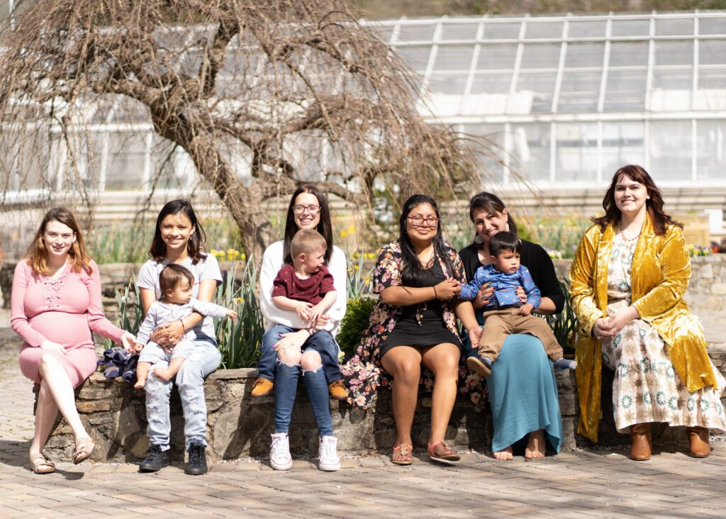
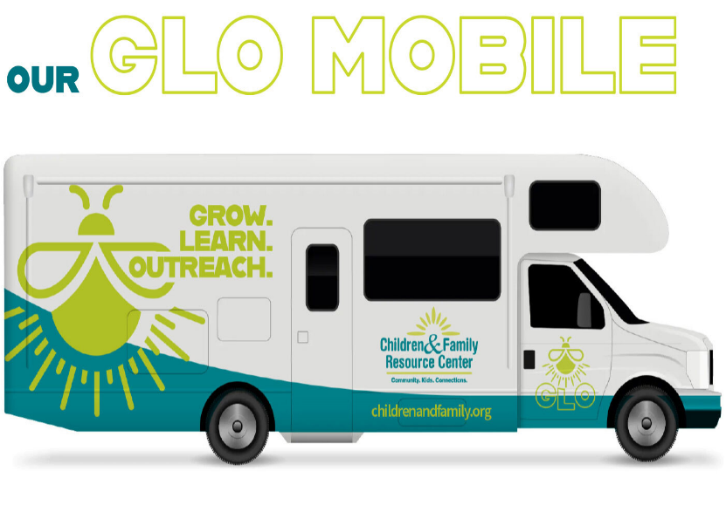
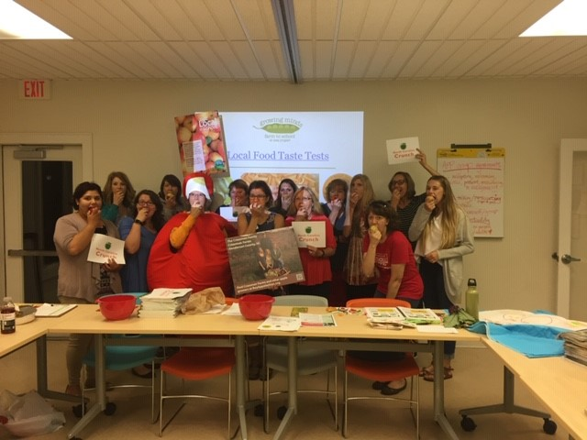
The Public Health Partners Award Winner is. . .
Children and Family Resource Center (CFRC)

Slide 6
Public Health Legislative Champion
Recognizes individuals that have made significant contributions to the advancement and promotion of public health in North Carolina

Slide 7
This Public Health Legislative Champion . . .
Chairman of the House Committee for Health and Human Services Appropriations
Vice Chairman of the House Committee for Appropriations
Senior Chairman of the House Committee for Health
Member of the House Committee for Education K-12; Homeland Security and Military and Veterans Affairs; Insurance; and Judiciary 1
Co-Chair of the Joint Legislative Oversight Committee on Health and Human Services
Co-Chair of the Joint Legislative Oversight Committee on Medicaid
Member of the Joint Legislative Commission on Governmental Operations

Slide 8
This Public Health Legislative Champion . . .
An avid supporter of public health in North Carolina.
Made time for discussions regarding public health funding needs and advocated for legislative allocations to increase local funding for local health departments.
Worked closely with Environmental Health Staff to introduce legislation to expand the minimum education qualifications for Environmental Health Specialists to increase the applicant pool.
Continues to listen to constituents’ concerns and takes action to improve conditions.

Slide 9
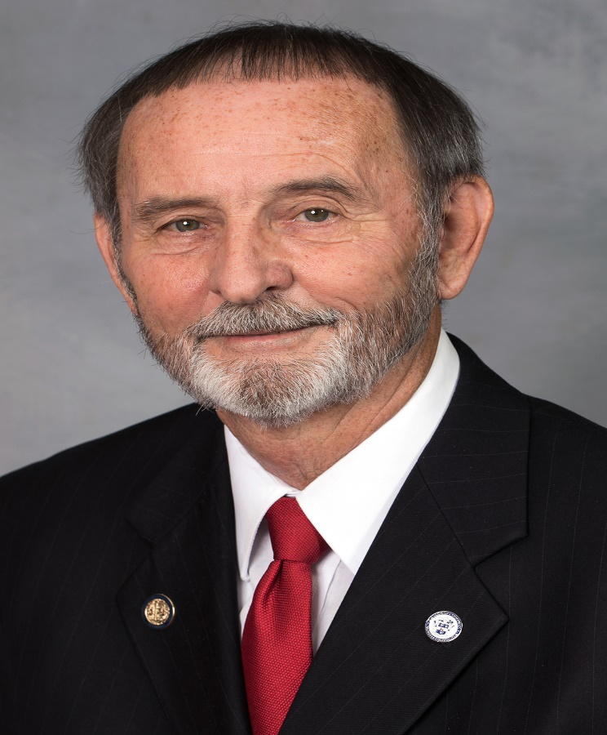
The Public Health Legislative Champion Award Winner is. . .
Representative Larry W. Potts
Republican Member of the North Carolina House of Representatives

Slide 10
Health Director of the Year
Recognizes outstanding involvement, leadership, and achievement in public health

Slide 11
Health Director of the Year Winner
Over 40 years of healthcare experience serving underserved populations and addressing the complex challenges of rural communities.
Over 20 years of executive public health leadership experience in a rural county.
Securing over $4.4 million in grant funding to combat chronic diseases, strategies for reducing teen pregnancy, and enhancing the Toothmobile Dental Care Program.

Slide 12
Health Director of the Year Winner
Visionary leadership, innovative strategies, and steadfast dedication led to improved population health outcomes in this county.
Spearheaded the county’s response during the COVID-19 pandemic to ensure access to testing, vaccinations, and accurate public health information while maintaining transparency and trust in the community.
Pillar of support during natural disasters, coordinating shelter operations, deploying staff, and ensuring the safety of vulnerable populations.

Slide 13
Health Director of the Year
Public Health Achievements
2005 – Became a Local Public Health Director
North Carolina County Health Rankings improvement of health outcomes (Once ranked #100, now this county is ranked at #91.)
Contributor to statewide discussions and initiatives aimed at improving health outcomes.
Instrumental in shaping policies and programs that reflect rural communities’ unique challenges.
Fostered innovative partnerships with Port Health and UNC Wilmington to expand access to critical services, such as mental health and substance use treatment.

Slide 14
Health Director of the Year
Accomplishments and Contributions to Local Public Health
Active Member of the
NC Association of Local Health Directors
NC Public Health Association
Eastern District NC Public Health Association
Served/serves on various committees
Committed to creating a healthier, stronger, and more resilient community.

Slide 15
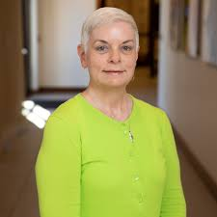
Health Director of the Year Award
Presented to:
Kimberly L. Smith, MPH
Columbus County Health Department

Slide 16
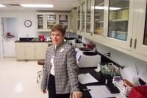
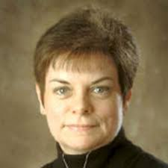
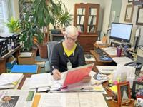
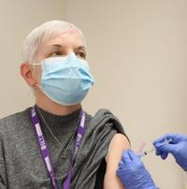
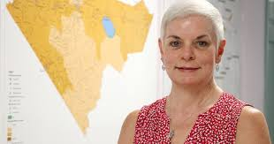
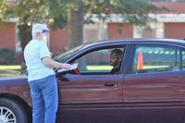
Health Director of the Year Award
Kimberly L. Smith, MPH
Columbus County Health Department

